Slide 1
Projet 2 DAI

Slide 2
What ?
Client
Server
TCP
User
Database : hashmap

Slide 3
Why ?
A fast and portable quick inventory manager
Ability with the docker container to deploy as much manager and client as possible very fast
With the possibility of altering host and port it is able to fit with ease on multiple environnement

Slide 4
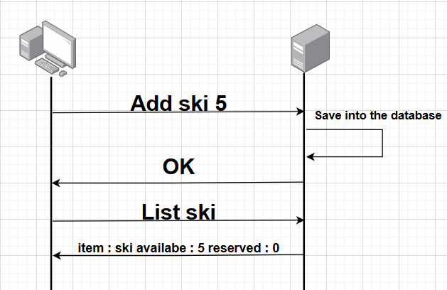
How ?

Slide 5
Client side
Container docker
Client
Server
Interface REPL
ADD
REMOVE
MODIFY
MANAGE
RESERVE
User

Slide 6
Server side
Container docker
Client
Server
Interface REPL
OK
INVALID
Database
Hashmap

Slide 7
Task separation
Thibault
Sofia
Quentin
Dockerisation
App Protocol
Presentation
Bug correction
Readme
Server
Container publishing
Client
Maven
GitHub
Concurrency

Slide 8
Deploiement with docker
Container docker
Server
Client

Slide 9
Questions ?

