Slide 1

Python for Data Analysis PROJECT Drug consumption (quantified) Data Set
Bruno PINCET, Quentin NAVARRE

Slide 2
Steps of the project
Data Cleaning
Preparation of the data set
Data-visualization
Data set presentation
Modeling
Creation and optimization of various machine learning model in a classification problem
First link between the features and the target
Flask API
Web application to make prediction based on ML model

Slide 3

DATA CLEANING

Slide 4
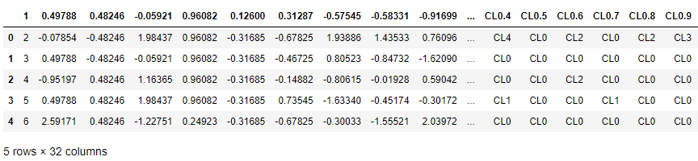
BEFORE
Problems
Column name instead of first row
Unable to see features name
Float data instead of clear categories
Solutions
Addition of a row which value were columns name
We renamed the columns
We applied a dictionnary on each features to have clear data
We deleted some outeliers

Slide 5
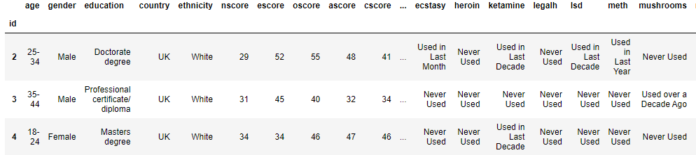
AFTER
Problems
Column name instead of first row
Unable to see features name
Float data instead of clear categories
Solutions
Addition of a row which value were columns name
We renamed the columns
We applied a dictionnary on each features to have clear data
We deleted some outeliers

Slide 6
DATASET INFORMATION

Slide 7
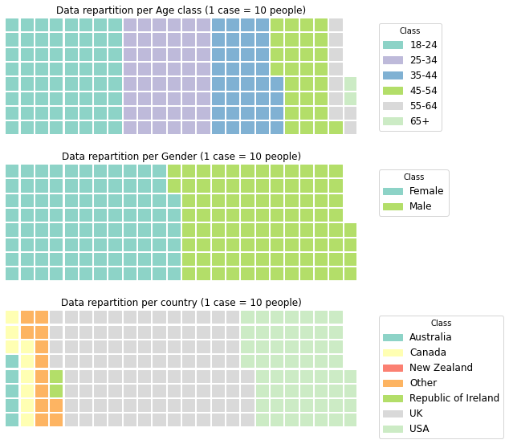
DATA SET INFORMATION
Database contains records for 1885 respondents. For each respondent 12 attributes are known
Personality measurements
neuroticism
extraversion
openness to experience
agreeableness
conscientiousness
impulsivity
sensation seeking
level of education
age
gender
country of residence
ethnicity
:

Slide 8
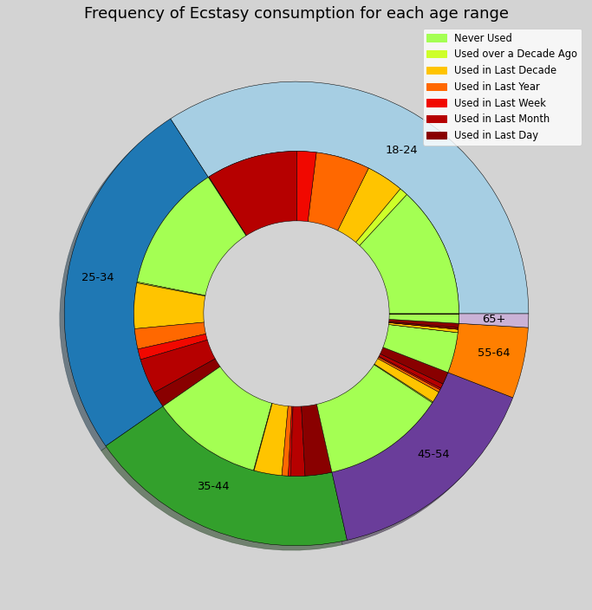
DATA SET INFORMATION
Questions concerning their use of 18 legal and illegal drugs
Alcohol
Amphetamines
Amyl nitrite
Benzodiazepine
Cannabis
Chocolate
Cocaine
Caffeine
Crack
Ecstasy
Heroin
Ketamine
Legal highs
LSD
Methadone
Mushrooms
Nicotine
Volatile substance
Fictitious drug (Semeron)

Slide 9

DATA SET INFORMATION
Illegal drugs :
Legal drugs :
Fictitious drug :
Amphetamines
Amyl nitrite
Benzodiazepine
Cannabis
Cocaïne
Crack
Ecstasy
Heroin
Ketamine
LSD
Methadone
Mushrooms
Volatile substance
Chocolate
Caffeine
Legal Highs
Nicotine
Semeron

Slide 10

ASKED QUESTION ?
Can we find a relation between the personality measurements and the use of illegal drug ?

Slide 11


Creation of a new CATEGORICAL VARIABLE with 2 possible outputs
-Never Used
-Used over a Decade Ago
-Used in Last Decade
-Used in Last Year
-Used in Last Month
-Used in Last Week
-Used in Last Day
Considered as a Drugged User
Considered as a Clean User

Slide 12
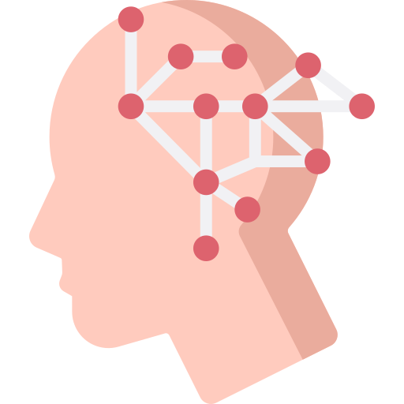
Features explanations
Features determined with the NEO PI-R, a personality inventory that assesses an individual on five dimensions of personality :
Neurotocism
Extraversion
Openess to experience
Agreeableness
Conscientiouness
Each of these features is a score between 12 and 60, the higher the score, the more the characteristic correspond to the person.

Slide 13
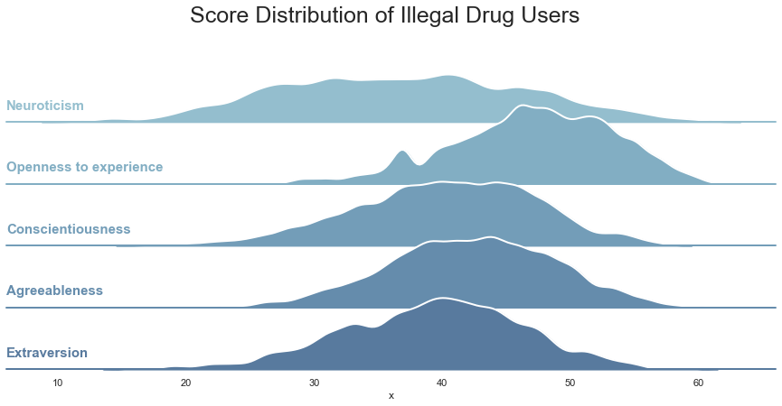
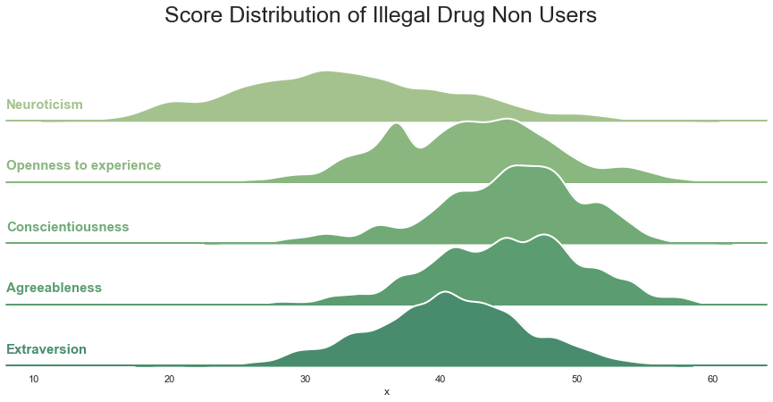
First OBSERVATIONs
-Illegal drug users have slightly higher scores in neuroticism and openess to experience
-Illegal drug users have slightly lower scores in conscientiousness and agreableness
-The distribution of the score is much more compact with the clean people in comparison with the drug users

Slide 14
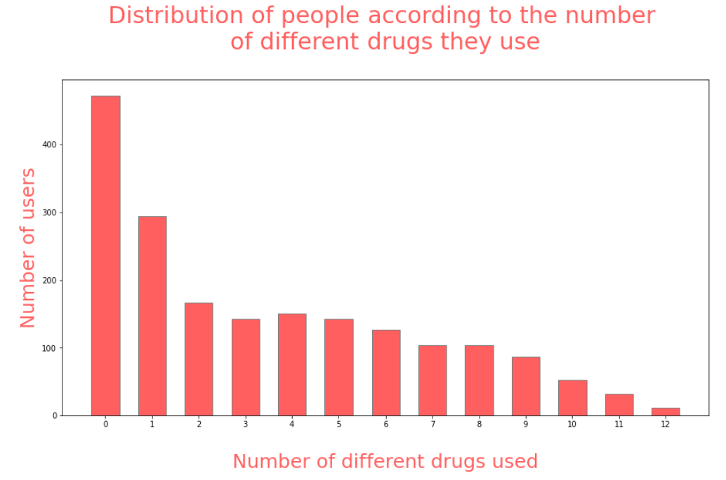
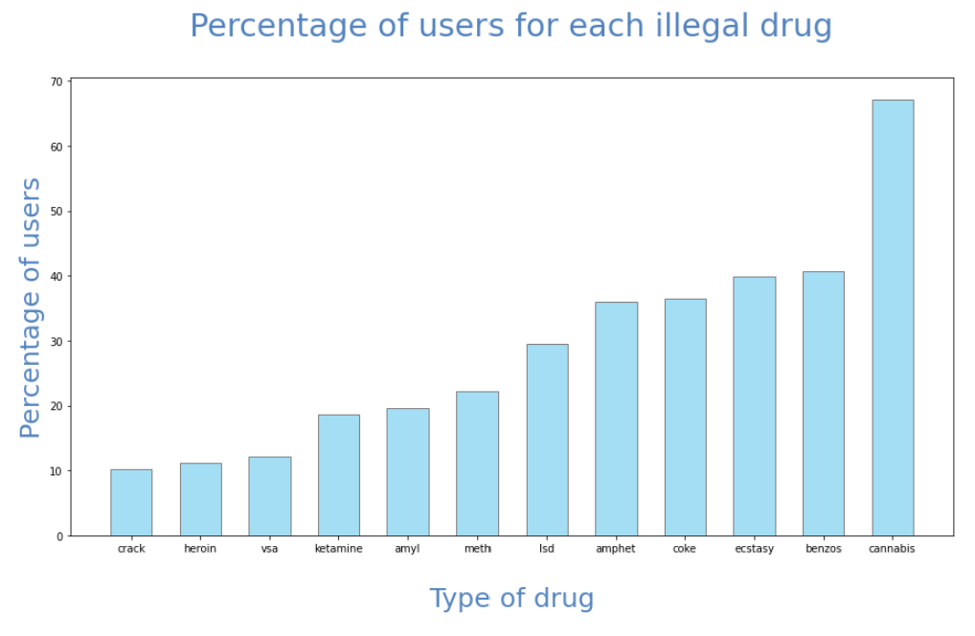
First OBSERVATIONs
Not surprisingly the most common drug is cannabis and the more the number of different drugs consumed increases the fewer people there are in the category.

Slide 15
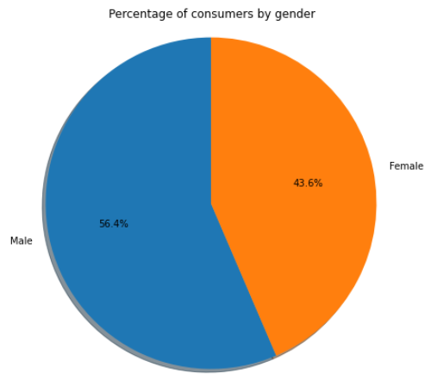
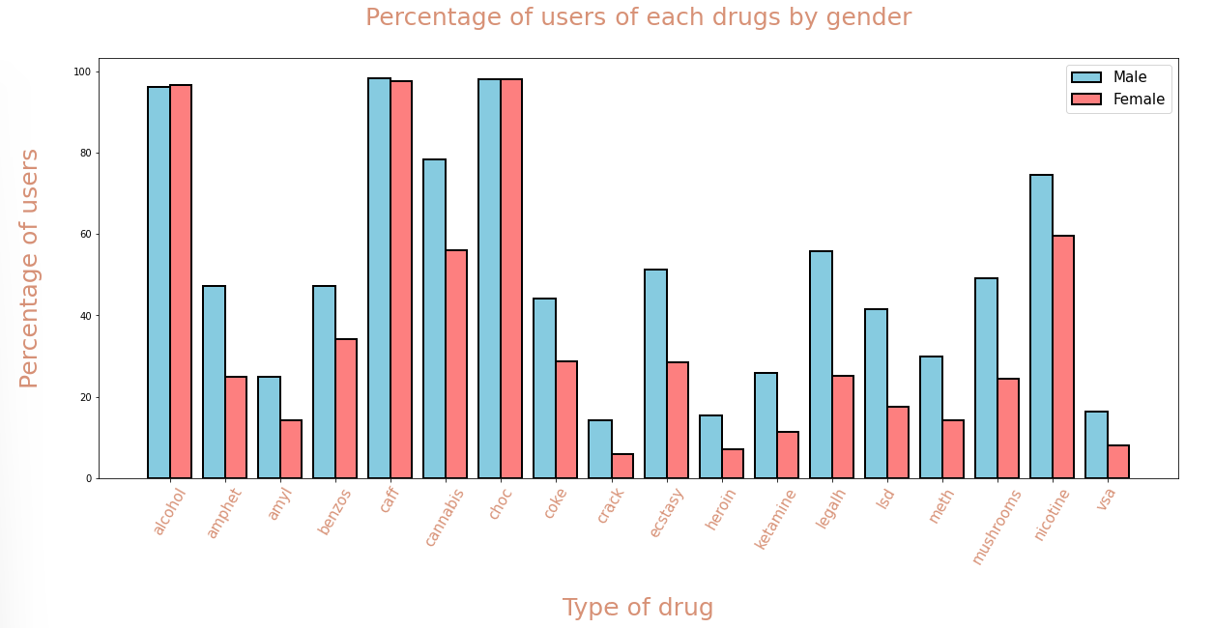
First OBSERVATIONs
We can see that there are more men who use drugs than women, this is also shown on the graph on the right where we get more male users for each illegal drug while the results are the same for legal drugs.

Slide 16
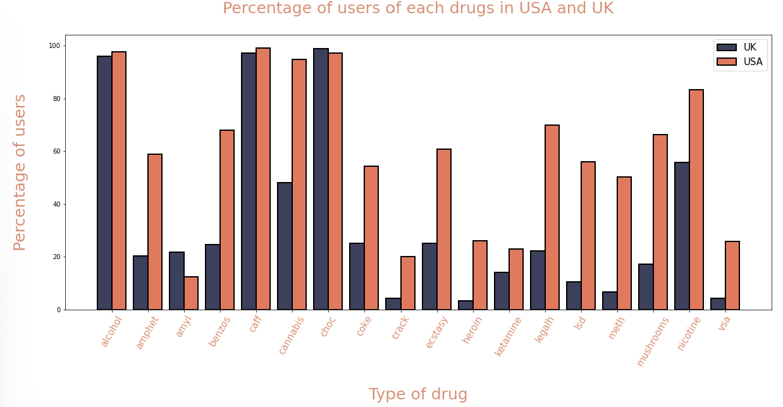

First OBSERVATIONs
From this graphic we can observe 2 things:
Concerning the legal drugs, ( alcohol, cafeine, chocolate) the percentage of users is almost the same if we compare various country.
However, concerning the hard drugs, the results are completely differents.
First OBSERVATIONs

Slide 17
Machine learning to answer the question
Scaling
Get Dummies
Removing Correlated Features
SVC
Basic
RFE + Grid Search
Random Forest
Basic
RFE + Grid Search
KNN
Basic
Grid Search
Linear SVC
Neural Network
Basic
RFE + Grid Search
Dense Model + Drop Out + Kernel regulizer
Can we find a relation between the personality measurements and the use of illegal drug ?

Slide 18
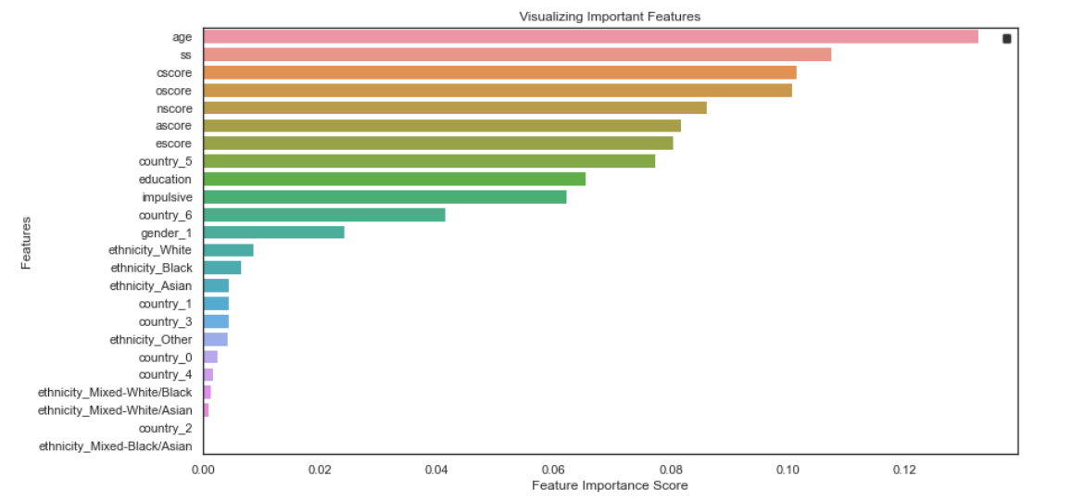
Most significant characteristics for illegal drug use
Apart from the age we can see that the most important features are mainly related to the personality of the individual.

Slide 19
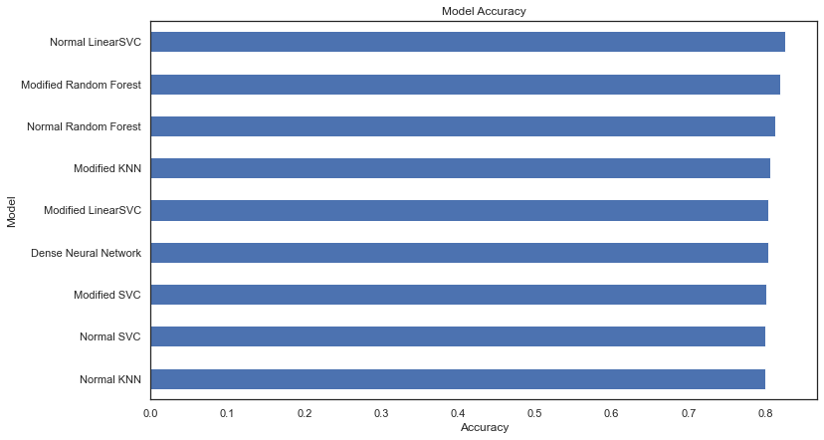
FINAL RESULTS
The average accuracy of the model is close to 80%
We can thus predict if a person is probably drugged or clean based on various personality measurements.

