Slide 1

From Textual Requirements
to BPMN
NIVON Quentin¹, SALAÜN Gwen¹
¹ Univ. Grenoble Alpes, CNRS, Grenoble INP, Inria, LIG F-38000 Grenoble France

Slide 2


Introduction
What is BPMN?
A workflow-based notation created in 2004 by the Business Process Management Initiative (BPMI) and the Object Management Group (OMG).
It aims at representing business processes in a way that is understandable for both experienced and novice users.
An ISO/IEC standard since version 2.0 in 2013.

Slide 3




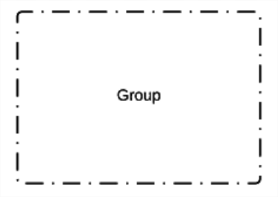



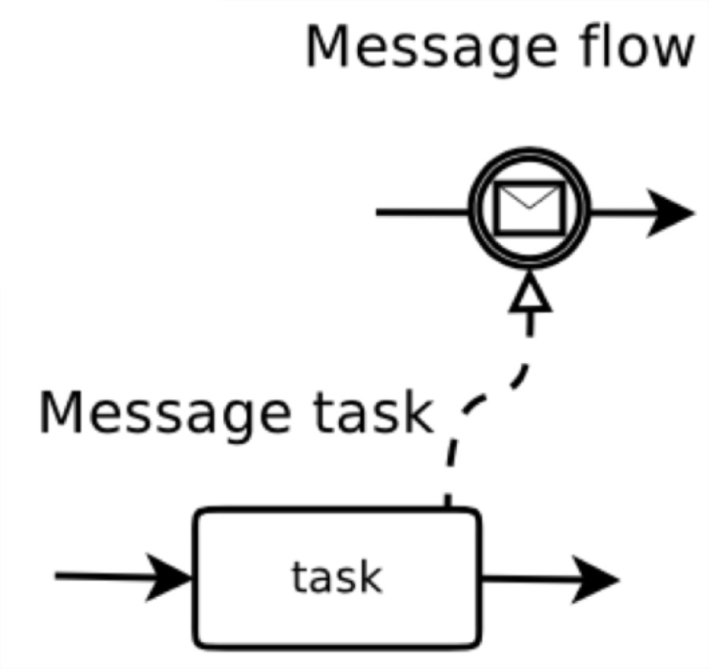



BPMN Syntax
Supported
Association
Sequence Flow
Task
Annotation
Initial Event
End Event
Event-based Gateway
Group
etc.
Exclusive Gateway
Parallel Gateway
Inclusive Gateway

Slide 4
Context
Companies are making use of the BPMN notation to represent their business processes.
They hire experts to analyse and design the most adequate BPMN process according to their needs.
These processes are often syntactically/semantically incorrect.

Slide 5
Research Questions
What if you do not know how to write BPMN?
What if you do not want to spend time designing your BPMN process graphically?
How can you be sure that your BPMN process is syntactically/semantically correct?

Slide 6



General Solution

Slide 7
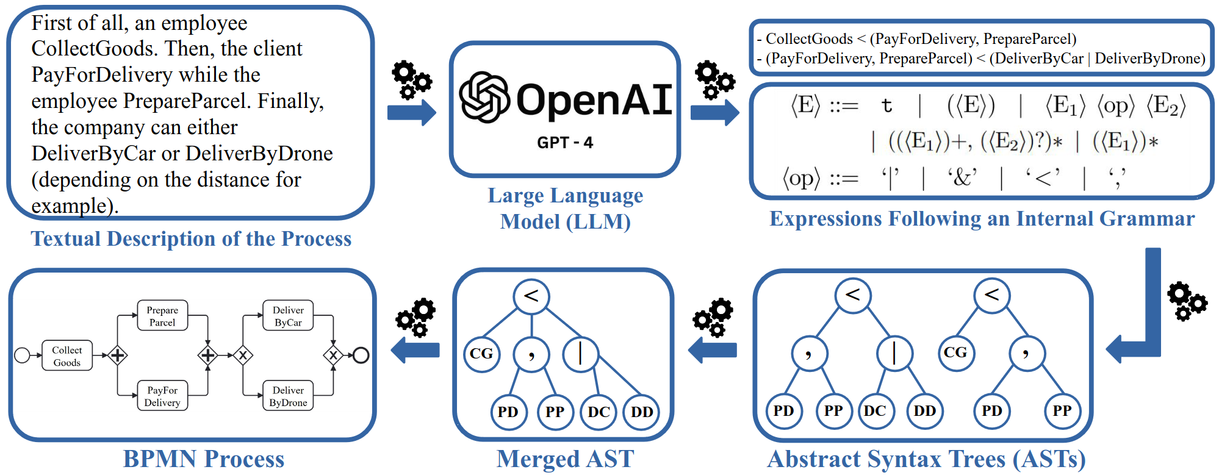
Overview of our Solution

Slide 8
Detailed Solution – Step 1
The user first has to write a textual description of the process-to-be.
First, the system ProcessApplication.
Then, if the client has an account, the system RetrieveCustomerProfile and AnalyseCustomerProfile.
Otherwise, the banker CreateProfile.
Once done, the system IdentifyAccountType, and the banker PrepareAccountOpening.
After that, the user ReceiveSupportDocuments, the banker UpdateInfoRecords, and the system also performs some BackgroundVerification at the same time than ReviewApplication.
Finally, the bank either NotifyRejection, or GenerateAccountNumber, SendStarterKit, and ActivateAccount.

Slide 9

Detailed Solution – Step 2
The textual description is then given to a (fine-tuned) LLM (GPT 3.5 atm).
First, the system ProcessApplication.
Then, if the client has an account, the system RetrieveCustomerProfile and AnalyseCustomerProfile.
Otherwise, the banker CreateProfile.
Once done, the system IdentifyAccountType, and the banker PrepareAccountOpening.
After that, the user ReceiveSupportDocuments, the banker UpdateInfoRecords, and the system also performs some BackgroundVerification at the same time than ReviewApplication.
Finally, the bank either NotifyRejection, or GenerateAccountNumber, SendStarterKit, and ActivateAccount.
The LLM processes the description and returns a set of expressions following an internal grammar.

Slide 10
Detailed Solution – Step 3
Given our description, the LLM returns five expressions:
ProcessApplication
ProcessApplication < ((RetrieveCustomerProfile, AnalyseCustomerProfile) | CreateProfile)
(ProcessApplication, RetrieveCustomerProfile, AnalyseCustomerProfile, CreateProfile) < (IdentifyAccountType, PrepareAccountOpening)
(IdentifyAccountType, PrepareAccountOpening) < (ReceiveSupportDocuments, UpdateInfoRecords, BackgroundVerification & ReviewApplication)
(ReceiveSupportDocuments, UpdateInfoRecords, BackgroundVerification, ReviewApplication) < (NotifyRejection | (GenerateAccountNumber, SendStarterKit, ActivateAccount))

Slide 11
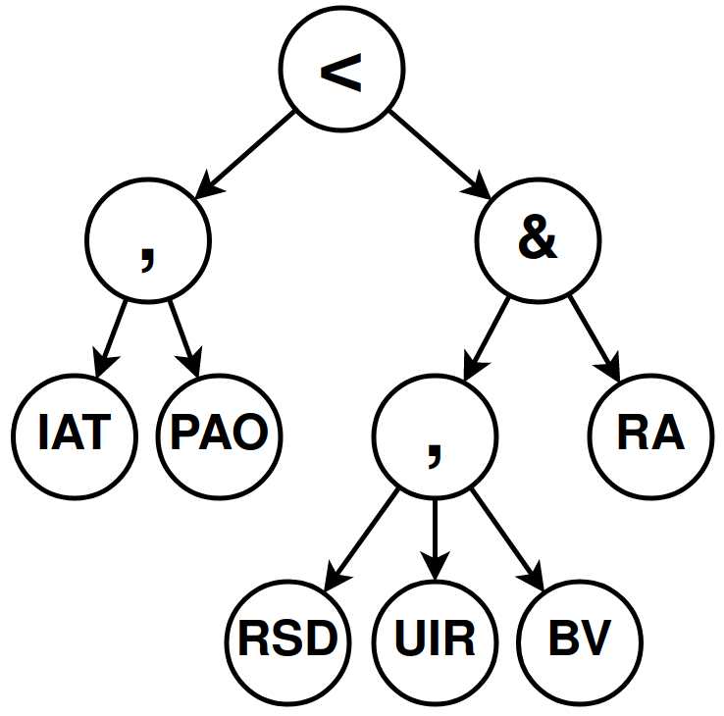
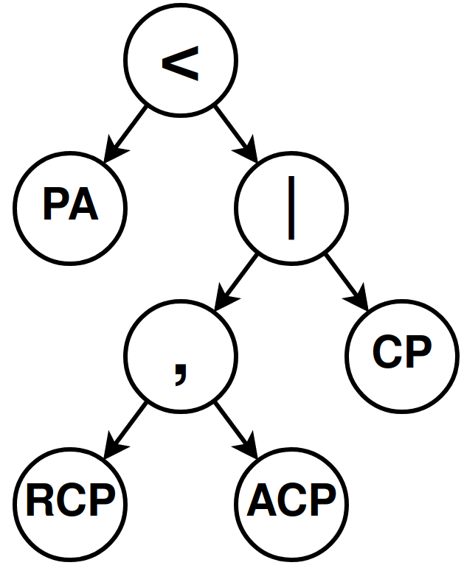

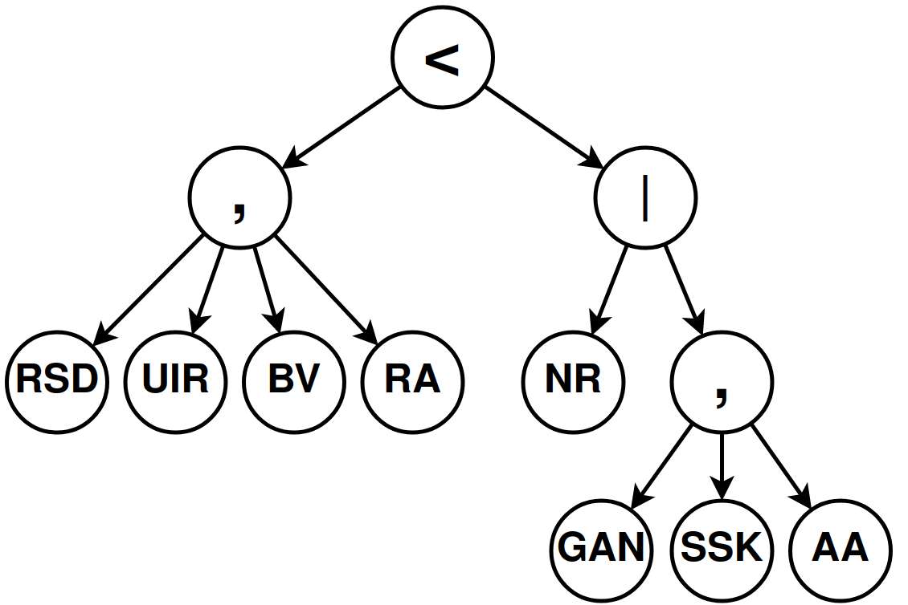
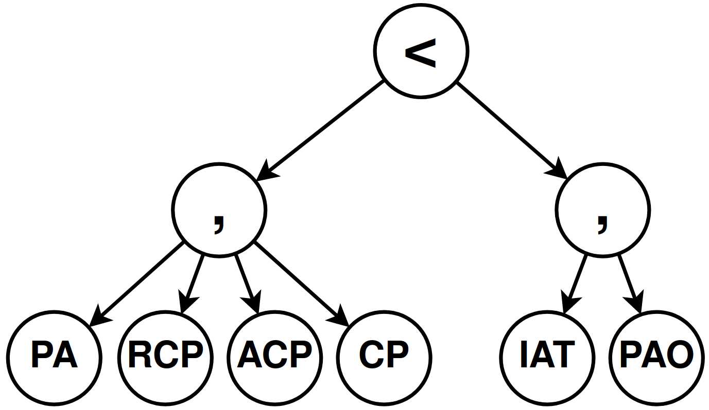
Detailed Solution – Step 4
These expressions are then mapped to their corresponding abstract syntax trees (ASTs).

Slide 12
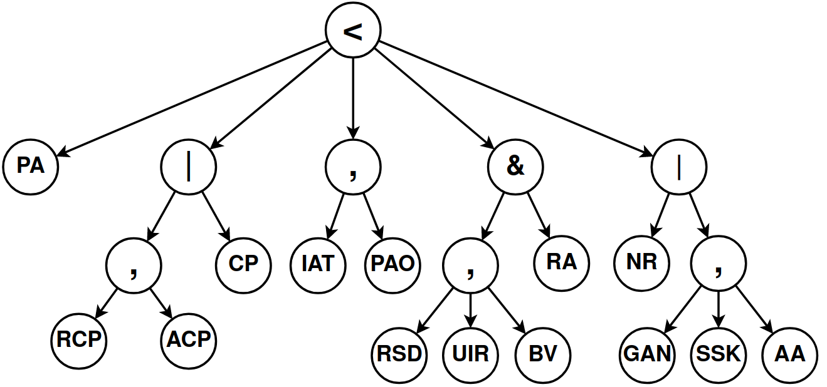
Detailed Solution – Step 5
Each AST contains a fragment of information about the desired process.
To gather this information, the ASTs are merged into a single AST.

Slide 13
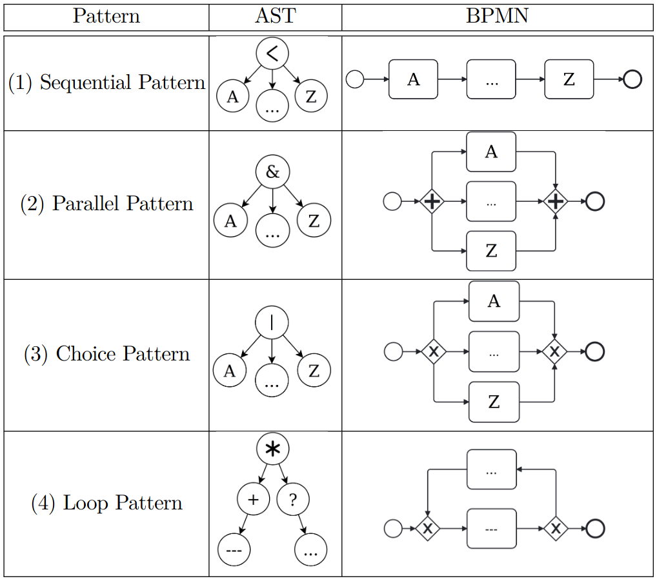
Detailed Solution – Step 6
Once the merged AST has been generated, the BPMN process is ready to be generated.
To do so, patterns are applied recursively to the merged AST, starting from the deepest nodes (leafs).

Slide 14
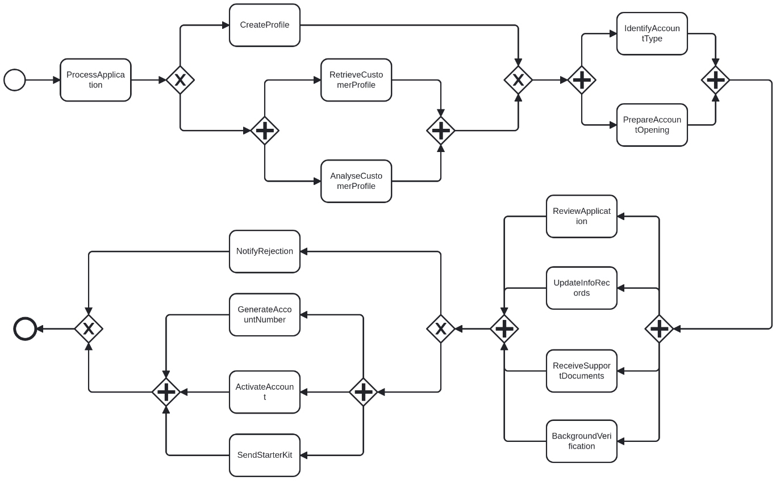
Detailed Solution – Result

Slide 15
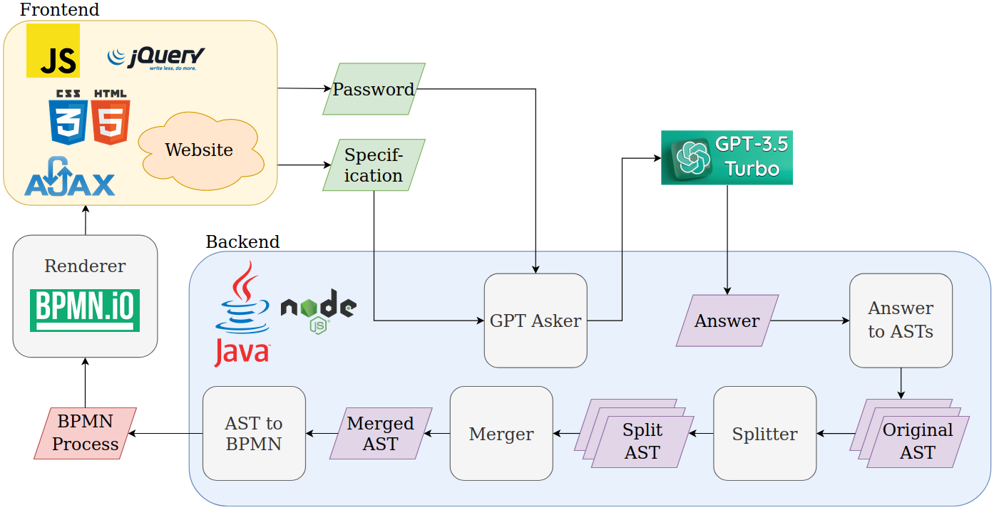
Tool – Description

Slide 16
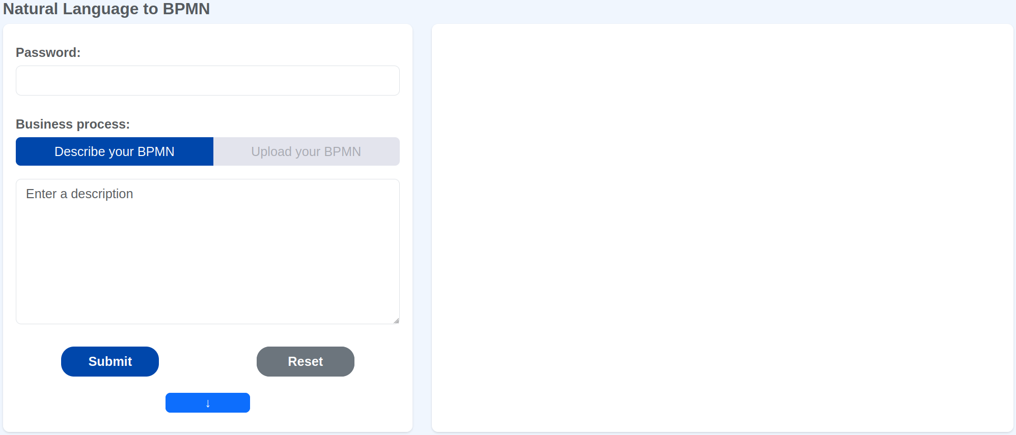
Tool – Online Version
Link: http://34.72.213.68:3000/

Slide 17
Conclusion
In this work, we proposed a 6 steps approach aiming at automatically designing syntactically and semantically correct BPMN processes from a textual description of the requirements.
The main perspectives of this work are:
Release the task naming constraints
Improve the loops management
Enlarge the supported BPMN syntax
Improve the results

