Slide 1



Patching Liveness Bugs
in Concurrent Programs
By Irman FAQRIZAL, Quentin NIVON & Gwen SALAUN

Slide 2
Introduction
Context
Designing and developing distributed softwares nowadays is a tedious and error-prone task due to the increasing complexity of the softwares.
We need ways of detecting automatically such bugs in concurrent programs.
Existing solutions
Model checking is a well-known technique that can be used to chase violations of temporal logic formulas in such specifications.
Model checkers return a trace that is a counterexample of the given property.
However, understanding and correcting this bug can be a hard and painful task.

Slide 3
Introduction
Motivations
Detect all violations of a liveness property and propose a correction of the specification.
Propose a correction which is as simple as possible.
Propose a correction that is as minimal as possible in terms of number of changes in the original specification.

Slide 4
Plan
Preliminaries
Model checking
Counterexample LTS
Single Inevitable Execution Property
Patch
Solving approach
Global Representation
Transition Sets Computation
Patches Computation
Implementation
Performance study
Conclusion

Slide 5
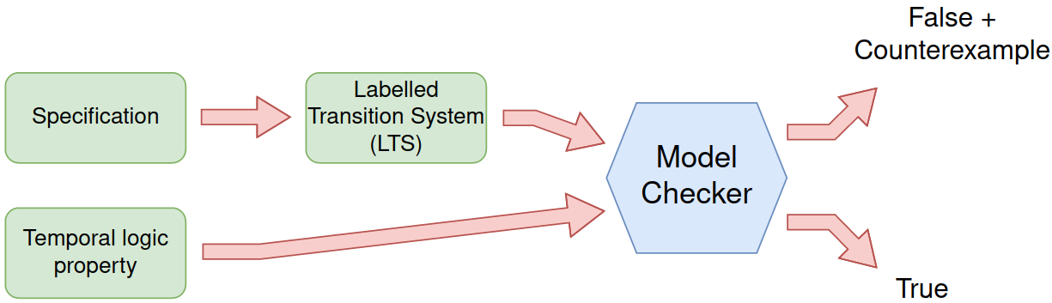
Preliminaries: Model Checking

Slide 6
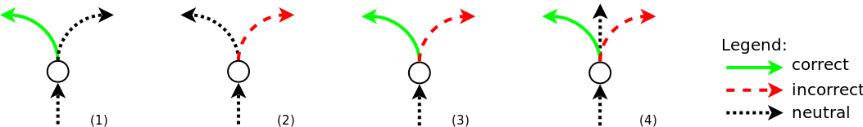
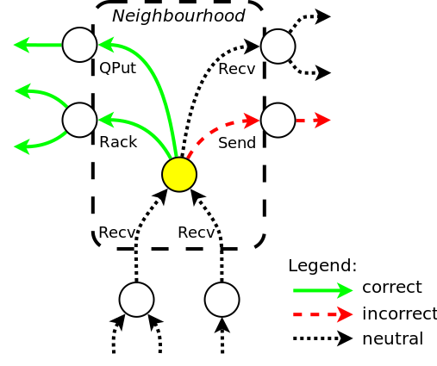
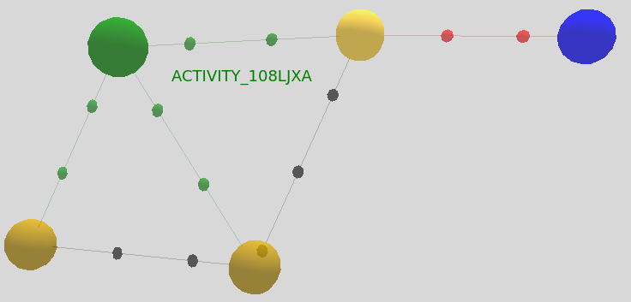
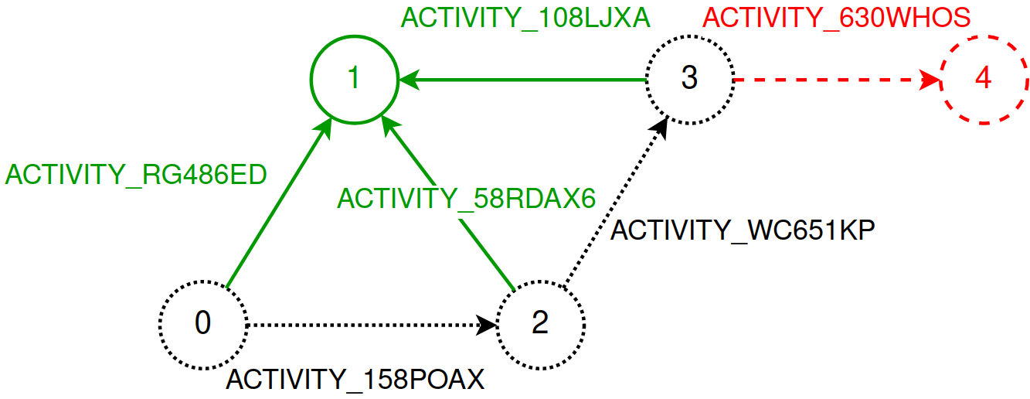
Preliminaries: Counterexample LTS
Key idea 1: transitions categorisation (3 types)
correct transitions
incorrect transitions
neutral transitions
Key idea 2: identification of faulty states
choices between transitions leading to a correct or an incorrect part of the model
Four kinds of faulty states:
CLTS output from the CLEAR tool
Clearer representation of the CLTS output

Slide 7
Preliminaries: Single Inevitable Execution Property
A single inevitable execution property is a temporal logic formula stating that the action belonging to the property should appear at least once in every trace of the specification.
This kind of property is one of the most used liveness property in practice.
[Avrunin, Corbett, Dwyer – ICSE’99]
It can be written as follows:
INEVITABLE(“action”)
mu X . (< true > true and [ not "action" ] X)
◇action
Textual representation
MCL representation
LTL representation

Slide 8
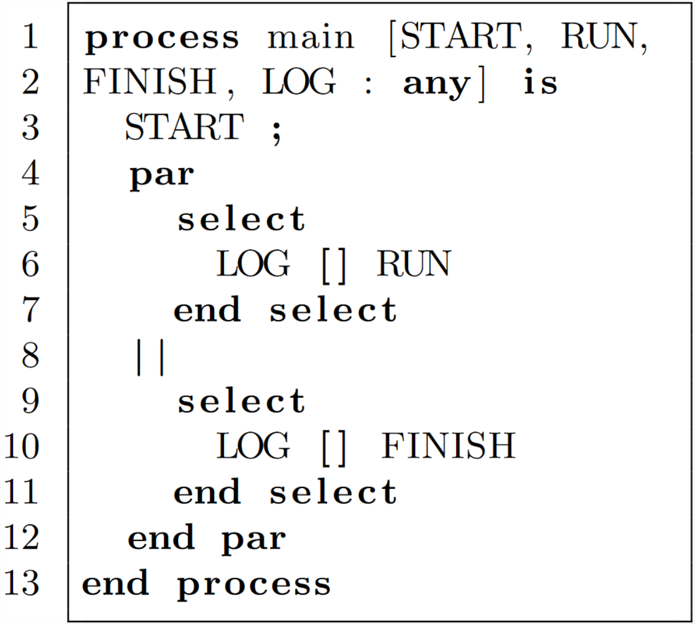
Preliminaries: Patch
Given a specification S and a single inevitable execution property P = INEVITABLE(“action”),
a patch is defined as a set of actions of S before which the action of the inevitable property should be put in order to correct the specification (i.e., make it compliant with the property).
Possible patches:
START
RUN + FINISH
…
INEVITABLE(“LOG”)

Slide 9
Plan
Preliminaries
Model checking
Counterexample LTS
Single Inevitable Execution Property
Patch
Solving approach
Global Representation
Transition Sets Computation
Patches Computation
Implementation
Performance study
Conclusion

Slide 10
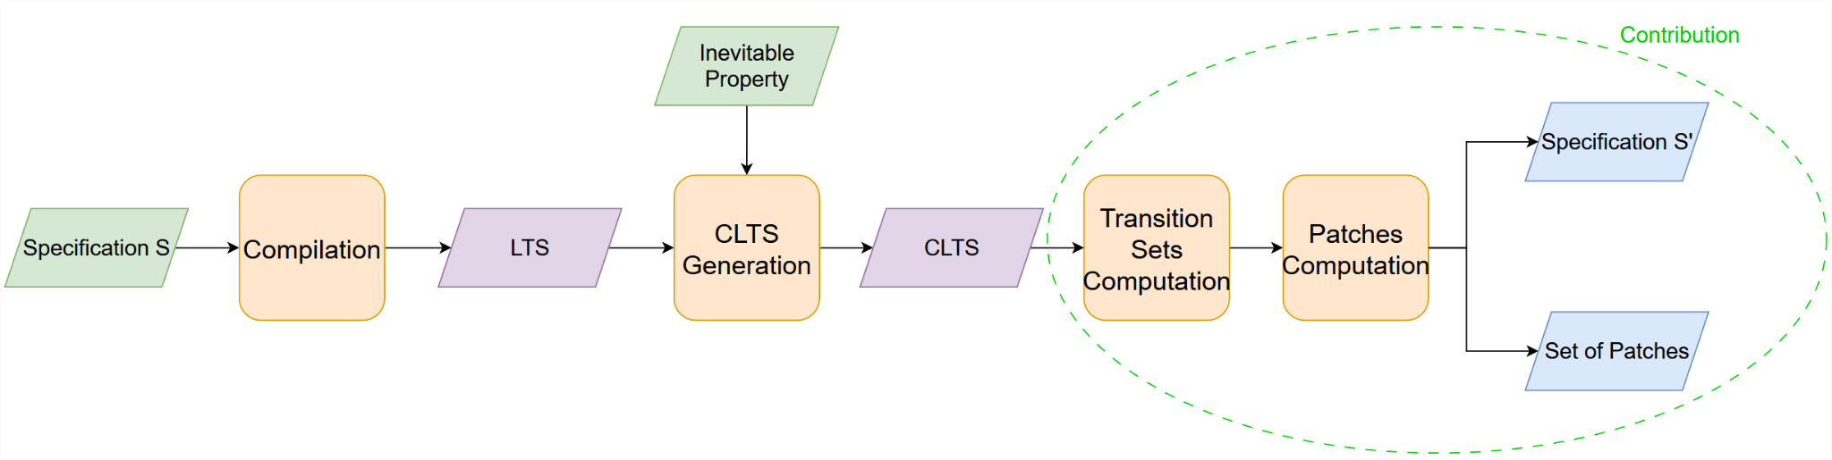
Solving approach: Global representation
The solving approach is a 2-step approach:
First, we compute several transition sets needed for the computation of patches.
Then, we compute the set of patches correcting the specification.
1
2
1
2

Slide 11
Solving approach: Transition Sets Computation – Definition
The purpose of this step is to compute three transition sets that we will use to compute the patches of the specification.
These three sets are the set of:
All Incorrect Transitions (AIT), which contains all the incorrect transitions of the CLTS.
First Incorrect Transitions (FIT), which is a subset of AIT containing all the incorrect transitions outgoing from faulty states.
Exclusively Incorrect Transitions (EIT), which is a subset of FIT containing all the incorrect transitions outgoing from faulty states for which there exists no other transition with the same label that is either correct or neutral in the CLTS.
Finally, we recall that EIT ⊆ FIT ⊆ AIT.

Slide 12
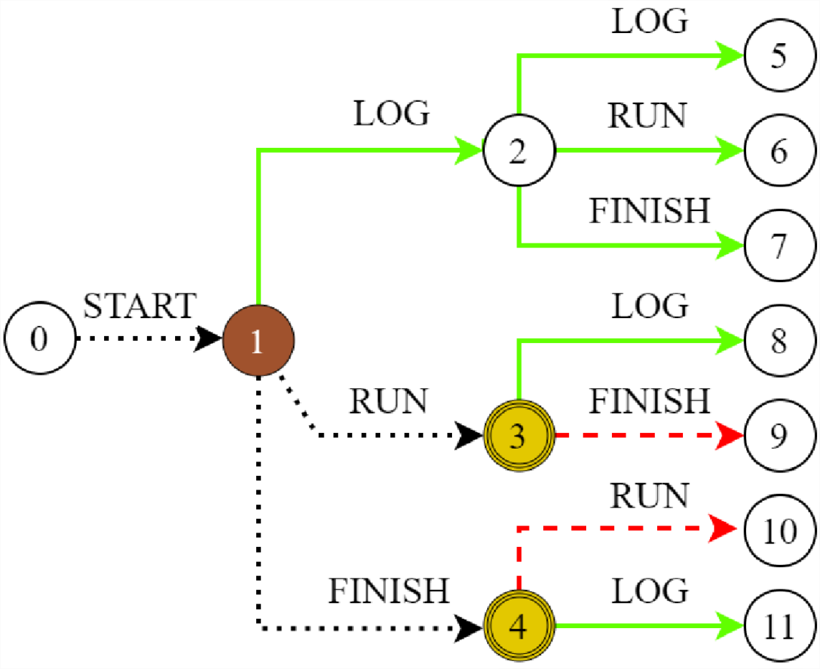
Solving approach: Transition Sets Computation - Example
AIT = {FINISH, RUN}
FIT = {FINISH, RUN}
EIT = {}
INEVITABLE(“LOG”)

Slide 13
Solving approach: Computation of Patches – Intuition
The intuition of this step is built on top of the notion of reachability between transitions.
A transition is said to be reachable from another transition as long as there exists several states (or transitions) connecting these transitions.
“FINISH” is reachable from “LOG”
“RUN” is reachable from “START”
…
is reachable from
is reachable from
Intuition: patching only some well-chosen actions should correct the specification.

Slide 14
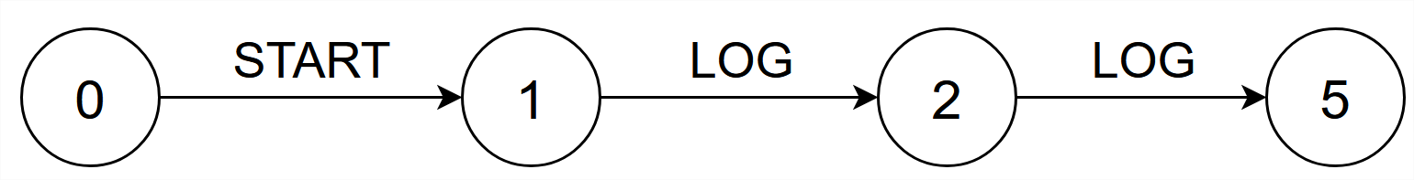
Solving approach: Computation of Patches – Impact
In this work, we differentiate two types of patches: patches that impact correct traces of the specification, and patches that do not.
A patch is said to impact correct traces of the specification if after applying this patch to the specification, some of its correct traces no longer exist.
INEVITABLE(“LOG”)
{START}
Trace no longer exists!

Slide 15
Solving approach: Computation of Patches – Optimality
In both cases, we want to compute the optimal patches.
In this work, the notion of optimality is defined by the size of the patches returned and the impact of these patches on correct traces of the specification.
The size of a patch corresponds to the number of actions that it contains, and the impact of a patch corresponds to the number of actions belonging to correct traces impacted by the patch.
The smaller the patch the more optimised it is, and the smaller its impact the more optimised it is.

Slide 16
Solving approach: Computation of Patches – First Step
In a first step of the computation, we check whether the patches will necessarily impact some correct traces of the specification or not.
In order to avoid impacting correct traces, at least one of the two following conditions must hold:
Condition 1: If all the first incorrect transitions are exclusively incorrect, we can patch the specification without impact on correct traces.
Condition 2: If all the incorrect transitions are reachable from exclusively incorrect transitions, we can patch the specification without impact on correct traces.

Slide 17
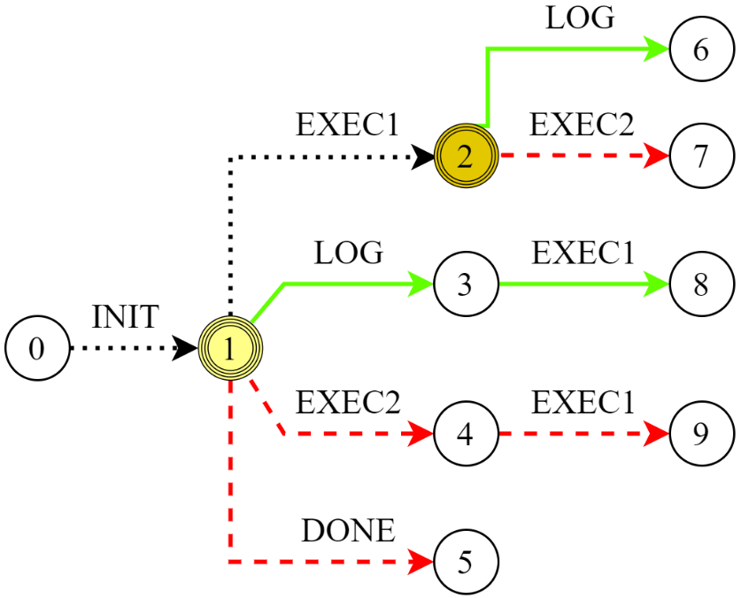


Solving approach: Computation of Patches – First Step (Example)
INEVITABLE(“LOG”)
INEVITABLE(“LOG”)
AIT = {EXEC1, EXEC2, RUN}
FIT = {EXEC2, DONE}
EIT = {EXEC2, DONE}
AIT = {FINISH, RUN}
FIT = {FINISH, RUN}
EIT = {}
=

Slide 18
Solving approach: Computation of Patches – Second Step
First scenario: Patches have no impact on correct traces.
Optimality criterion: Size of the patches.
Intuition of the algorithm:
1
Compute all combinations of EIT of size 1.
2
For each combination, verify if the corresponding transitions can reach all incorrect transitions of the CLTS (i.e., they can correct the specification).
3
If the combination corrects the specification, add it to the list of patches.
3
4
If a patch was found in step , stop iterating and return the patches found.
Otherwise, restart an iteration with combinations of size 2 (and so on).

Slide 19
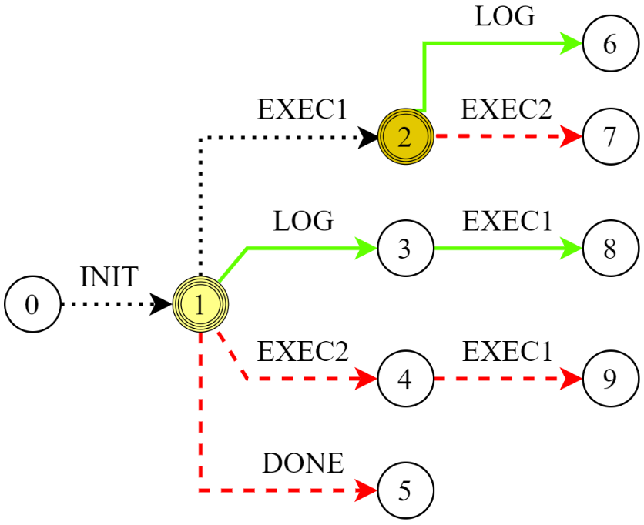
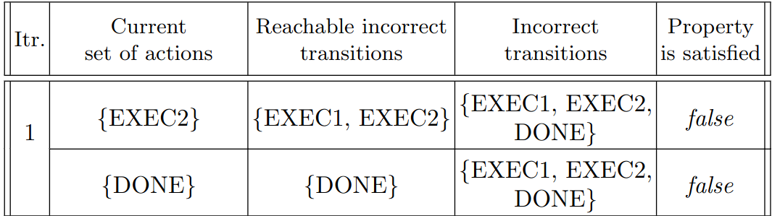
Solving approach: Computation of Patches – Example
AIT = {EXEC1, EXEC2, RUN}
FIT = {EXEC2, DONE}
EIT = {EXEC2, DONE}
Patches: {{EXEC2, DONE}}

Slide 20
Solving approach: Computation of Patches – Second Step
First scenario: Patches have an impact on correct traces.
Optimality criterion: Impact on correct traces.
Intuition of the algorithm:
1
Compute all combinations of FIT of size 1.
2
For each combination, verify if the corresponding transitions can reach all incorrect transitions of the CLTS (i.e., they can correct the specification).
3
If the combination corrects the specification, verifies if its impact is smaller than or equal to the previous patches found.
4
If yes, add it to the list of patches.
5
Start a new iteration until having computed all combinations of FIT, regardless of their size.

Slide 21
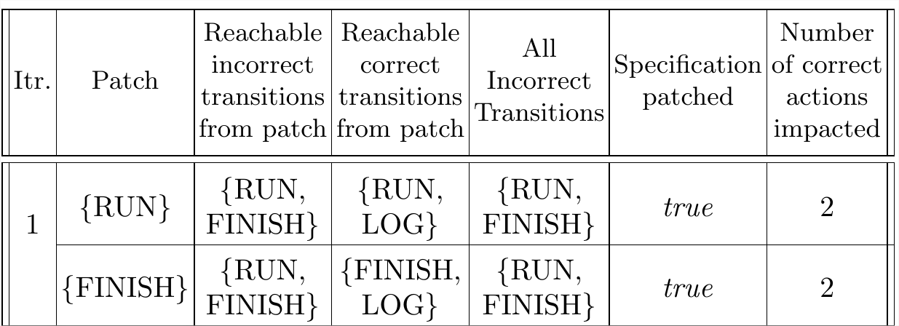
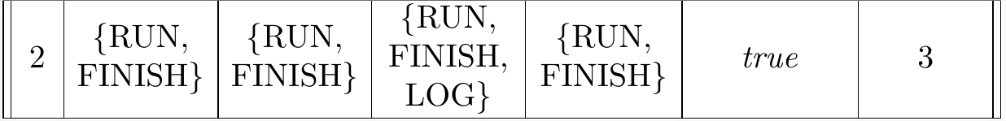
Solving approach: Computation of Patches – Example
AIT = {FINISH, RUN}
FIT = {FINISH, RUN}
EIT = {}
Patches: {{RUN}, {FINISH}}

Slide 22
Plan
Preliminaries
Model checking
Counterexample LTS
Single Inevitable Execution Property
Patch
Solving approach
Global Representation
Transition Sets Computation
Patches Computation
Implementation
Performance study
Conclusion

Slide 23
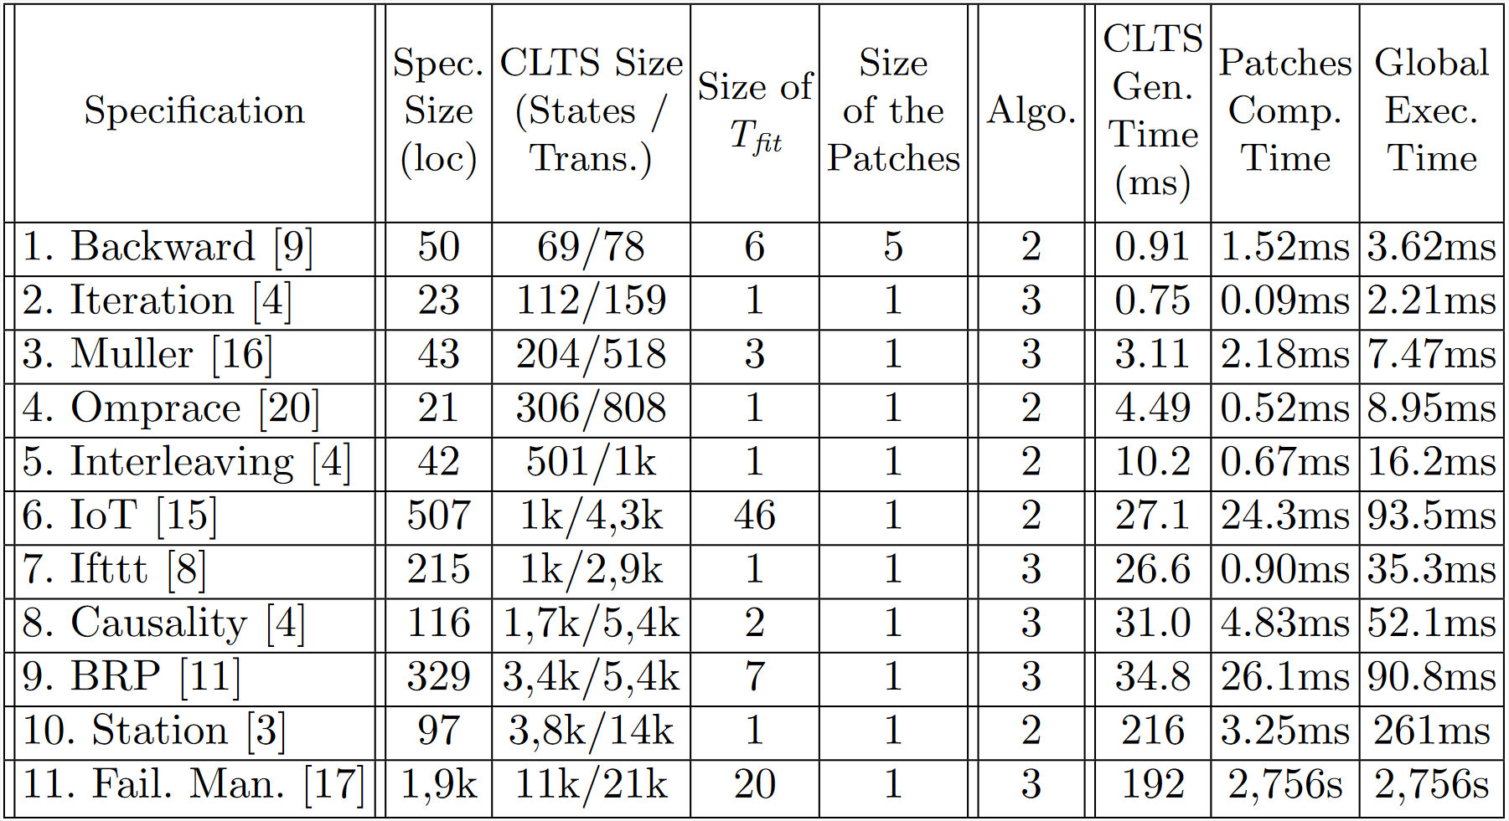
Implementation
Prototype
The approach detailed in this presentation has been fully implemented and tested on dozens of LNT specifications. It consists of approximately 2,000 lines of Python code.
Performance study
Very short!
(300ms at most)
Rather long (~45m)

Slide 24
Plan
Preliminaries
Model checking
Counterexample LTS
Single Inevitable Execution Property
Patch
Solving approach
Global Representation
Transition Sets Computation
Patches Computation
Implementation
Performance study
Conclusion

Slide 25
Conclusion
In this work, we proposed a way for automatically finding and correcting bugs related to single inevitable execution properties in labelled transitions systems.
We also provided an automated tool implementing the proposed solution, for which we assessed the scalability through a performance study.
Short-term improvements:
Manage non-fixed action names (such as “!” or “?” in LNT).
Try to reduce the complexity of the algorithm (avoid computing all combinations)
Mid-term improvements:
Extend the approach to (at least) nested inevitable properties.

Slide 26

Questions

Slide 27
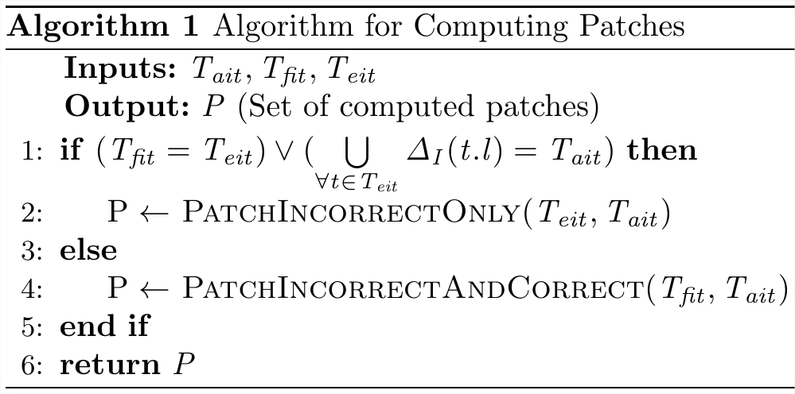
Solving approach: Computation of Patches – Main Algo
In a first step of the computation, we check whether the patches will necessarily impact some correct traces of the specification or not.
C1: If all the first incorrect transitions are exclusively incorrect, we can patch the specification without impact on correct traces
C1
C2
C2: If all the incorrect transitions are reachable from exclusively incorrect transitions, we can patch the specification without impact on correct traces

Slide 28
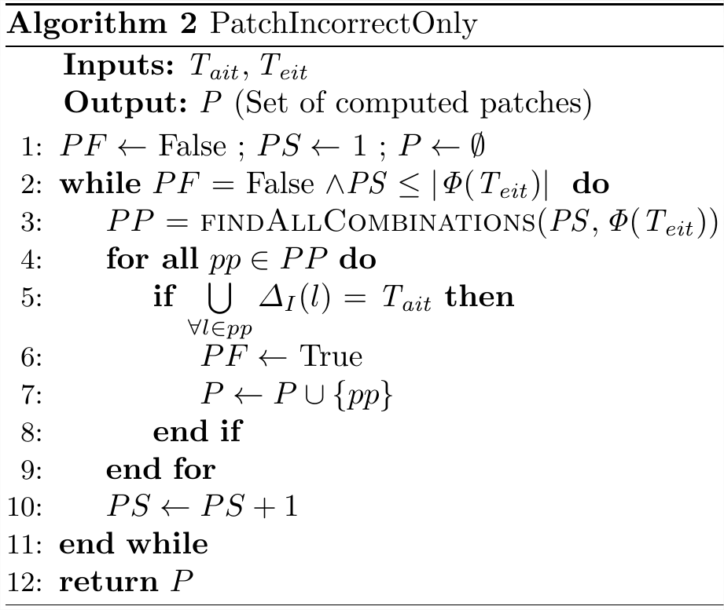
Solving approach: Computation of Patches – Second Step
First scenario: Patches have no impact on correct traces
Optimality criterion: Size of the patches
iterate until finding a patch
find all combinations of size PS of EIT
for each combination, verifies if it corrects the specification
if yes, add the combination to the list of patches and prevent the next iteration

Slide 29
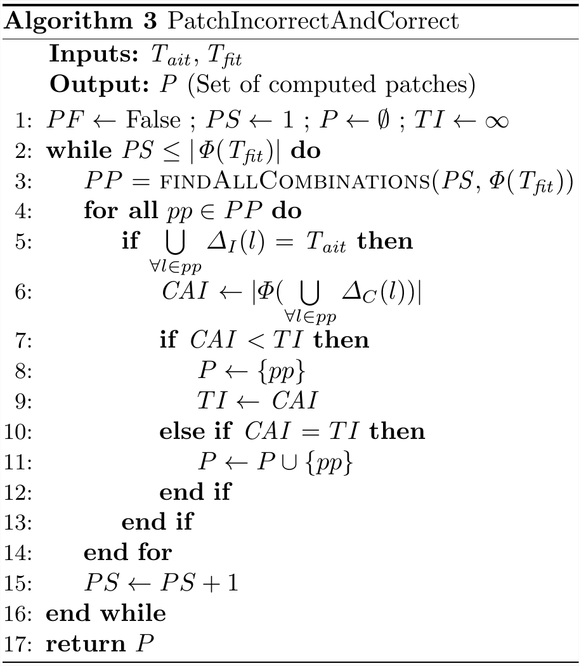
Solving approach: Computation of Patches – Impact
Second scenario: Patches have impact on correct traces
Optimality criterion: Impact on correct traces
iterate over all possible combinations
find all combinations of size PS of FIT
for each combination, verifies if it corrects the specification
if yes, verifies if it has at most the same impact than previous patches found

