Slide 1

LLM-Based Generation of BPMN Workflows From Textual Descriptions
NIVON Quentin, SALAÜN Gwen

Slide 2


Introduction
What is BPMN?
A workflow-based notation created in 2004 by the Business Process Management Initiative (BPMI) and the Object Management Group (OMG).
It aims at representing business processes in a way that is understandable for both experienced and novice users.
An ISO/IEC standard since version 2.0 in 2013.

Slide 3




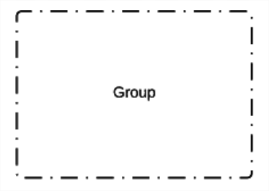



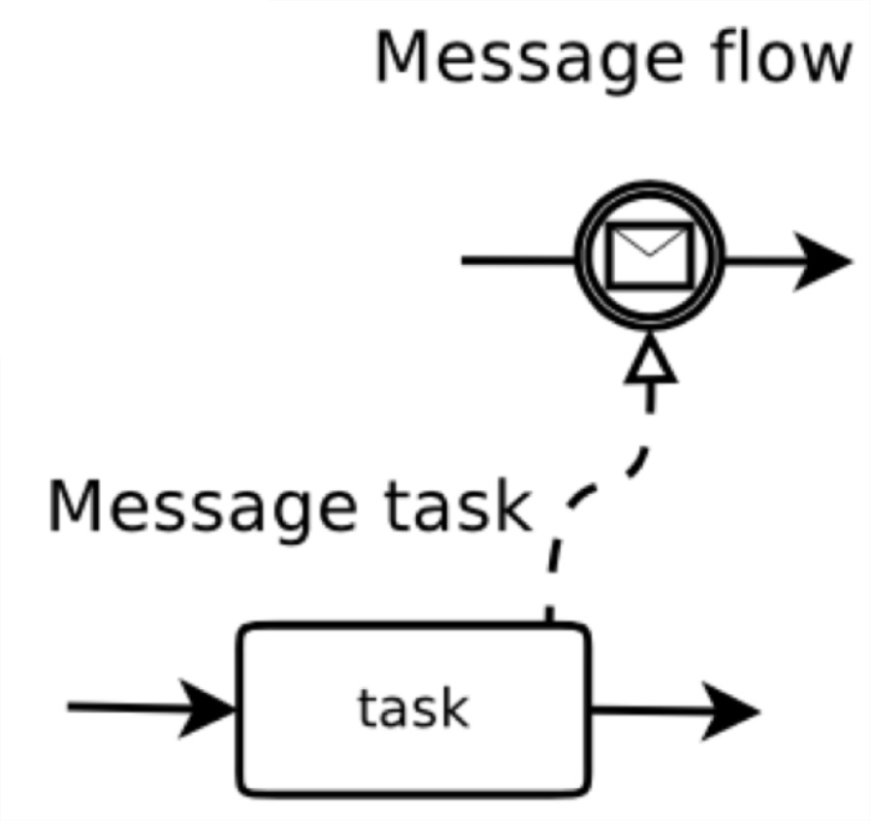



BPMN Syntax
Association
Sequence Flow
Task
Annotation
Initial Event
End Event
Event-based Gateway
Group
etc.
Exclusive Gateway
Parallel Gateway
Inclusive Gateway

Slide 4
BPMN Syntax
Supported
Association
Sequence Flow
Task
Annotation
Initial Event
End Event
Event-based Gateway
Group
etc.
Exclusive Gateway
Parallel Gateway
Inclusive Gateway

Slide 5
Context
Companies are making use of the BPMN notation to represent their business processes.
They hire experts to analyse and design the most adequate BPMN process according to their needs.
These processes are often syntactically/semantically incorrect.

Slide 6
Research Questions
What if you do not know how to write BPMN?
What if you do not want to spend time designing your BPMN process graphically?
How can you be sure that your BPMN process is syntactically/semantically correct?

Slide 7

General Solution

Slide 8


General Solution

Slide 9
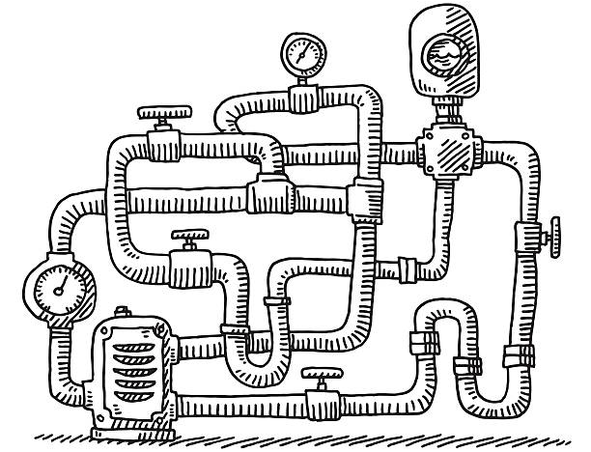
General Solution
Internal Computations

Slide 10
General Solution
Internal Computations

Slide 11
Overview of our Solution
First of all, an employee CollectGoods. Then, the client PayForDelivery while the employee PrepareParcel. Finally, the company can either DeliverByCar or DeliverByDrone (depending on the distance for example)
Textual Representation
of the Process

Slide 12


Overview of our Solution
First of all, an employee CollectGoods. Then, the client PayForDelivery while the employee PrepareParcel. Finally, the company can either DeliverByCar or DeliverByDrone (depending on the distance for example)
Large Language
Model (LLM)
Textual Representation
of the Process

Slide 13


Overview of our Solution
First of all, an employee CollectGoods. Then, the client PayForDelivery while the employee PrepareParcel. Finally, the company can either DeliverByCar or DeliverByDrone (depending on the distance for example)
- CollectGoods < (PayForDelivery, PrepareParcel)
- (PayForDelivery, PrepareParcel) < (DeliverByCar,
DeliverByDrone)
Large Language
Model (LLM)
Expressions Following an Internal Grammar
Textual Representation
of the Process

Slide 14

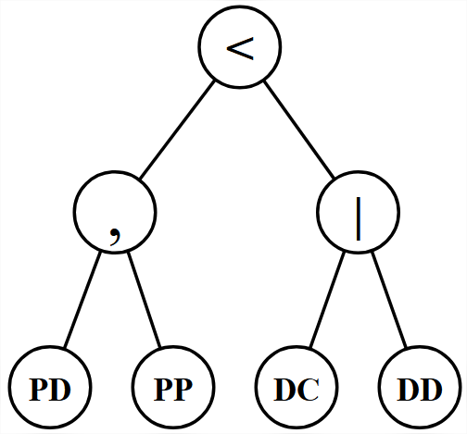
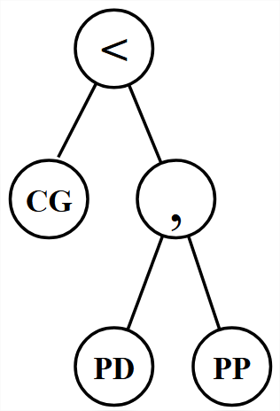
Overview of our Solution
First of all, an employee CollectGoods. Then, the client PayForDelivery while the employee PrepareParcel. Finally, the company can either DeliverByCar or DeliverByDrone (depending on the distance for example)
- CollectGoods < (PayForDelivery, PrepareParcel)
- (PayForDelivery, PrepareParcel) < (DeliverByCar,
DeliverByDrone)
Large Language
Model (LLM)
Expressions Following an Internal Grammar
Textual Representation
of the Process
Abstract Syntax Trees

Slide 15

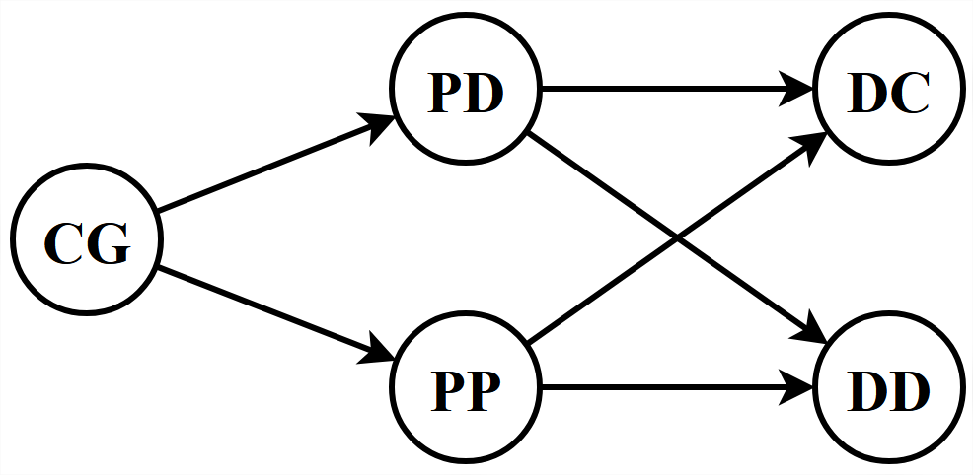
Overview of our Solution
First of all, an employee CollectGoods. Then, the client PayForDelivery while the employee PrepareParcel. Finally, the company can either DeliverByCar or DeliverByDrone (depending on the distance for example)
- CollectGoods < (PayForDelivery, PrepareParcel)
- (PayForDelivery, PrepareParcel) < (DeliverByCar,
DeliverByDrone)
Large Language
Model (LLM)
Expressions Following an Internal Grammar
Textual Representation
of the Process
Dependency Graph
Abstract Syntax Trees

Slide 16
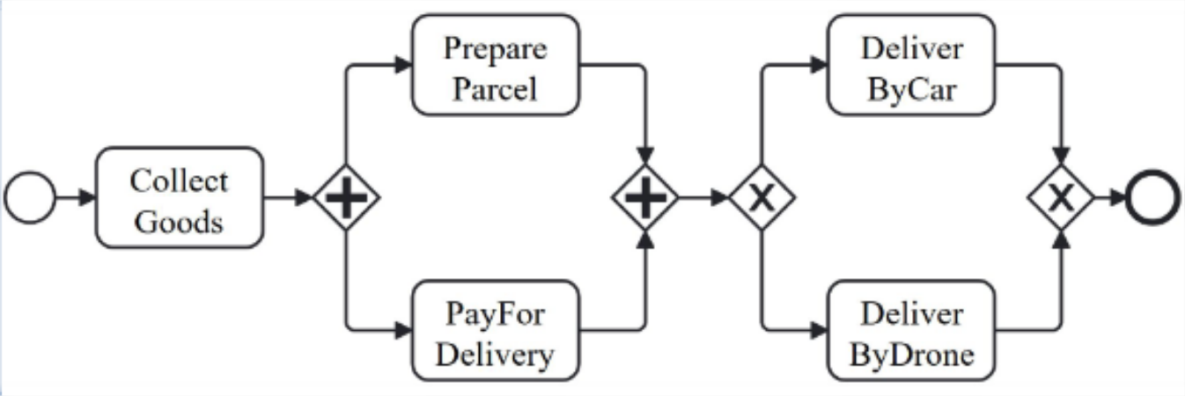
Overview of our Solution
First of all, an employee CollectGoods. Then, the client PayForDelivery while the employee PrepareParcel. Finally, the company can either DeliverByCar or DeliverByDrone (depending on the distance for example)
- CollectGoods < (PayForDelivery, PrepareParcel)
- (PayForDelivery, PrepareParcel) < (DeliverByCar,
DeliverByDrone)
Large Language
Model (LLM)
Expressions Following an Internal Grammar
Textual Representation
of the Process
Dependency Graph
BPMN Process
Abstract Syntax Trees

Slide 17
Detailed Solution – Step 1
The user first has to write a textual description of the process-to-be.
First, the banker either CreateProfile (CP) for the user, or, if it is not
needed, he RetrieveCustomerProfile (RCP) which triggers the system to perform the AnalyseCustomerProfile (ACP) task.
Then, the user executes the task ReceiveSupportDocuments (RSD) so that the system can start UpdateInfoRecords (UID) and perform a BackgroundVerification (BV).
If the verification finds missing or incorrect information, the system RequestAdditionalInfo (RAI) to the user, who has to ReceiveSupportDocuments (RSD) again.
Otherwise, the process ends with CreateAccount (CA).

Slide 18

Detailed Solution – Step 2
The textual description is then given to a (fine-tuned) LLM (GPT 3.5 atm).
First, the banker either CreateProfile (CP) for the user, or, if it is not
needed, he RetrieveCustomerProfile (RCP) which triggers the system to perform the AnalyseCustomerProfile (ACP) task.
Then, the user executes the task ReceiveSupportDocuments (RSD) so that the system can start UpdateInfoRecords (UID) and perform a BackgroundVerification (BV).
If the verification finds missing or incorrect information, the system RequestAdditionalInfo (RAI) to the user, who has to ReceiveSupportDocuments (RSD) again.
Otherwise, the process ends with CreateAccount (CA).
- 3.5

Slide 19
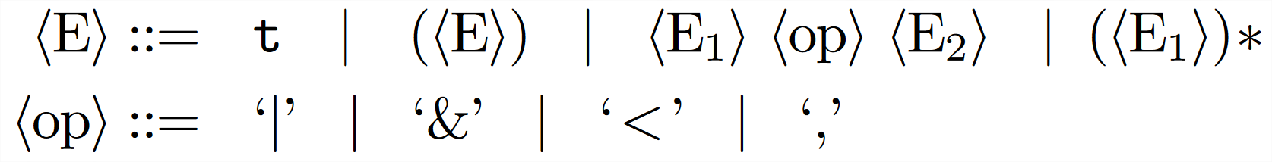
Detailed Solution – Step 2
The textual description is then given to a (fine-tuned) LLM (GPT 3.5 atm).
First, the banker either CreateProfile (CP) for the user, or, if it is not
needed, he RetrieveCustomerProfile (RCP) which triggers the system to perform the AnalyseCustomerProfile (ACP) task.
Then, the user executes the task ReceiveSupportDocuments (RSD) so that the system can start UpdateInfoRecords (UID) and perform a BackgroundVerification (BV).
If the verification finds missing or incorrect information, the system RequestAdditionalInfo (RAI) to the user, who has to ReceiveSupportDocuments (RSD) again.
Otherwise, the process ends with CreateAccount (CA).
- 3.5
The LLM processes the description and returns a set of expressions following an internal grammar.

Slide 20
Detailed Solution – Step 3
Given our description, the LLM returns three expressions:
(RetrieveCustomerProfile < AnalyseCustomerProfile) | CreateProfile

Slide 21
Detailed Solution – Step 3
Given our description, the LLM returns three expressions:
(RetrieveCustomerProfile < AnalyseCustomerProfile) | CreateProfile
(RetrieveCustomerProfile, AnalyseCustomerProfile, CreateProfile) < (ReceiveSupportDocuments < (UpdateInfoRecords, BackgroundVerification))

Slide 22
Detailed Solution – Step 3
Given our description, the LLM returns three expressions:
(RetrieveCustomerProfile < AnalyseCustomerProfile) | CreateProfile
(RetrieveCustomerProfile, AnalyseCustomerProfile, CreateProfile) < (ReceiveSupportDocuments < (UpdateInfoRecords, BackgroundVerification))
(UpdateInfoRecords, BackgroundVerification) < ((RequestAdditionalInfo < ReceiveSupportDocuments) | CreateAccount)

Slide 23
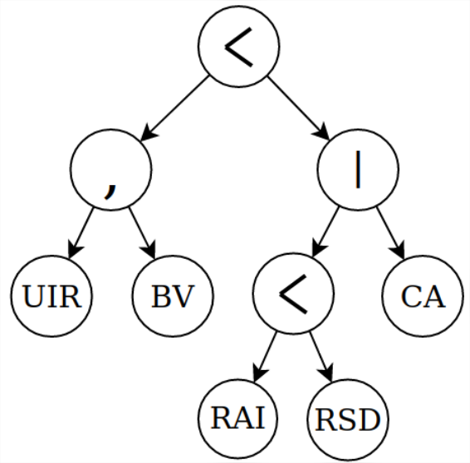
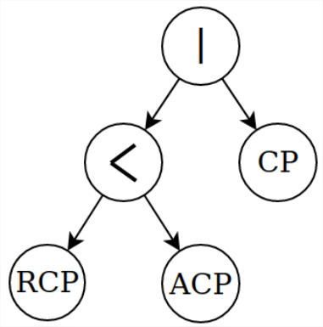
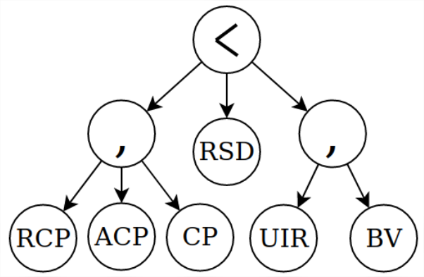
Detailed Solution – Step 4
These expressions are then mapped to their corresponding abstract syntax trees (ASTs).

Slide 24
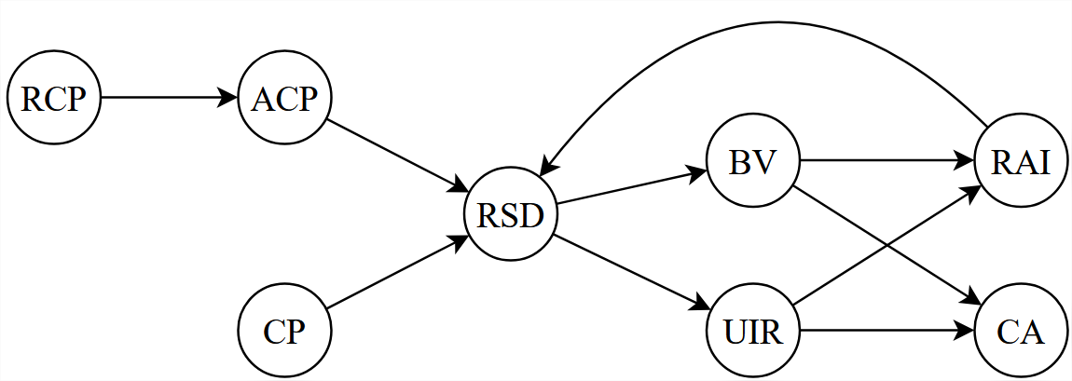
Detailed Solution – Step 5
The sequential information contained in the multiple ASTs is gathered to obtain a cleaner representation of it, called dependency graph.

Slide 25
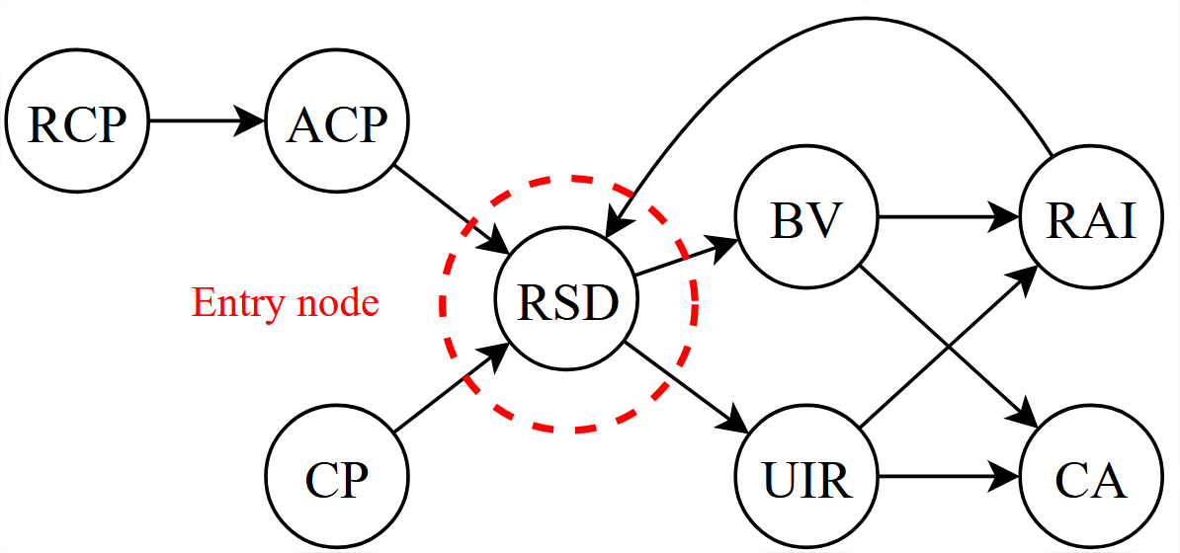
Detailed Solution – Step 6
If the dependency graph contains loops, they are analysed, and all the information needed to reconstruct them is extracted.
Entry node(s) computation

Slide 26
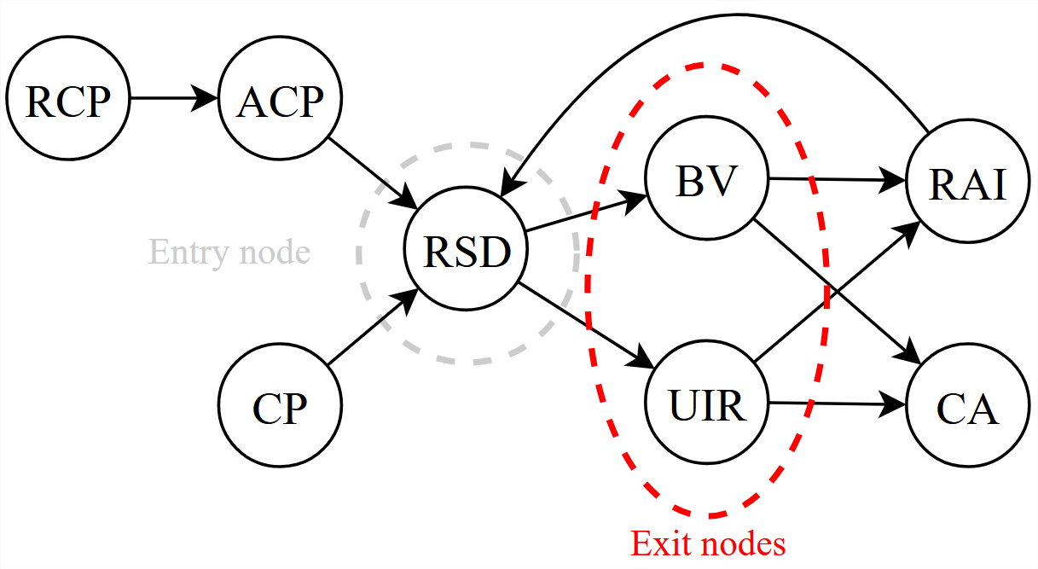
Detailed Solution – Step 6
If the dependency graph contains loops, they are analysed, and all the information needed to reconstruct them is extracted.
Entry node(s) computation
Exit node(s) computation

Slide 27
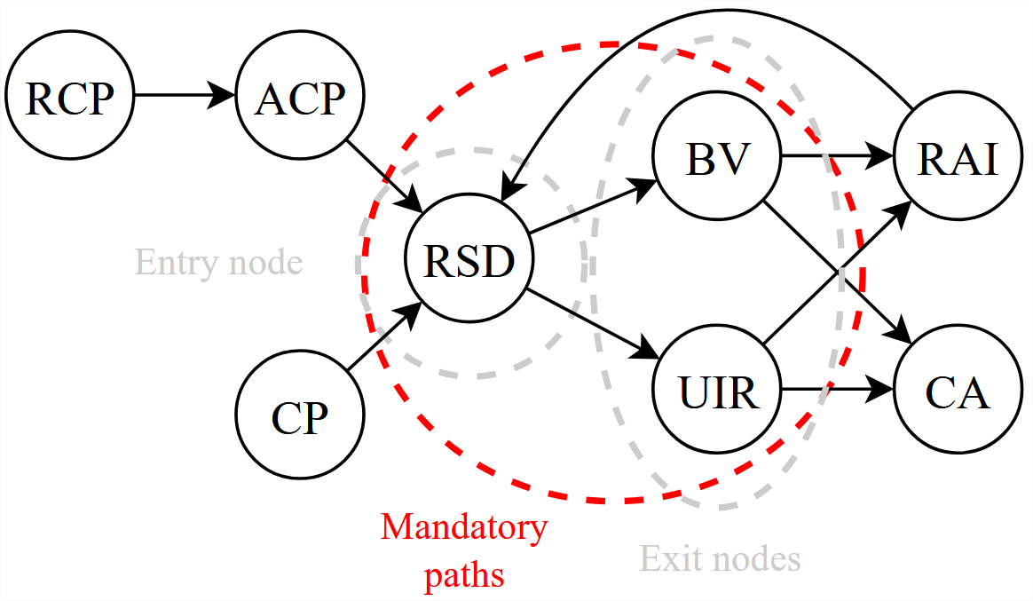
Detailed Solution – Step 6
If the dependency graph contains loops, they are analysed, and all the information needed to reconstruct them is extracted.
Entry node(s) computation
Exit node(s) computation
Mandatory path(s) computation

Slide 28
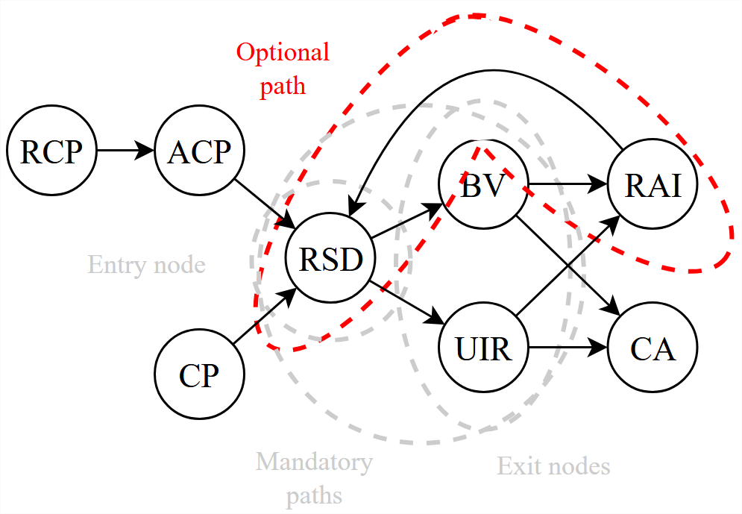
Detailed Solution – Step 6
If the dependency graph contains loops, they are analysed, and all the information needed to reconstruct them is extracted.
Entry node(s) computation
Exit node(s) computation
Mandatory path(s) computation
Optional path(s) computation

Slide 29
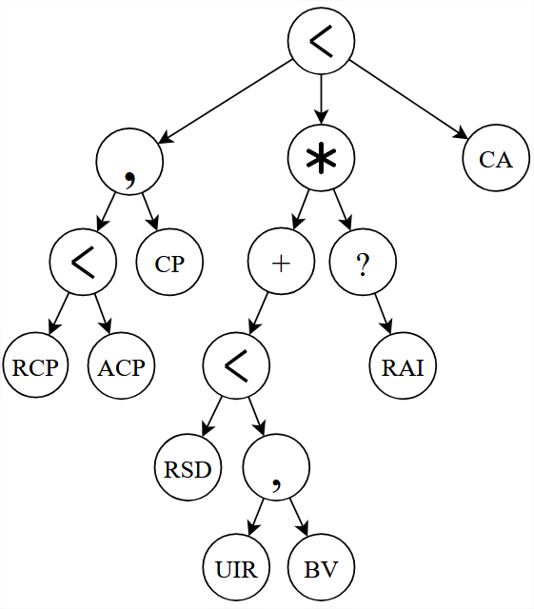
Detailed Solution – Step 7
Once the loops have been retrieved, the AST corresponding to the dependency graph is built from the dependency graph.

Slide 30
Detailed Solution – Step 8
The ultimate step to obtain an AST containing all the information belonging to the original expressions consists in inserting the choices.
(RCP < ACP) | CP
(RAI < RSD) | CA

Slide 31

Detailed Solution – Step 8
The ultimate step to obtain an AST containing all the information belonging to the original expressions consists in inserting the choices.
(RCP < ACP) | CP
(RAI < RSD) | CA

Slide 32
Detailed Solution – Step 8
The ultimate step to obtain an AST containing all the information belonging to the original expressions consists in inserting the choices.
(RCP < ACP) | CP
(RAI < RSD) | CA
Already included
due to the loop!

Slide 33
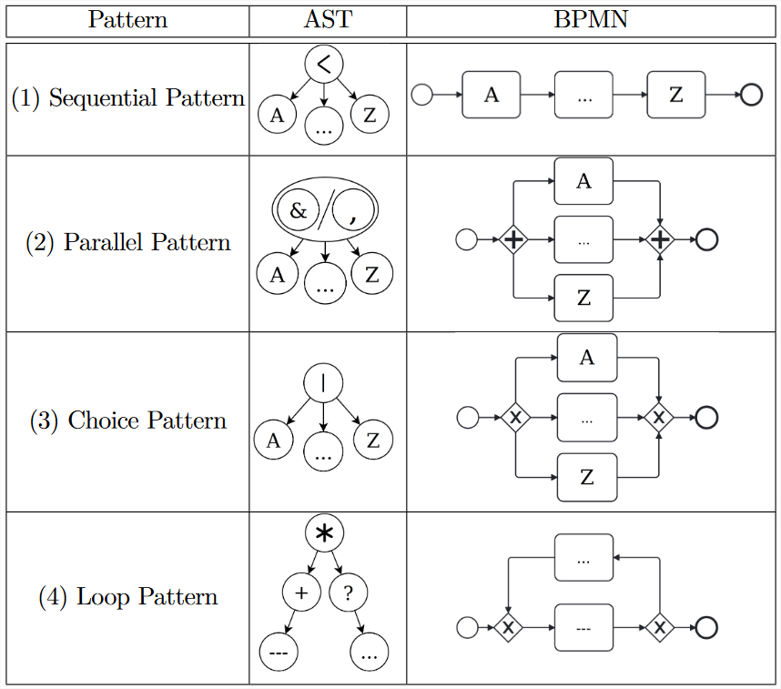
Detailed Solution – Step 9
Now that the AST contains the choices, the BPMN process is ready to be generated.
To do so, patterns are applied recursively to the merged AST, starting from the deepest nodes (leafs).

Slide 34
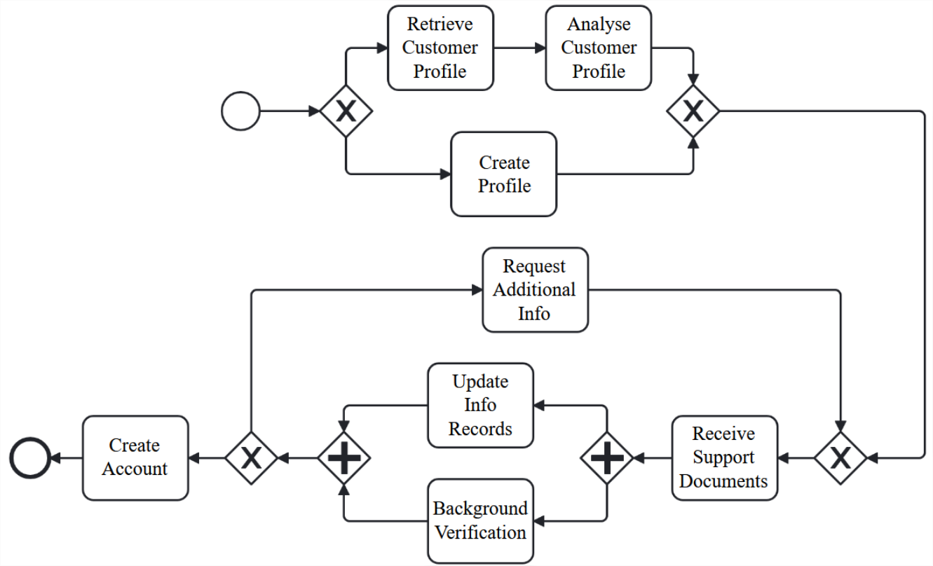
Detailed Solution – Result

Slide 35
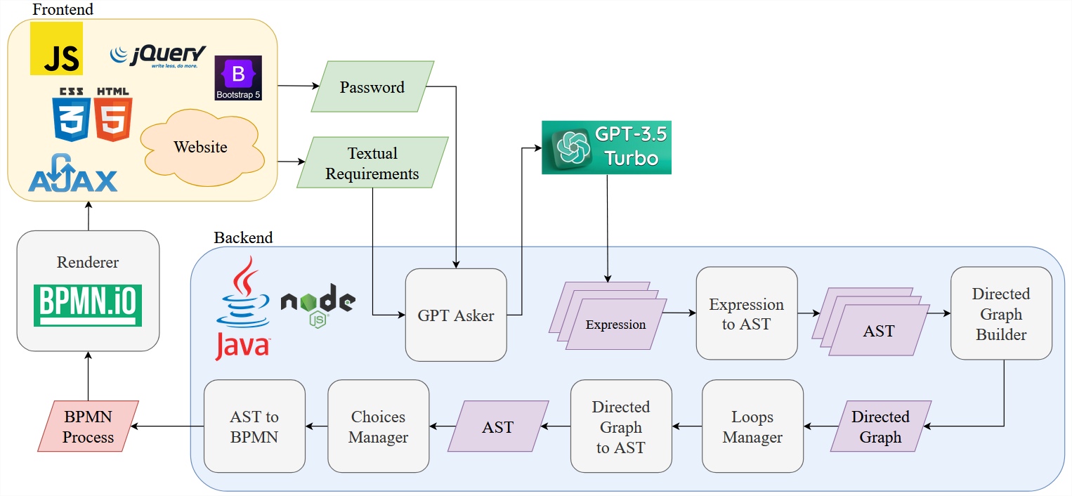
Tool – Presentation

Slide 36
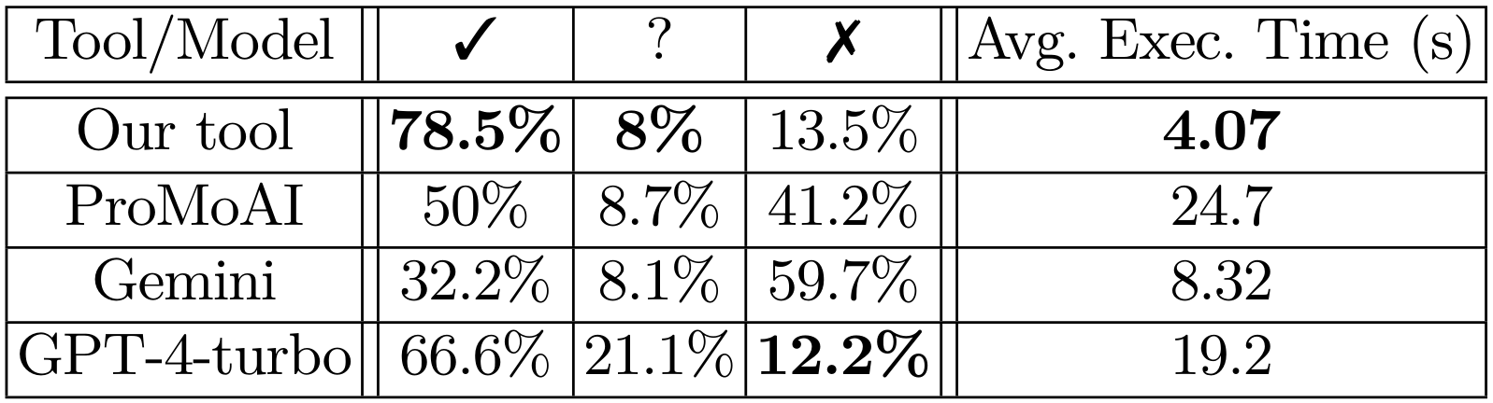
Tool – Experiments: Quality of the Processes
Correct
processes
Ambiguous
processes
Incorrect
processes
An ambiguous process is a process that is not incorrect with regards to the description, but which does not correspond to the expectations of the experts.

Slide 37

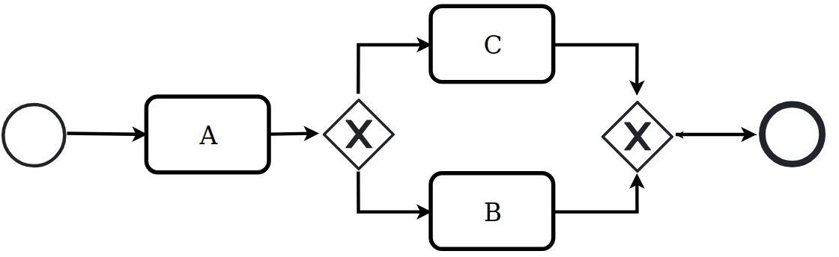
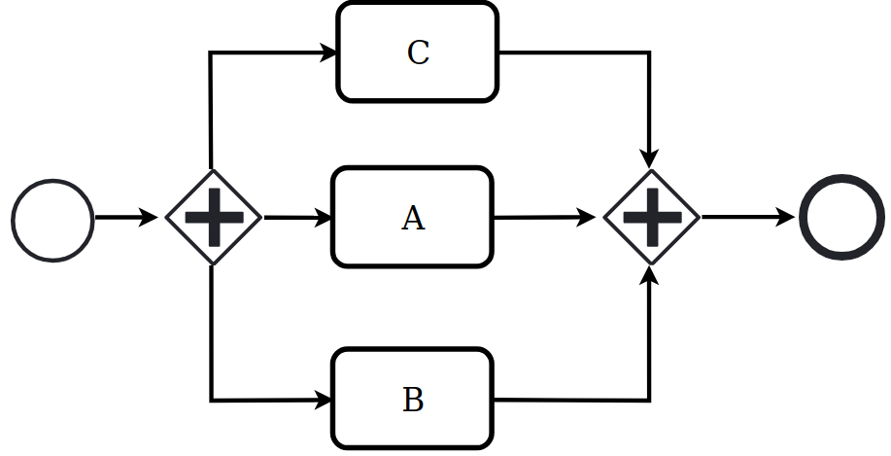
Tool – Experiments: Ambiguous Processes
I want A B C
etc.

Slide 38
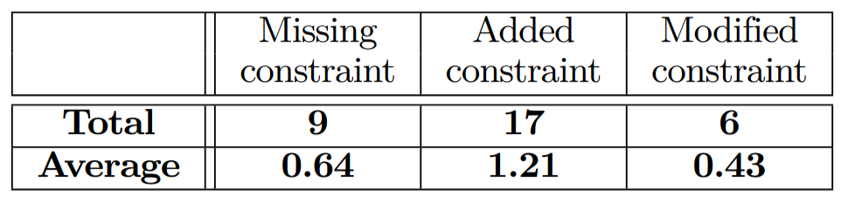
Tool – Experiments: Incorrect Processes
The experiments conducted showed 14 incorrectly generated processes. To understand the source of this incorrect generation, we analysed the constraints returned by GPT in these 14 cases.

Slide 39
Tool – Experiments: Unnamed Tasks
The last phase of these experiments consisted in analysing the quality of the tool when the description is raw (i.e., the tasks of the description are not named beforehand).
First, the banker either CreateProfile (CP) for the user, or, if it is not
needed, he RetrieveCustomerProfile (RCP) which triggers the system to perform the AnalyseCustomerProfile (ACP) task.
First, the banker either creates a profile for the user, or, if it is not needed, he retrieves the customer profile which triggers the system to analyse it.

Slide 40
Tool – Experiments: Unnamed Tasks
These experiments showed a degradation of 16% of the quality of the results when tasks are unnamed, for three different reasons:
GPT may introduce unnecessary tasks
GPT may remove desired tasks
GPT may not recognise that two distinct portions of text correspond to the same task, thus creating two different tasks

Slide 41

Tool – Online Version
Link: https://quentinnivon.github.io/pages/givup.html

Slide 42
Conclusion
In this work, we proposed an approach aiming at automatically designing syntactically and semantically correct BPMN processes from a textual description of the requirements.
We already worked on several perspectives of this work:
Get rid of ASTs to allow more complex constructs (intricate loops/unbalanced gateways)
Formalise the transformation operations
Add new features (such as model checking of textual properties)
While some others are still ongoing:
Adapt the description to (visual) process changes
[TSE’25]
[FSE’25]
David’s work

