Slide 1
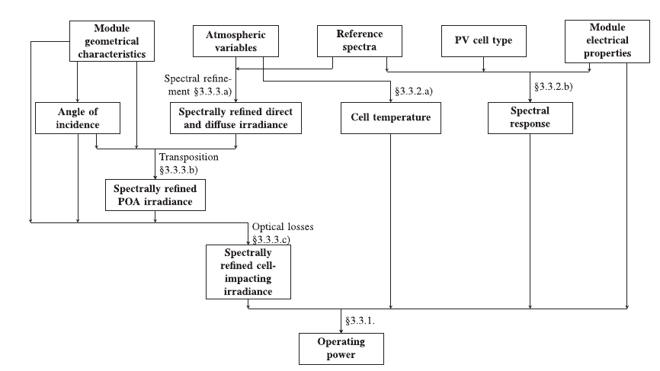
WO2PV (Weather outputs to PhotoVoltaics)
SW_{dir}, SW_{diff}
A code to convert atmospheric variables into PV production
Based on physical principles (no free parameter)
Available through GitHub (https://github.com/liboisq/WO2PV)
Practical use :
→ model output (e.g. Meso-NH)
→ in situ observations
POA ?
T_{a}, U, V
T ?
PV power
Panel characteristics
Lindsay et al., 2020

Slide 2
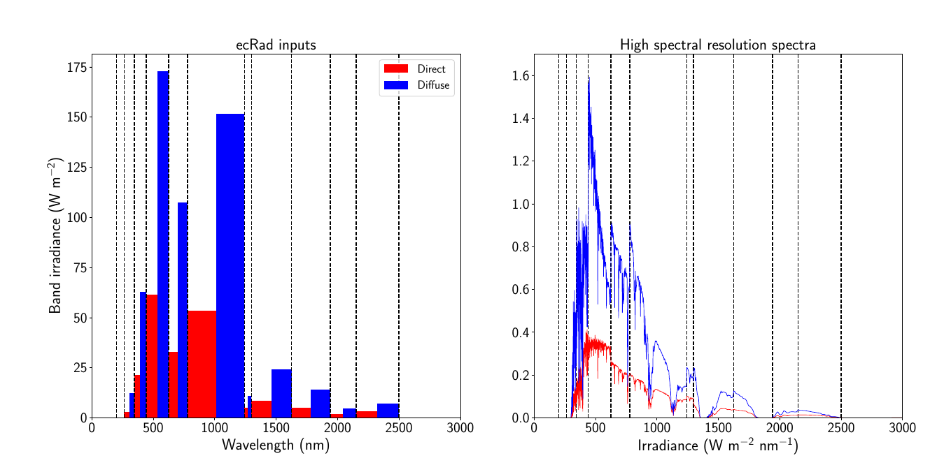
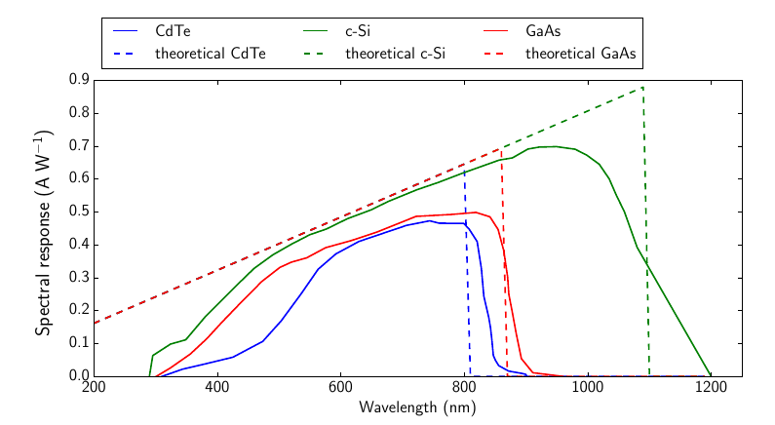
WO2PV (Weather outputs to PhotoVoltaics)
Many models just use Global Horizontal Irradiance from forecasts (GHI)
= SW_{dir} + SW_{diff}
Then machine learning or very basic physical models to reconstruct the dir/diff components
→ overall loss of information from atmospheric radiative code
Specificity of the code = treatment of detailed spectral information
Spectral responses of various solar cells
Spectral enhancement of band outputs
The efficiency of a panel depends on the nature of the incident spectrum
(cf broadband albedo of a surface)

Slide 3
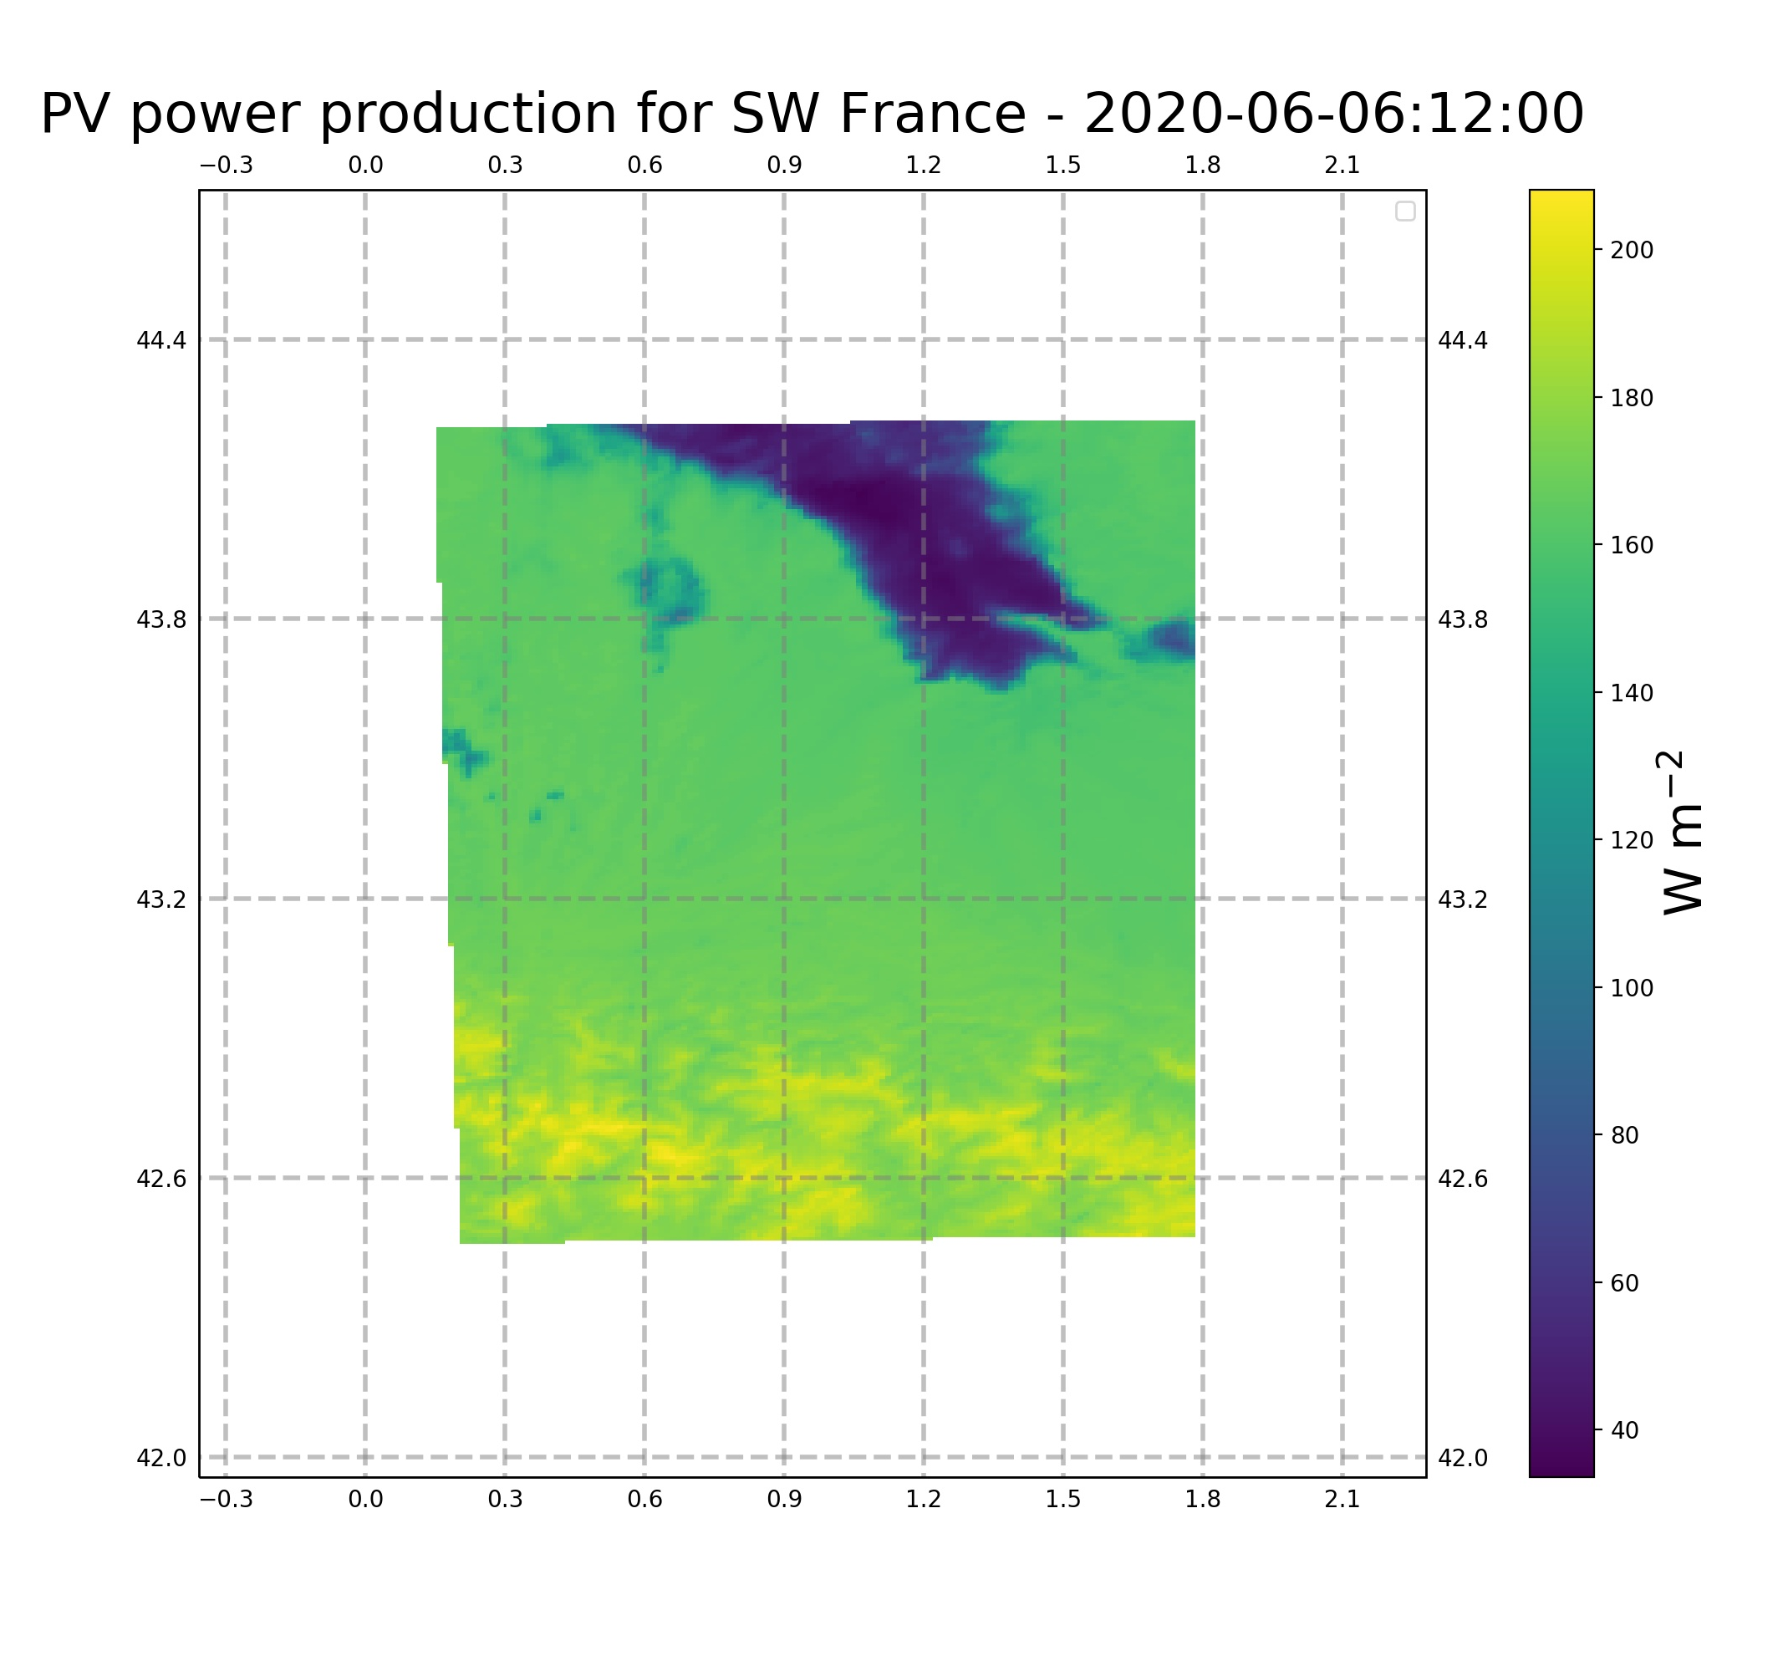
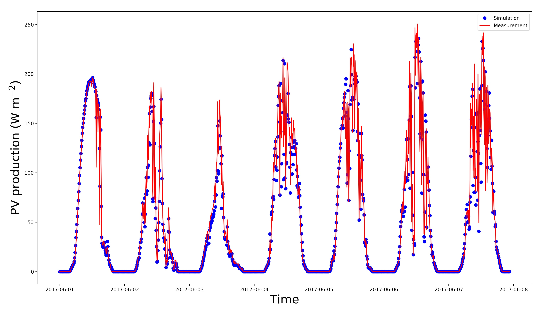
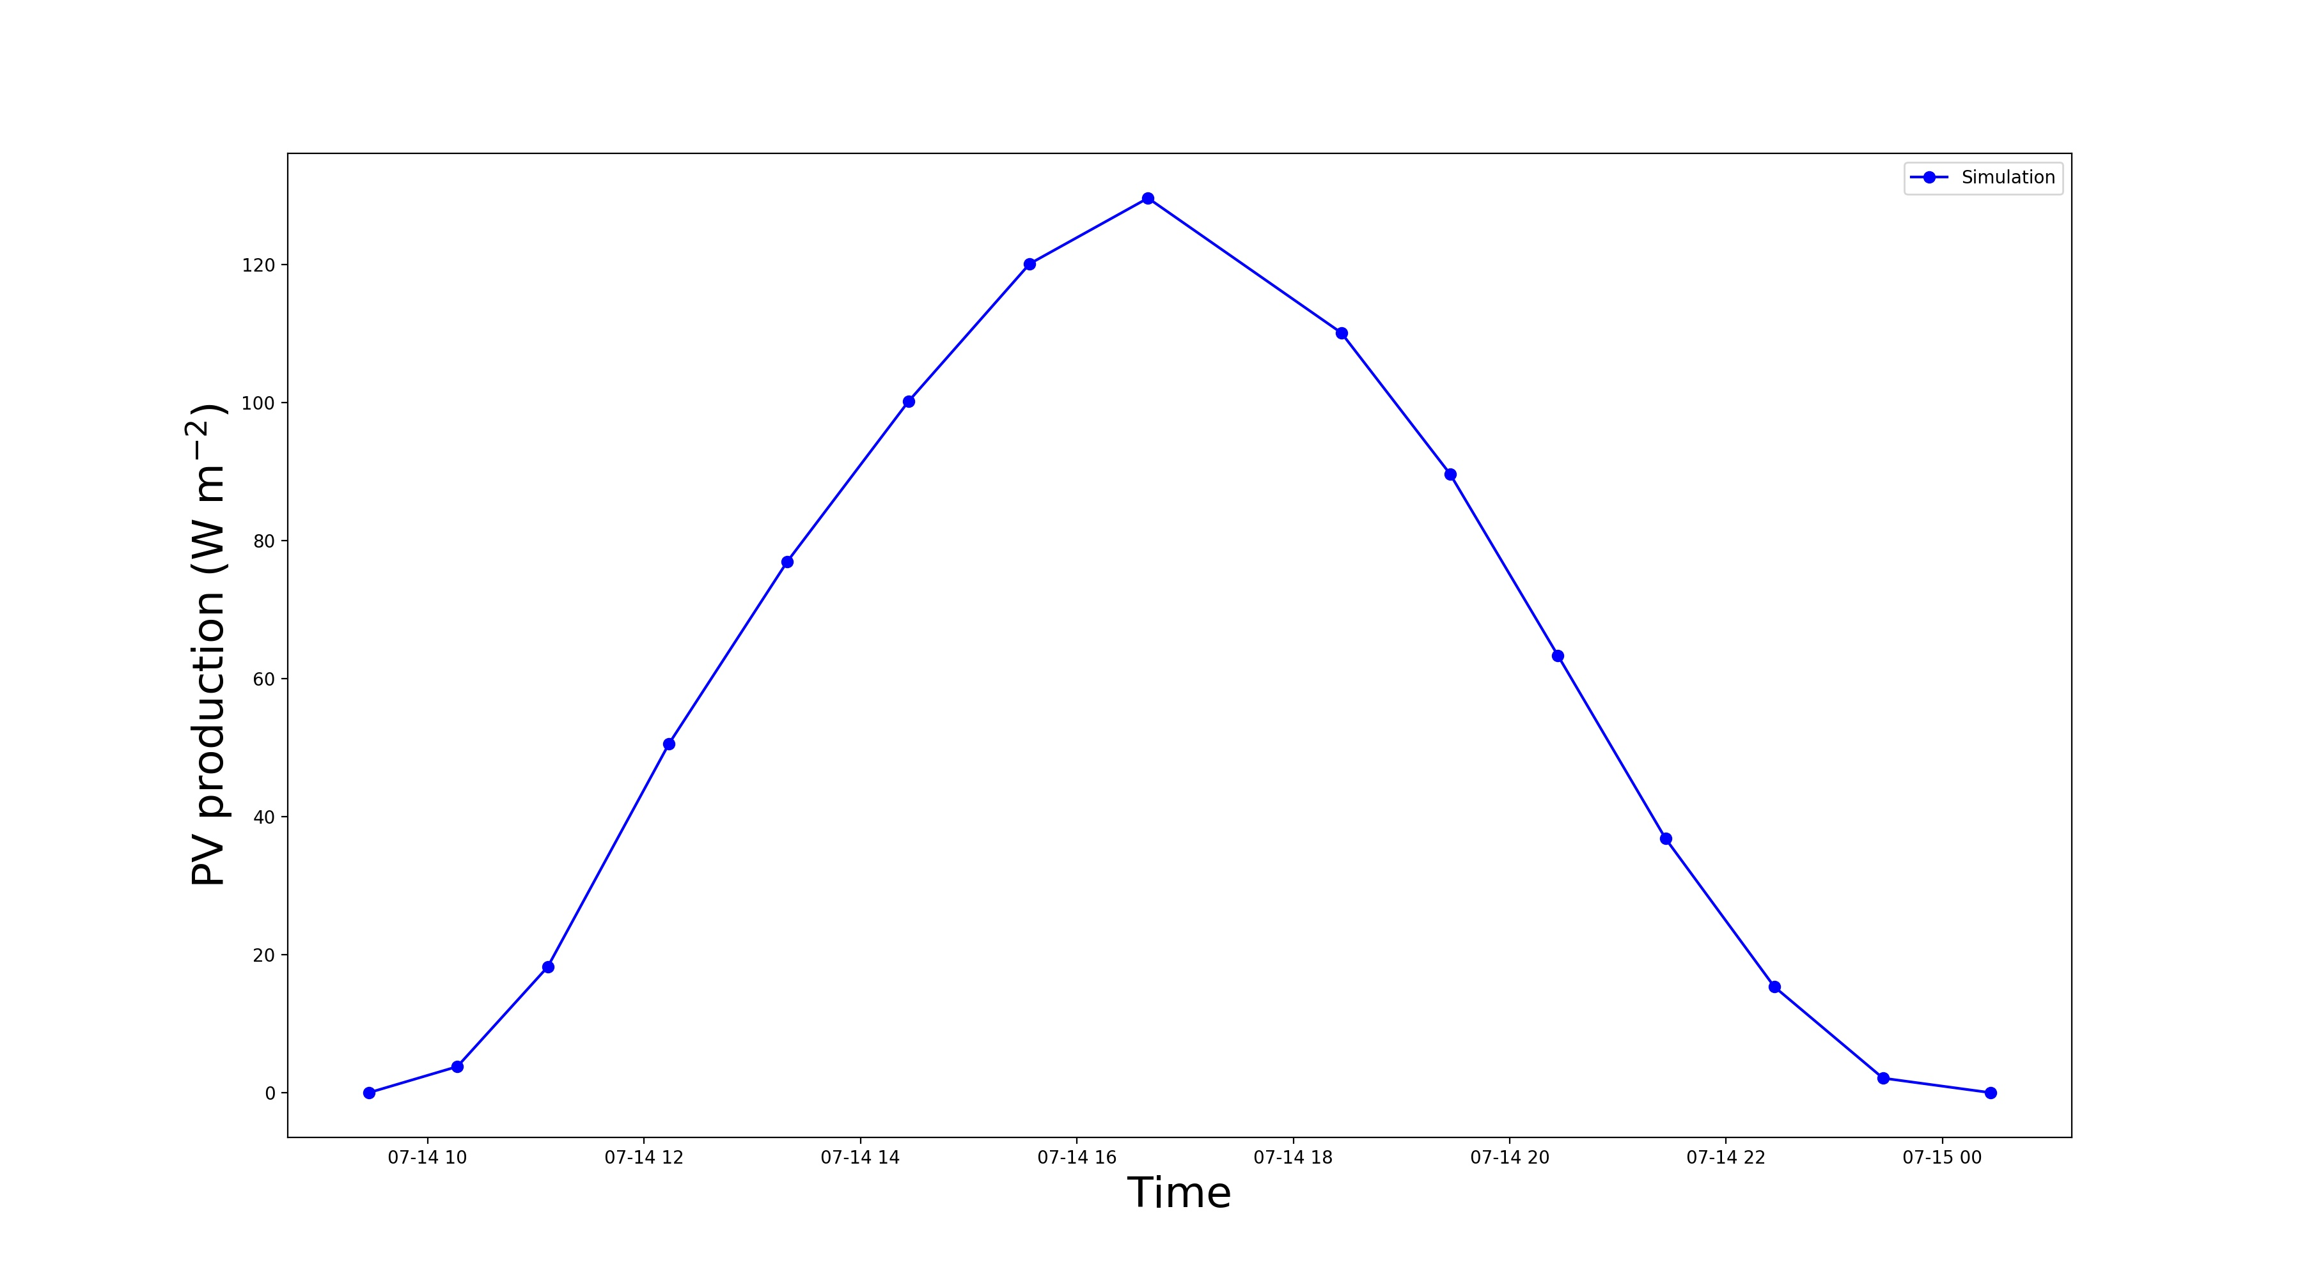
WO2PV (Weather outputs to PhotoVoltaics)
Atlas
Timeseries
SIRTA observations 1 spectral band
AROME outputs 14 spectral bands
Meso-NH outputs 14 spectral bands

