Slide 1




Nom playlist

Slide 2




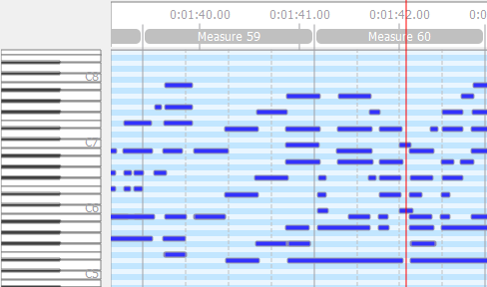


Taratata.mid
Time :
1:42 / 3:50
Speed factor
1.3

