Slide 1












Virtuoso
WOOPSA
Concept HMI
Art & technologie
Web page
Smartphone
Wifi

Slide 2






Classique
4 saison, Vivaldi
1
2
5ème symphonie, Beethoven
3
…
4
…
Add
Remove 1
Remove all

Slide 3
Playlists
1
Classique
2
Rock
3
Jazz
4
Pop
Add
Remove 1
Remove all

Slide 4




Four saisons, Vivaldi
DO
SI
LA #
LA
SOL #
SOL
FA #
FA
MI
RE #
RE
DO #
DO
SI
LA #
LA
SOL #
SOL
FA #
FA
MI
RE #
RE
DO #
DO
SI
LA #
LA
SOL #
SOL
FA #
FA
Mi
RE #
RE
DO#
DO
Speed : 1.5x
1.5

Slide 5
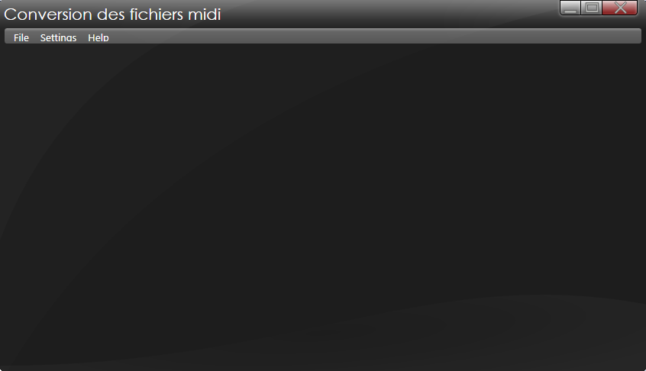
SI
LA #
LA
SOL #
SOL
FA #
FA
Mi
RE #
RE
DO#
DO
SI
LA #
LA
SOL #
SOL
FA #
FA
Mi
RE #
RE
DO#
DO

