Slide 1




Nom playlist

Slide 2
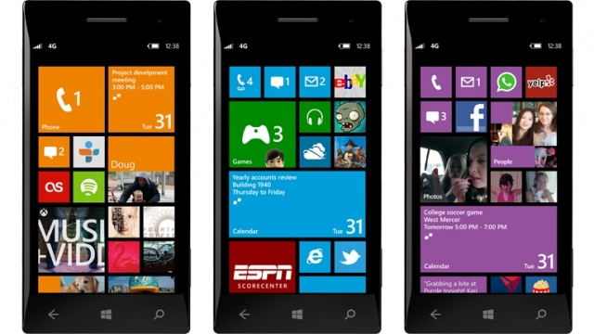


Nom playlist
Add
Remove 1
Remove all

Slide 3
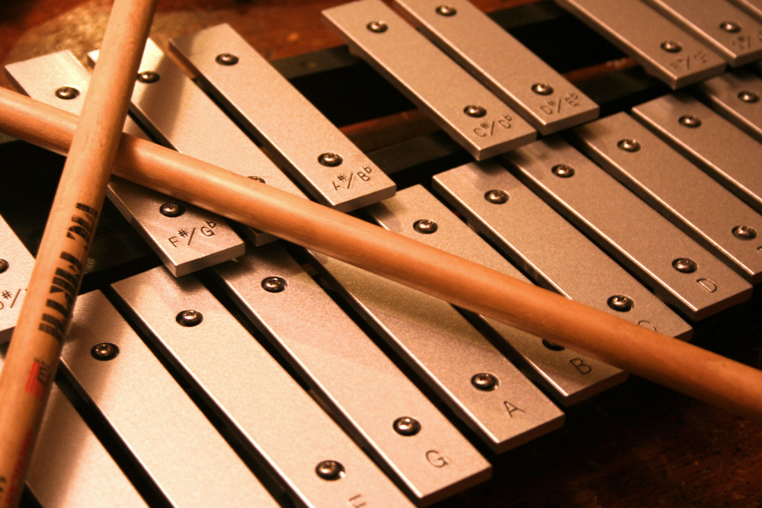

Nom playlist
Add
Select a new music to the play list
Add
Remove 1
Remove all

Slide 4

Nom playlist

Slide 5




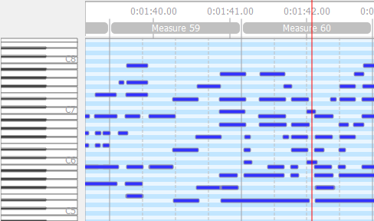


Taratata.mid
Time :
1:42 / 3:50
Tempo :
1.3

