Slide 1
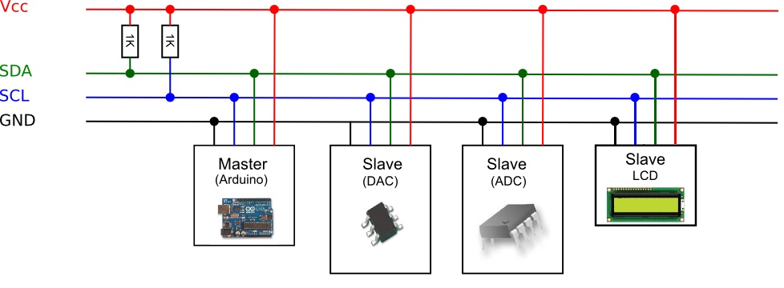
R
R
Master
(Arduino)
Slave
(MCP23017)
Slave
(MCP23017)
Slave
(MCP23017)

