Slide 1
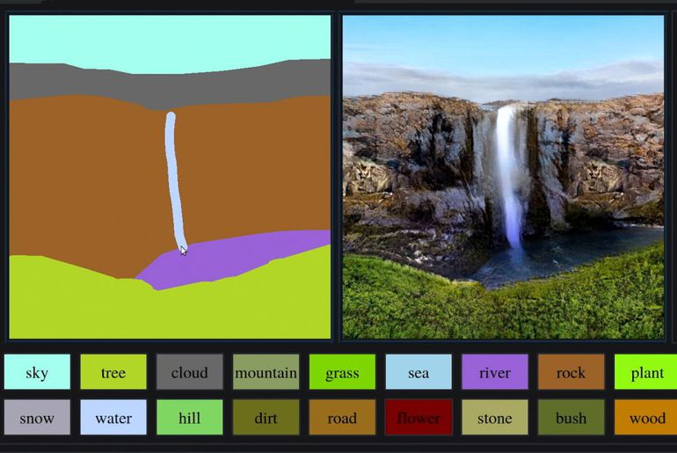
I.A and art

Slide 2


First network : Generator
Random
Noise
Fake Image

Slide 3
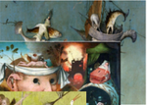
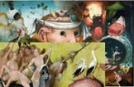

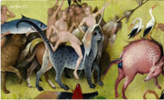
Second network : Discriminator
Training Set
Real images
Real or Fake

Slide 4
Global network
Random
Noise
Training Set
Real images
Fake Image
Real or Fake

