Slide 1
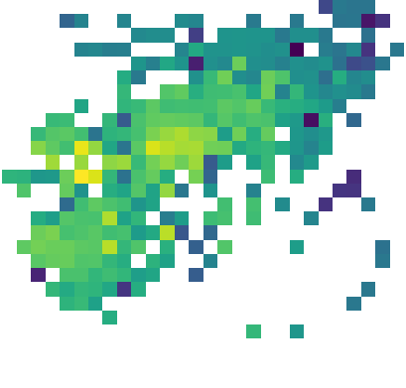
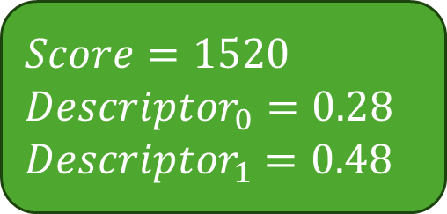
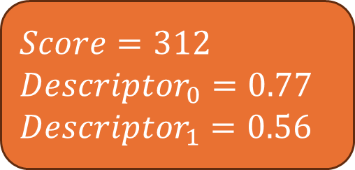
$$Score=312$$
$${Descriptor}_{0}=0.77$$
$${Descriptor}_{1}=0.56$$
$$Score=1520$$
$${Descriptor}_{0}=0.28$$
$${Descriptor}_{1}=0.48$$

