Slide 1
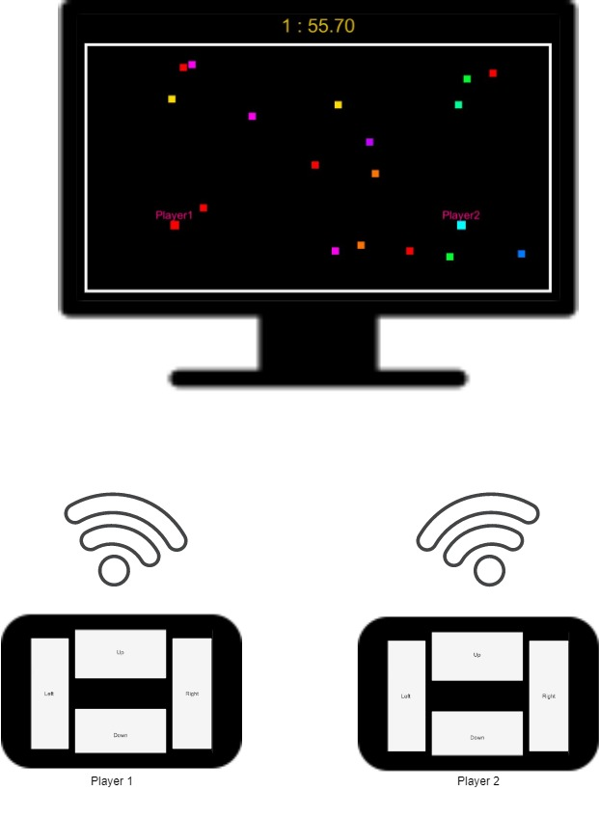
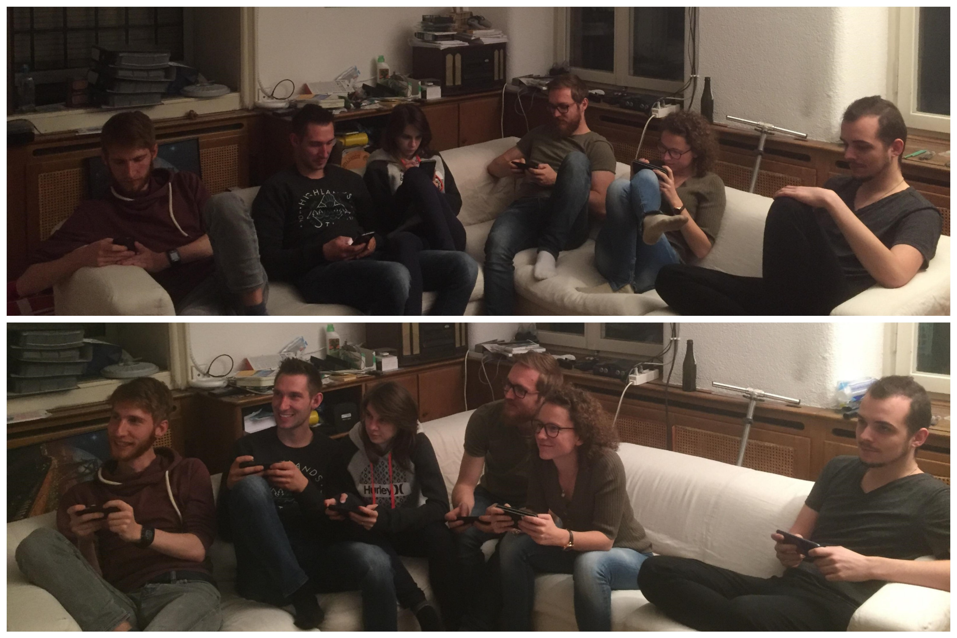
Starting position
Playing games is becoming more and more popular and in everyone's daily life, be it board games, video games or mobile games. Even though most of the games played on smartphones are multiplayer, they don’t involve the users to physically interact with each other. Instead, they tend to isolate the players. On the contrary to split screen games on console, which are increasingly rare, but for which one needs a costly controller. This problem of equipment is located within boardgames as well. One game uses a set of pieces and another one uses another set. It is tedious to stow away a large number of games in this case. Thus came our idea of mixing the advantages.
Goal
The goal of this bachelor thesis was to develop a generic platform that uses a computer as the server that plays games and use smartphone(s) as game controller.
Approach
As smartphones are very common, powerful, small and lightweight they were the best tool to fulfill our problematic.
We chose to implement two games to demonstrate the base possibilities a platform such as this one would be capable of.
The first game is a multiplayer snake, playable from one to four players where the controller is very basic with four buttons to control our snake. We decided to develop such a game to show that the smartphone is used but as a mere tool, one which the players don’t need to look at when they play and so the possibility to interact with the other increase.
The second one is a domino game, playable with two players. Here the controller is at the center of the game as a domino game is a sort of card game where each player hides their hands to the other. This allowed us to start working toward a “Smart” controller.
Results
The two games we developed allowed us to grasp more the problems coming with such a platform but as well the benefits of it.
With a tool as powerful as a smartphone we just used the tip of the iceberg in terms of possibility to make the controller “Smart”. For example, one could develop a Pictionary, or make use of the speakers, camera incorporated in the smartphone.
Although the base has been created and can be re-used it still needs some work to make it fully generic.
Representation of people playing on their smartphone alone and then together
Generic smartphone game controller
Graduate(s): | Quentin Flückiger
Professor: | Marcus Hudritsch
Expert: | Eric Dubuis
Bachelor Thesis 2019 Degree Programme Computer Science

