Slide 1
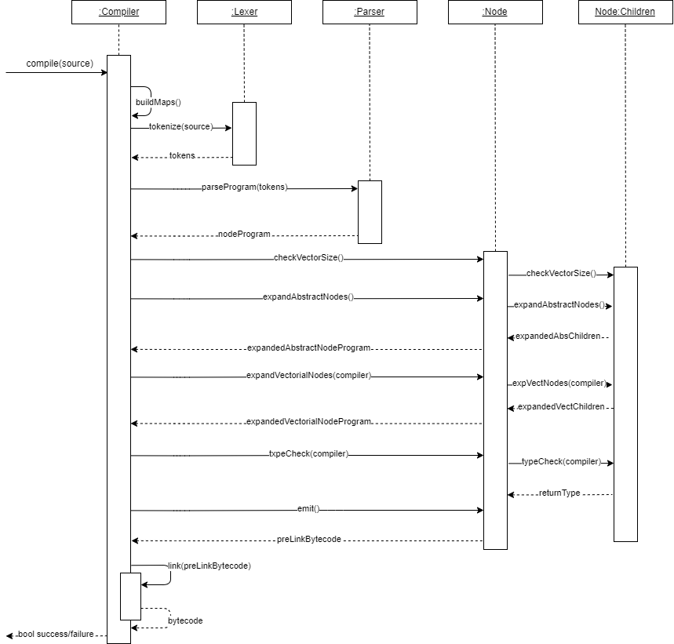
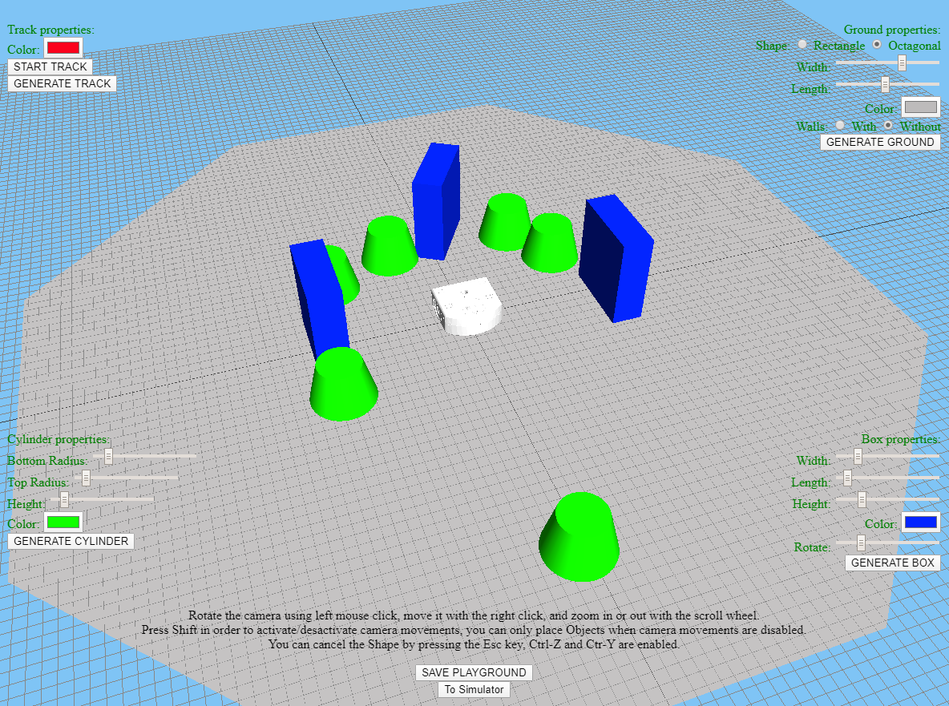
Starting position
Thymio is an educational robot that aims at improving early education in science, technology, engineering, mathematics and researching the acknowledgment by kids of robots in their learning environment. One of the main drawbacks is material, be it the space required to make it operate or the hardware capabilities (battery tends to run out fast). In this work, we explore one solution: Simulating the behavior in a web browser.
the robot and it’s surrounding, and simulate the behavior of a Thymio robot with a given program from a file with the .aesl extension. Furthermore, it is supposed to allow users to create customized playgrounds that can be loaded in the simulator. And lastly, the application should not require any software installation, thus it comes in the form of a web application, and has to be compatible with modern browsers.
Besides, we added some proximity sensor to the robot, which shoots raycast and check for intersections. We decided to use the compiler from Aseba, thus we had to translate it from C++ to JavaScript. To compile the behavior file, we first read it and pass the content to a Lexer that will create tokens containing the position and their type. Depending on the character we might need to look one, two or more ahead to determine its type. Once this operation is done, the file containing the tokens is parsed, thus creating a three. We then expand and control its integrity.
Approach
We decided to use the three.js library to represent and create graphical elements, it is a library for JavaScript which uses a default WebGL renderer, thus allowing it to display, create and animate 3D computer graphics in a web browser. We chose to implement basic dissimilar playgrounds directly in the application, to give the user a direct way to use the simulator and let him the possibility to creates his playground via a tool we developed. The data containing the properties of the different shapes, meshes that populate the playground were put into a JSON file. We simulated the movement of a two wheels robot by considering each motor power as a vector and moving accordingly to the resulting vector calculated depending on the cases.
Goal
The goal of this bachelor thesis was to develop a simulation environment that would let users see a 3D representation of
Compilation sequence diagram
Playground creator tool
Web Simulation of a Thymio Robot
Graduate: | Quentin Flückiger
Professor: | Claude Fuhrer
Expert: | Eric Dubuis
Bachelor Thesis 2019/20 Degree Programme Computer Science

