Slide 1


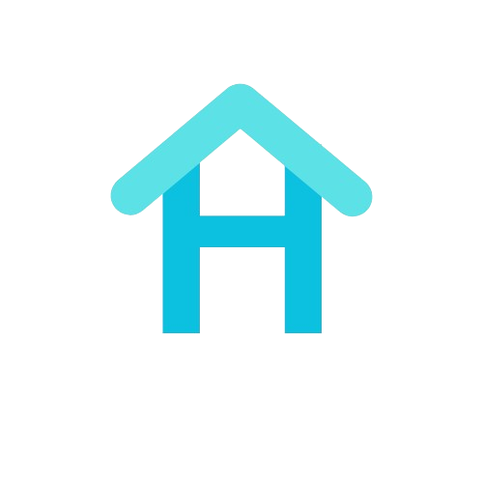
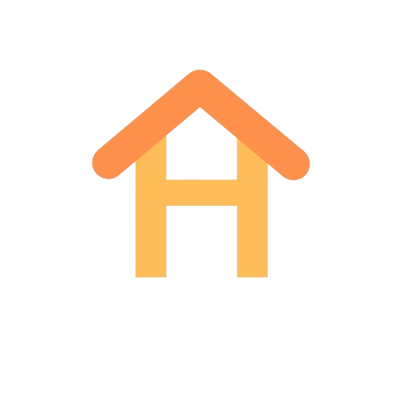

GROUP 11
HOMESYNC
Notes:
QUERALT

Slide 2
OUR FIRST STEPS
Notes:
QUERALT

Slide 3
MAIN GOALS
AUTOMATION
EFFICIENCY
SECURITY
Notes:
QUERALT

Slide 4
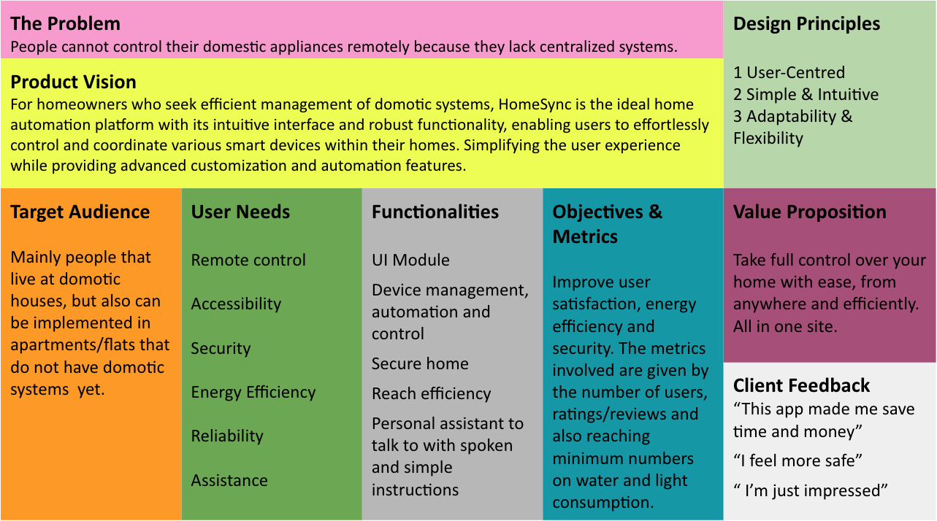
PRODUCT CANVAS
Notes:
QUERALT

Slide 5
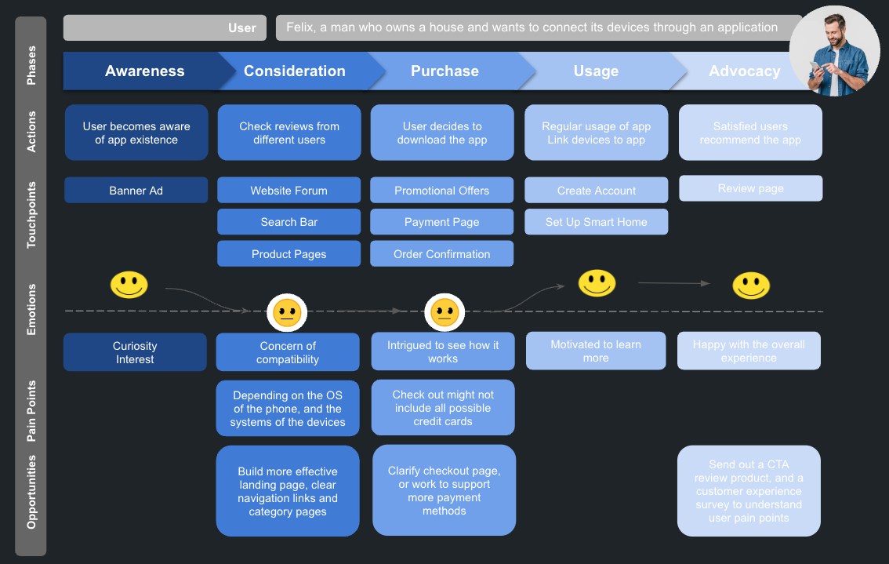
JOURNEY MAPPING
Notes:
QUERALT

Slide 6
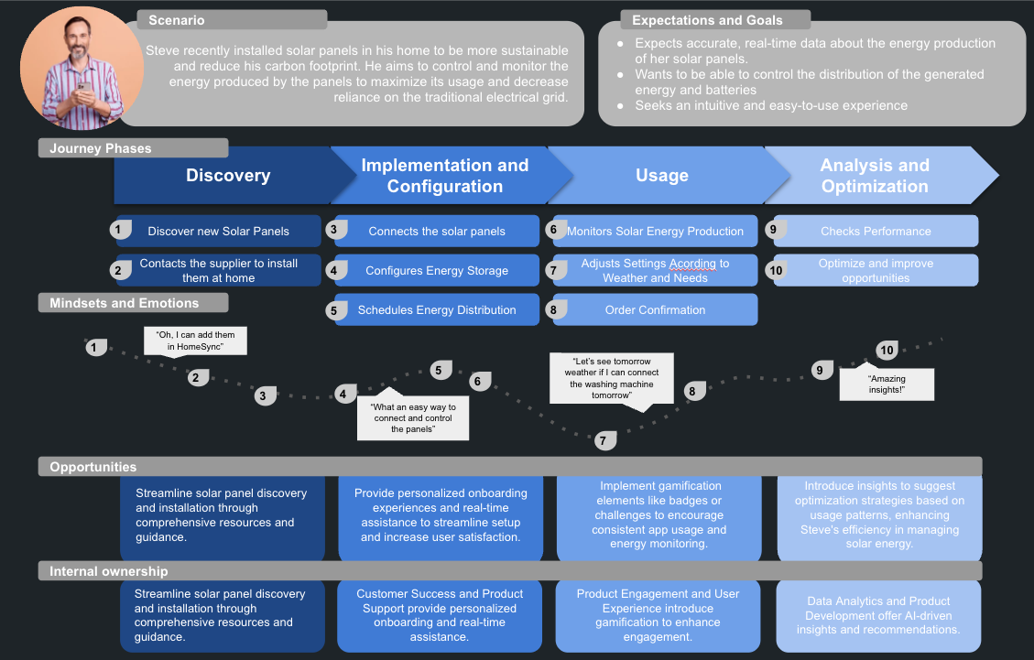
JOURNEY MAPPING
Notes:
QUERALT

Slide 7
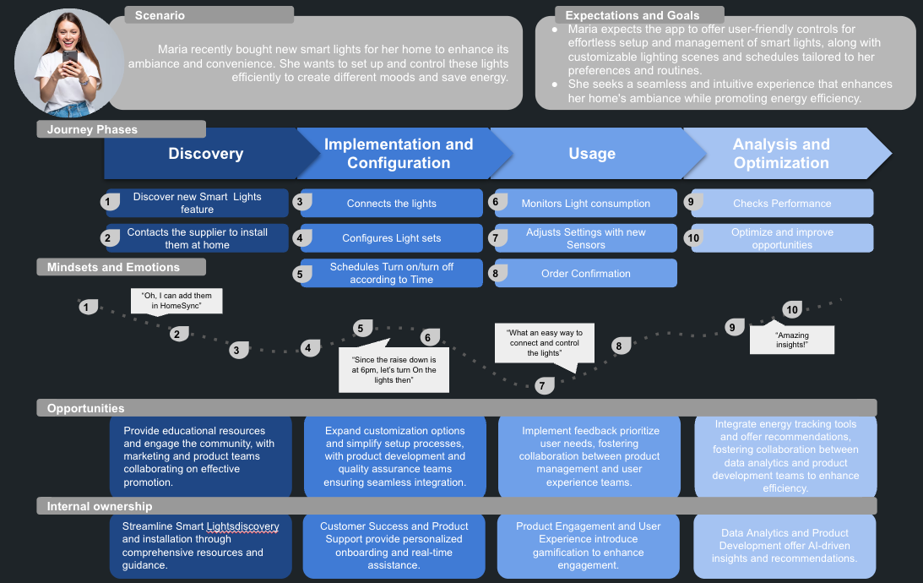
JOURNEY MAPPING
Notes:
QUERALT

Slide 8
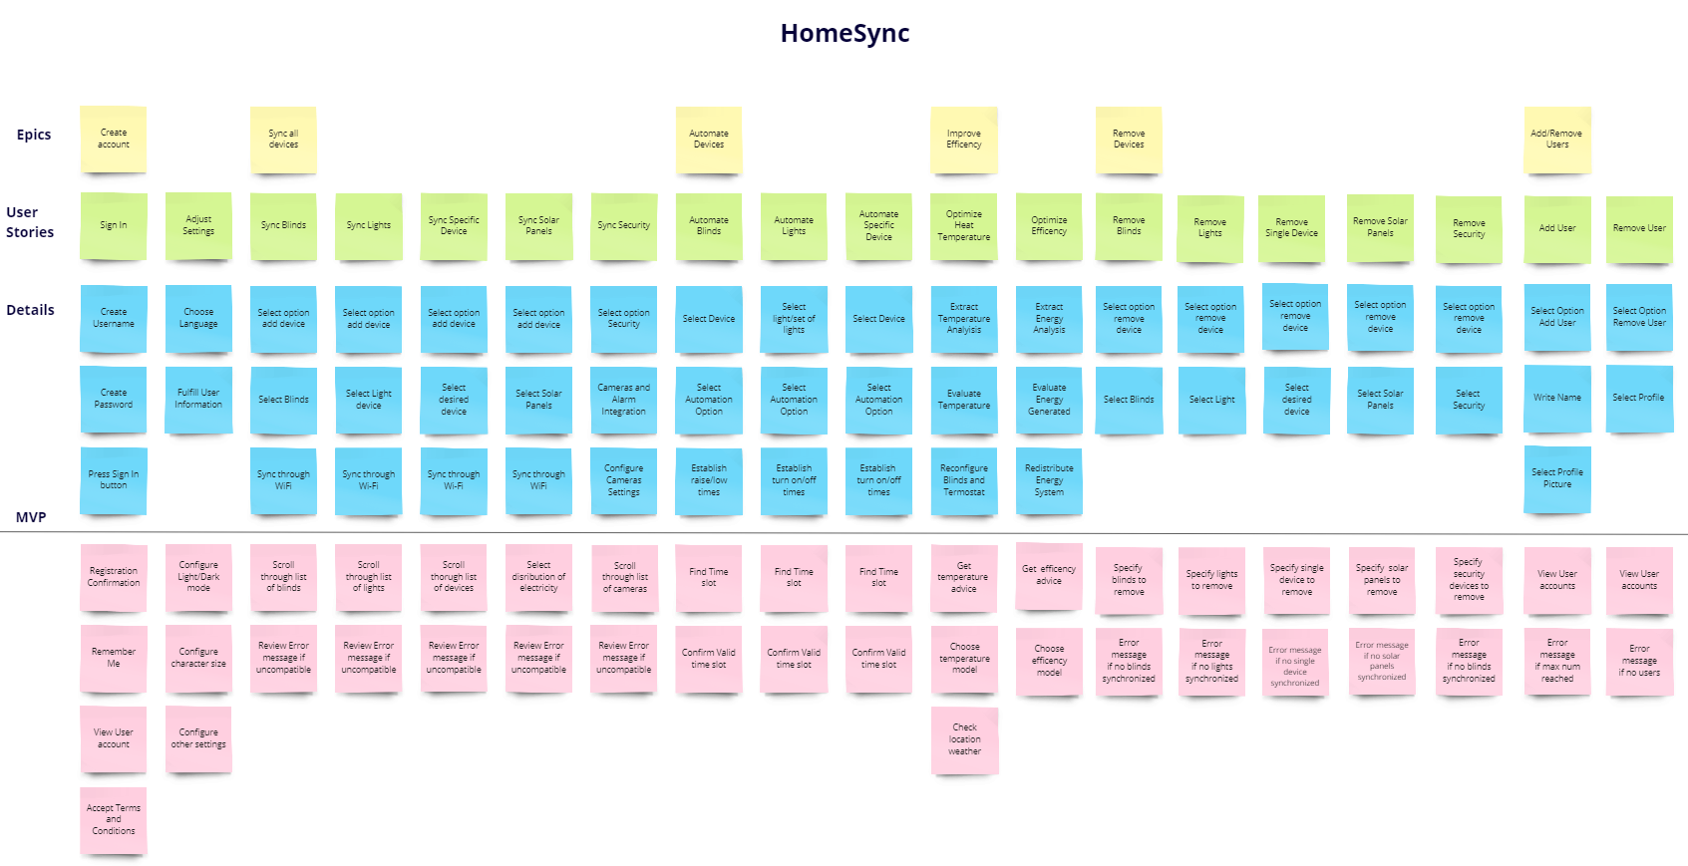
USER STORIES
Notes:
MARC

Slide 9
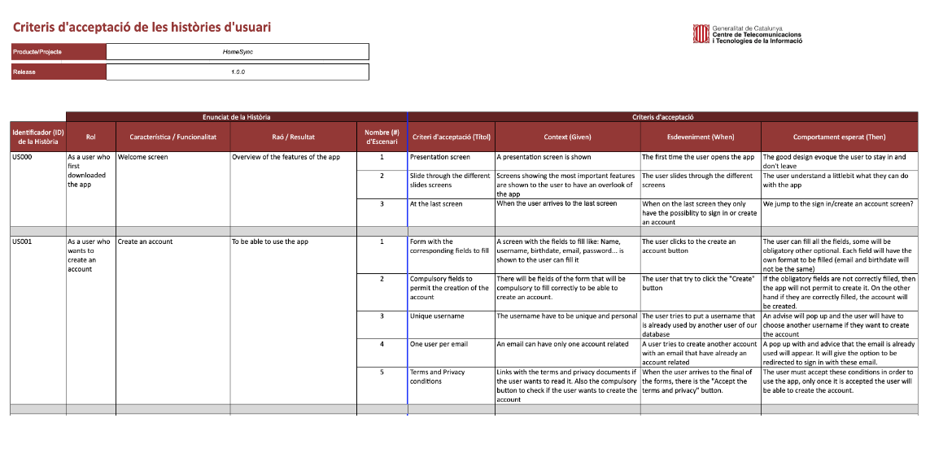
ACCEPTANCE CRITERIA
Notes:
MARC

Slide 10




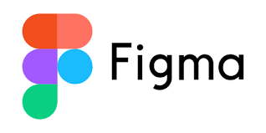

TEAM TOOLS
Notes:
MARC
Trello: Organizing tasks
Drive: Sharing and organizing folders and documents
FlutterFlow: Used for coding the app
Figma: Develop Prototype of the app
Miro: Used for the canvas and documentation of user stories
Github: sharing the code in the repository

Slide 11
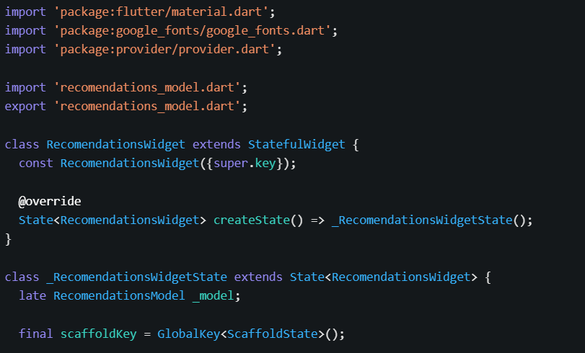
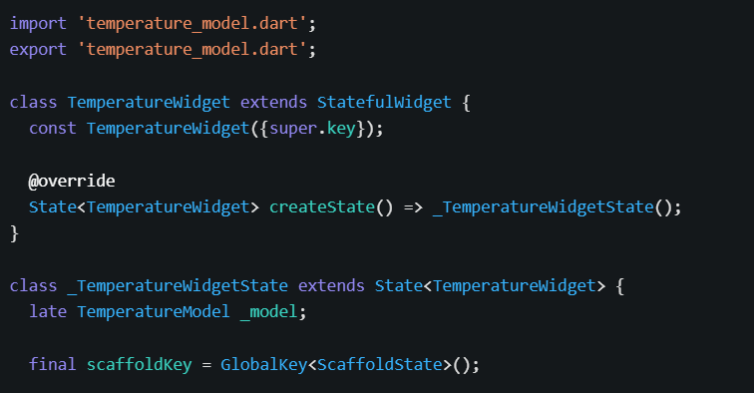
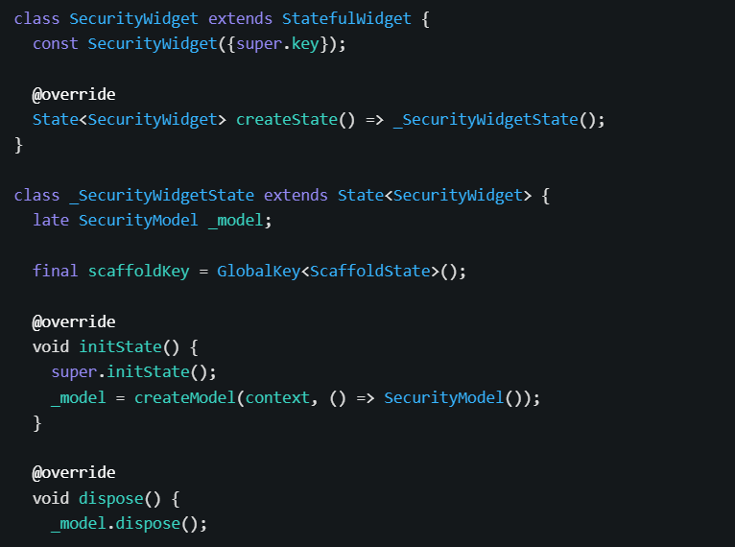

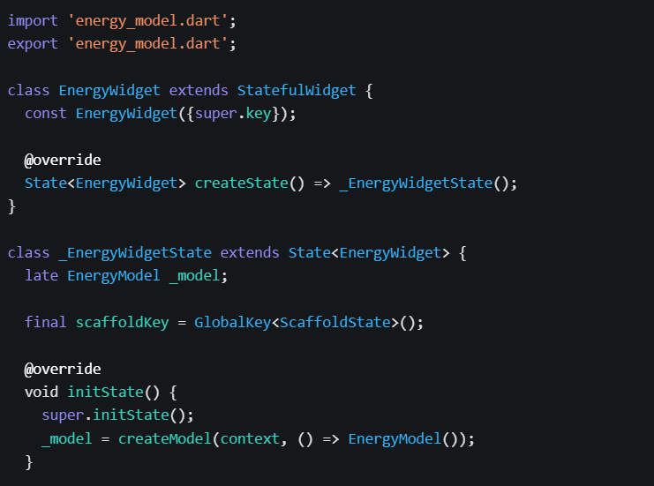
CODE SNIPPET
Notes:
MARC
After several hours coding with flutter flow, we are eager to present you the latest version of HOMESYNC, our slogan is SMART, SECURE, CONNECTED

Slide 12
HomeSync
Notes:
MARC

Slide 13
“SMART. SECURE. CONNECTED.”
HomeSync
Notes:
MARC

Slide 14
USER SET UP
Notes:
SERGI: The first thing that the user will have to do once the app has HomeSync has been download is the user set up

Slide 15
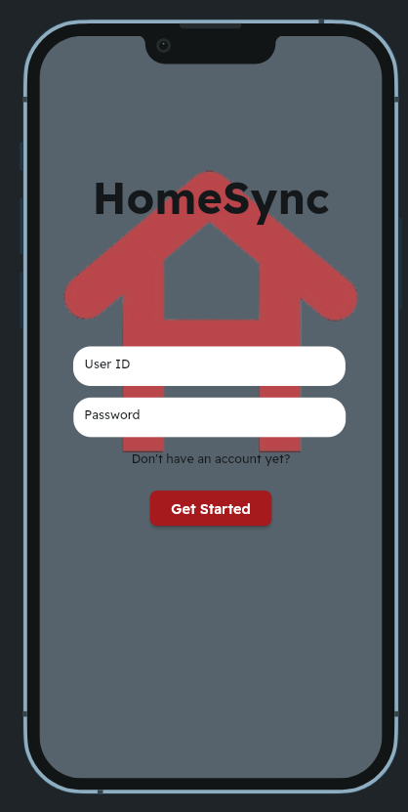
Notes:
SERGI: This is the first screen that will appear and here the users can either sign in or create a new account, the main purpose of having users profiles is to be connected from different devices to your home, that way you will be able to control your devices from either your phone, tablet, computer or others.

Slide 16
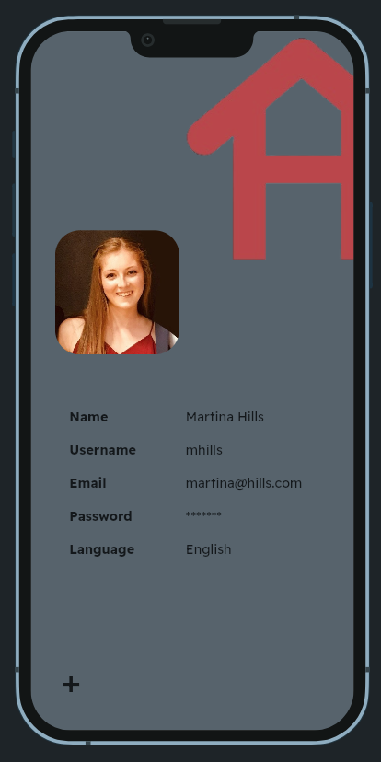
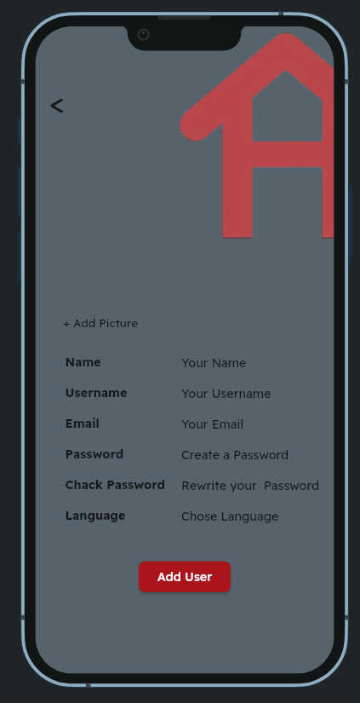
Notes:
SERGI: This will be the profile information, you will only be asked for your name, username, email, password and check password and also the language of preference. Another interesting feature is the Add User, which is mainly focused on families. The idea here is that both parents have access to all devices, but if needed, the younger children will have restricted usage (ex: able to control lights and blinds, unable to control washing machine and dishwasher)

Slide 17
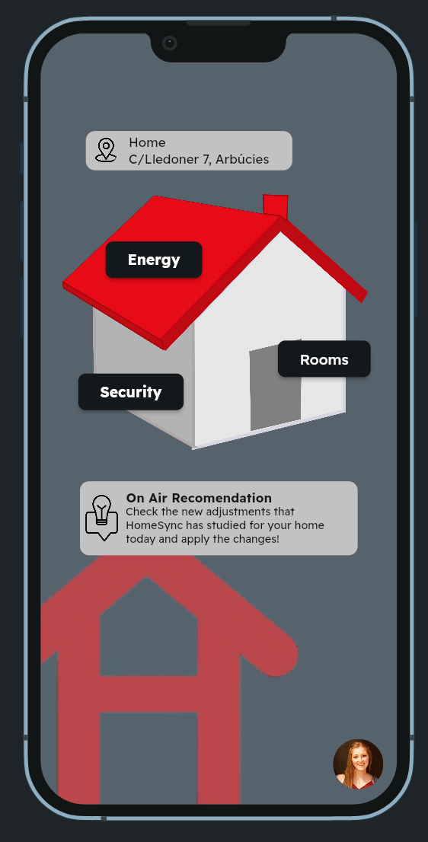
Notes:
SERGI: Once in this will be the main pace with the user here, and this 3 different features: Energy, Security and Rooms, with some Pop up notifications with different recommendations

Slide 18
AUTOMATION
EFFICIENCY
SECURITY
Notes:
SERGI: Now we will go on with the explanation of the Automation, Efficiency and Security sections of the code DESIGN

Slide 19
AUTOMATION
Notes:
RAUL

Slide 20
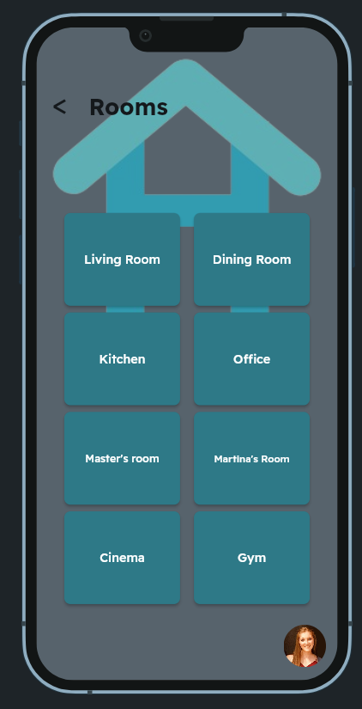
Notes:
RAUL

Slide 21
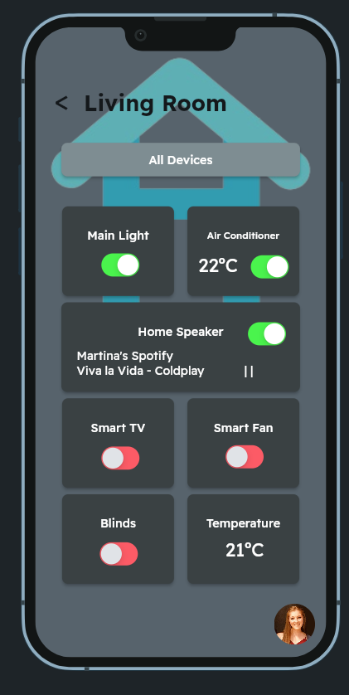
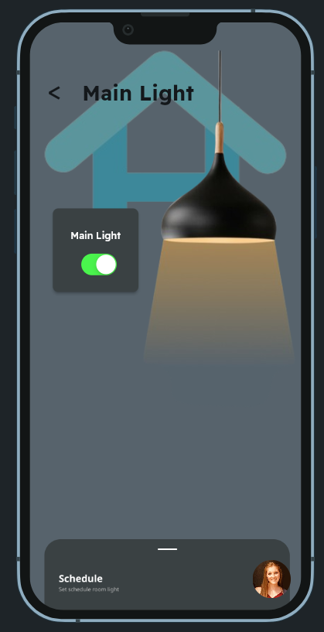
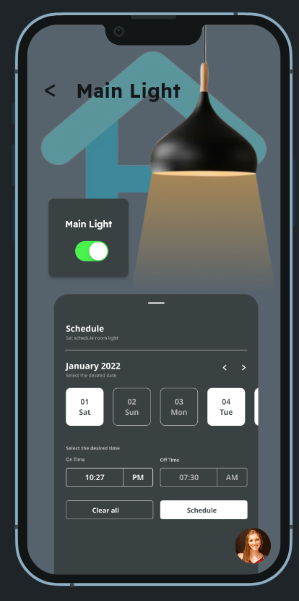
Notes:
RAUL

Slide 22
EFFICIENCY
Notes:
One of our ideas was that we want, for the people who uses our app, to be more eco friendly, without losing any comfort and also important, pay less on bills.
Here is where our section of Energy enters.

Slide 23
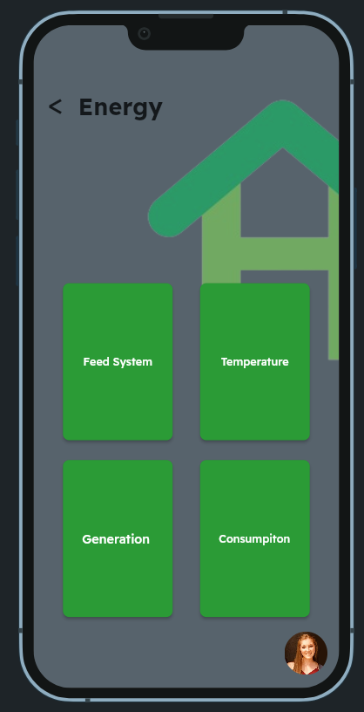
Notes:
In our main page we can see the Energy button, where we will manage our systems to be more efficient, both with our temperature system or our electrical system also including the solar panel generation.

Slide 24
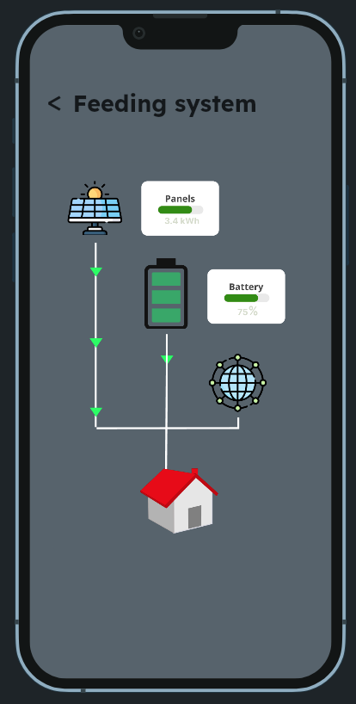
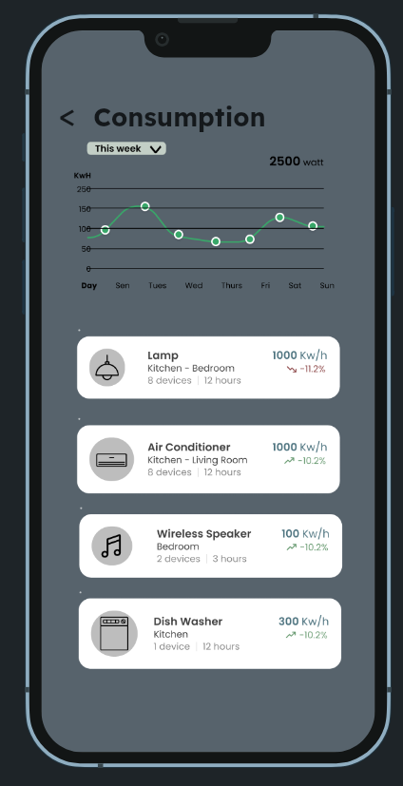
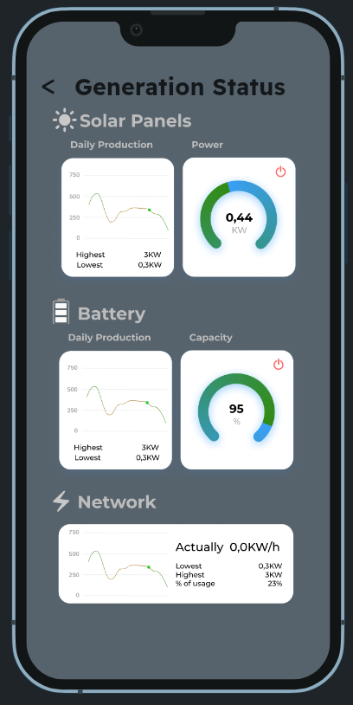
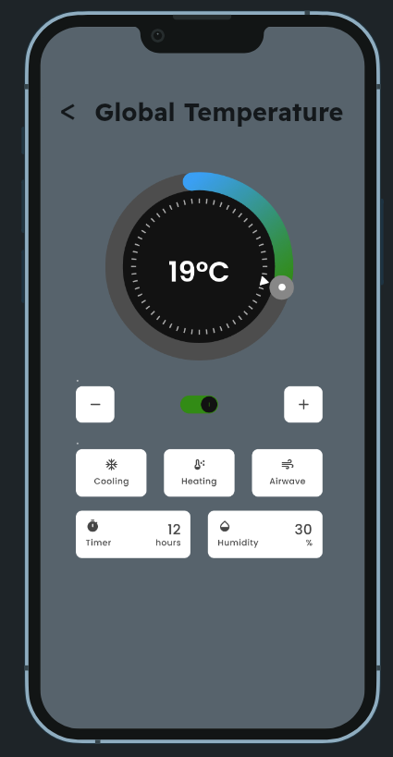
Notes:
For example what we could do there:
We could see where the electricity that we are consuming right now comes from.
The electrical consumption that we had along the day or week and which were the devices that consumed more.
All the information related to our solar panel system and the batteries integrated, meaning the generation that's being in the moment, the status of the battery, the amount of electricity that we needed from the network.
Also we could control the cooling and heating system, to always stay in a comfortable temperature, adjusting and programming it.

Slide 25
RECOMMENDATIONS
Notes:
UZAIR

Slide 26
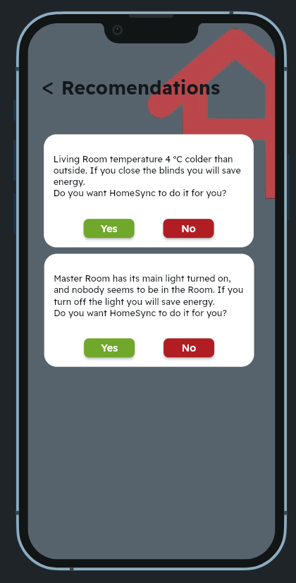
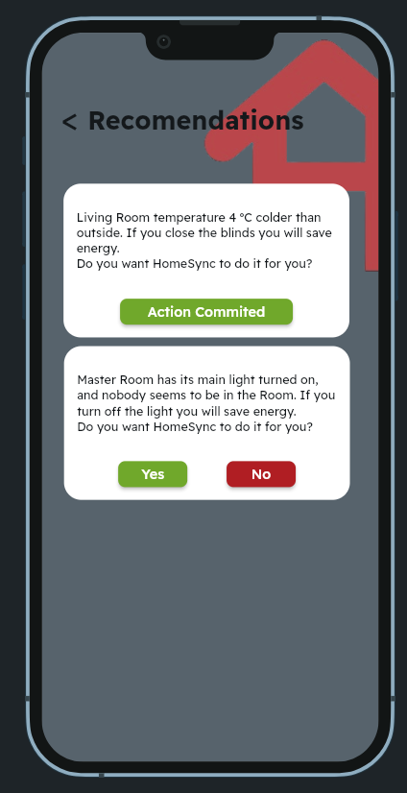
Notes:
UZAIR

Slide 27
SECURITY
Notes:
JULEN

Slide 28
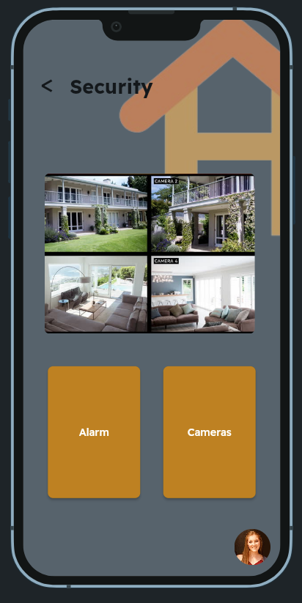
Notes:
JULEN

Slide 29
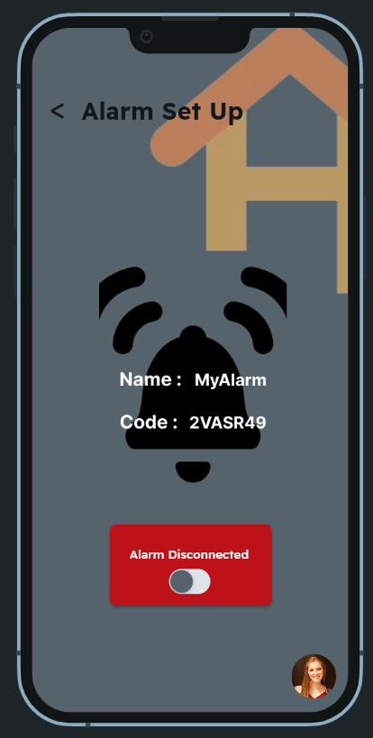
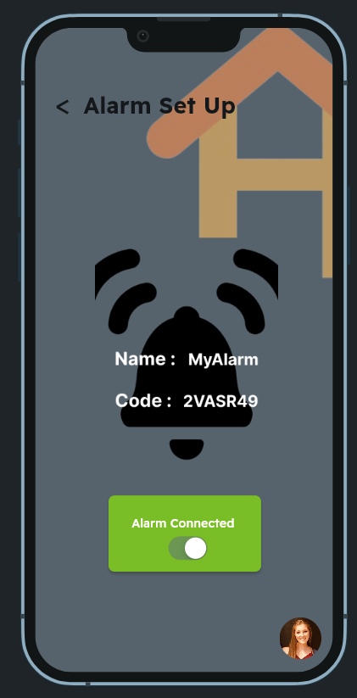
Notes:
JULEN

Slide 30
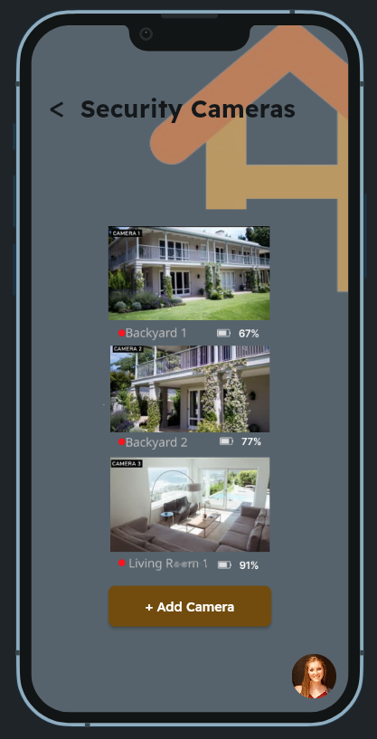
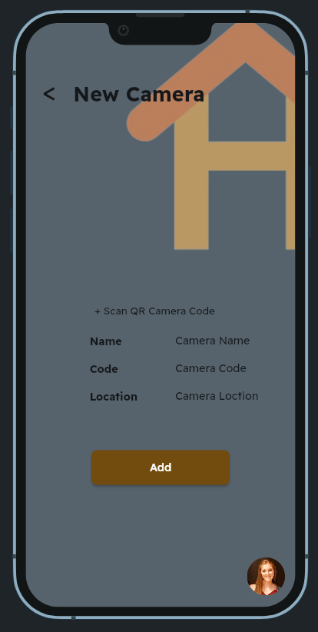
Notes:
JOEL

Slide 31
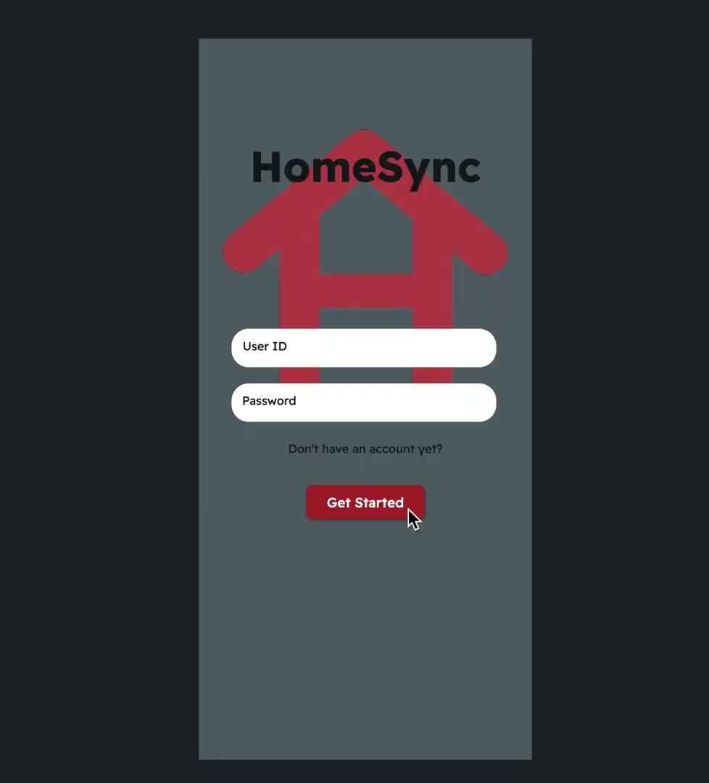
Notes:
JOEL

Slide 32
HOMESYNC
Notes:
JOEL

Slide 33
HOMESYNC - GROUP 11
Students NIA
254255
251599
251247
268309
268823
269091
253986
252155
HomeSync Drive File
HomeSync Code FlutterFlow
Flutter Flow Scripts File
HomeSync GitHub
Notes:
JOEL

