Slide 1

EDM-RoBERTa
Natural Language Processing:
Enhancing the Dependency Mechanism of RoBERTa
PRJ2020-002 Team Members: 李昱廷 郭為軒 曹仲辰 吳岳霖 林裕峰
Instructor: 張炎清 教授

Slide 2
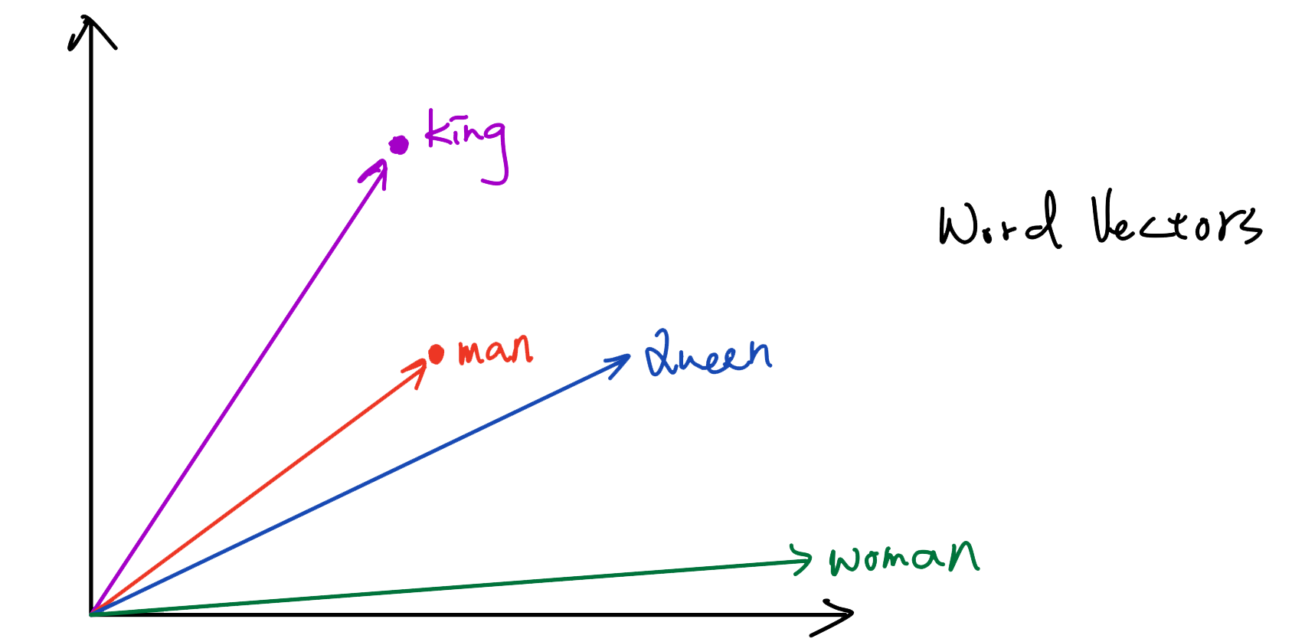
Enhancing the Dependency Mechanism of RoBERTa (EDM-RoBERTa)
Learning Language Representations: Word Vectors (Word Embeddings)

Slide 3
General Language Model
Goal: Build a general language model to process with natural language
Target: The model can be adapted to different NLP tasks by transfer learning
Transfer Learning: Pre-training and fine-tuning the language model
Conventional Language Model: Sequence to Sequence model (Seq2Seq)

Slide 4
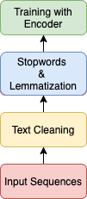
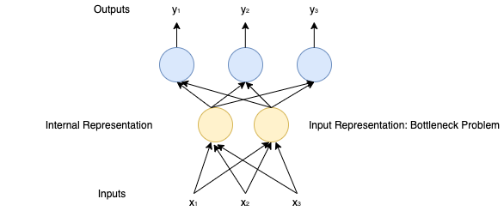
Flowchart of NLP &Model and Bottleneck Problem

Slide 5
Encoder-Decoder Structure
Natural Language Understanding (NLU) with Encoder: Sentiment Analysis, Named Entity Classification, etc.
Natural Language Generation (NLG) with Decoder: Neural Machine Translation, Question Answering, etc.
Context Vector: Causing “Bottleneck Problem”

Slide 6
Encoder-Decoder Structure: Transformer-based Models
Models: BERT, RoBERTa, XLNet, DistilBERT
Task: Sentiment Analysis
Benchmark Datasets:
First GOP Debate Twitter Sentiment
Tweets from verified users concerning stocks traded on the NYSE, NASDQ & SNP
SST-2: IMDb Movies Reviews
SST-5: Rotten Tomatoes Movies Reviews

Slide 7
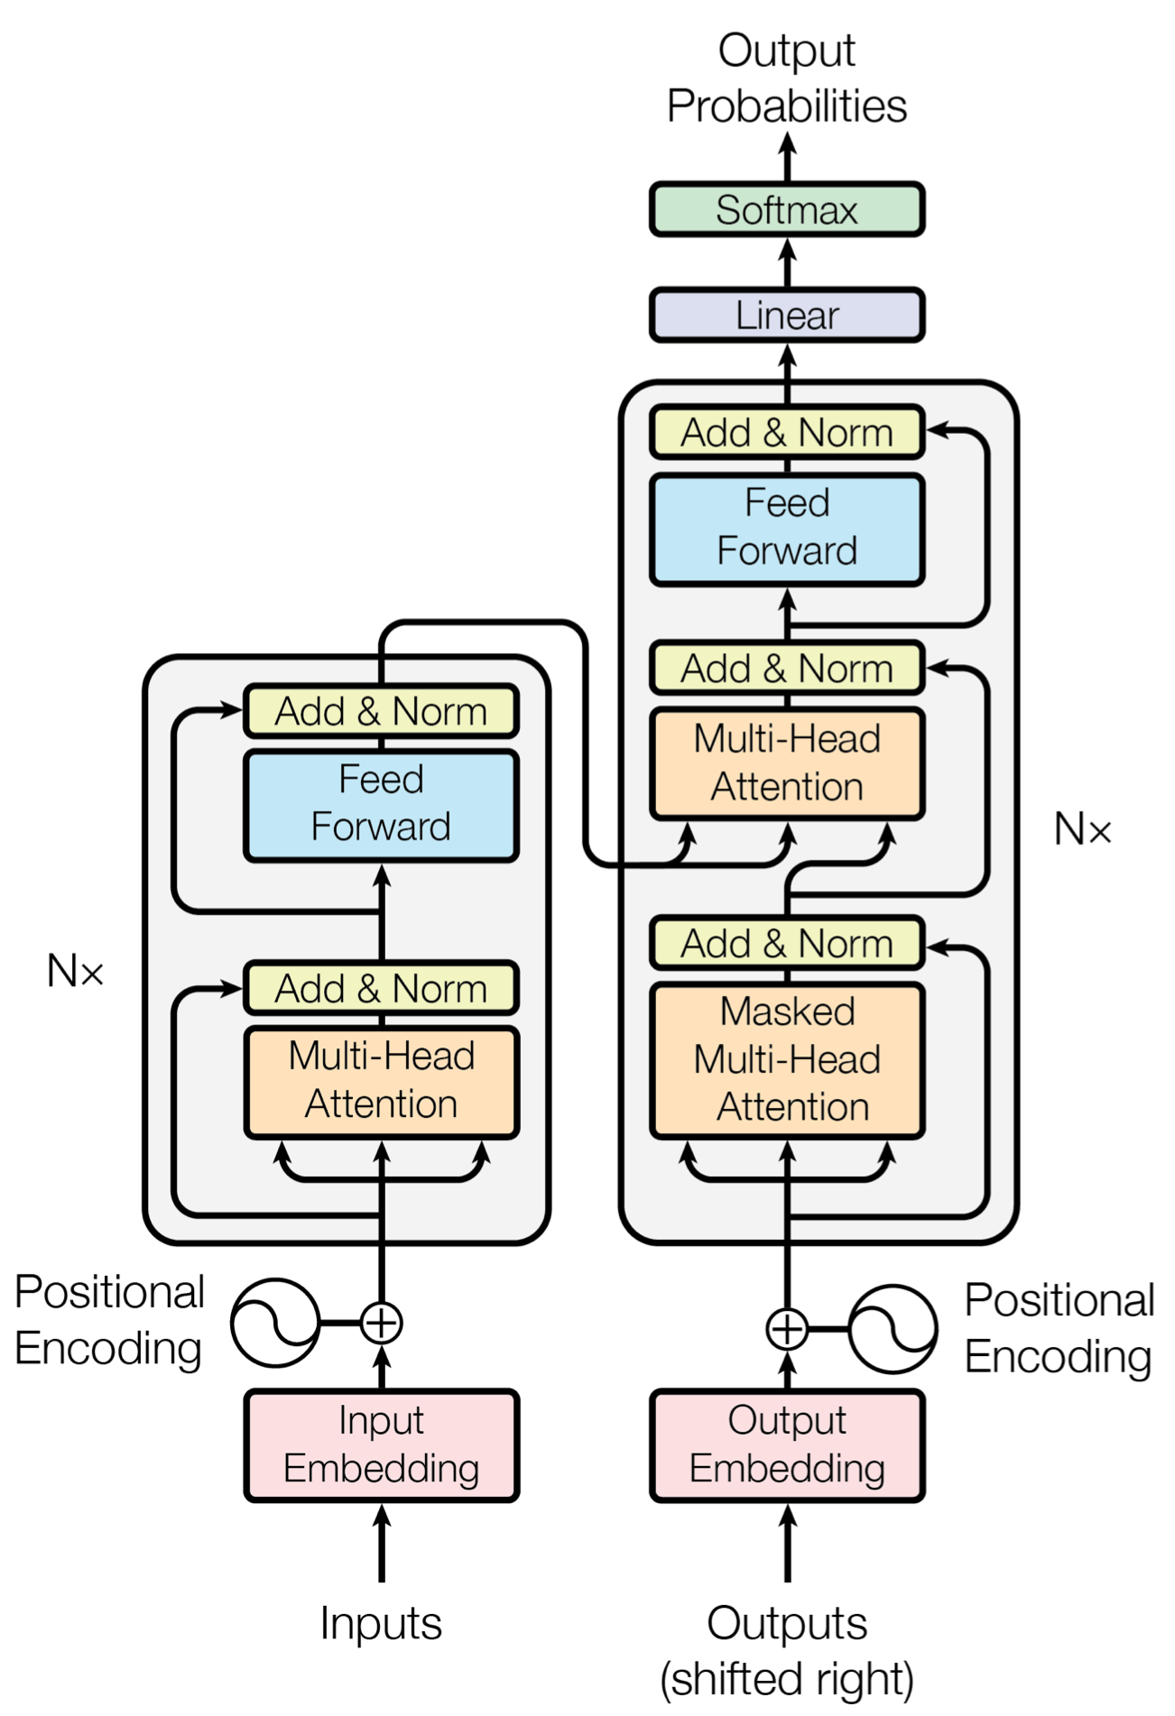
Structure: Transformer-based Models
Pre-training approaches
BERT: Maskd LM & Next Sentence Prediction
RoBERTa:
Trained on More Corpus (WikiText103, BookCorpus, CCNews)
Trained with Bigger batch sizes
Next Sentence Prediction

Slide 8
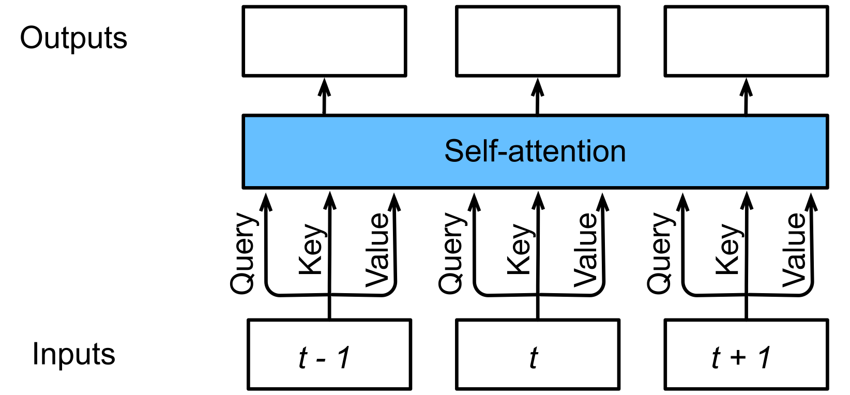
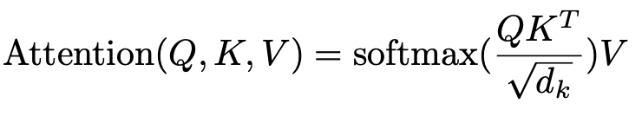
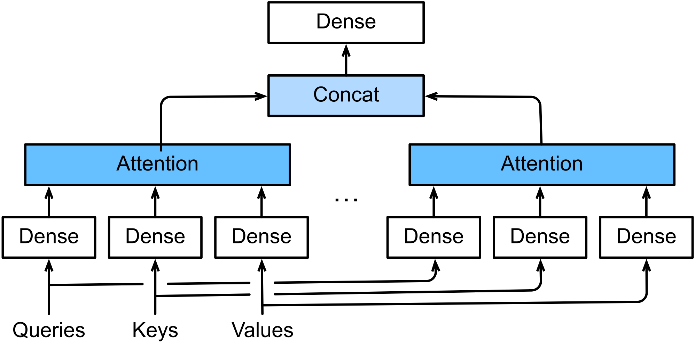
Attention Mechanism
Self Attention
Multi-headed Attention

Slide 9
Problems with Attention Mechanism
Too many heads -> Impossible to process queries from multiple positions
in parallel.
Valid heads are unknown
Processing with “Valid heads” problem: We propose EDM-RoBERTa to optimize the attention process

Slide 10
Optimization
Single-headed RNN (SHA-RNN)
Boom Layer
Activation Function: Gaussian Linear Unit (GeLU)
Models: BERT, RoBERTa, DistilBERT, XLNet
Solving the short-term dependency problem of Transformer-based Models

Slide 11
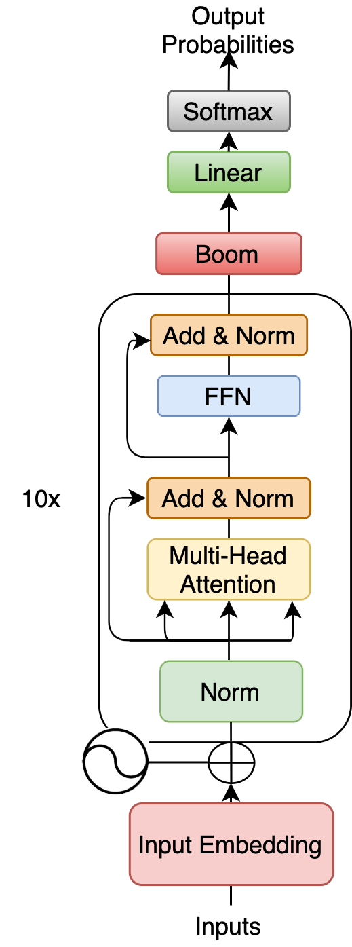
Optimization: EDM-RoBERTa
Choose the best-performed model: RoBERTa
Re-organize: Optimizing with Boom Layer
Enhancing the Dependency Mechanism of RoBERTa

Slide 12
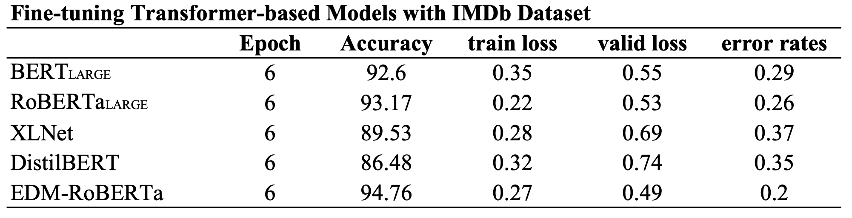
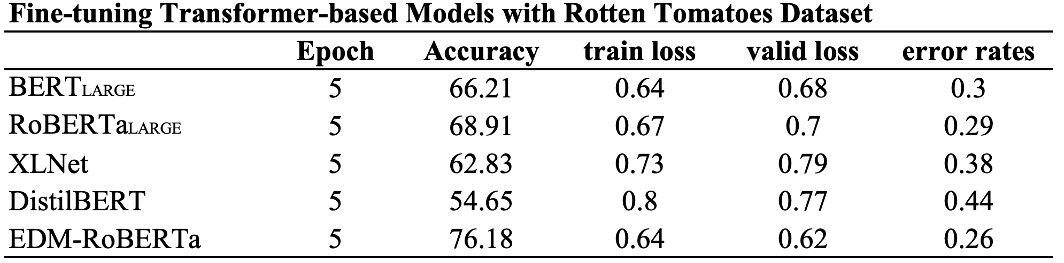
Optimization: Statistics

Slide 13
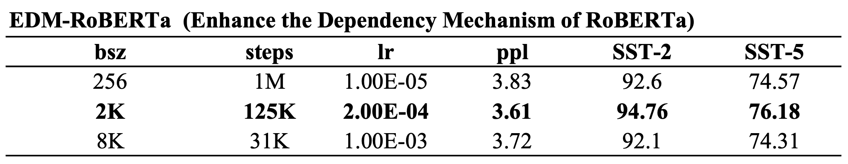
EDM-RoBERTa: Enhancing the Dependency Structure of RoBERTa
Detailed parameters of EDM-RoBERTa

Slide 14
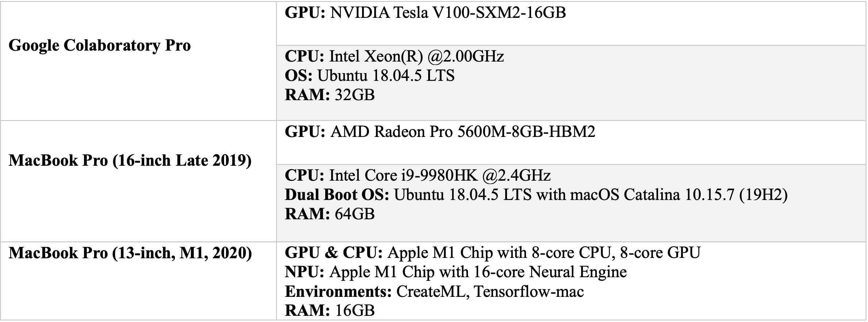
Runtimes & Environments

Slide 15
Conclusions
We introduced a language representation model called “EDM-RoBERTa”, which stands for “Enhancing the Dependency Mechanism of RoBERTa”.
EDM-RoBERTa is designed to improve the dependency mechanism, and fine-tuning the whole
model with “Sentiment Analysis Datasets.
Experiments and statistics show the model we proposed successfully enhance the dependency
mechanism on local context.
EDM-RoBERTa outperforms conventional pre-trained models.

