Slide 1
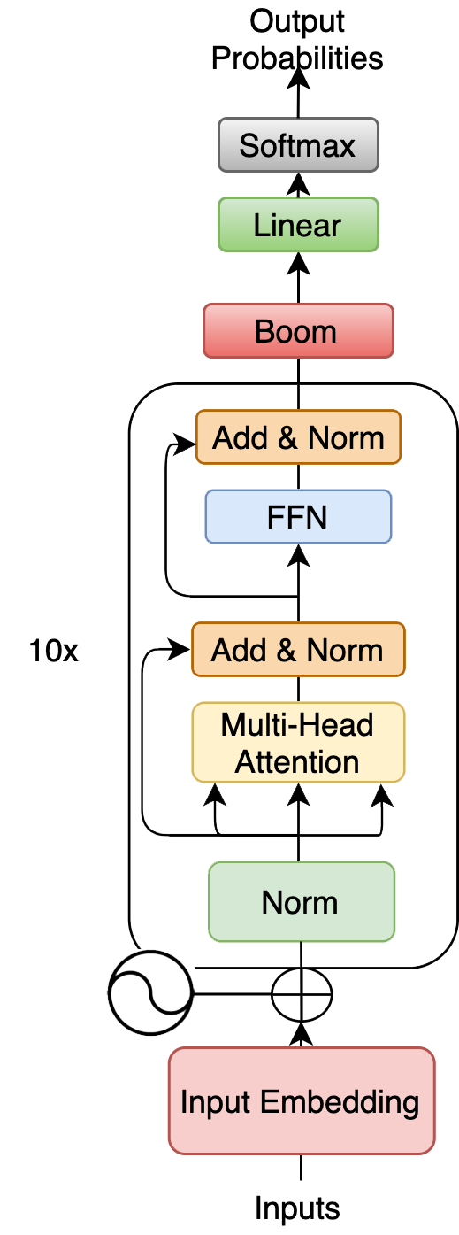
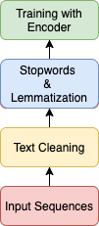

EDM-RoBERTa : Enhancing the Dependency Mechanism of RoBERTa
指導教授 : 張炎清 教授
專題組員 : 李昱廷、郭為軒、曹仲辰、
吳岳霖、林裕峰
Abstract
EDM-RoBERTa
(Enhance the Dependency Mechanism of RoBERTa)
Our proposed model, EDM-RoBERTa uses SHA-RNN to improve the Multi-headed Attention
mechanism in the encoder of Transformer model.
Compared with the original Transformer and
SHA-RNN models, the reorganization of Boom
Layer and RoBERTa can meet both long and short text sequence input, and keep the original long-term dependency of Transformer.In the calculation process, it can also reduce the amount of calculation, improving the accuracy and text classification performance.
Flowchart & Architecture
The research source are Transformer-based models
(BERT, RoBERTa, XLNet, DistilBERT), SHA-RNN , and the self-attention mechanism in Transformer as the main axis. The Boom Layer of SHA-RNN is
transformed to realize the attention mechanism for high-dimensional vectors convertion, improve the original multi-head attention mechanism in the encoder of Transformer.
Result
Fine-tuning Transformer-based Models with IMDb Dataset
Conclusions
Results shows that our EDM-RoBERTa model
obtains more accurate prediction results than the
original Transformer model on word meaning
analysis output, improving the disorderly lack in
coding and decoding process.
EDM-RoBERTa not only possesses the
long-term dependence characteristics of the
original Transformer, but meet the short-term
dependency requirements.
The results of this research will be applied to
other natural language sentiment analysis tasks
such as sentiment analysis and social network
analysis.
Fine-tuning Transformer-based Models with
Rotten Tomatoes Dataset
中山醫學大學醫學資訊學系 專題編號 PRJ2020-002

