Slide 1

Enhancing the Dependency
Mechanism of RoBERTa
Natural Language Processing: k EDM-RoBERTa
PRJ2020-002 Team Members: 李昱廷 郭為軒 曹仲辰 吳岳霖 林裕峰
Instructor: 張炎清 教授

Slide 2
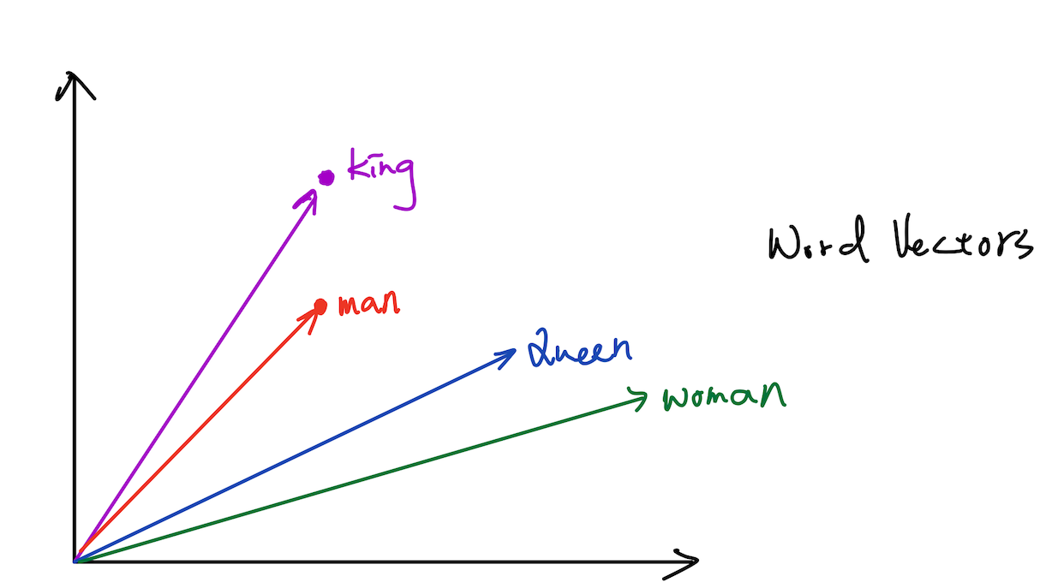
EDM-RoBERTa: Enhancing the Dependency Mechanism of RoBERTa
Learning Language Representations: Word Vectors (Word Embeddings)
1

Slide 3
General Language Model
Goal: Build a general language model to process with natural language.
The model can be adapted to different NLP tasks by transfer learning.
Transfer Learning: Pre-train and fine-tune the language model.
Conventional Language Model: Sequence to Sequence model (Seq2Seq)
2

Slide 4
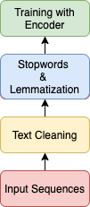
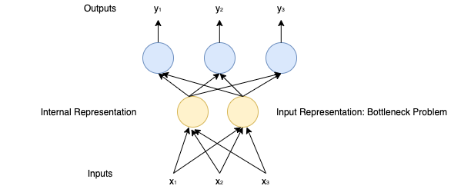
Flowchart of Text Sequences Processing and Bottleneck Problem
3

Slide 5
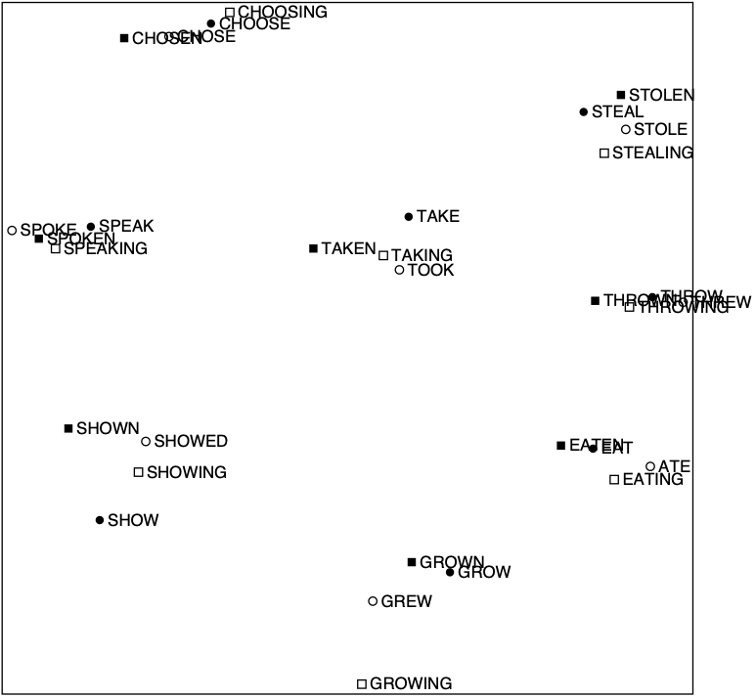
Syntactic Patterns Emerge in Word Vectors
4

Slide 6
Flowchart of Text Sequences Processing and Bottleneck Problem
5

Slide 7
Encoder-Decoder Structure
Natural Language Understanding (NLU) with Encoder: Sentiment Analysis, Named Entity Classification, etc.
Natural Language Generation (NLG) with Decoder: Neural Machine Translation, Question Answering, etc.
Context Vector: Causing “Bottleneck Problem”
6

Slide 8
Encoder-Decoder Structure: Transformer-based Models
Models: BERT, RoBERTa, XLNet, DistilBERT
Bidirectional Encoder Representation from Transformers (BERT)
Robustly optimized BERT approach (RoBERTa)
Task: Sentiment Analysis
Benchmark Datasets:
First GOP Debate Twitter Sentiment
Tweets from verified users concerning stocks traded on the NYSE, NASDQ & SNP
SST-2: IMDb Movies Reviews
SST-5: Rotten Tomatoes Movies Reviews
7

Slide 9
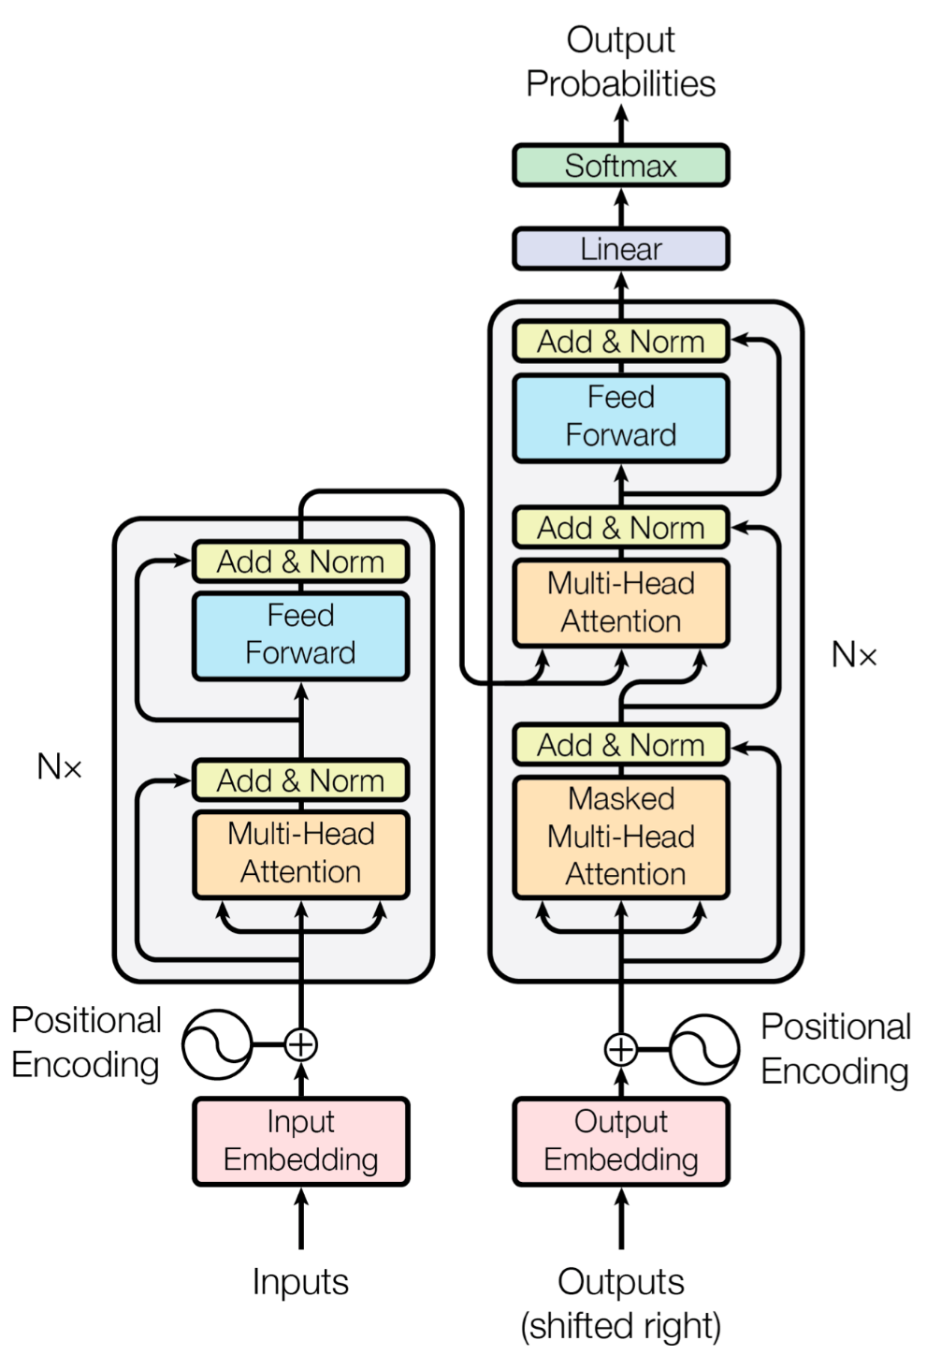
Structure: Transformer-based Models
Pre-training approaches
BERT: Maskd LM & Next Sentence Prediction
RoBERTa:
Trained on More Corpus (WikiText103, BookCorpus, CCNews)
Trained with Bigger batch sizes
8

Slide 10
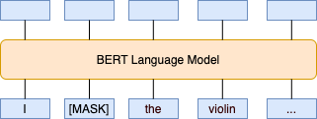
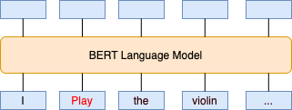
Masked Language (Masked LM)
Masked LM
9

Slide 11
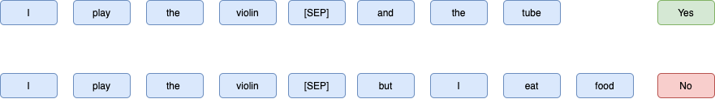
Next Sentence Prediction (NSP)
NSP
10

Slide 12
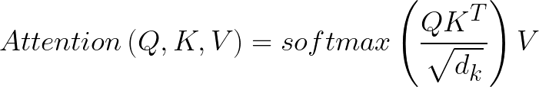
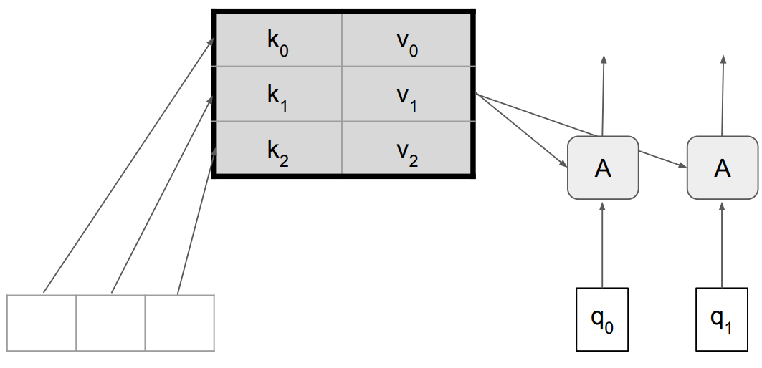
Attention Mechanism
Scaled Dot-Product Self Attention
11

Slide 13
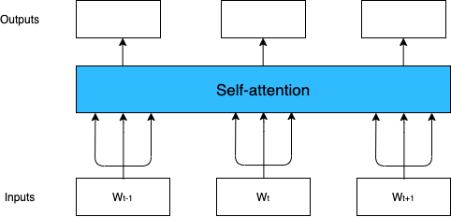
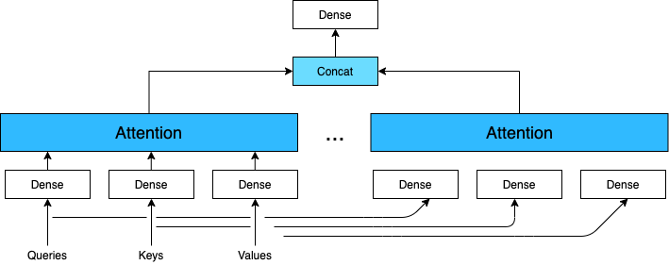
Attention Mechanism
Scaled Dot-Product Attention
Multi-Headed Attention
12

Slide 14
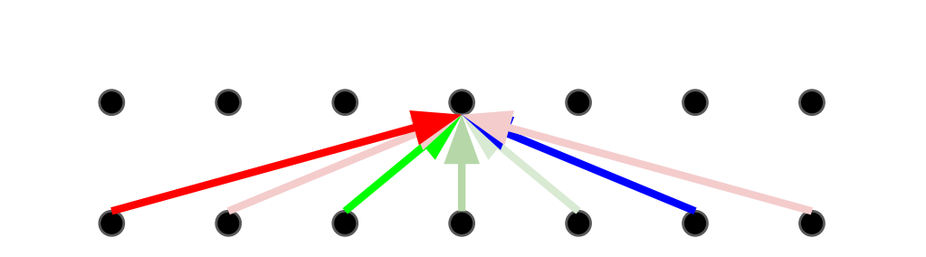
Attention Mechanism: The Fix – Multi-Headed Attention
Multi-Headed Attention
Multiple attention layers (heads) in parallel (shown by different colors)
Each layer uses different linear transformations.
Different heads can learn different relationships.
13

Slide 15
Problems with Attention Mechanism
Too many heads -> Hard to process queries from multiple positions
in parallel.
Valid heads are unknown
Processing with “Valid heads” problem: We propose EDM-RoBERTa to optimize the attention process
14

Slide 16
Optimization
Single-headed Attention RNN (SHA-RNN)
Boom Layer
Activation Function: Gaussian Error Linear Units (GELUs)
Models: BERT, RoBERTa, DistilBERT, XLNet
Solving the short-term dependency problem from Transformer-based Models
15

Slide 17
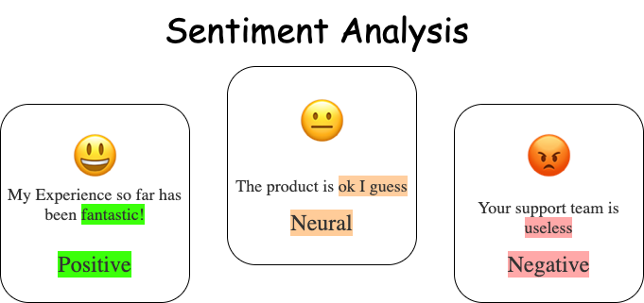
Optimization: Sentimental Ambiguity
16

Slide 18
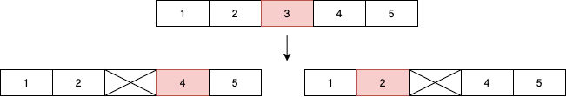
Optimization: Sentimental Ambiguity
Why using both two-dimensional and multi-dimensional sentiment analysis datasets
to train EDM-RoBERTa ?
Deal with the sentences with sentimental ambiguity
17

Slide 19
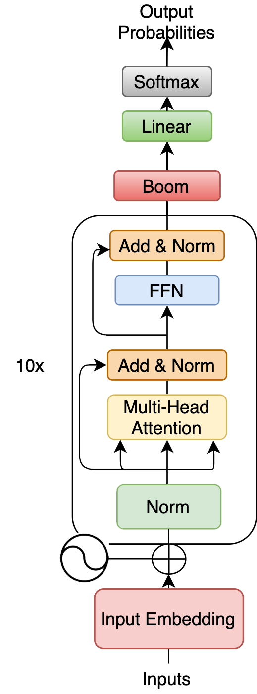
Improved Learning Model: EDM-RoBERTa
Choose the best-performed model: RoBERTa
Optimize the RoBERTa model with Boom Layer
Enhancing the Dependency Mechanism of RoBERTa
18

Slide 20
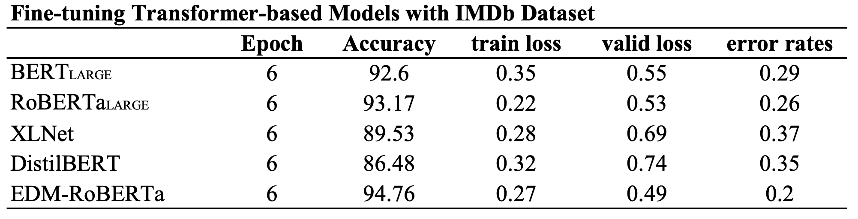
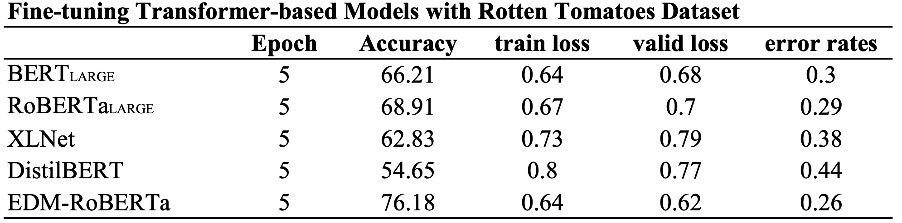
Optimization: Statistics
19

Slide 21
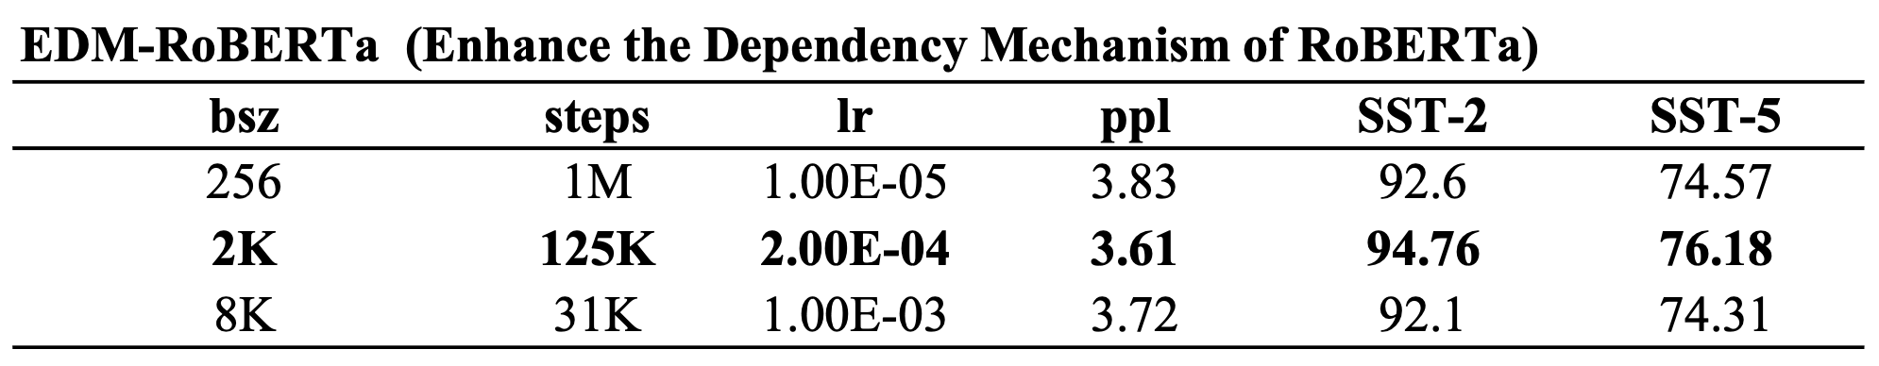
EDM-RoBERTa: Enhancing the Dependency Structure of RoBERTa
Detailed parameters of EDM-RoBERTa
20

Slide 22
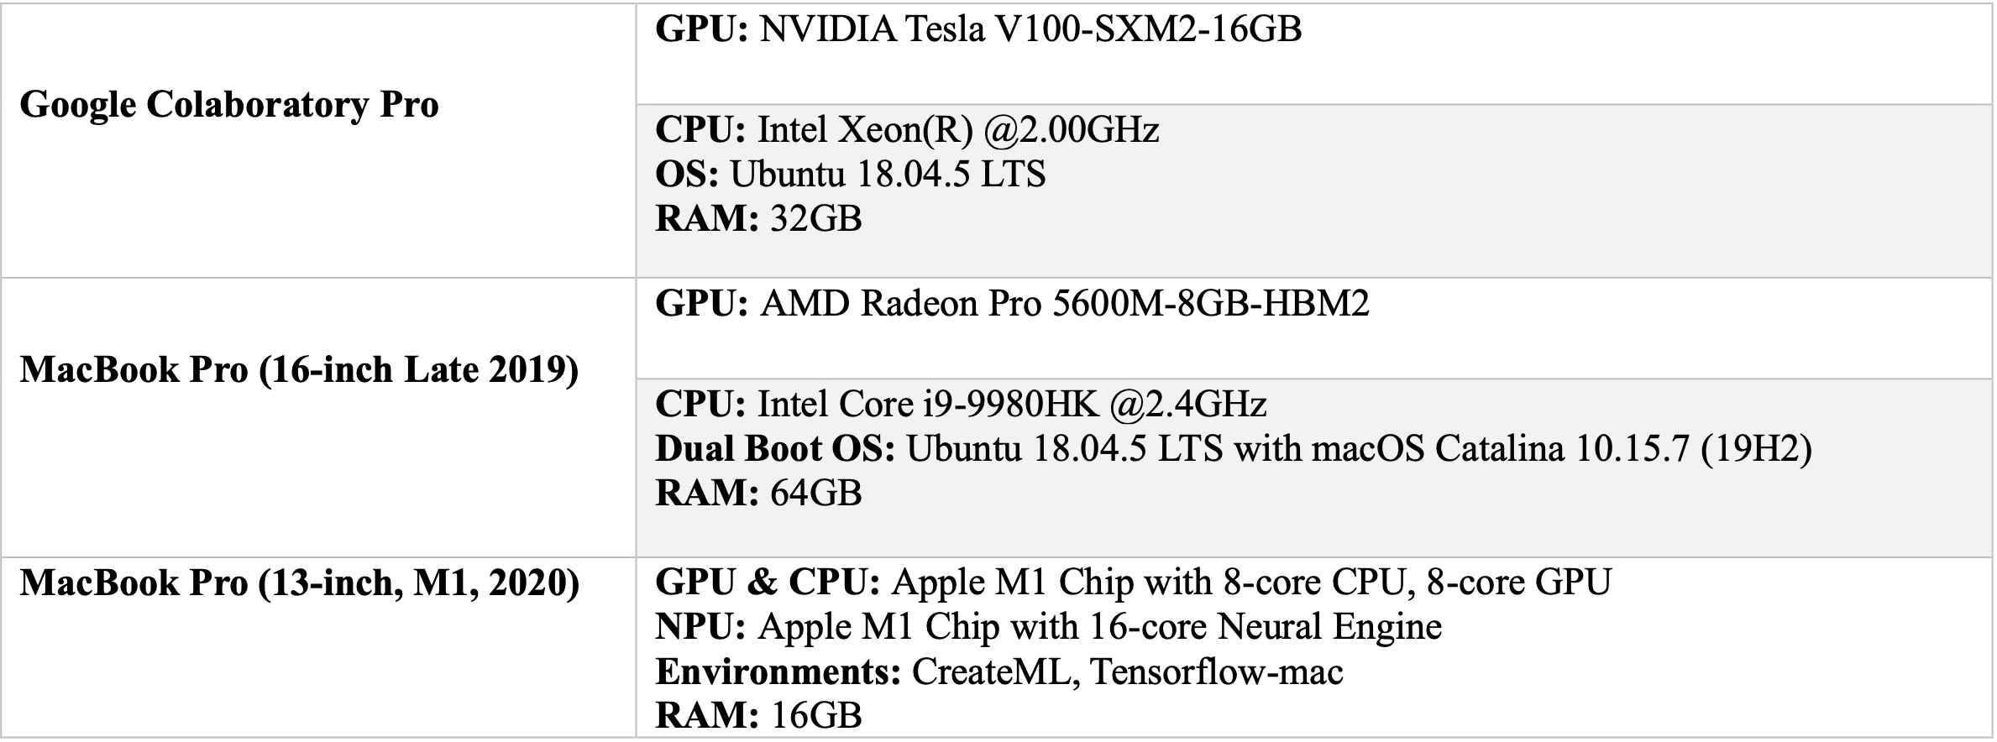
Runtimes & Environments
21

Slide 23
Conclusions
We introduced a language representation model called EDM-RoBERTa.
EDM-RoBERTa is designed to improve the dependency mechanism, and fine-tune the whole
model with sentiment analysis datasets.
Experiments and statistics show our proposed model successfully enhance the dependency
mechanism on local context.
EDM-RoBERTa outperforms conventional pre-trained models, including Seq2Seq, BERT, RoBERTa, XLNet, and DistilBERT.
22

