Slide 1

EDM-RoBERTa
Natural Language Processing:
Enhancing the Dependency Mechanism of RoBERTa
PRJ2020-002 Team Members: 李昱廷 郭為軒 曹仲辰 吳岳霖 林裕峰
Instructor: 張炎清 教授

Slide 2
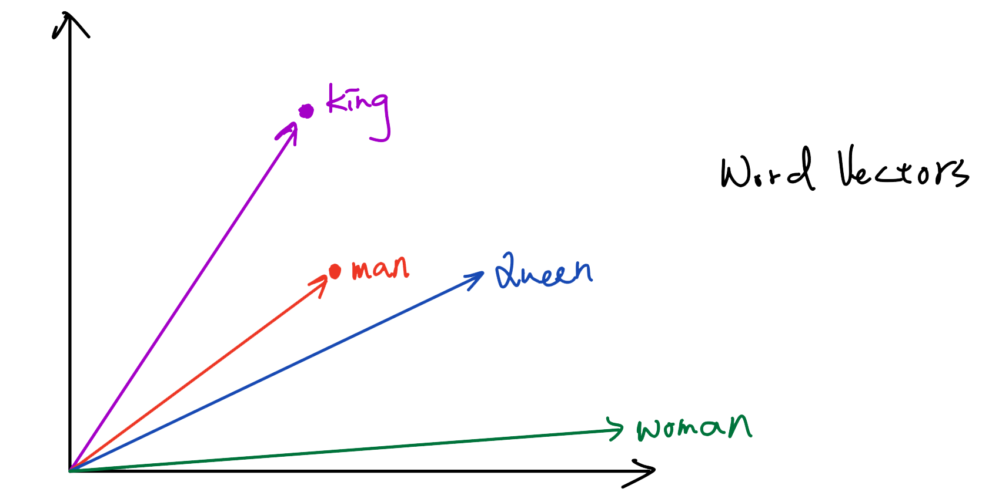
Enhancing the Dependency Mechanism of RoBERTa (EDM-RoBERTa)
Learning Language Representations: Word Vectors (Word Embeddings)

Slide 3
General Language Model
Goal: Build a general language model to process with natural language
Target: The model can be adapted to different NLP tasks by transfer learning
Transfer Learning: Pre-training and fine-tuning the language model
Conventional Language Model: Sequence to Sequence model (Seq2Seq)

Slide 4
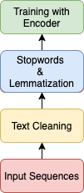
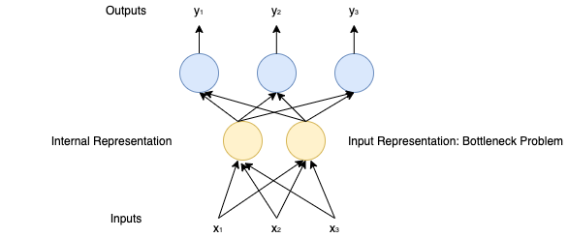
Flowchart of NLP &Model and Bottleneck Problem

Slide 5
Encoder-Decoder Structure
Natural Language Understanding (NLU) with Encoder: Sentiment Analysis, Named Entity Classification, etc.
Natural Language Generation (NLG) with Decoder: Neural Machine Translation, Question Answering, etc.
Context Vector: Causing “Bottleneck Problem”

Slide 6
Encoder-Decoder Structure: Transformer-based Models
Models: BERT, RoBERTa, XLNet, DistilBERT
Task: Sentiment Analysis
Benchmark Datasets:
First GOP Debate Twitter Sentiment
Tweets from verified users concerning stocks traded on the NYSE, NASDQ & SNP
SST-2: IMDb Movies Reviews
SST-5: Rotten Tomatoes Movies Reviews

Slide 7
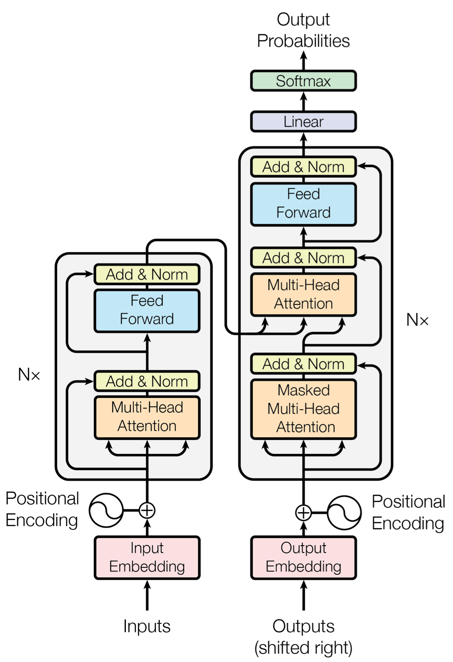
Structure: Transformer-based Models
Pre-training approaches
BERT: Maskd LM & Next Sentence Prediction
RoBERTa:
Trained on More Corpus (WikiText103, BookCorpus, CCNews)
Trained with Bigger batch sizes
Next Sentence Prediction

Slide 8
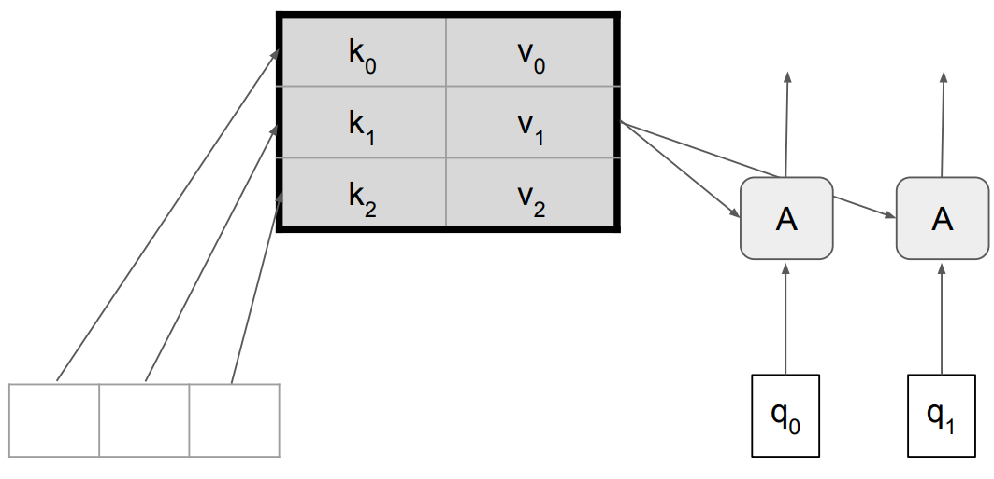
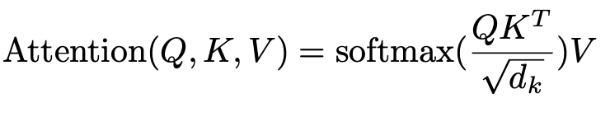
Attention Mechanism
Scaled Dot-Product Self Attention

Slide 9
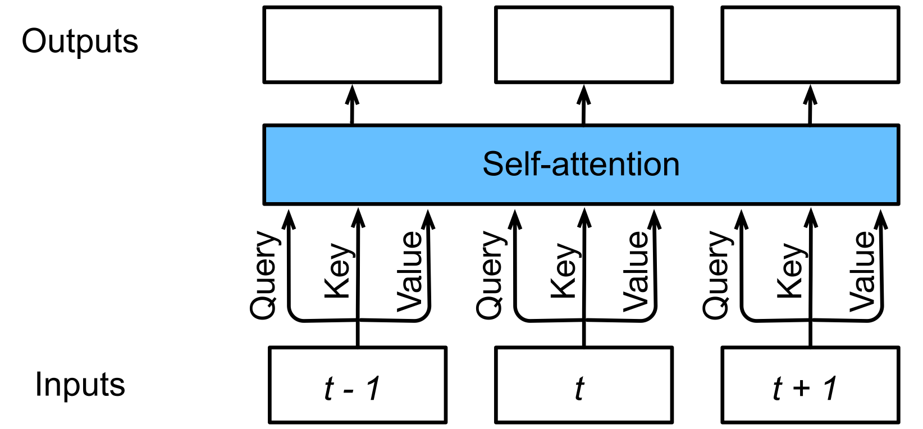
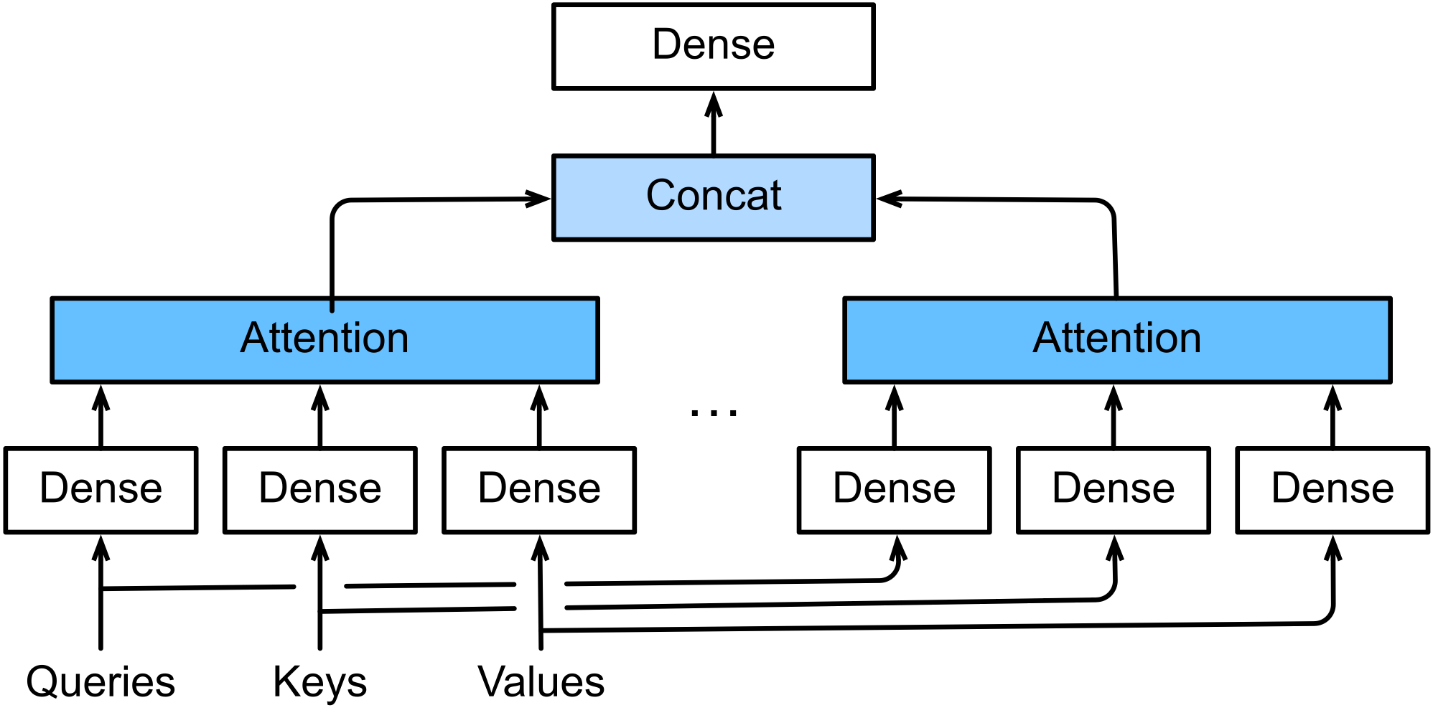
Attention Mechanism
Scaled Dot-Product Attention
Multi-Headed Attention

Slide 10
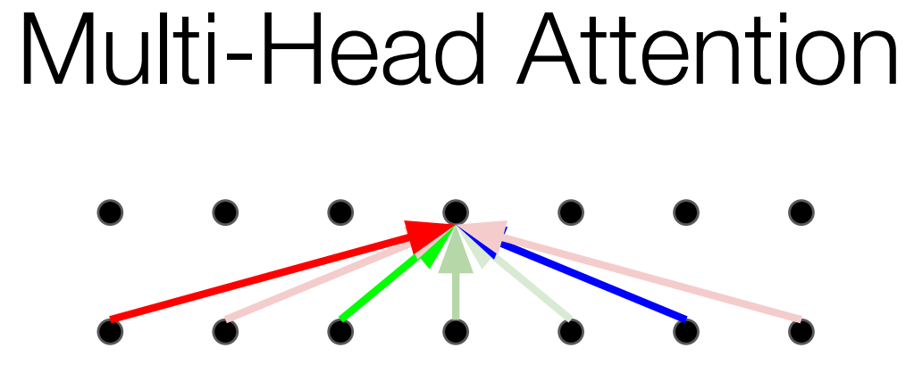
Attention Mechanism: The Fix – Multi-Headed Attention
Multi-Headed Attention
Multiple attention layers (heads) in parallel (shown by different colors)
Each layers uses different linear transformations.
Different heads can learn different relationships.

Slide 11
Problems with Attention Mechanism
Too many heads -> Hard to process queries from multiple positions
in parallel.
Valid heads are unknown
Processing with “Valid heads” problem: We propose EDM-RoBERTa to optimize the attention process

Slide 12
Optimization
Single-headed RNN (SHA-RNN)
Boom Layer
Activation Function: Gaussian Linear Unit (GeLU)
Models: BERT, RoBERTa, DistilBERT, XLNet
Solving the short-term dependency problem of Transformer-based Models

Slide 13
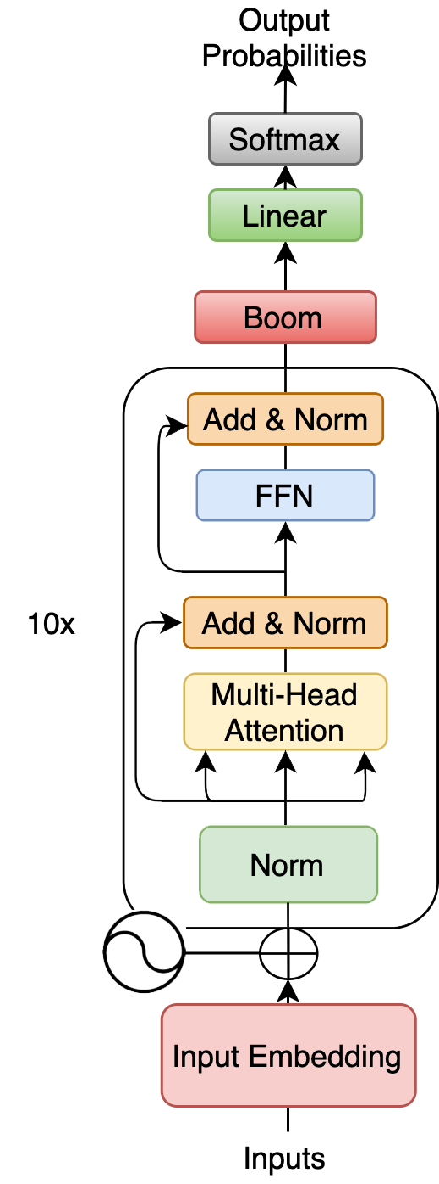
Optimization: EDM-RoBERTa
Choose the best-performed model: RoBERTa
Re-organize: Optimizing with Boom Layer
Enhancing the Dependency Mechanism of RoBERTa

Slide 14
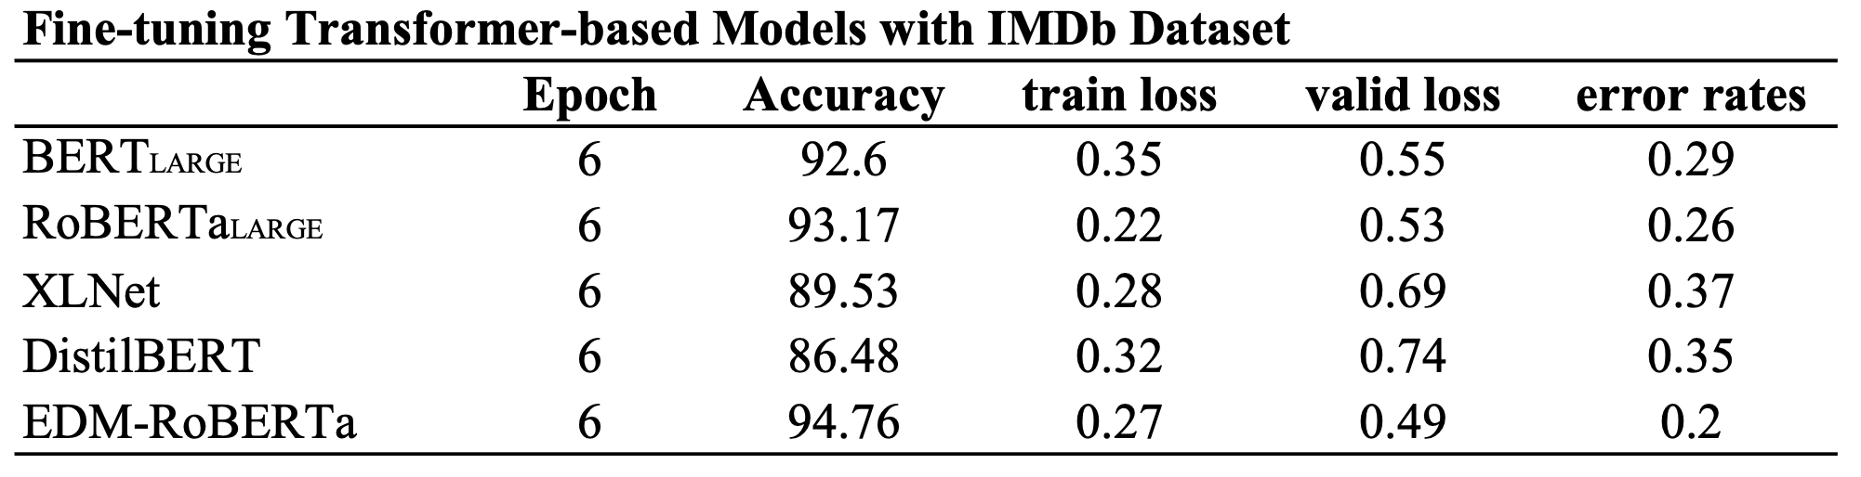
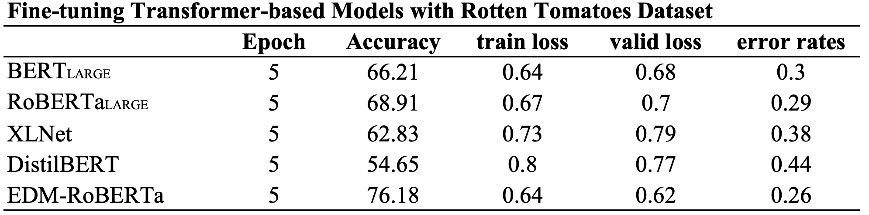
Optimization: Statistics

Slide 15
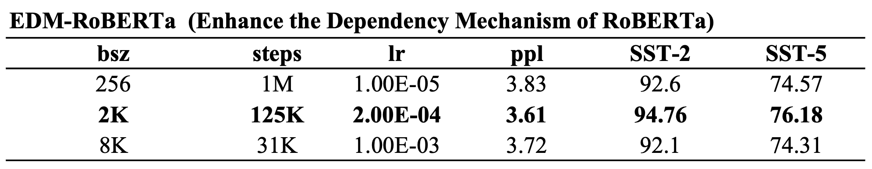
EDM-RoBERTa: Enhancing the Dependency Structure of RoBERTa
Detailed parameters of EDM-RoBERTa

Slide 16
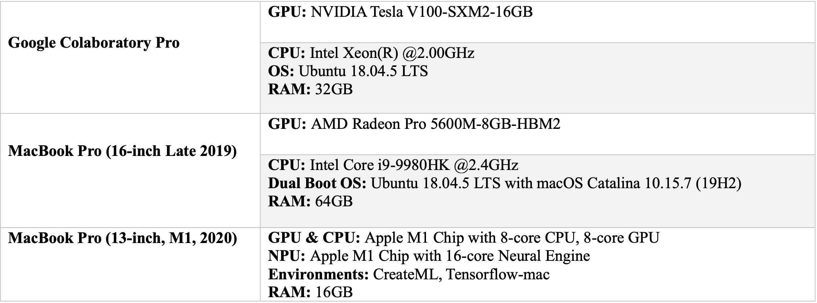
Runtimes & Environments

Slide 17
Conclusions
We introduced a language representation model called “EDM-RoBERTa”, which stands for “Enhancing the Dependency Mechanism of RoBERTa”.
EDM-RoBERTa is designed to improve the dependency mechanism, and fine-tuning the whole
model with “Sentiment Analysis Datasets”.
Experiments and statistics show the model we proposed successfully enhance the dependency
mechanism on local context.
EDM-RoBERTa outperforms conventional pre-trained models.

