Slide 1

Natural Language Processing
Bidirectional Encoder Representations from Transformers (BERT)

Slide 2

3 BERT
We introduce BERT and its detailed implementation in this section. There are two steps in our framework: pre-training and fine-tuning. During pre-training, the model is trained on unlabeled data over different pre-training tasks. For fine-tuning, the BERT model is first initialized with the pre-trained parameters, and all of the parameters are fine-tuned using labeled data from the downstream tasks.
A distinctive feature of BERT is its unified architecture across different tasks. There is minimal difference between the pre-trained architecture and the final downstream architecture.

Slide 3
3 BERT
這個模型的核心是Transformer的聚焦機制，對於一個語句，可以同時啓用多個聚焦點，而不必侷限於從前往後的，或者從後往前的。BERT 用了兩個步驟，試圖去正確地訓練模型的參數。 第一個步驟是把一篇文章中，15% 的詞彙遮蓋，讓模型根據上下文全向地預測被遮蓋的詞。假如有 1 萬篇文章，每篇文章平均有 100 個詞彙，隨機遮蓋 15% 的詞彙，模型的任務是正確地預測這 15 萬個被遮蓋的詞彙。通過全向預測被遮蓋住的詞彙，來完成初步訓練 Transformer 模型。
第二個步驟繼續訓練模型的參數。 譬如從上述 1 萬篇文章中，挑選 20 萬對語句，總共 40 萬條語句。挑選語句對的時候，其中 2*10 萬對語句，是連續的兩條上下文語句，另外 2*10 萬對語句，不是連續的語句。然後讓 Transformer 模型來識別這 20 萬對語句，哪些是連續的，哪些不連續。
這兩步訓練合在一起，稱爲預訓練 pre-training。
通用語言表徵模型 (Language Representation Model)

Slide 4
3 BERT
Language Model
Pre-training
Transformer - Attention

Slide 5
3.0.1 BERT – Model Architecture
BERT’s model architecture is a multi-layer bidirectional Transformer encoder based on the original implementation described in Vaswani et al. (2017) and released in the tensor2tensor library. Because the use of Transformers has become common and our implementation is almost identical to the original, we will omit an exhaustive background description of the model architecture and refer readers to Vaswani et al. (2017) as well as excellent guides such as “The Annotated Transformer.” In this work, we denote the number of layers (i.e., Transformer blocks) as L, the hidden size as H, and the number of self-attention heads as A.
We primarily report results on two model sizes: BERT_{BASE} (L=12, H=768, A=12, Total Parameters=110M) and ^{BERT}_{LARGE} (L=24, H=1024, A=16, Total Parameters=340M).

Slide 6
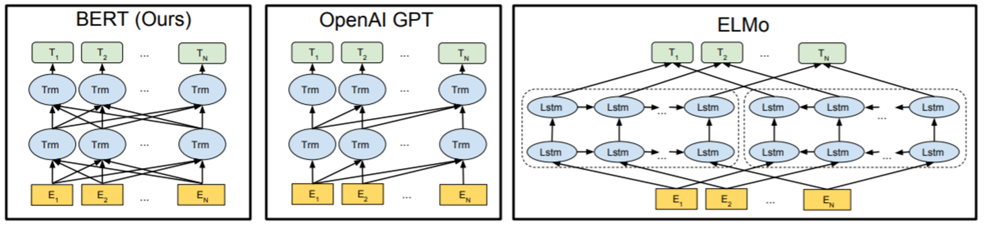
3.0.1 BERT – Model Architecture
^{BERT}_{BASE} was chosen to have the same model size as OpenAI GPT for comparison purposes. Critically, however, the BERT Transformer uses bidirectional self-attention, while the GPT Transformer uses constrained self-attention where every token can only attend to context to its left.

Slide 7
3.0.2 BERT – Input/Output Representation
To make BERT handle a variety of down-stream tasks, our input representation is able to unambiguously represent both a single sentence and a pair of sentences (e.g., ⟨ Question, Answer ⟩) in one token sequence. Throughout this work, a “sentence” can be an arbitrary span of contiguous text, rather than an actual linguistic sentence. A “sequence” refers to the input token sequence to BERT, which may be a single sentence or two sentences packed together.
We use WordPiece embeddings (Wu et al., 2016) with a 30,000 token vocabulary. The first token of every sequence is always a special classification token ([CLS]). The final hidden state corresponding to this token is used as the aggregate sequence representation for classification tasks. Sentence pairs are packed together into a single sequence. We differentiate the sentences in two ways.

Slide 8

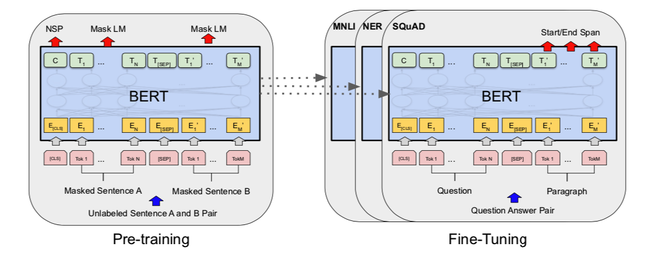
3.0.2 BERT – Input/Output Representation
First, we separate them with a special token ([SEP]). Second, we add a learned embedding to every token indicating whether it belongs to sentence A or sentence B. As shown in Figure 1, we denote input embedding as E, the final hidden vector of the special [CLS] token as , and the final hidden vector for the input token as .

Slide 9
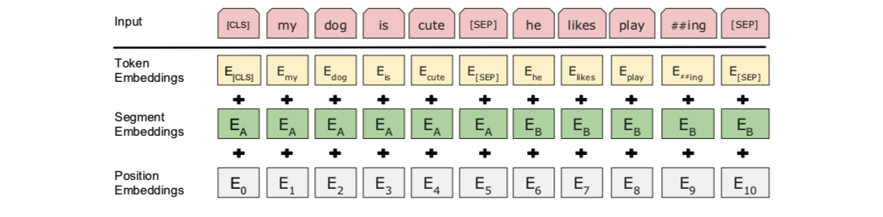
3.0.2 BERT – Input/Output Representation
For a given token, its input representation is constructed by summing the corresponding token, segment, and position embeddings. A visualization of this construction can be seen in Figure 2.

Slide 10
3.1 BERT – Pre-training BERT
Unlike Peters et al. (2018a) and Radford et al. (2018), we do not use traditional left-to-right or right-to-left language models to ^{pre-train BERT.} Instead, we pre-train BERT using two unsupervised tasks, described in this section. This step is presented in the left part of Figure 1.

Slide 11
3.1 BERT – Pre-training BERT
3.1.1 Task #1 : Masked LM (MLM)
Intuitively, it is reasonable to believe that a deep bidirectional model is strictly more powerful than either a left-to-right model or the shallow concatenation of a left-to-right and a right-to-left model.
Unfortunately, standard conditional language models can only be trained left-to-right or right-to-left, since bidirectional conditioning would allow each word to indirectly “see itself”, and the model could trivially predict the target word in a ^{multi-layered context.}
In order to train a deep bidirectional representation, we simply mask some percentage of the input tokens at random, and then predict those masked tokens. We refer to this procedure as a “masked LM” (MLM), although it is often referred to as a Cloze task in the literature (Taylor, 1953). In this case, the final hidden vectors corresponding to the mask tokens are fed into an output softmax over the vocabulary, as in a ^{standard LM.}

Slide 12
3.1 BERT – Pre-training BERT
3.1.1 Task #1 : Masked LM (MLM)
In all of our experiments, we mask 15% of all WordPiece tokens in each sequence at random. In contrast to denoising auto-encoders (Vincent et al., 2008), we only predict the masked words rather than reconstructing the entire input.
Although this allows us to obtain a bidirectional pre-trained model, a downside is that we are creating a mismatch between pre-training and fine-tuning, since the [MASK] token does not appear during fine-tuning. To mitigate this, we do not always replace “masked” words with the actual [MASK] token.

Slide 13
3.1 BERT – Pre-training BERT
3.1.1 Task #1 : Masked LM (MLM)
The training data generator chooses 15% of the token positions at random for prediction. If the token is chosen, we replace the token with (1) the [MASK] token 80% of the time Ex: my dog is hairy -> my dog is [MASK] (2) a random token 10% of the time Ex: my dog is hairy -> my dog is apple (3) the unchanged token 10% of the time Ex: my dog is hairy -> hairy

Slide 14
3.1 BERT – Pre-training BERT
3.1.2 Task #2 : Next Sentence Prediction (NSP)
Many important downstream tasks such as Question Answering (QA) and Natural Language Inference (NLI) are based on understanding the relationship between two sentences, which is not directly captured by language modeling. In order to train a model that understands sentence relationships, we pre-train for a binarized next sentence prediction task that can be trivially generated from any monolingual corpus. Specifically, when choosing the sentences A and B for each pre-training example, 50% of the time B is the actual next sentence that follows A (labeled as IsNext), and 50% of the time it is a random sentence from the corpus (labeled as NotNext).
Ex:
Input = [CLS] the man went to [MASK] store [SEP]
he bought a gallon [MASK] milk [SEP]
Label = IsNext
Input = [CLS] the man [MASK] to the store [SEP]
penguin [MASK] are flight ##less birds [SEP]
Label = NotNext

Slide 15
3.1 BERT – Pre-training BERT
3.1.2 Task #2 : Next Sentence Prediction (NSP)
As we show in Figure 1, C is used for next sentence prediction (NSP). Despite its simplicity, we demonstrate in Section 5.1 that pre-training towards this task is very beneficial to both QA and NLI.
The NSP task is closely related to representation learning objectives used in Jernite et al. (2017) and Logeswaran and Lee (2018). However, in prior work, only sentence embeddings are transferred to down-stream tasks, where BERT transfers all parameters to initialize end-task model parameters.

Slide 16
3.1 BERT – Pre-training BERT
3.1.3 Pre-training data
The pre-training procedure largely follows the existing literature on language model pre-training. For the pre-training corpus we use the BooksCorpus (800M words) (Zhu et al., 2015) and English Wikipedia (2,500M words). For Wikipedia we extract only the text passages and ignore lists, tables, and headers. It is critical to use a document-level corpus rather than a shuffled sentence-level corpus such as the Billion Word Benchmark (Chelba et al., 2013) in order to extract long contiguous sequences.

Slide 17
3.2 BERT – Fine-tuning BERT
Fine-tuning is straightforward since the self-attention mechanism in the Transformer allows BERT to model many downstream tasks— whether they involve single text or text pairs—by swapping out the appropriate inputs and outputs. For applications involving text pairs, a common pattern is to independently encode text pairs before applying bidirectional cross attention, such as Parikh et al. (2016); Seo et al. (2017). BERT instead uses the self-attention mechanism to unify these two stages, as encoding a concatenated text pair with self-attention effectively includes bidirectional cross attention between two sentences.

Slide 18
3.2 BERT – Fine-tuning BERT
For each task, we simply plug in the task- specific inputs and outputs into BERT and fine-tune all the parameters end-to-end. At the in- put, sentence A and sentence B from pre-training are analogous to (1) sentence pairs in paraphrasing (2) hypothesis-premise pairs in entailment (3) question-passage pairs in question answering (4) a degenerate text-∅ pair in text classification or sequence tagging

Slide 19
3.2 BERT – Fine-tuning BERT
Compared to pre-training, fine-tuning is relatively inexpensive. All of the results in the paper can be replicated in at most 1 hour on a single Cloud TPU, or a few hours on a GPU, starting from the exact same pre-trained model. We describe the task-specific details in the corresponding subsections of Section 4. More details can be found in Appendix A.5.

Slide 20
4.2 SQuAD v1.1
The Stanford Question Answering Dataset (SQuAD v1.1) is a collection of 100k crowd-sourced question/answer pairs (Rajpurkar et al., 2016). Given a question and a passage from Wikipedia containing the answer, the task is to predict the answer text span in the passage.

Slide 21
4.2 SQuAD v1.1
•輸入問題：
水滴在哪裡與冰晶碰撞形成沉澱？
•輸入段落：
...沉澱形成為較小的液滴通過與雲中的其他雨滴或冰晶碰撞而聚結。...
•輸出答案：
在雲中

Slide 22
4.2 SQuAD v1.1
As shown in Figure 1, in the question answering task, we represent the input question and passage as a single packed sequence, with the question using the A embedding and the passage using the B embedding.
We only introduce a start vector S ∈ R^{H} and an end vector E ∈ R^{H} during fine-tuning.

Slide 23
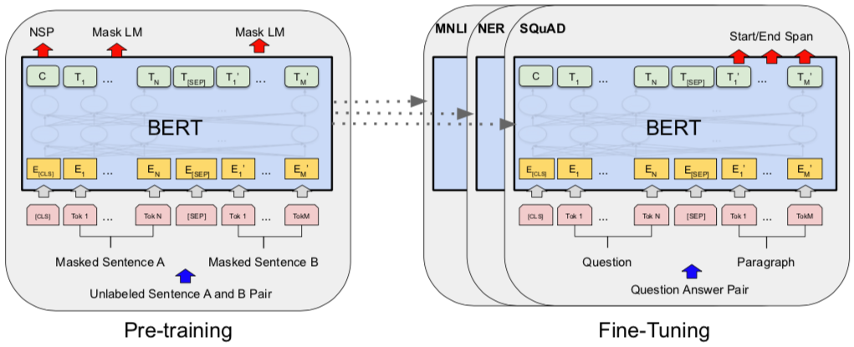
4.2 SQuAD v1.1

Slide 24

4.2 SQuAD v1.1
The probability of word i being the start of the answer span is computed as a dot product between Ti and S followed by a softmax over all of the words in the paragraph:

Slide 25
4.2 SQuAD v1.1
The analogous formula is used for the end of the answer span. The score of a candidate span from position i to position j is defined as S ·Ti + E ·Tj and the maximum scoring span where j ≥ i is used as a prediction. The training objective is the sum of the log-likelihoods of the correct start and end positions. We fine-tune for 3 epochs with a learning rate of 5e-5 and a batch size of 32.

Slide 26
4.2 SQuAD v1.1
Table 2 shows top leaderboard entries as well as results from top published systems (Seo et al., 2017; Clark and Gardner, 2018; Peters et al., 2018a; Hu et al., 2018). The top results from the SQuAD leaderboard do not have up-to-date public system descriptions available, and are allowed to use any public data when training their systems. We therefore use modest data augmentation in our system by first fine-tuning on TriviaQA (Joshi et al., 2017) before fine-tuning on SQuAD.

Slide 27
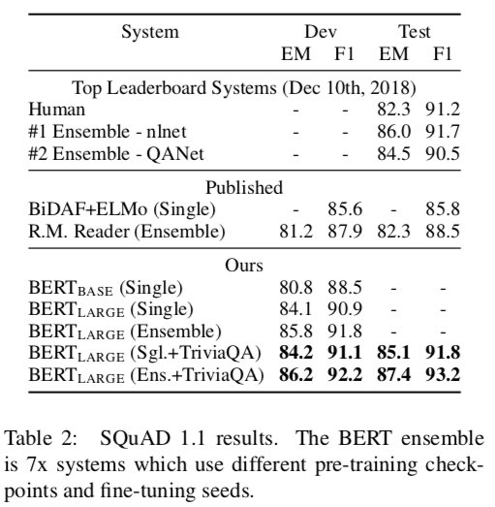
4.2 SQuAD v1.1

Slide 28
4.2 SQuAD v1.1
Our best performing system outperforms the top leaderboard system by +1.5 F1 in ensembling and +1.3 F1 as a single system. In fact, our single BERT model outperforms the top ensemble system in terms of F1 score. Without TriviaQA fine-tuning data, we only lose 0.1-0.4 F1, still outperforming all existing systems by a wide margin.

Slide 29
Natural Language Processing
Sequence to Sequence
Learning with
Neural Networks (Seq2Seq)

Slide 30
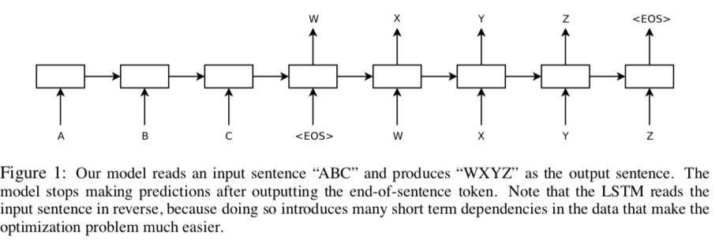
1. Introduction

Slide 31
1. Introduction
The main result of this work is the following.
On the WMT’14 English to French translation task, we obtained a BLEU score of 34.81 by directly extracting translations from an ensemble of
5 deep LSTMs (with 384M parameters and 8,000 dimensional state each) using a simple left-to-right beam-search decoder.

Slide 32
1. Introduction
This is by far the best result achieved by direct translation with large neural networks.
For comparison, the BLEU score of an SMT baseline on this dataset is 33.30 .
The 34.81 BLEU score was achieved by an LSTM with a vocabulary of 80k words, so the score was penalized whenever the reference translation contained a word not covered by these 80k.

Slide 33
1. Introduction
This result shows that a relatively unoptimized small-vocabulary neural network architecture which has much room for improvement outperforms a phrase-based SMT system.

Slide 34
1. Introduction
Finally, we used the LSTM to rescore the publicly available 1000-best lists of the SMT baseline on the same task.
By doing so, we obtained a BLEU score of 36.5, which improves the baseline by 3.2 BLEU points and is close to the previous best published result on this task (which is 37.0).

Slide 35
1. Introduction
Surprisingly, the LSTM did not suffer on very long sentences, despite the recent experience of other researchers with related architectures.
We were able to do well on long sentences because we reversed the order of words in the source sentence but not the target sentences in the training and test set.

Slide 36
1. Introduction
By doing so, we introduced many short term dependencies that made the optimization problem much simpler (see sec. 2 and 3.3).
As a result, SGD could learn LSTMs that had no trouble with long sentences.
The simple trick of reversing the words in the source sentence is one of the key technical contributions of this work.

Slide 37
1. Introduction
A useful property of the LSTM is that it learns to map an input sentence of variable length into a fixed-dimensional vector representation.

Slide 38
1. Introduction
Given that translations tend to be paraphrases of the source sentences, the translation objective encourages the LSTM to find sentence representations that capture their meaning, as sentences with similar meanings are close to each other while different sentences meanings will be far.

Slide 39
1. Introduction
A qualitative evaluation supports this claim, showing that our model is aware of word order and is fairly invariant to the active and passive voice.

Slide 40
Beam Search Decoder
French : "Jane visite l'Afrique en septembre."
English: Jane is visiting Africa in September.
English: Jane is going to be visiting Africa in September.
Beam Width = 3

Slide 41
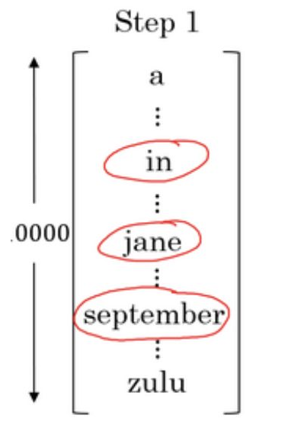
Beam Search Decoder
Beam Width = 3
Dictionary Size: 10000, B=3

Slide 42
Beam Search Decoder
Beam Width = 3
Dictionary Size: 10000, B=3
in september
jane is
jane visits
in september jane
jane is visiting
jane visits africa

Slide 43
Beam Search Decoder
Beam Width = 3
Dictionary Size: 10000, B=3
in september
jane is
jane visits
in september jane
jane is visiting
jane visits africa
Jane visits africa in september”

Slide 44
Greedy Search
Beam Width = 1
French : Jane visite l'Afrique en septembre.
English: Jane is visiting Africa in September.
English: Jane is going to be visiting Africa in September.

