Slide 1

Enhancing the Dependency
Mechanism of RoBERTa
Natural Language Processing: k EDM-RoBERTa
PRJ2020-002 Team Members: 李昱廷 郭為軒 曹仲辰 吳岳霖 林裕峰
Instructor: 張炎清 教授

Slide 2
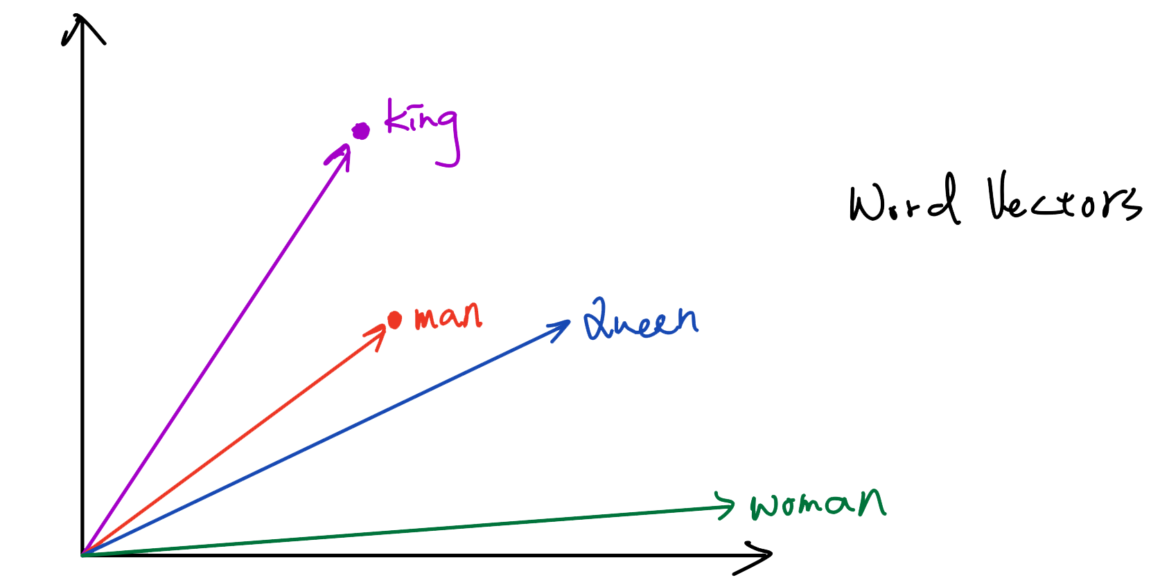
EDM-RoBERTa: Enhancing the Dependency Mechanism of RoBERTa
Learning Language Representations: Word Vectors (Word Embeddings)
1

Slide 3
General Language Model
Goal: Build a general language model to process with natural language.
The model can be adapted to different NLP tasks by transfer learning.
Transfer Learning: Pre-train and fine-tune the language model.
Conventional Language Model: Sequence to Sequence model (Seq2Seq)
2

Slide 4
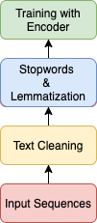
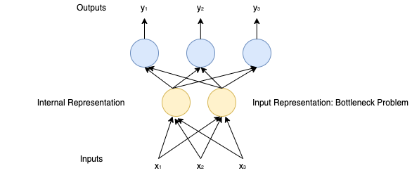
Flowchart of Text Sequences Processing and Bottleneck Problem
3

Slide 5
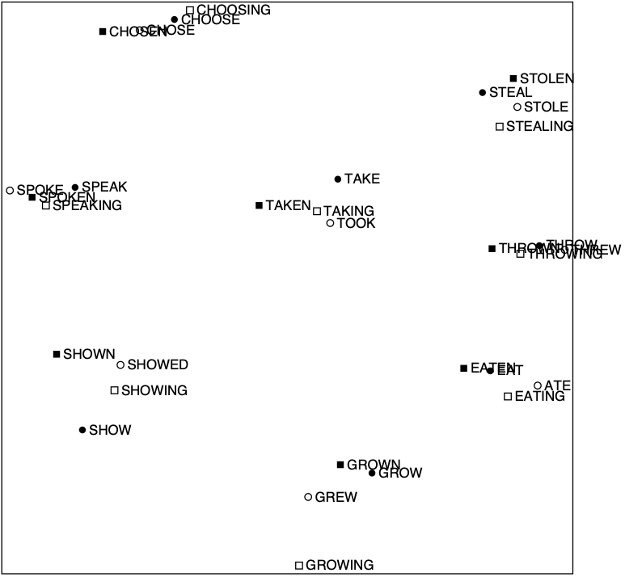
Syntactic Patterns Emerge in Word Vectors
3

Slide 6
Encoder-Decoder Structure
Natural Language Understanding (NLU) with Encoder: Sentiment Analysis, Named Entity Classification, etc.
Natural Language Generation (NLG) with Decoder: Neural Machine Translation, Question Answering, etc.
Context Vector: Causing “Bottleneck Problem”
4

Slide 7
Encoder-Decoder Structure: Transformer-based Models
Models: BERT, RoBERTa, XLNet, DistilBERT
Bidirectional Encoder Representation from Transformers (BERT)
Robustly optimized BERT approach (RoBERTa)
Task: Sentiment Analysis
Benchmark Datasets:
First GOP Debate Twitter Sentiment
Tweets from verified users concerning stocks traded on the NYSE, NASDQ & SNP
SST-2: IMDb Movies Reviews
SST-5: Rotten Tomatoes Movies Reviews
5

Slide 8
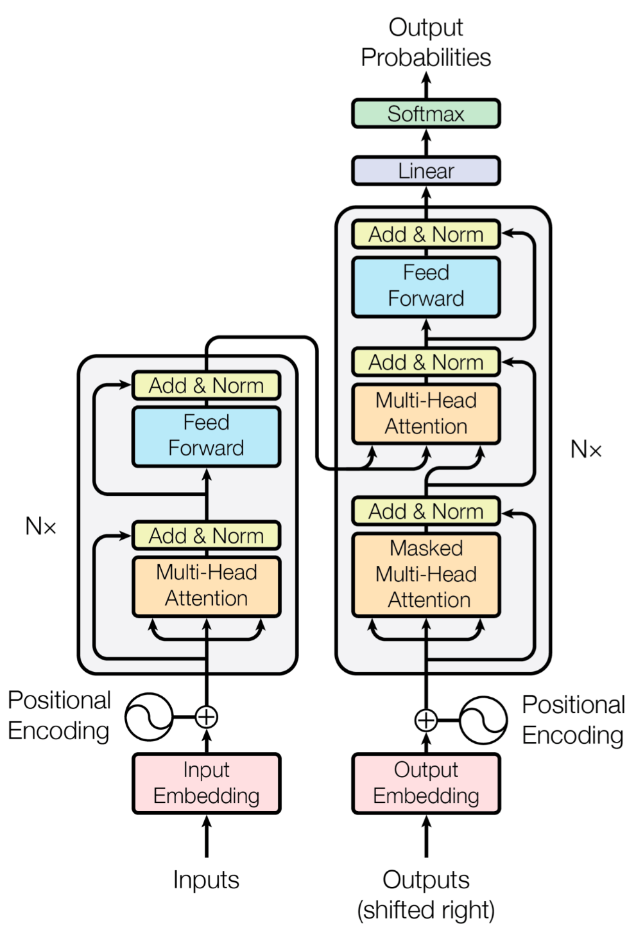
Structure: Transformer-based Models
Pre-training approaches
BERT: Maskd LM & Next Sentence Prediction
RoBERTa:
Trained on More Corpus (WikiText103, BookCorpus, CCNews)
Trained with Bigger batch sizes
6

Slide 9
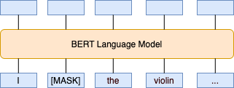
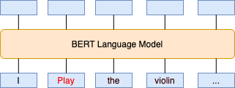
Masked Language (Masked LM)
Masked LM
6

Slide 10
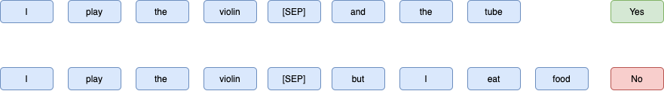
Next Sentence Prediction (NSP)
NSP
6

Slide 11
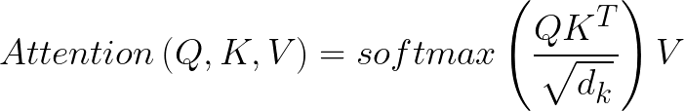
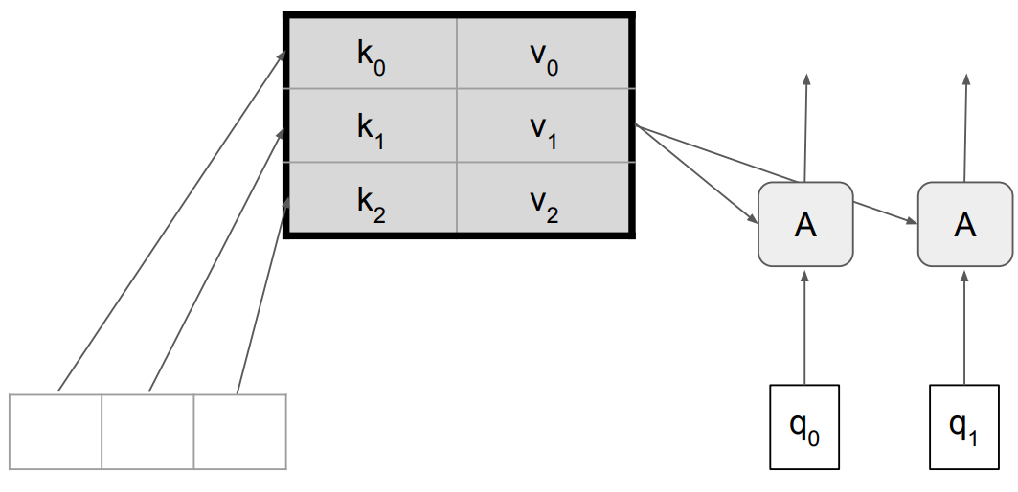
Attention Mechanism
Scaled Dot-Product Self Attention
7

Slide 12
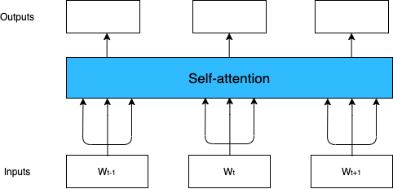
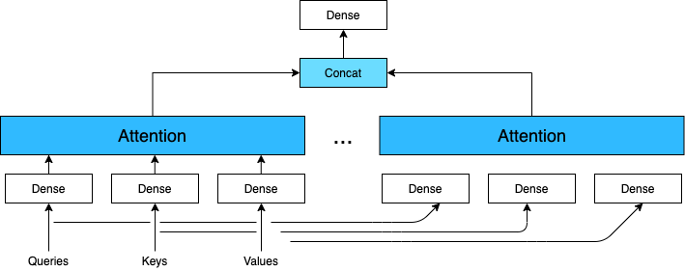
Attention Mechanism
Scaled Dot-Product Attention
Multi-Headed Attention
8

Slide 13
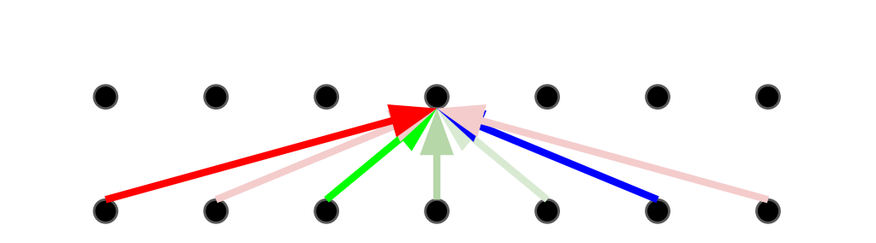
Attention Mechanism: The Fix – Multi-Headed Attention
Multi-Headed Attention
Multiple attention layers (heads) in parallel (shown by different colors)
Each layer uses different linear transformations.
Different heads can learn different relationships.
9

Slide 14
Problems with Attention Mechanism
Too many heads -> Hard to process queries from multiple positions
in parallel.
Valid heads are unknown
Processing with “Valid heads” problem: We propose EDM-RoBERTa to optimize the attention process
10

Slide 15
Optimization
Single-headed Attention RNN (SHA-RNN)
Boom Layer
Activation Function: Gaussian Error Linear Units (GELUs)
Models: BERT, RoBERTa, DistilBERT, XLNet
Solving the short-term dependency problem from Transformer-based Models
11

Slide 16
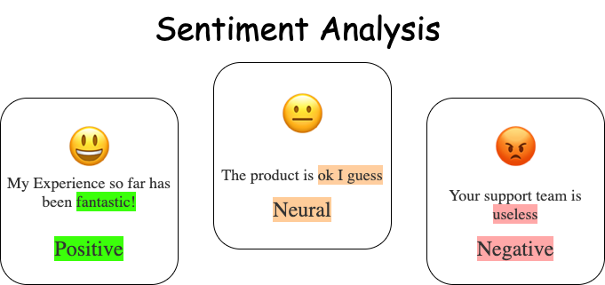
Optimization: Sentimental Ambiguity
11

Slide 17
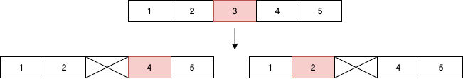
Optimization: Sentimental Ambiguity
Why using both two-dimensional and multi-dimensional sentiment analysis datasets
to train EDM-RoBERTa ?
Deal with the sentences with sentimental ambiguity
11

Slide 18
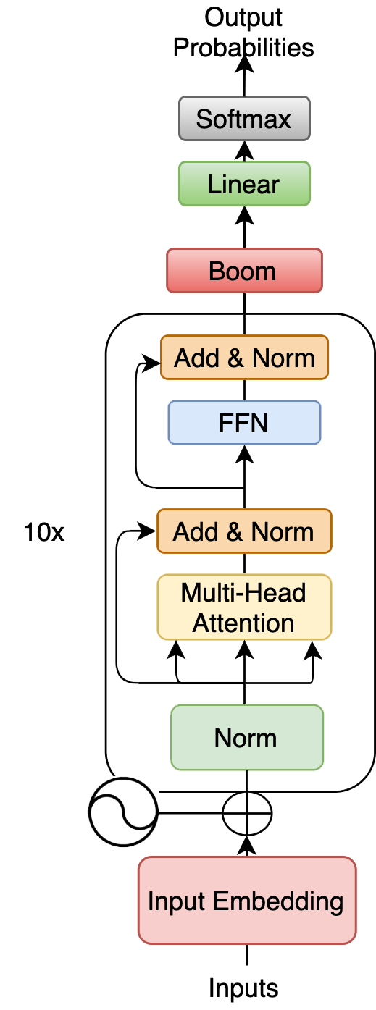
Improved Learning Model: EDM-RoBERTa
Choose the best-performed model: RoBERTa
Optimize the RoBERTa model with Boom Layer
Enhancing the Dependency Mechanism of RoBERTa
12

Slide 19
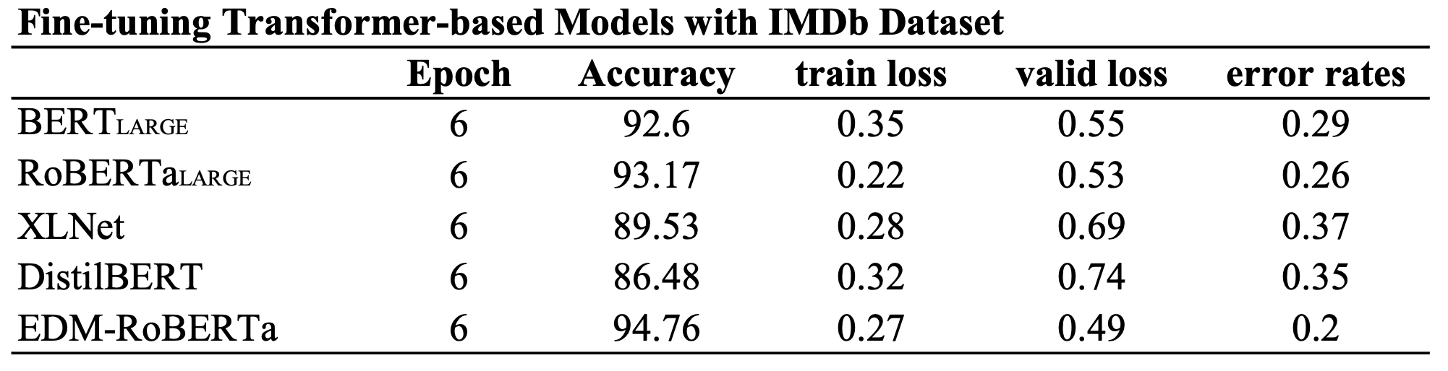
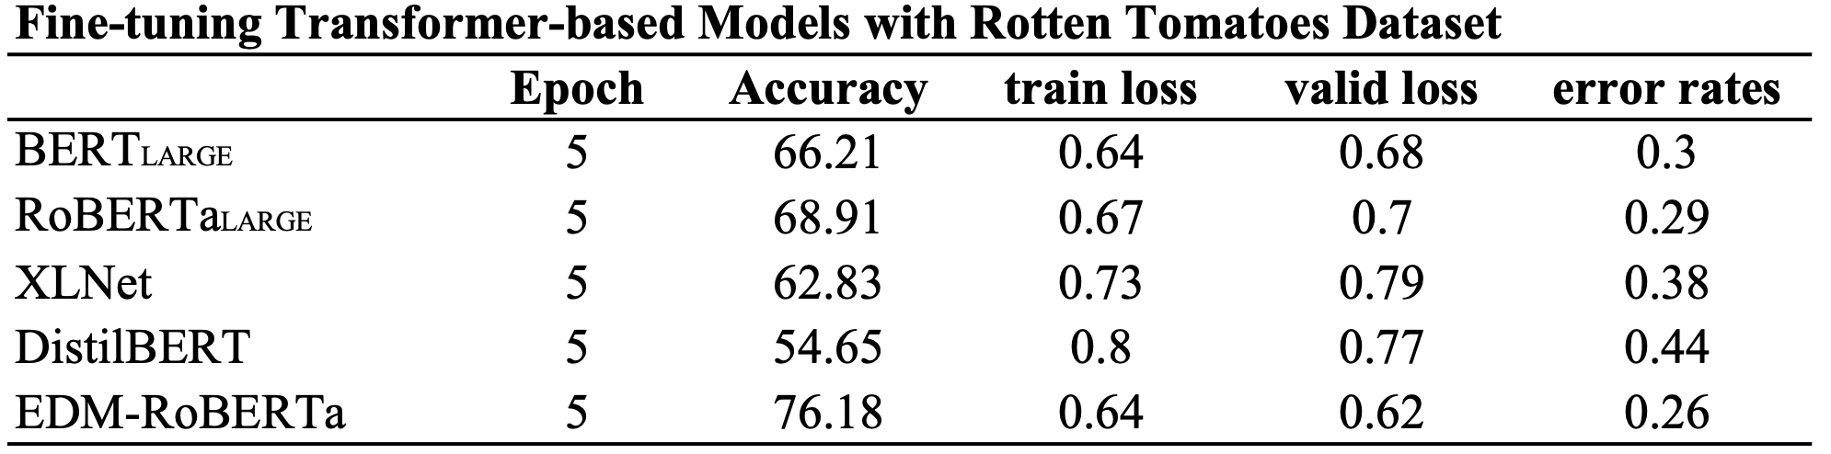
Optimization: Statistics
13

Slide 20
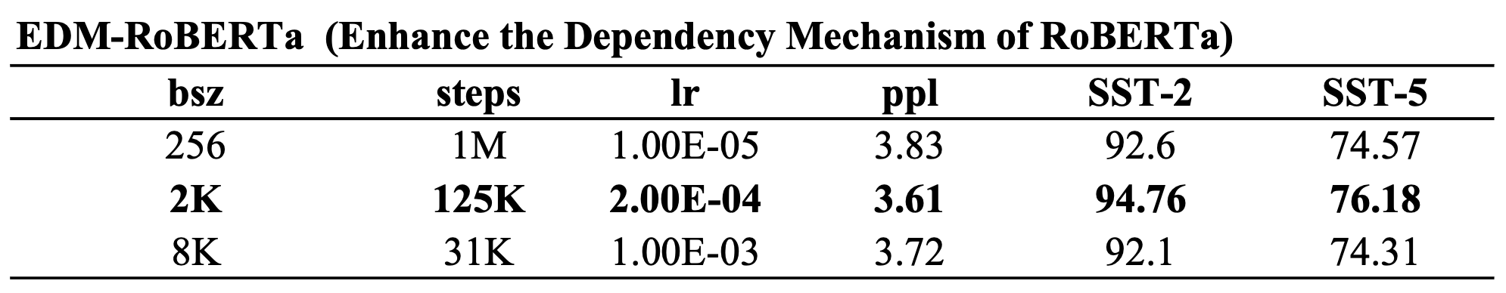
EDM-RoBERTa: Enhancing the Dependency Structure of RoBERTa
Detailed parameters of EDM-RoBERTa
14

Slide 21
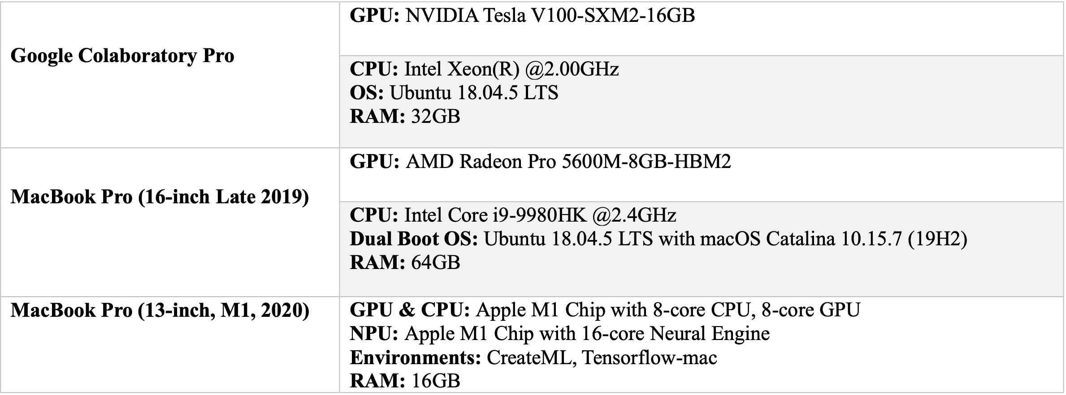
Runtimes & Environments
15

Slide 22
Conclusions
We introduced a language representation model called EDM-RoBERTa.
EDM-RoBERTa is designed to improve the dependency mechanism, and fine-tune the whole
model with sentiment analysis datasets.
Experiments and statistics show our proposed model successfully enhance the dependency
mechanism on local context.
EDM-RoBERTa outperforms conventional pre-trained models, including Seq2Seq, BERT, RoBERTa, XLNet, and DistilBERT.
16

