Slide 1
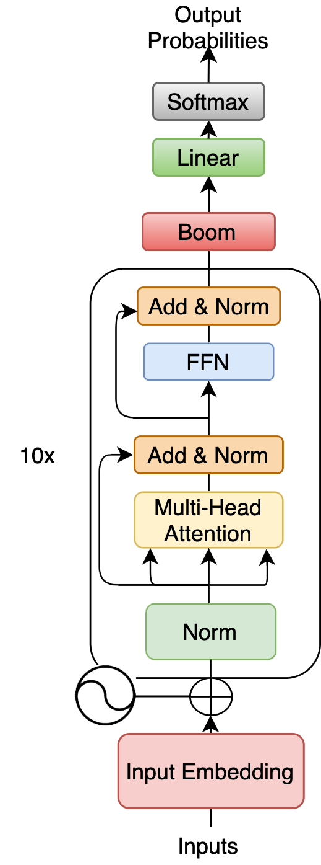
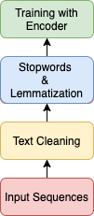

Enhancing the Dependency Mechanism of RoBERTa
指導教授 : 張炎清 教授
專題組員 : 李昱廷、郭為軒、曹仲辰、
吳岳霖、林裕峰
Abstract
EDM-RoBERTa
(Enhance the Dependency Mechanism of RoBERTa)
Our proposed model, EDM-RoBERTa, uses the Boom Layer to improve the multi-headed attention
mechanism in the encoder of Transformer model.
Compared with the original Transformer and
SHA-RNN models, the reorganization of Boom
Layer and RoBERTa can meet both long and short input text sequences, and keep the original long-term dependency of Transformer. In the calculation process, it can also reduce the amount of calculation, thereby improving the accuracy and performance on text classification.
Architecture
The research source are Transformer-based models (BERT, RoBERTa, XLNet, DistilBERT), SHA-RNN, and the self-attention mechanism in the Transformer as the main structure. The Boom Layer of SHA-RNN is transformed to realize the attention mechanism for high-dimensional vector convertion and then improve the multi-headed attention mechanism in the encoder of Transformer.
Result
Fine-tuning Transformer-based Models with IMDb Dataset
Conclusions
The results shows that our EDM-RoBERTa model obtains more accurate prediction results than the original Transformer model on word meaning analysis output, and thereby improving the short-dependency in the encoding process.
The results will also be applied to other natural language sentiment analysis tasks such as sentiment analysis and social network analysis.
Fine-tuning Transformer-based Models with
Rotten Tomatoes Dataset
中山醫學大學醫學資訊學系 專題編號 PRJ2020-002

