Slide 1
Sigma Cabs Surge Pricing Data Story

Slide 2
Sigma Cabs
Indian cab aggregator service operating for nearly a year
Smartphone app empowers customers to easily book cabs and access best options through surge pricing data
In-depth analysis conducted on surge_pricing_type data to enhance understanding of market dynamics

Slide 3
Data Dictionary
Trip_ID: ID for TRIP
Trip_Distance: The distance for the trip requested by the customer
Type_of_Cab: Category of the cab requested by the customer
Customer_Since_Months: Customer using cab services since n months; 0 month means current month
Life_Style_Index: Proprietary index created by Sigma Cabs showing lifestyle of the customer based on their behaviour
Confidence_Life_Style_Index: Category showing confidence on the index mentioned above
Destination_Type: Sigma Cabs divides any destination in one of the 14 categories.
Customer_Rating: Average of life time ratings of the customer till date
Cancellation_Last_1Month: Number of trips cancelled by the customer in last 1 month
Var1, Var2 and Var3: Continuous variables masked by the company. Can be used for modelling purposes
Gender: Gender of the customer
Surge_Pricing_Type: Target (can be of 3 types)

Slide 4
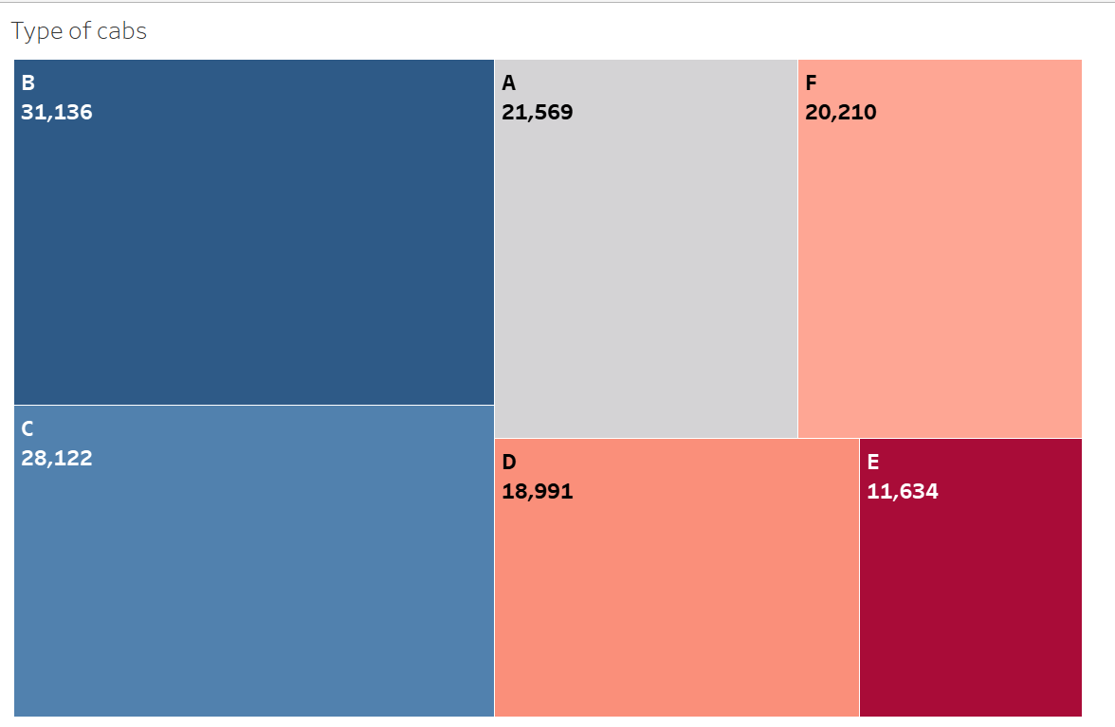
Cab type “B” is the most often booked for the cab services
Followed by type "C", "A" & "D".
Cab E is considerably low when compared.

Slide 5
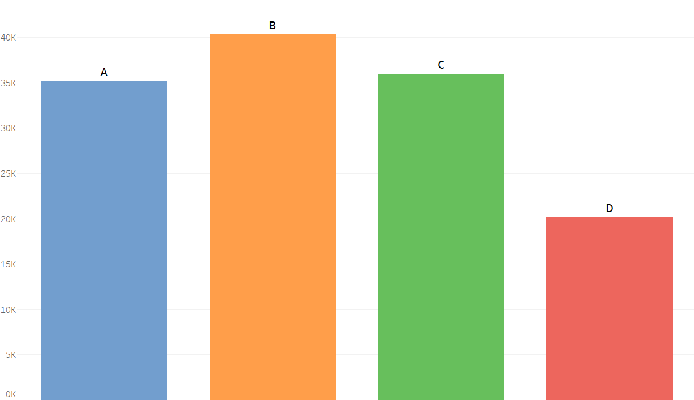
“B” type Confidence life style index is more
While the other types "A" and "C" are also almost equal to the type B.
The "D" type which we considered for the null values is significantly low which is a good sign.

Slide 6
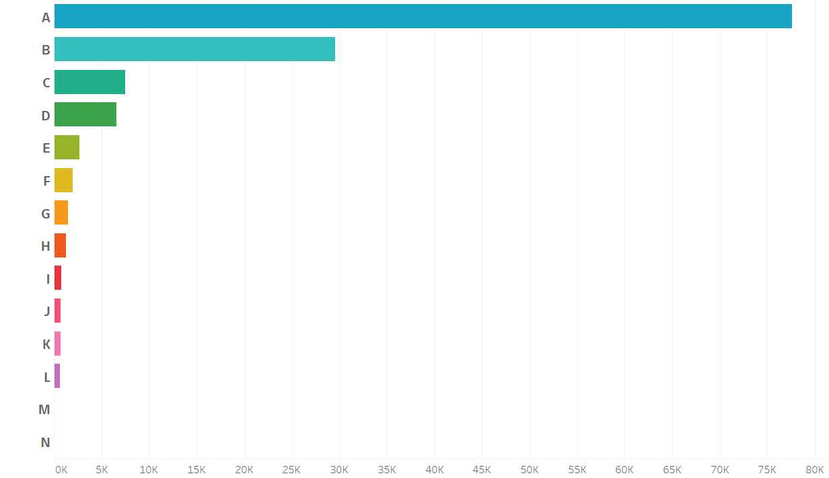
More than 50% of cabs are being booked for destination “A”
Even though it is followed by type "B" the number is significantly very low compared to type A destination.
While all the number of trips booked for other destinations are very low.

Slide 7
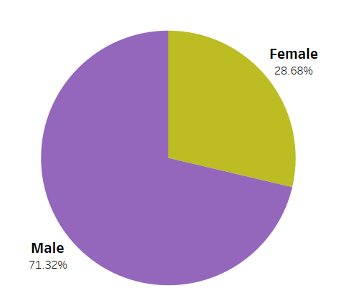
More than 70% of cab service users are Male
71 % cab service users are Male
While female cab users are only about 28%

Slide 8
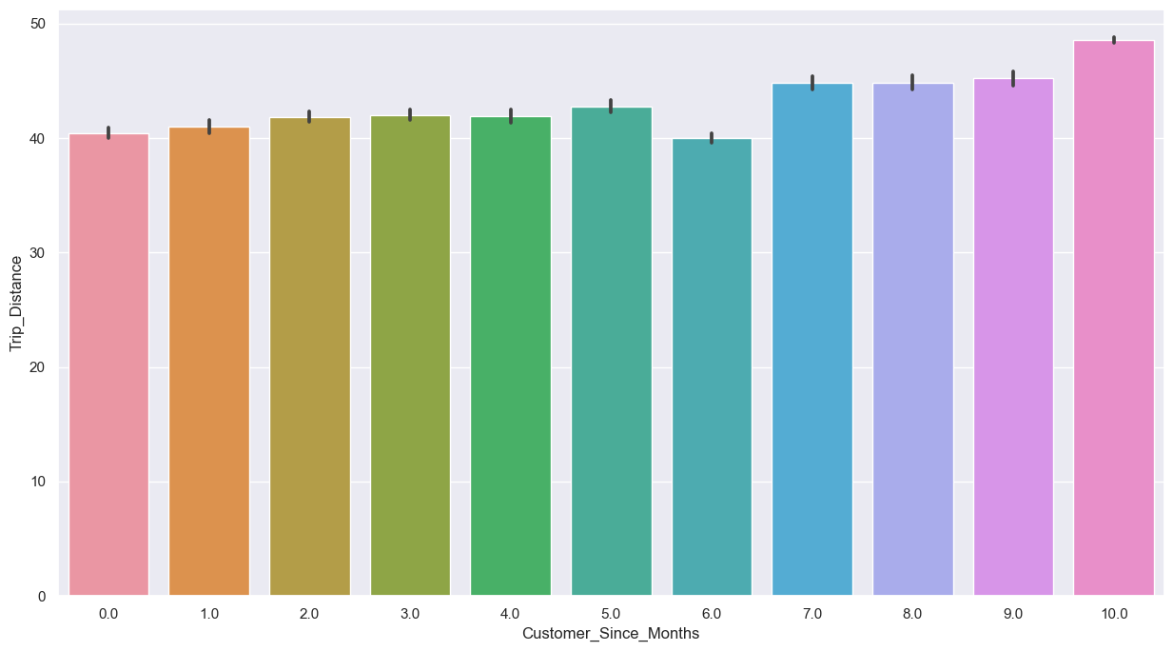
The trip distance does not count for a user being customer for months.
As we can see the distance covered is almost similar for all the months associated.
The one who are associated for more then 6 months, their trip distance can be seen a little higher than others but that too its not any significant difference.

Slide 9
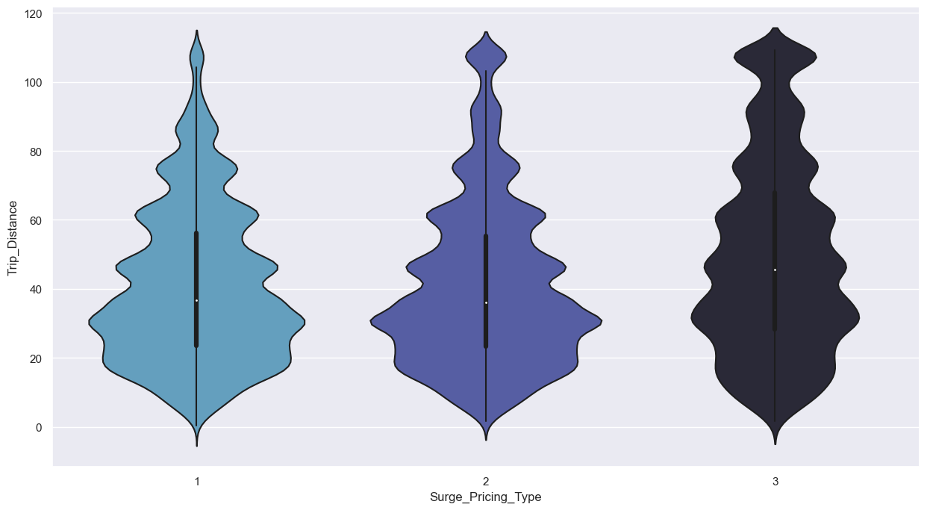
Below 40KM, the surge pricing type is maintained between 1 to 2
Whereas for distance above 50KM, the surge pricing increased to type 3
We can also observe that surge pricing type is given based on the distance of the trip being booked
Key Note: Surge pricing can be classified into 3 types based on distance as follows: Below 40KM - Type 1 || Between 40KM to 50KM - Type 2||
Above 50Km - Type 3

Slide 10
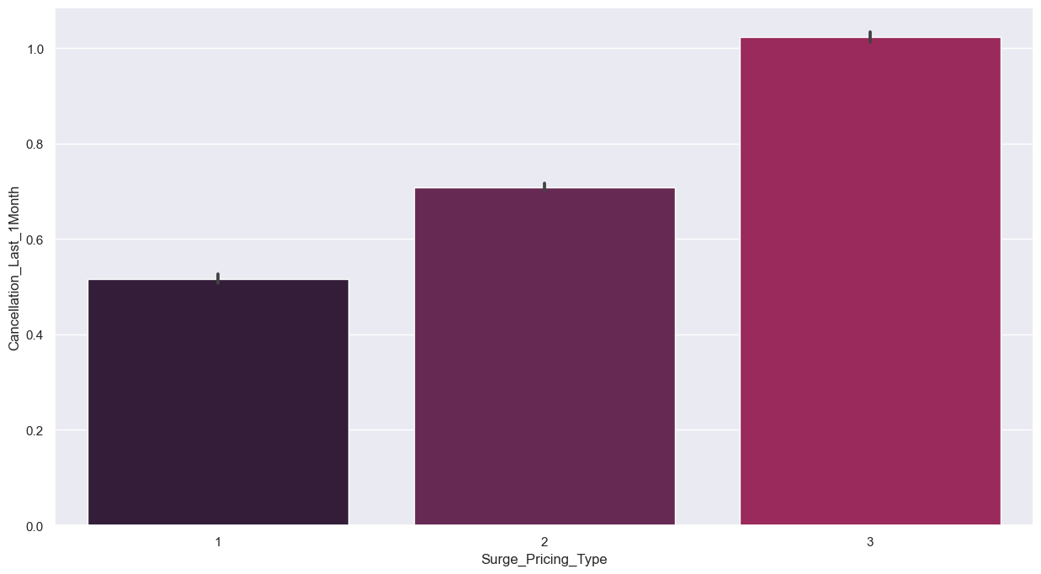
Cancellations are comparatively high due to surge pricing of type “3”
For surge pricing of type 1, the cancellations are around 0.5
For type 2 , the cancellations are around 0.7
For type 3, the cancellation are very high reaching a bit greater than 1
Key Note: Surge pricing can be classified into 3 types based on distance as follows: Low, Medium & High for Type 1,2 & 3 respectively.

Slide 11
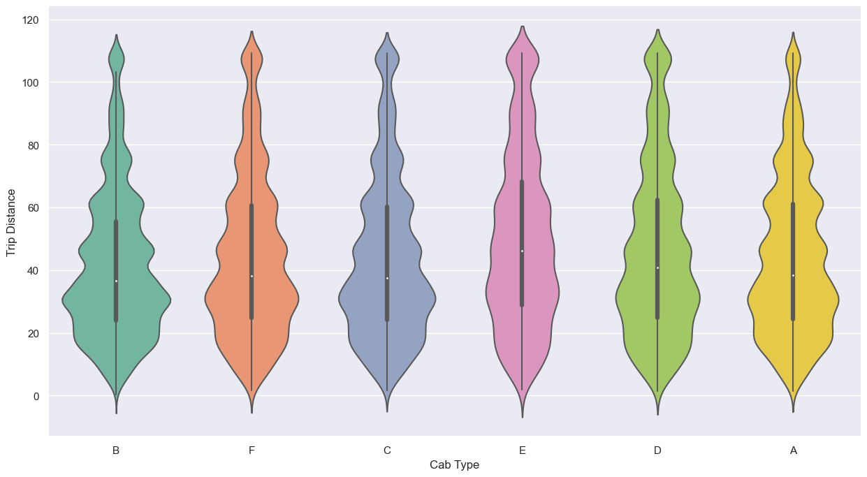
Trip count for Cab E is less due to high cancellation for long distances
Cab E is most frequently being booked for long distances
For trips of long distances, there is high surge pricing being included due to which it has higher cancellations
So, the trip count for cab E is being very less comparatively

Slide 12
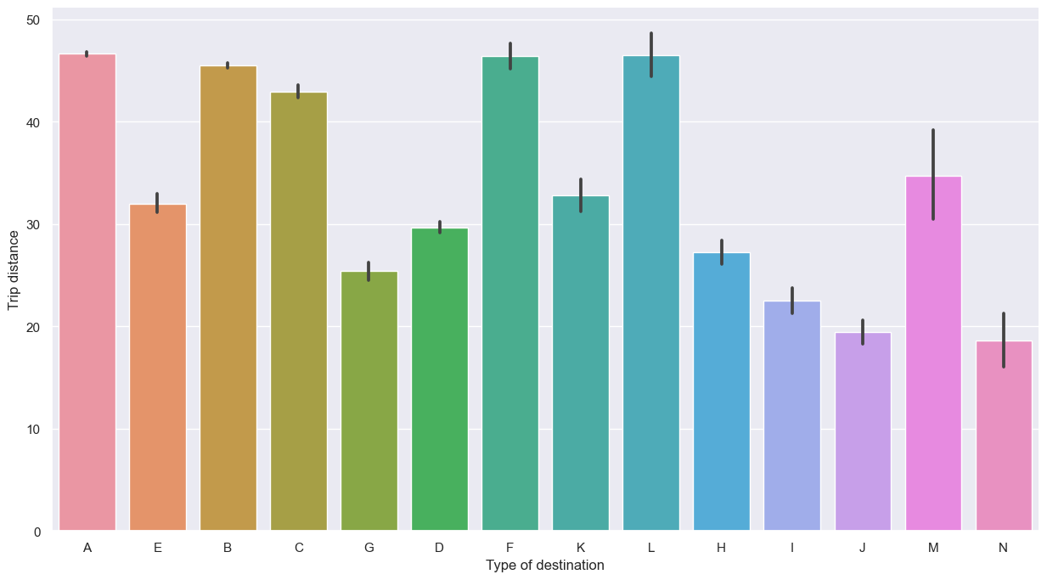
Destination A is more than 40KM trip distance
We have seen that most of the trips from data are been booked for Type "A" destination.
We can observe for all other destination types, the trip distance is around or below 30KM.In our data, majority of the trips are for greater than 40KM.
So, for destinations more than 40Km trip distance, the trip count is more

Slide 13
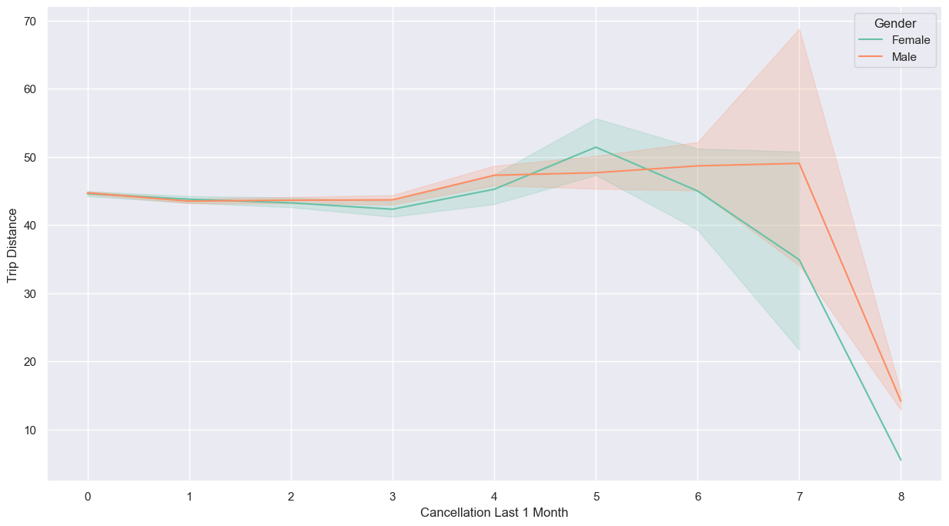
Female cab service users have higher cancellations
It seems that majority of the females using the cab services are cancelling the most.
It can also be seen that they are booking the cabs mostly for distances below 40KM. Very few cabs are booked for long distances.

Slide 14
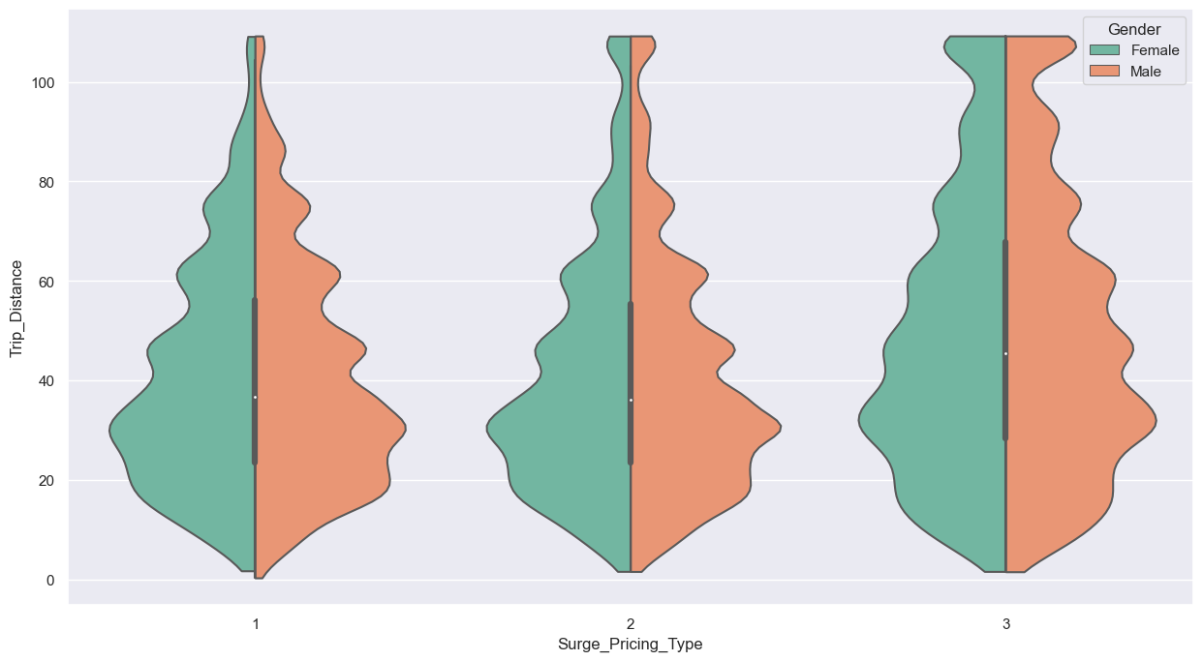
Female customers are frequently opting for cab services for trip distance below 40KM
Only a few cabs are being booked for long trip distance by female

Slide 15
Key Take Aways
Surge Pricing Impact on Cancellations:
High surge pricing (>50KM) correlates with increased cancellations, indicating customer reluctance.
Unusual trend: Some 40-50KM trips with low surge (type 1) also experience high cancellations, suggesting dissatisfaction.
Long-Distance Trips and Cab Preference:
High surge pricing deters long-distance bookings, especially for E type cabs, leading to reduced trip counts.
Trips beyond 40KM see a surge in bookings, hinting at consistent demand for these longer journeys.

Slide 16
Key Take Aways
Gender Discrepancy in Cancellations:
Female passengers exhibit higher cancellation rates, likely due to dissatisfaction with added surge prices, emphasizing the need for fair pricing strategies.
Short-Distance Bookings and Demand:
Minimal bookings for trips under 30KM highlight a potential market gap, indicating an area for business growth and improved customer engagement strategies.

Slide 17
THANK YOU

