Slide 1

Inventory System
John Rix Domaoal Mercy Alcaide Yvonne Kate Banigan

Slide 2
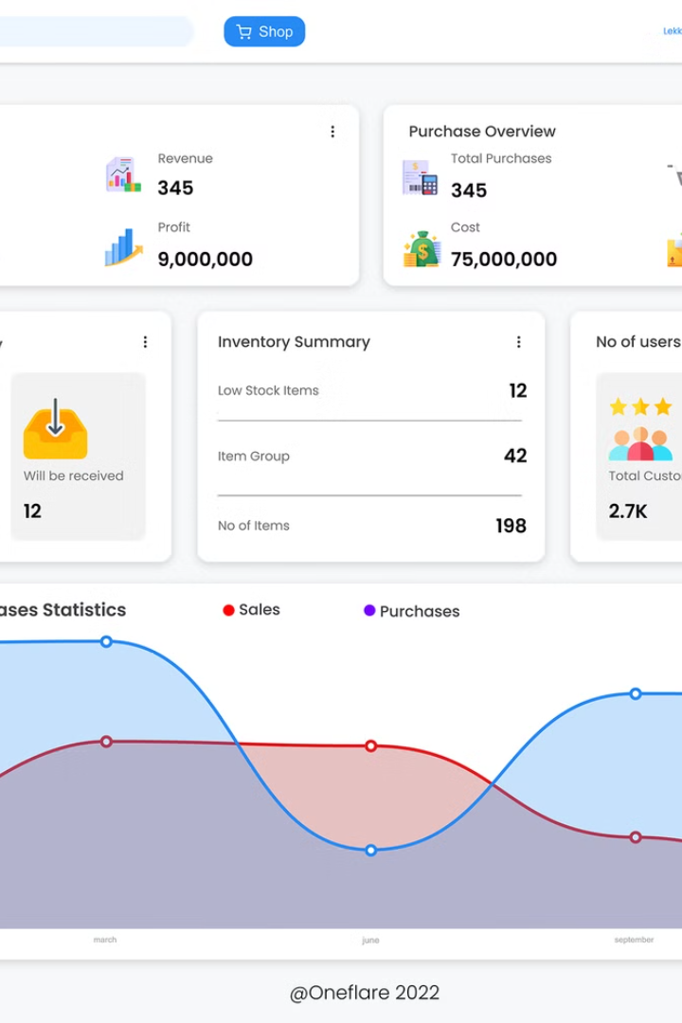
Inventory System
This presentation highlights a comprehensive inventory system designed for efficient business operations. It features secure login and registration capabilities, allowing users to access and manage their accounts reliably.
The system facilitates product management through functionalities to add, edit, and delete products. Additionally, it supports advanced features to search for items quickly and export product data as CSV files, enhancing data portability and reporting.

Slide 3
User Authentication: Login and Registration
Login Feature
Registration Process
The login function ensures secure access by validating user credentials against stored data. It supports standard error handling for invalid inputs and maintains session integrity throughout usage.
Users can create new accounts by providing necessary information including username, and password. The system enforces password complexity and uniqueness of user identifiers for security.

Slide 4
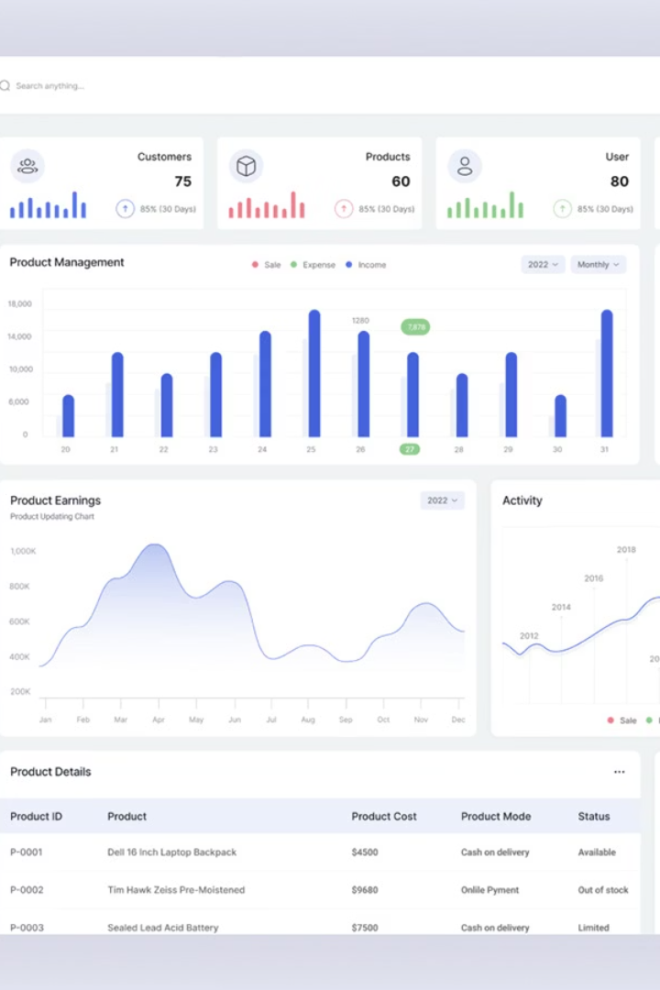
Product Management: Add and Edit Products
Add Product
Users can input product details such as name of the product, quantity, unit, and price. The system validates inputs to prevent duplicates and inconsistencies.
Edit Product
The edit function allows updating product information dynamically, supporting accurate inventory tracking and corrections as needed.

Slide 5
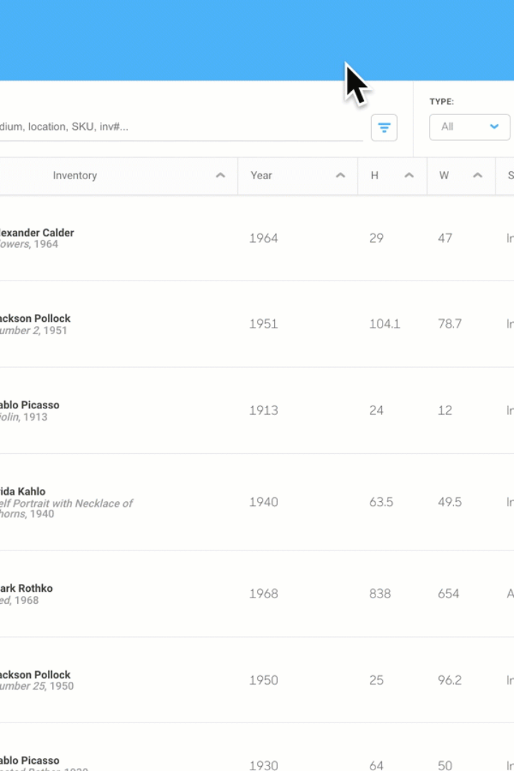
Product Management: Delete Products
Safe Deletion Protocols
The system incorporates confirmation prompts to prevent accidental deletions and it has a confirmation for deletion
Impact on Inventory
Deleting a product updates stock records and reflects changes across the system, ensuring real-time accuracy of inventory data.

Slide 6


Search Functionality
Efficient Search
Users can locate products using keywords, Name of the product, or the ID significantly reducing lookup time.

Slide 7
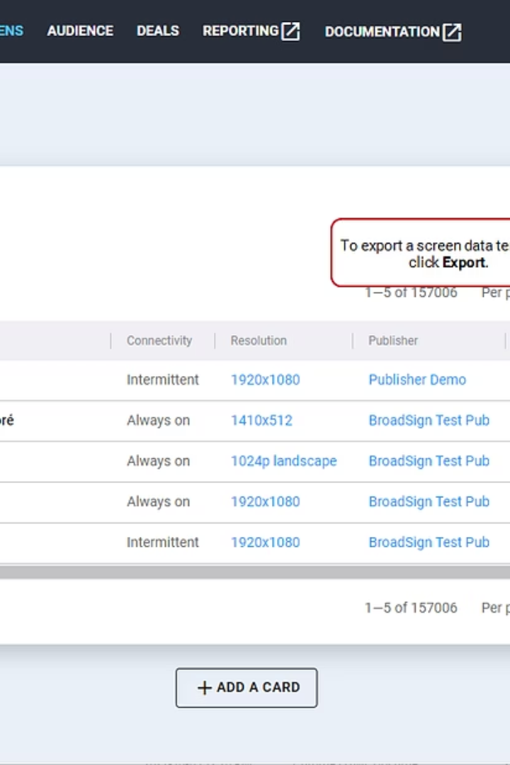



Export Products to CSV Feature
Data Export
Users choose to export the entire product list with up-to-date information.
CSV Format
The system converts data into comma-separated values, compatible with spreadsheet software and data analysis tools.
Download and Sharing
Once exported, users can download the CSV file for reporting, sharing, or backup purposes.

Slide 8
System User Interface Design
Responsive Layout
The interface adapts to various devices, ensuring seamless user experience on desktops, tablets, and mobile devices alike.

Slide 9

Security and Data Integrity
1
User Authentication
2
Data Validation
Robust password policies and secure sessions protect user data from unauthorized access.
Input validation prevents data corruption and ensures reliable inventory records.
3
Password Encryption
User passwords are encrypted using secure hashing algorithms to prevent exposure in case of data breaches.

Slide 10

Conclusion
The Inventory Management System provides secure login and registration, ensuring that only authorized users access the platform.
It allows users to add, edit, and delete products, offering full control over the inventory database.
The CSV export feature enables easy backup and external use of product data.
The real-time search functionality helps users quickly locate specific products.
Overall, the system is user-friendly, efficient, and scalable, making it ideal for both small businesses and larger operations.

