Slide 1

Final Software Project Student Course Registration System
By Wendy Diershaw
CST499 Capstone for Computer Software Technology
Professor: Amr Elchouemi
June 4, 2021

Slide 2
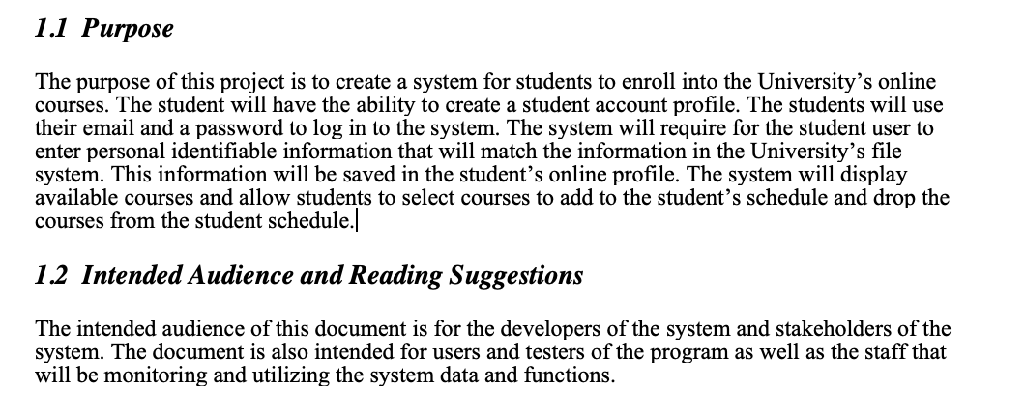
Software Requirements Specification Overview

Slide 3
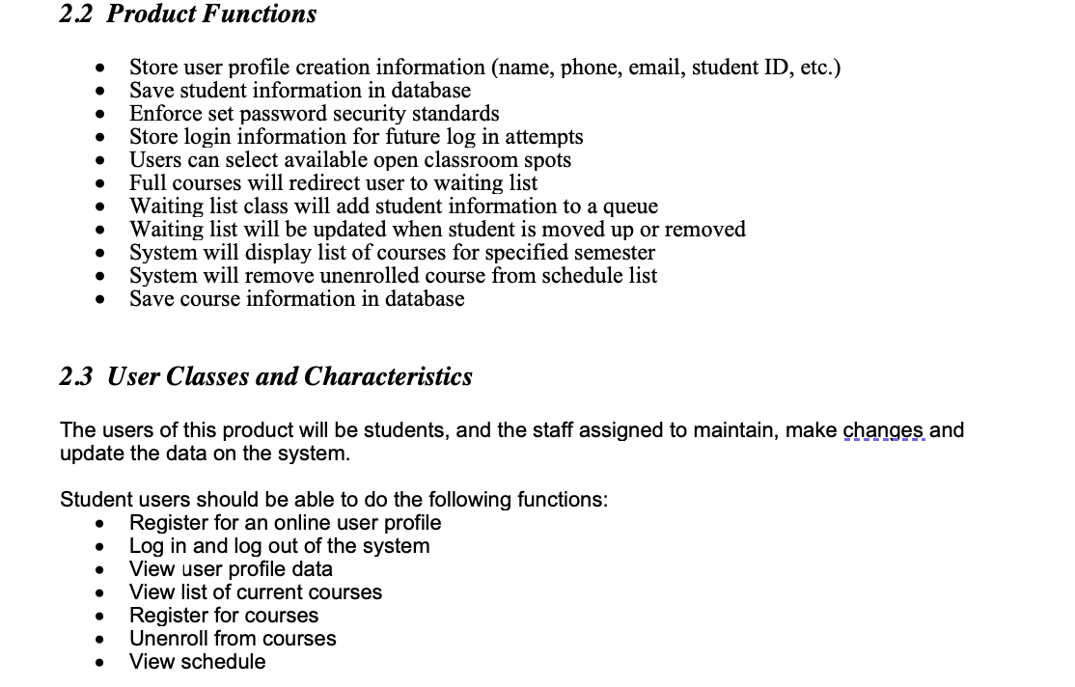
Software Requirements Specification Overview

Slide 4
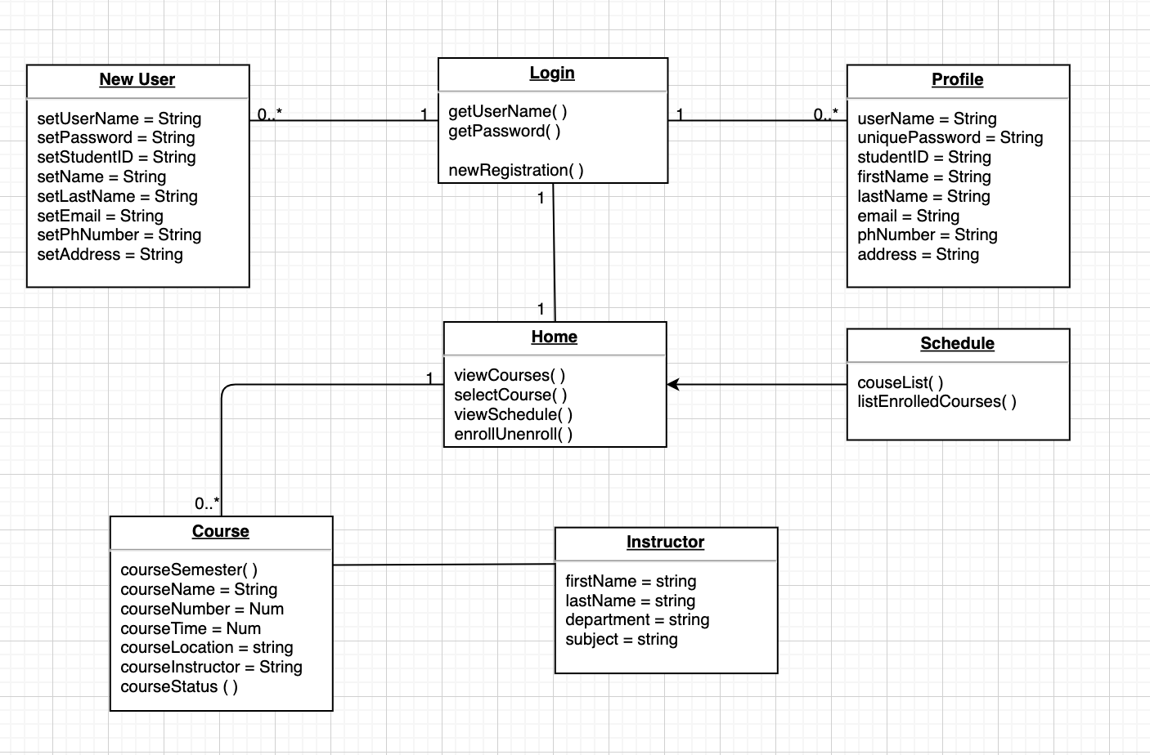
UML Models
Class Diagram

Slide 5
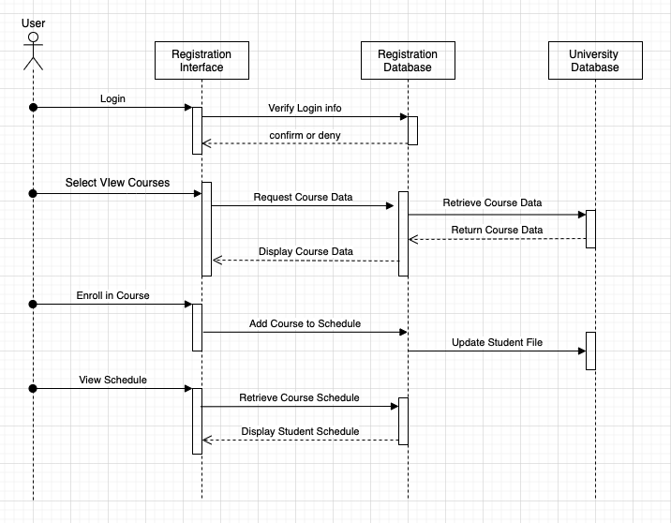
Sequence Diagram

Slide 6
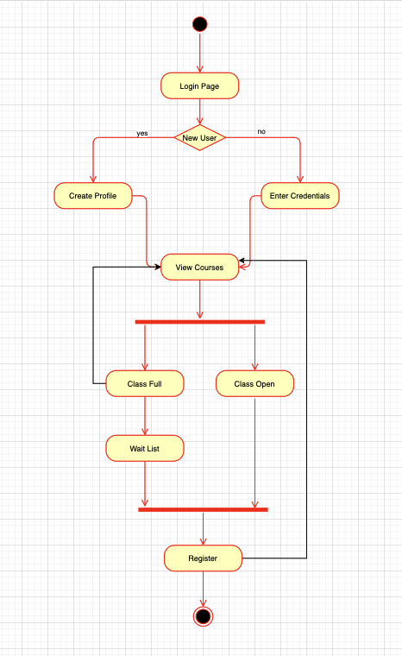
Activity Diagram

Slide 7
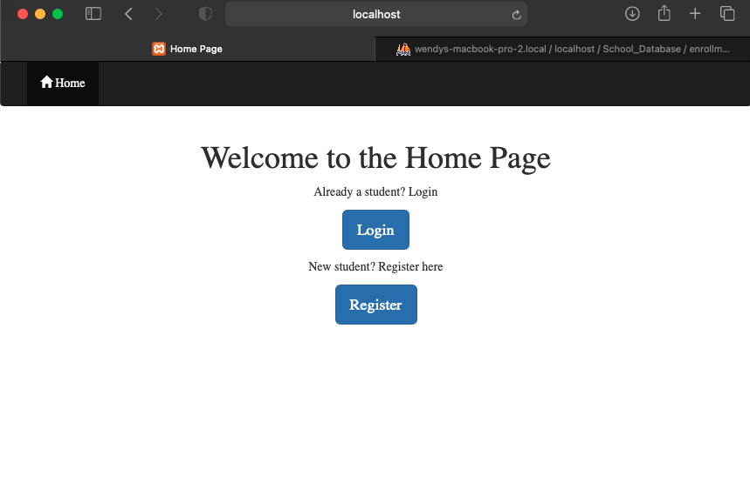
Landing/Home Page

Slide 8
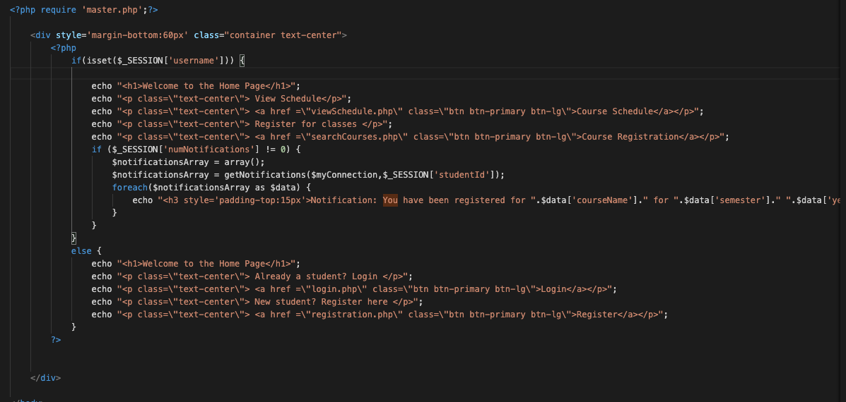
Homepage PHP Code

Slide 9
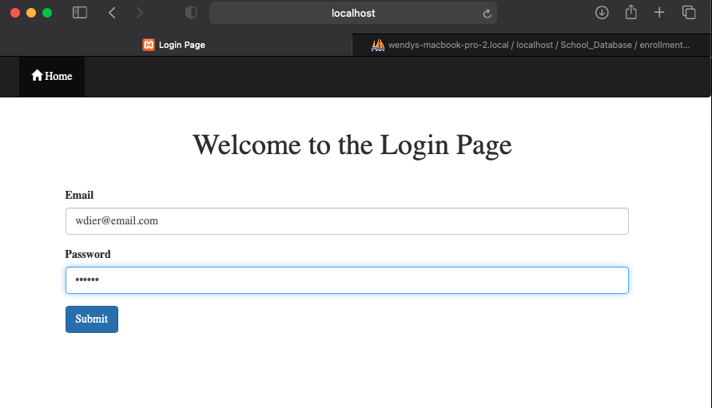
Login Page

Slide 10
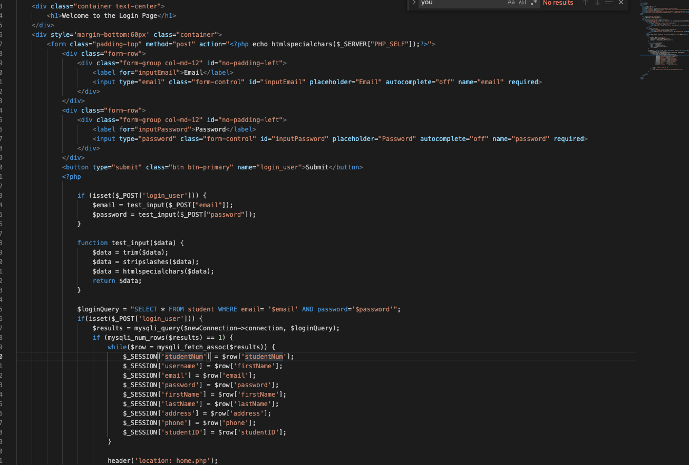
Login Page PHP Code

Slide 11
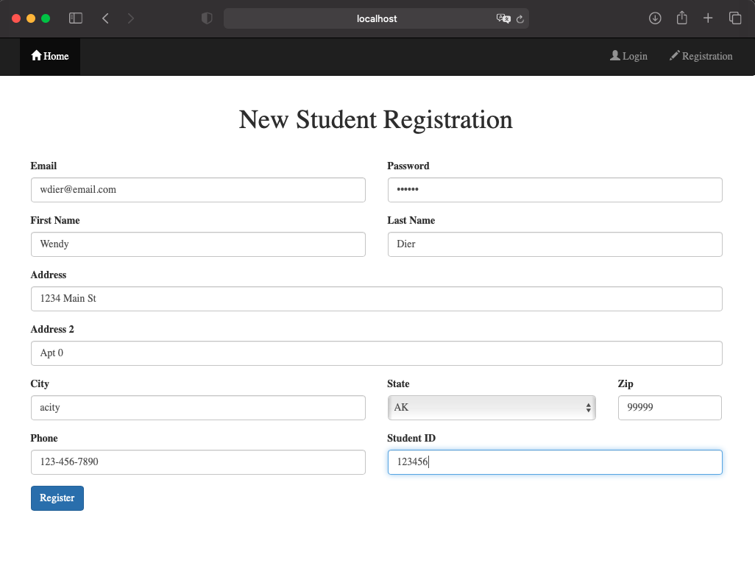
Registration Page

Slide 12
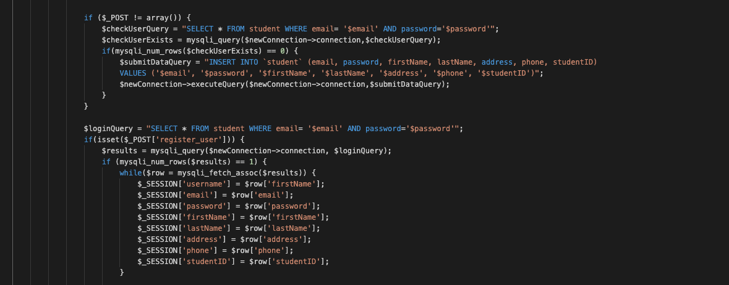
Registration PHP Code Snippet

Slide 13
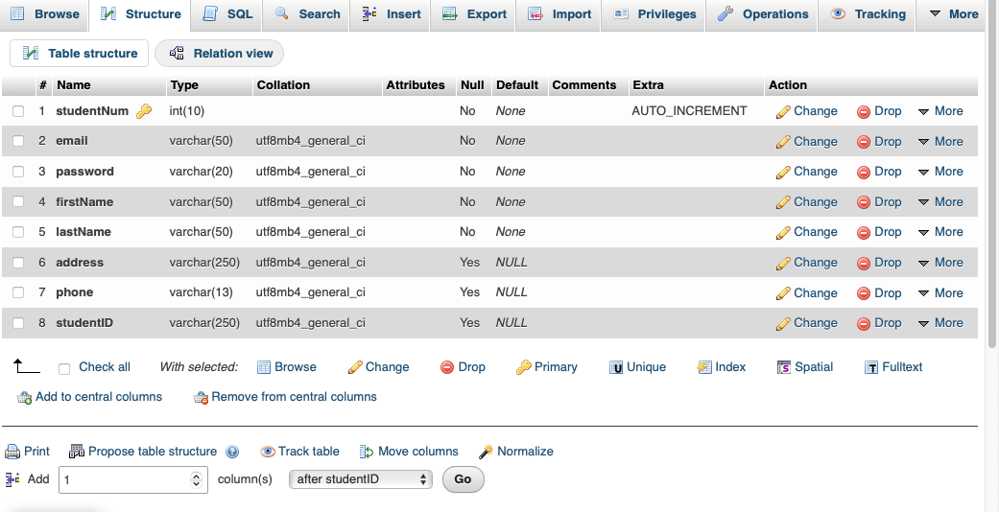
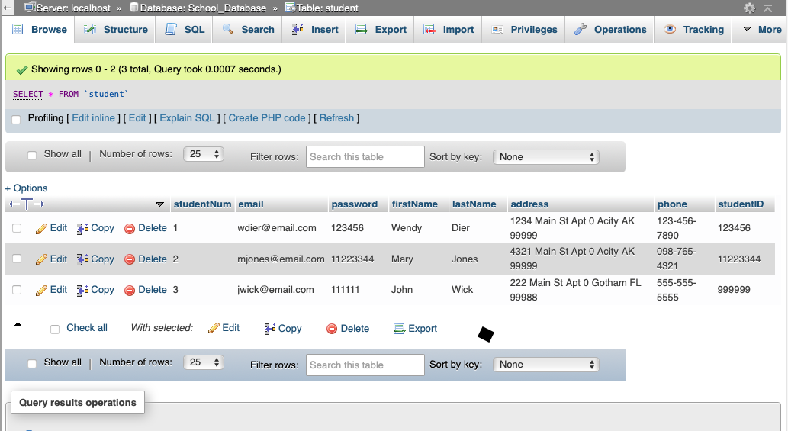
Student SQL Tables

Slide 14
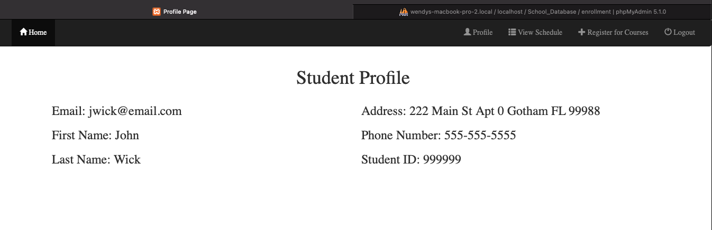
Registered User Profile

Slide 15
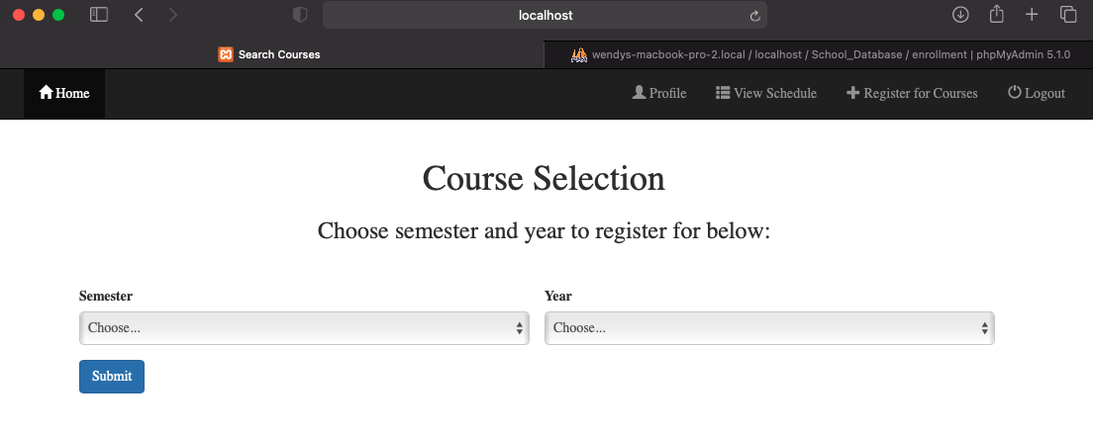
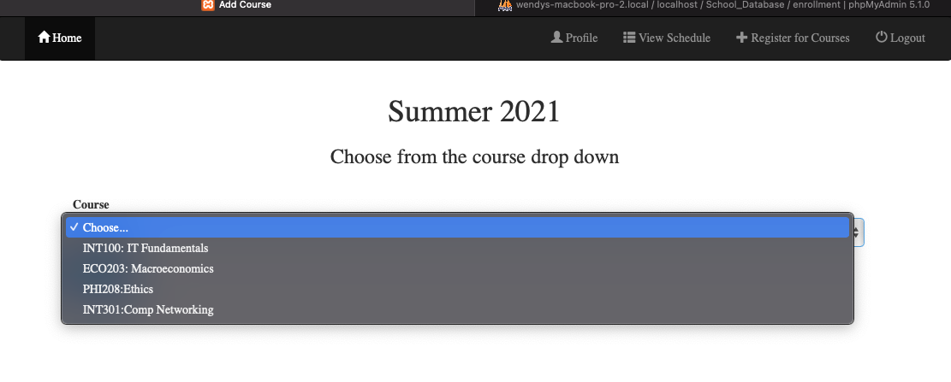
Course Enrollment Page

Slide 16
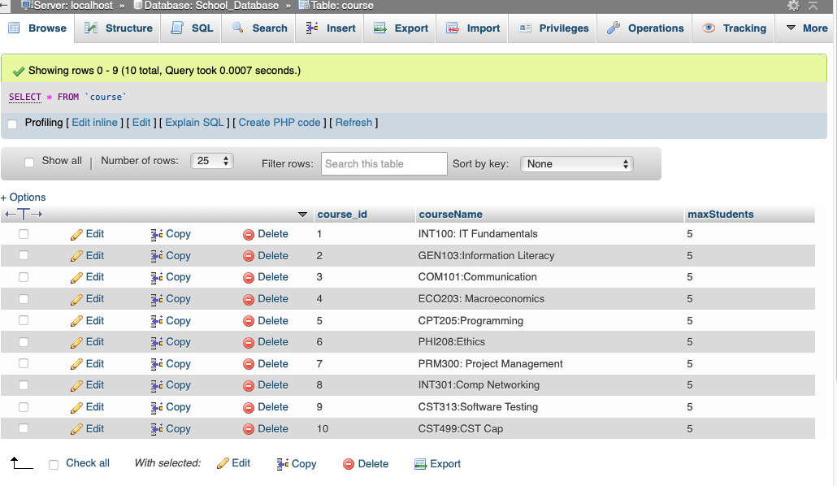
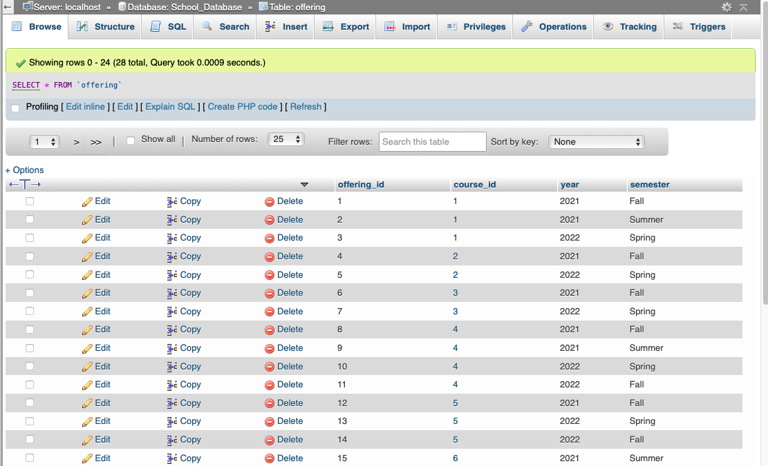
Course and Semester Tables

Slide 17
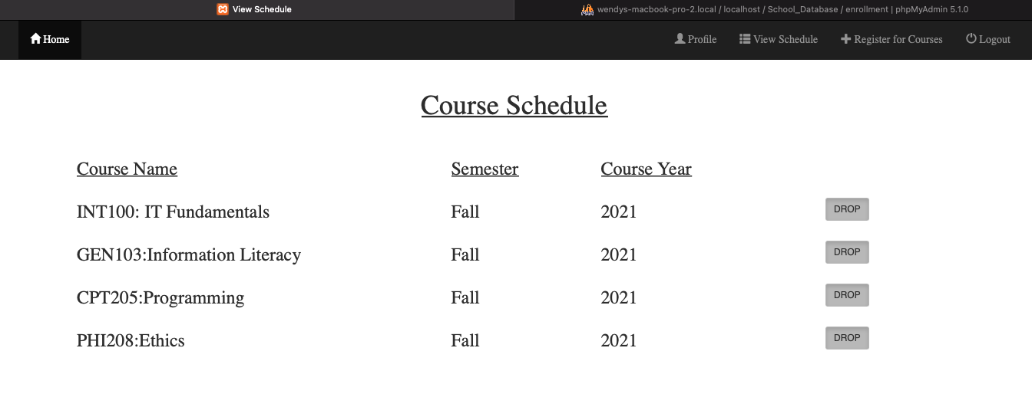
Student Schedule

Slide 18
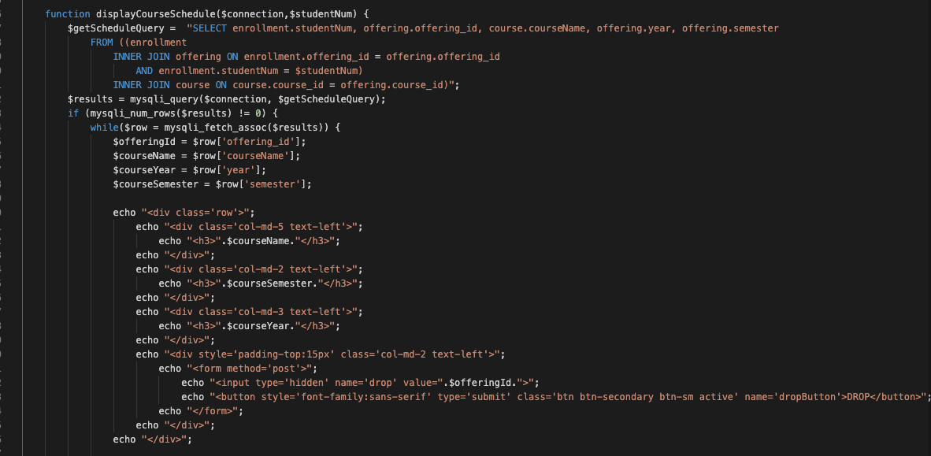
Student Schedule PHP Code

Slide 19
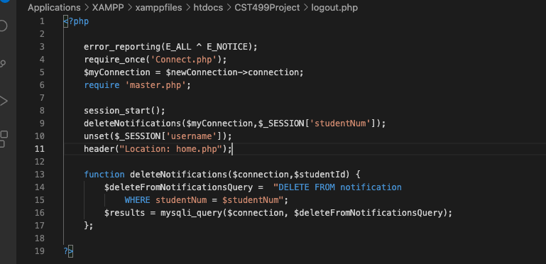
Log out

