Slide 1
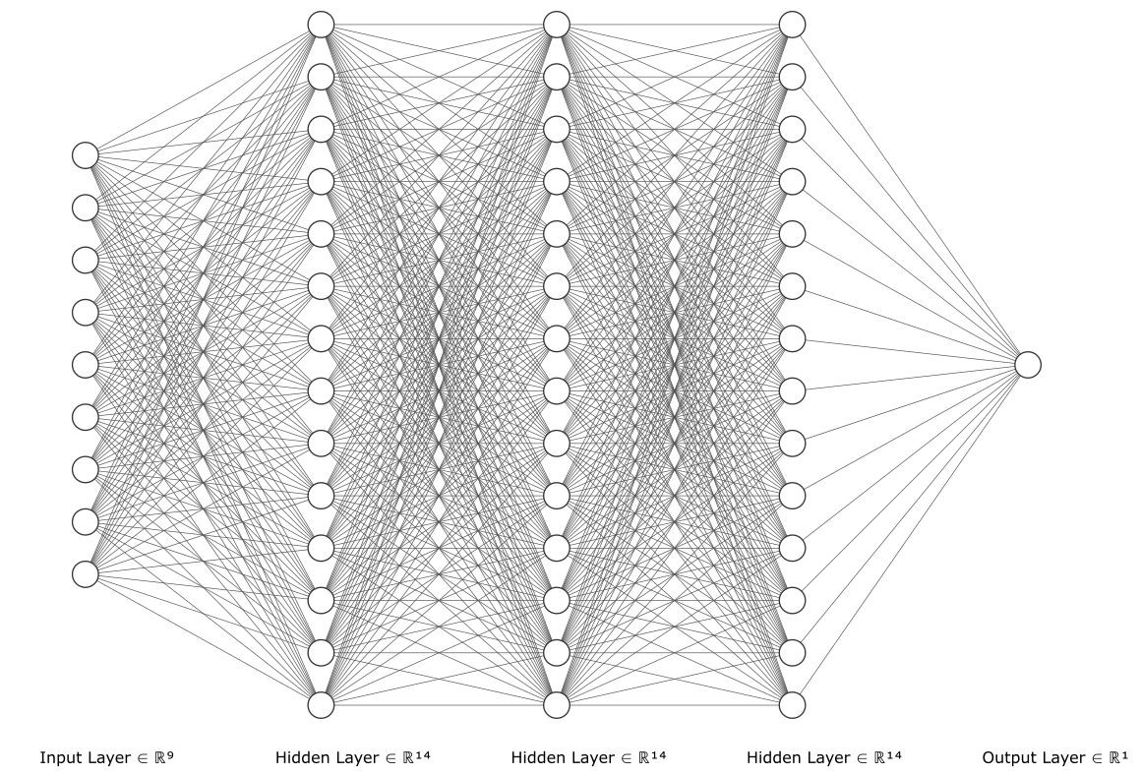
Load
Entrainment Velocity
Reduced Radius
Reduced Elastic Modulus
Pressure-Viscosity Coefficient
Central Film Thickness
Lubricant Viscosity
Lubricant Density
Poisson’s Ratio
Contact Length

