Slide 2
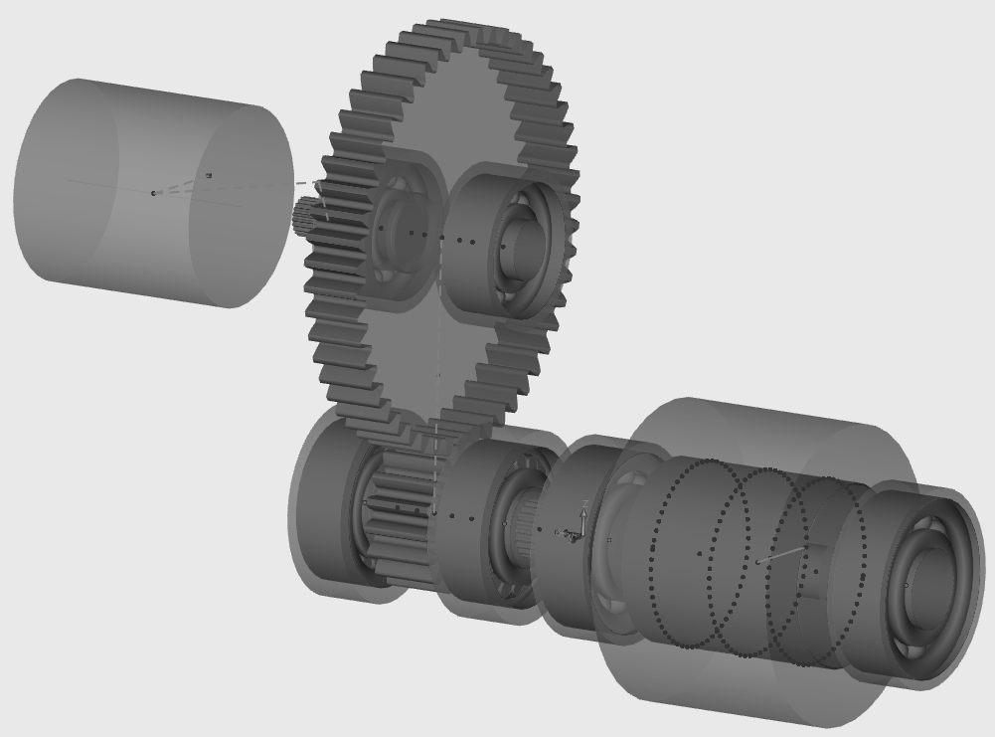
System Boundary
Gear
Pinion
Input Bearings
Motor

Slide 3
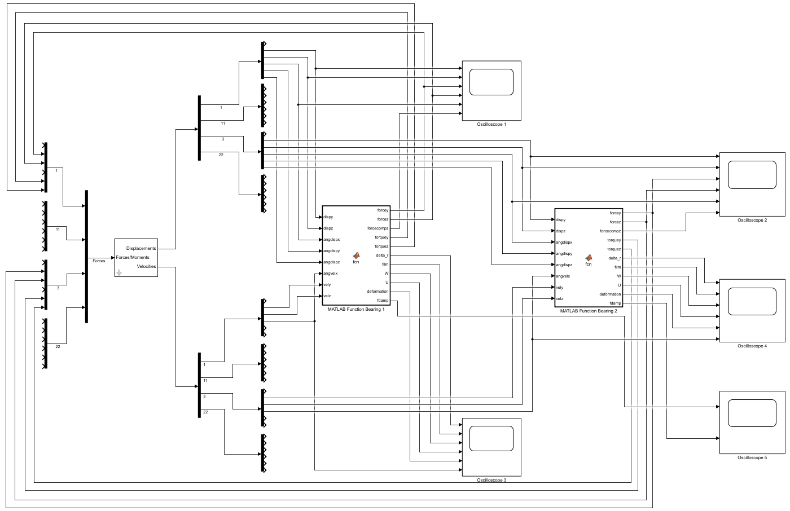
Degrees of Freedom
Output Ports
Lubricated Bearing Model
Input Port

Slide 4
DOF-1 | DOF-2 | DOF-3 | DOF-4 | DOF-5 | DOF-6
DOF-1 | DOF-2 | DOF-3 | DOF-4 | DOF-5 | DOF-6
… …
DOF-1 | DOF-2 | DOF-3 | DOF-4 | DOF-5 | DOF-6
pin - 1
pin - 2
pin - n

Slide 5
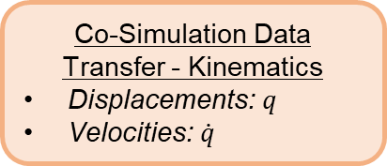
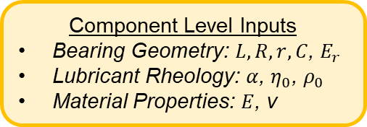
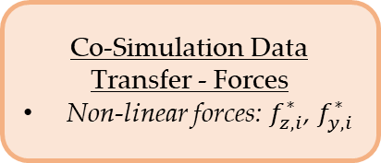
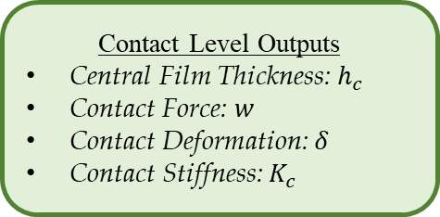
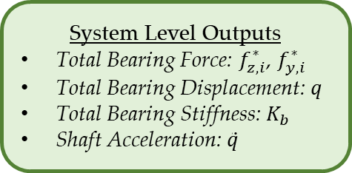
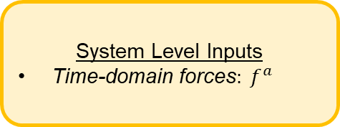
System Level Inputs
Time-domain forces$: f^{a}$
Component Level Inputs
Bearing Geometry: $L,R,r,C$, $E_{r}$
Lubricant Rheology: $α$, $η_{0}$, $ρ_{0}$
Material Properties: $E$, ν
Co-Simulation Data Transfer - Kinematics
Displacements: $q$
Velocities: $\dot{q}$
System Level FMBD Model:
AVL EXCITETM
Flexible bodies
Simulation control
Lubricated Component Level Bearing Model: MATLAB/Simulink
Lubricated Contact Mechanics
Co-Simulation Data Transfer - Forces
Non-linear forces: $f_{z,i}^{∗}$, $f_{y,i}^{∗}$
System Level Outputs
Total Bearing Force: $f_{z,i}^{∗}$, $f_{y,i}^{∗}$
Total Bearing Displacement: $q$
Total Bearing Stiffness: $K_{b}$
Shaft Acceleration: $\ddot{q}$
Contact Level Outputs
Central Film Thickness: $h_{c}$
Contact Force: $w$
Contact Deformation: $δ$
Contact Stiffness: $K_{c}$

Slide 6
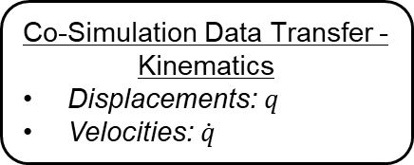
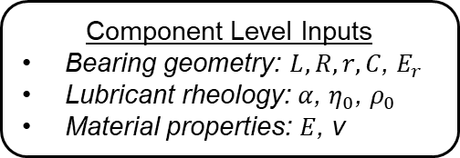
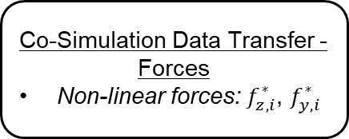
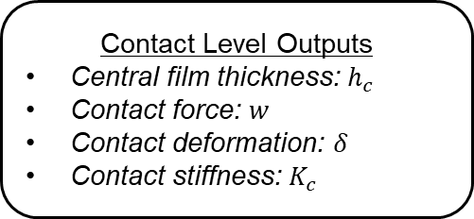
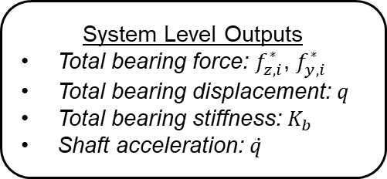
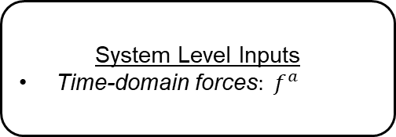
System Level Inputs
Time-domain forces$: f^{a}$
Component Level Inputs
Bearing geometry: $L,R,r,C$, $E_{r}$
Lubricant rheology: $α$, $η_{0}$, $ρ_{0}$
Material properties: $E$, ν
Co-Simulation Data Transfer - Kinematics
Displacements: $q$
Velocities: $\dot{q}$
System Level FMBD Model:
AVL EXCITETM
Flexible bodies
Simulation control
Lubricated Component Level Bearing Model: MATLAB®/Simulink®
Lubricated contact mechanics
Co-Simulation Data Transfer - Forces
Non-linear forces: $f_{z,i}^{∗}$, $f_{y,i}^{∗}$
System Level Outputs
Total bearing force: $f_{z,i}^{∗}$, $f_{y,i}^{∗}$
Total bearing displacement: $q$
Total bearing stiffness: $K_{b}$
Shaft acceleration: $\ddot{q}$
Contact Level Outputs
Central film thickness: $h_{c}$
Contact force: $w$
Contact deformation: $δ$
Contact stiffness: $K_{c}$

