Slide 2
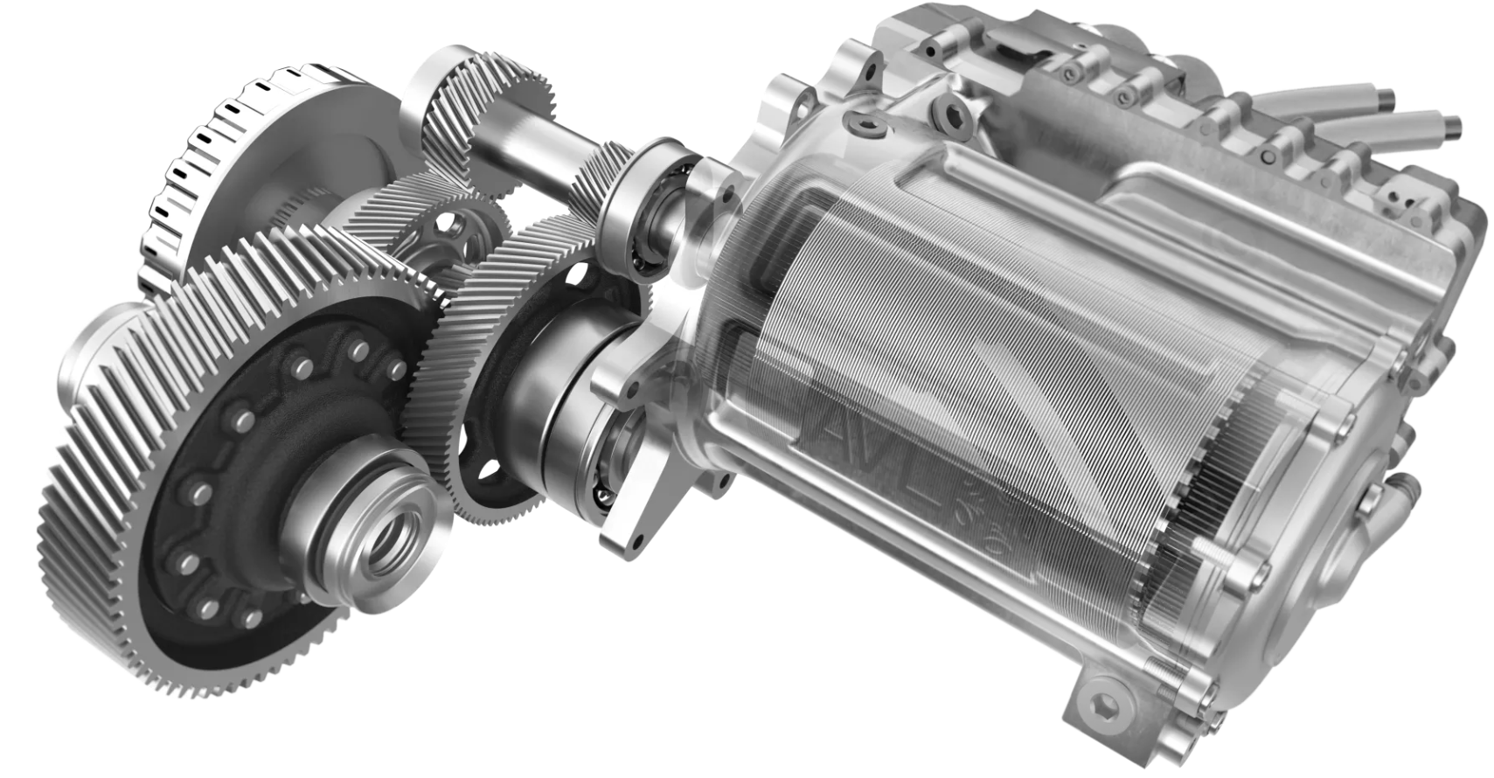
Rolling Element Bearings
Electric Motor
Gear Pair

