Slide 2
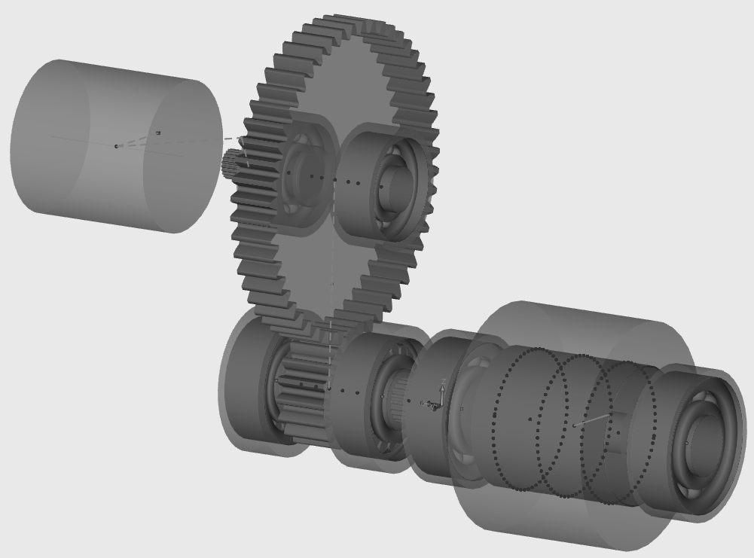
System Boundary
Gear
Pinion
Input Bearings
Motor

Slide 3
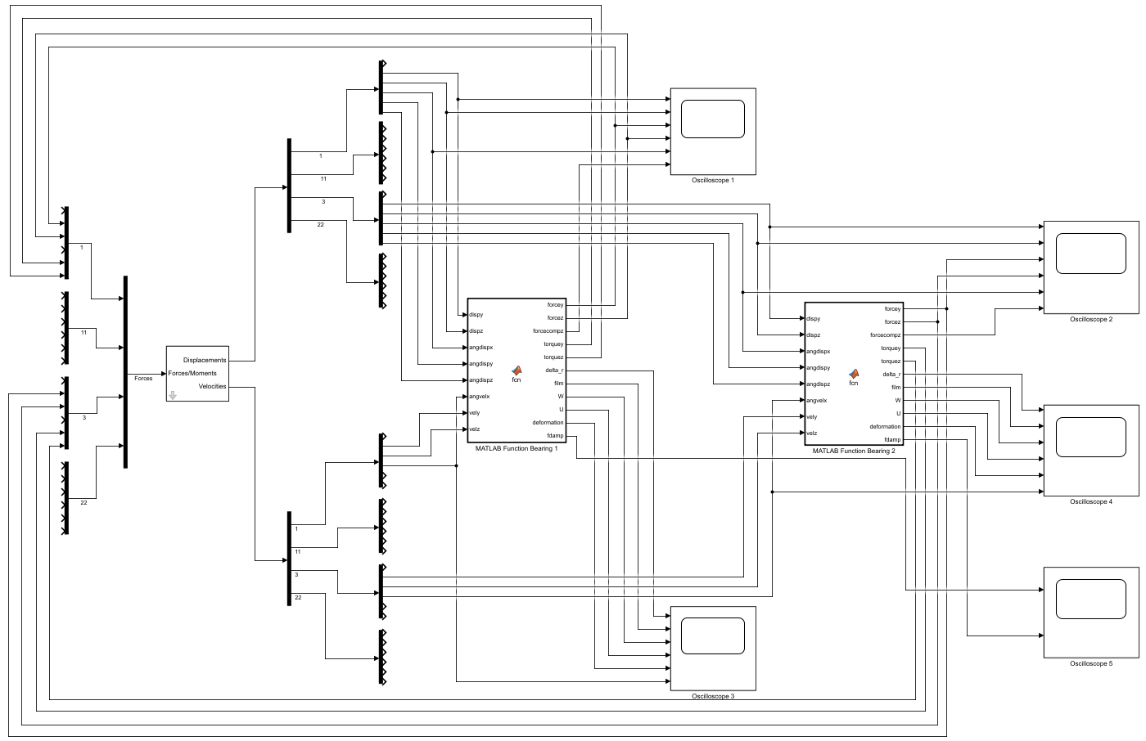
Degrees of Freedom
Output Ports
Lubricated Bearing Model
Input Port

