Slide 1
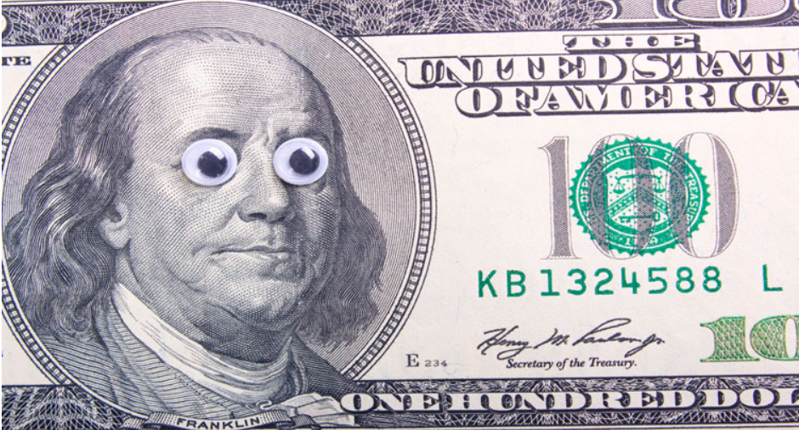


Funny
Money
Corey Levinson
Angelo Garetto

Slide 2
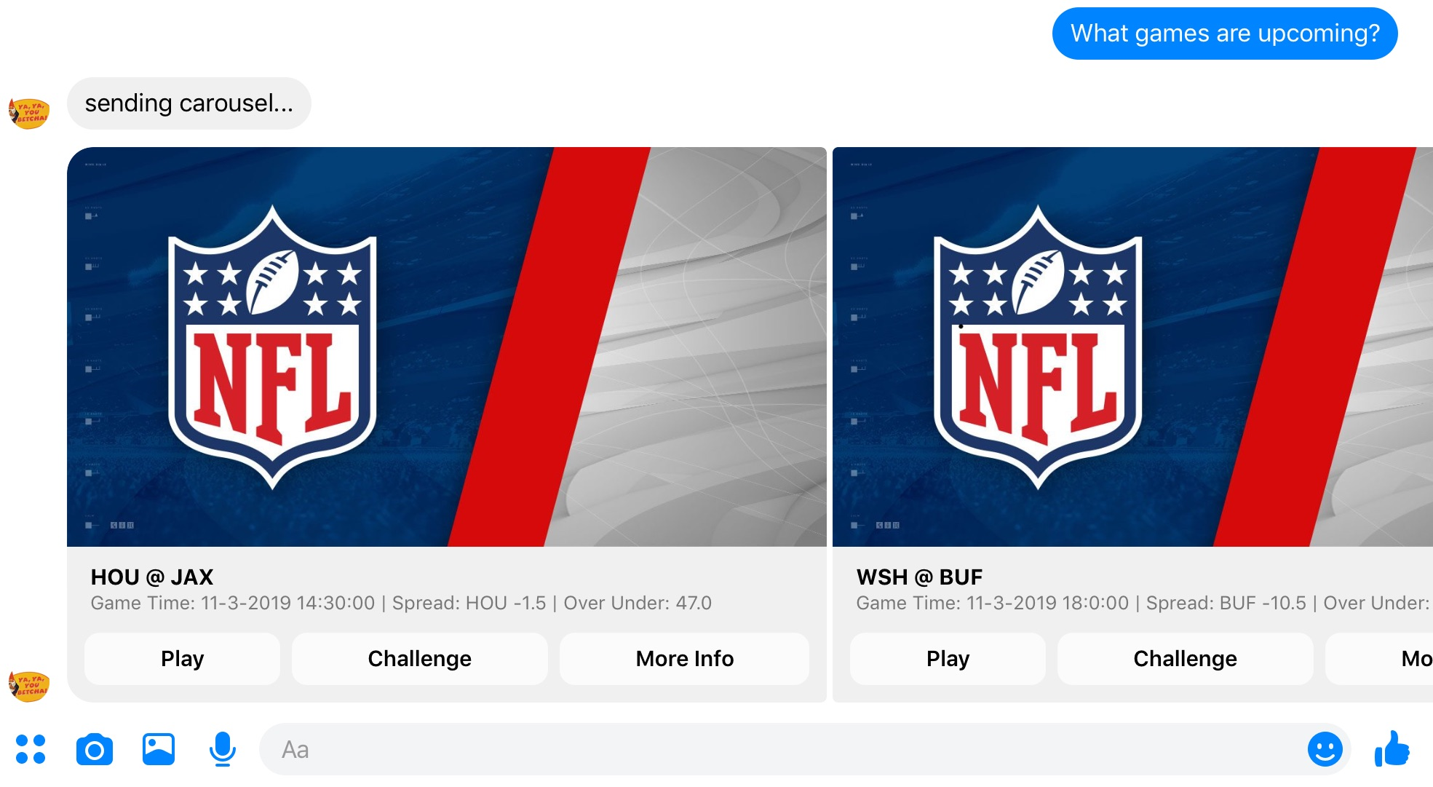
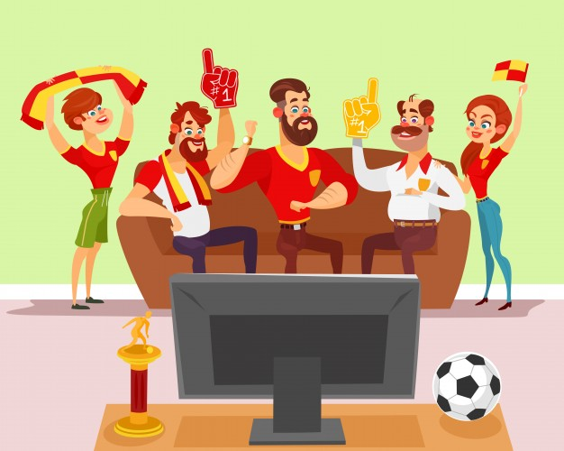





Meet the Jones
“Buffalo has a team this year, no one is going to stop them”
“Nonsense, they are playing WSH. BOUT TO GET STOMPED”
“Man grandpa is going loco”
“I’m with grandpa, Dad, what’s the pulse?”
Wsh 60%
Passionate Sports Fans
Split Family Allegiances
Buf 40%
Funny Money Split
Match Up Statistics
Live Updates
Bettor Pulse

Slide 3
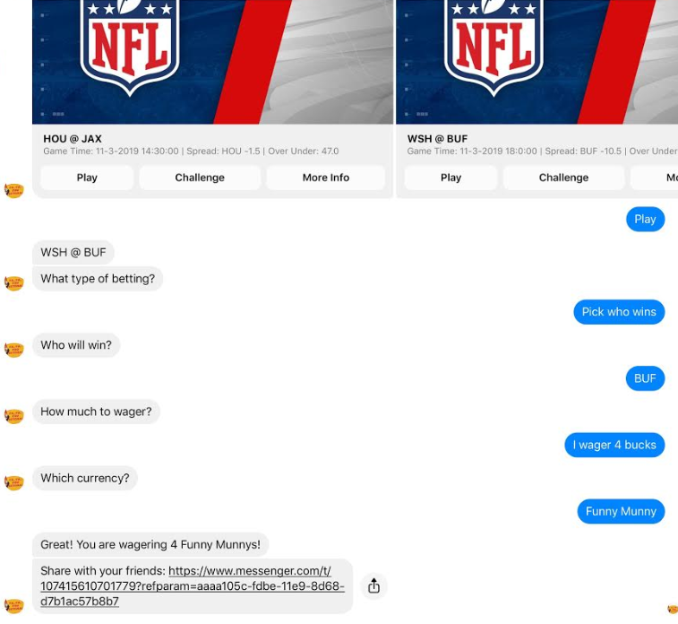

Bragging Rights
“Ha! Knew it, I’m going to wager some Funny Money. Whatya say Gramps?”
Hou 40%

Slide 4
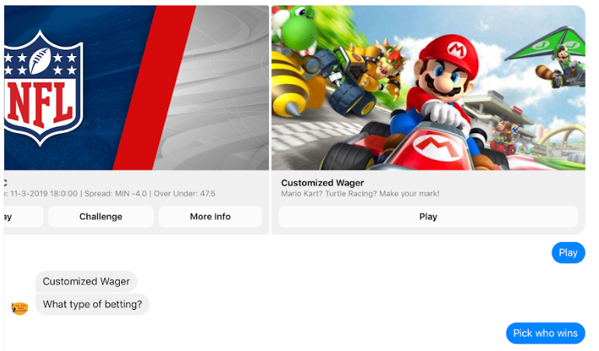
Not just Organized Athletics…
Hou 40%
Engaging Competition. Locally or Globally

Slide 5
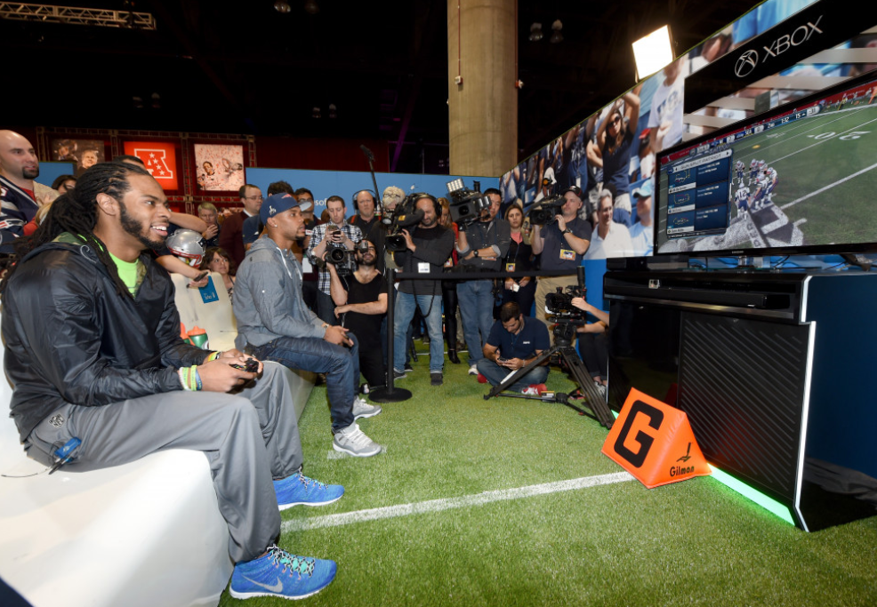


How about Karl and His Friends
Kingpin Karl vs. Challenger Robin
K/D Ratio: 4.1
Best Skill: Sniper
K/D Ratio: 3.1
Best Skill: Dagger
THE GAME : Overwatch
THE DETAILS : Deathmatch
THE TYPE : STRAIGHT UP
Facebook
IF Karl Wins
Safeguards against non-payers and distributes winnings
Gaming Fanatics
Competitive to the Core
Karl accepts Robin’s challenge
IF Robin Wins
Enables Gamer Group to get in on Side games

Slide 6
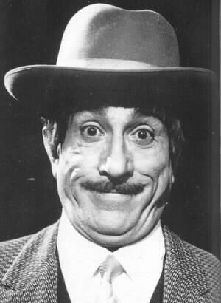
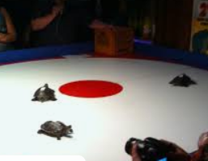
or Peppino
Regular at Big Joe’s in Ravenswood
Loves Turtle Racing

