Slide 1

Scooter Use In Nashville Month of July
(This chick obviously needs a scooter) →

Slide 2
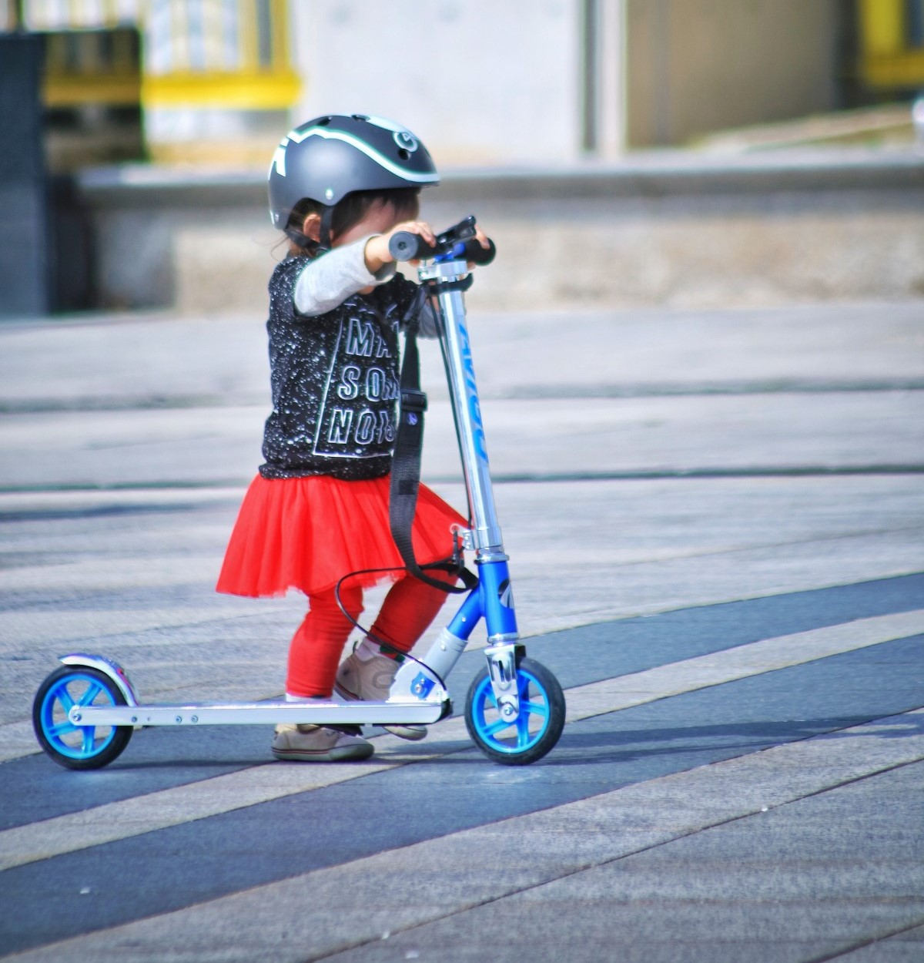
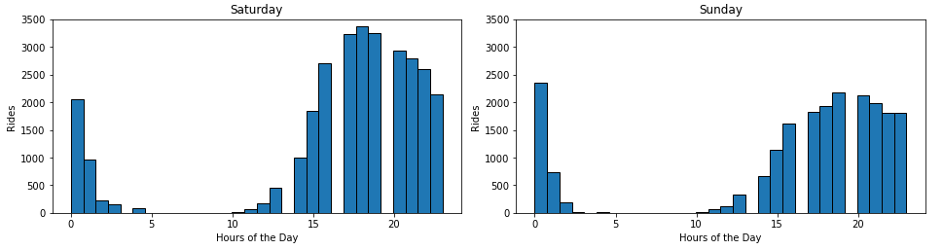
Scooter Rides
By the Hour: Weekends

Slide 3
The Last Mile
Scooter Use During Rush Hour
The 3 zip codes with the most rentals for the month of July were 37203, 37201, and 37219.
Rush hour was defined as 7-10 AM and 5-7 PM, Monday through Friday.
Within the 3 busiest zip codes only 11% of the rentals occurred during the rush hour time frame.
Most rentals occurred in the evenings, with significant increases on the weekends.

Slide 4

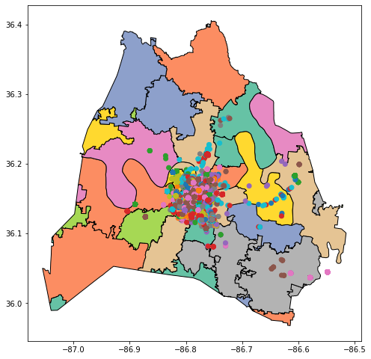

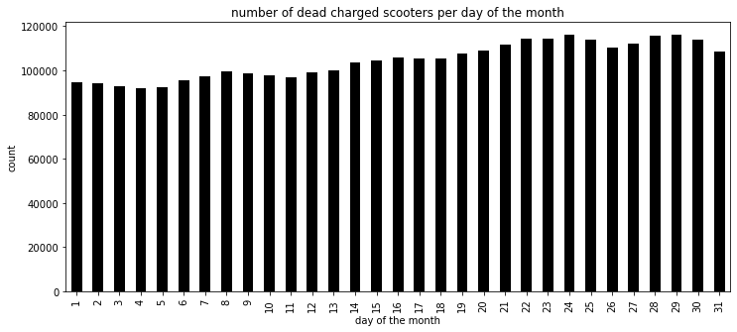
Scooters: Charged and Uncharged
Scooters with 0 charge
COMPARISON POINT 2

Slide 5
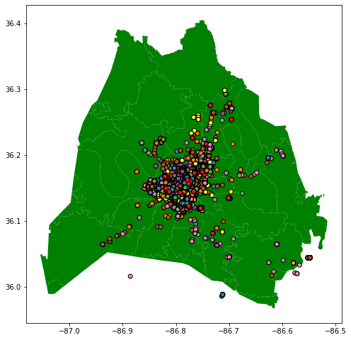
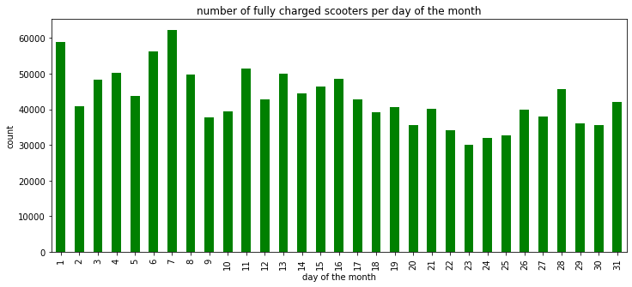
Scooters: Charged and Uncharged
Scooters with 100% charge
COMPARISON POINT 2

Slide 6
Frequency of Pings
Number of Pings During Use Per Minute

Slide 7
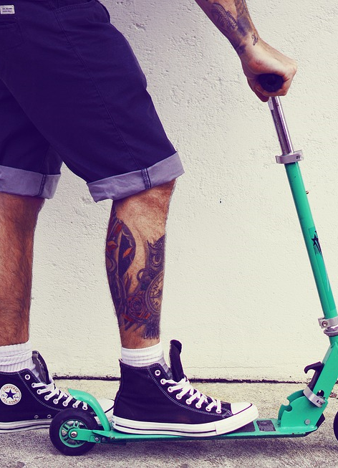
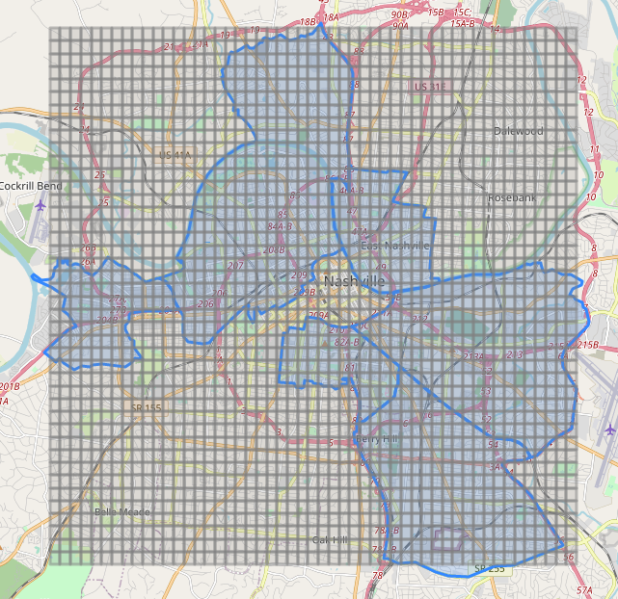
Average Trip Distance and Duration by Micro-District
Map Link

Slide 8
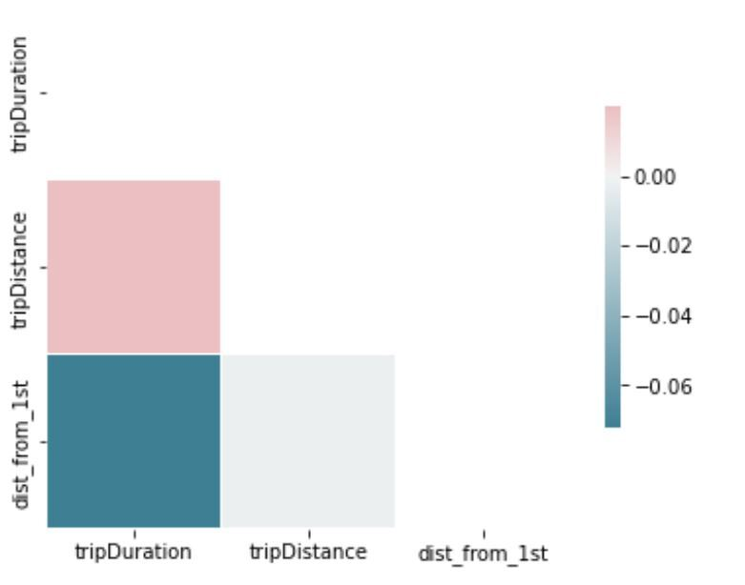
Distance From First and Broadway Variables’ Impacts on Distance and Duration
Trip Duration | Trip Distance | Distance from First
1.000000 | 0.019725 | -0.071840
0.019725 | 1.000000 | -.002027
-0.071840 | -0.002027 | 1.000000

Slide 9
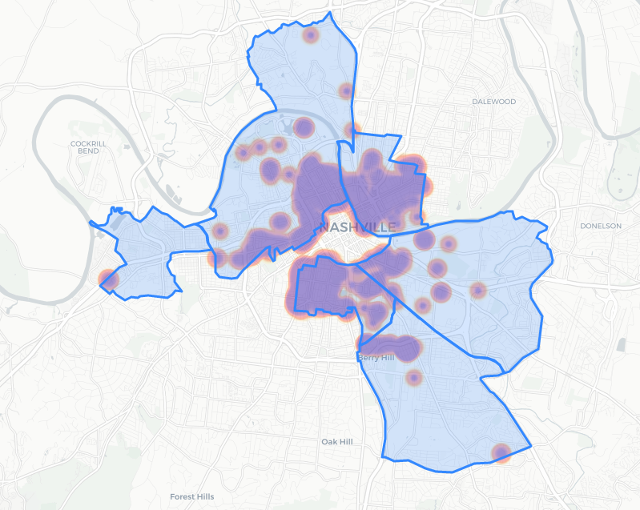
Heat Map of Scooter Use
Map Link

