Slide 1
Web Components
Use the Platform

Slide 2
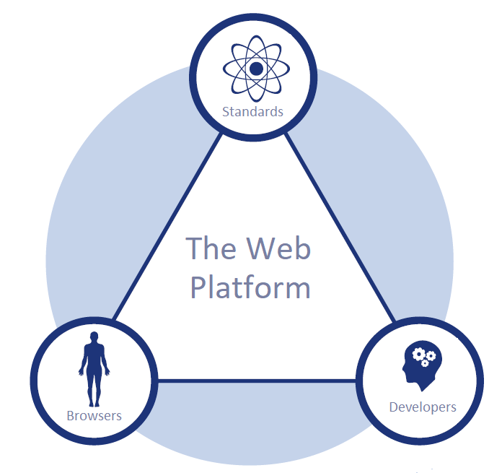

Good ideas get standardized
Object Relational Mapping is a good idea that has been standardized into the Java Persistence API.
  First implemented by Hibernate then standardized.
  Code to an interface not an implementation.
Using a JavaScript library to make life easier is a good idea.
  jQuery was a good idea that was standardized into various Web APIs.
  Write JavaScript not jQuery.
Creating reusable components is a good idea.
  Vue/Angular/React components were good ideas and this idea was standardized and named the Web Component Standards.
  Build applications with HTML not framework specific components.

Slide 3

What are web components?
A custom HTML tag built with web platform APIs that allow developers to encapsulate UI/UX into a reusable component that can be tested, documented, versioned, extended, and distributed to compose application GUIs.
  Custom Element -The Custom Elements specification lays the foundation for designing and using new types of DOM elements.
  Shadow DOM - The shadow DOM specification defines how to use encapsulated style, script, and markup in web components.
  ES Modules - The ES Modules specification defines the inclusion and reuse of JavaScript documents in a standards based, modular, performant way.
  HTML Template - The HTML template element specification defines how to declare fragments of markup that go unused at page load, but can be instantiated later on at run time.
  Can be used anywhere HTML can be used.

Slide 4

Timeline
2011 Alex Russell Fronteers Web Components Presentation
First published draft of the Web Components Standards. May 22nd 2012
React is released May 29th 2013
Vue is released December 8th 2013
Angular 2 is released October 22nd 2014
Web component polyfills released May 11th 2017 – makes web components possible without browser support.
Supported in Chome September 4th 2017
Supported in Safari September 18th 2017
Supported in Firefox October 22nd 2018
Supported in Edge January 14th 2020 (after re-basing on top on chromium)

Slide 5
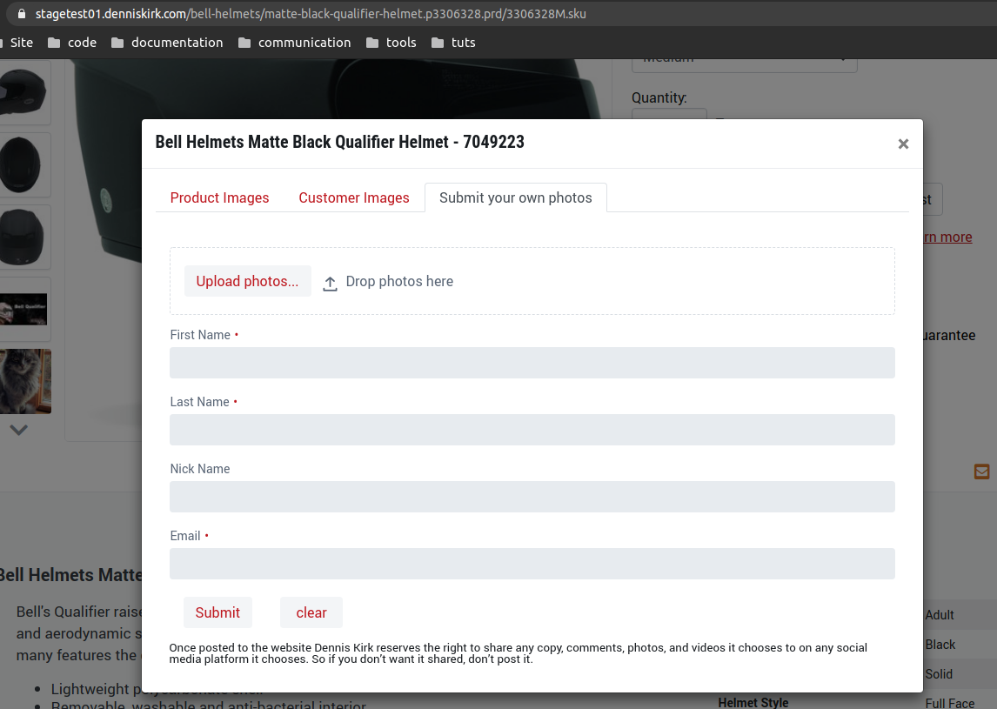

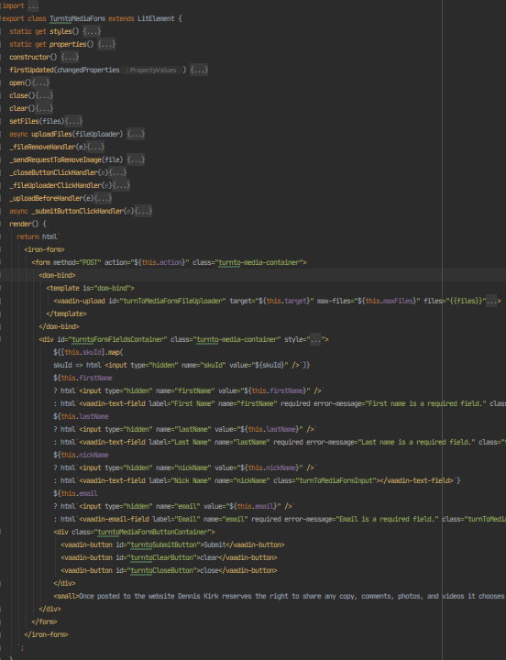
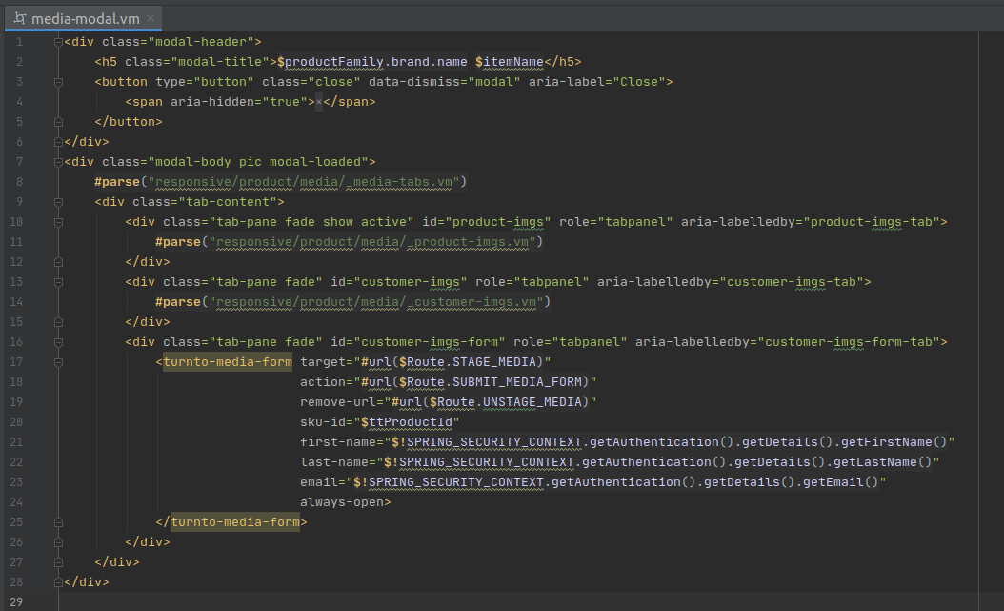
Example
The turnto-media-form HTML element
This code example demonstrates how a web component can replace a velocity template. The top arrow points at the source code that gets written by a component developer. All markup, style, and logic are contained in one location. The middle arrow points at what the component looks like. The bottom arrow is pointing at the custom HTML tag that gets used by application developers. It is more semantically meaningful as the custom tag name and attributes that configure the component describe its purpose.

Slide 6
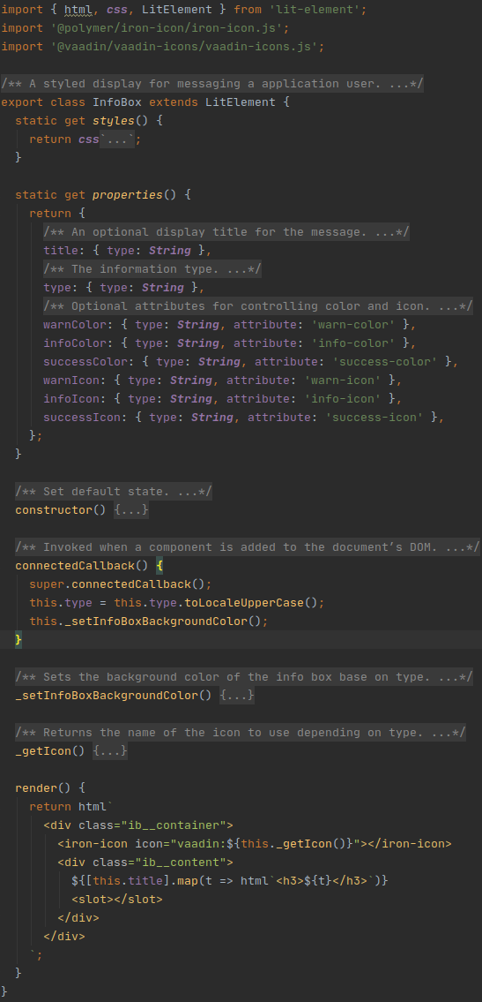
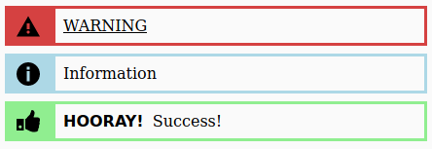
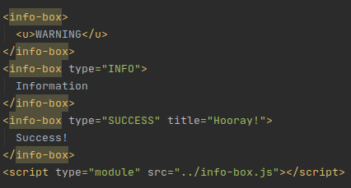
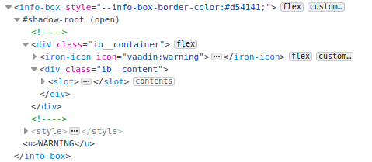
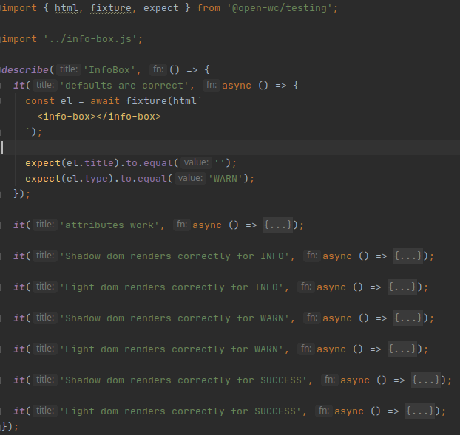
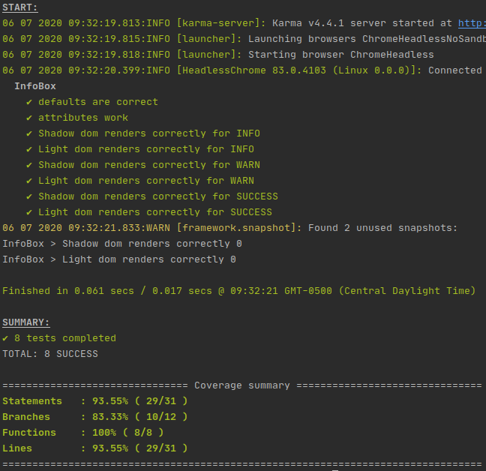


Another Example
Source code
Displayed in browser
Open-wc recommends using LitElement as a base class. LitElement is a web component wrapper around the lit-html project which is an extremely small and fast templating library.
  lit-html ~ 1.7Kb
  Vue ~ 30Kb
  JQuery ~ 97.85Kb
How it’s used
Unit tests
Rendered in browser
How it’s registered
How it’s loaded
Dependency management

Slide 7

Common arguments
Don’t work in IE. polyfills.
APIs too verbose. LitElement.
If your going to use a library we might as well use what’s provided by a JS framework.
  LitElement smaller, faster, and will work in any application framework.
  We don’t need to choose a JavaScript framework. Have you heard of Vaadin Flow?
Its not stable enough. Supported by all major browsers.
We can’t rely on standards. We already are.
  HTML tags are defined by web standards and implemented by browsers. Now the Web Platform provides a way for developers to create custom HTML tags.

Slide 8
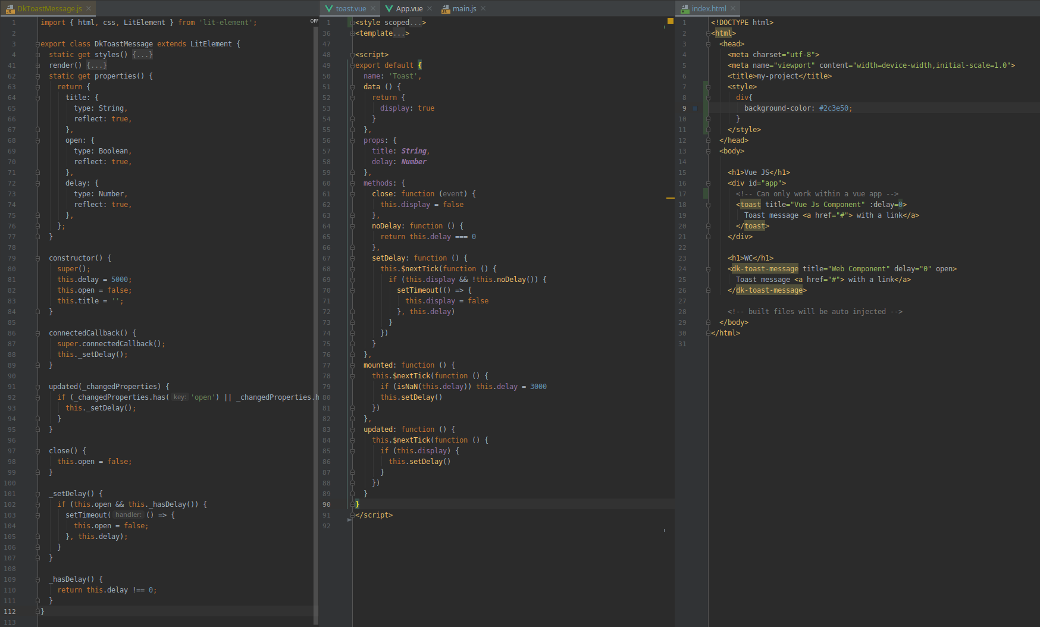
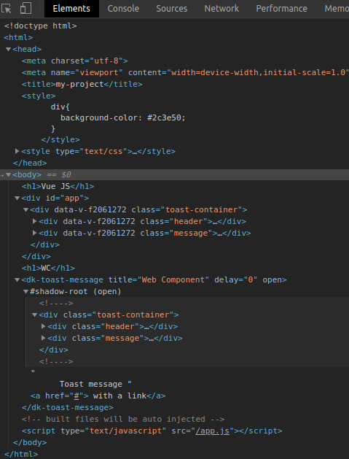
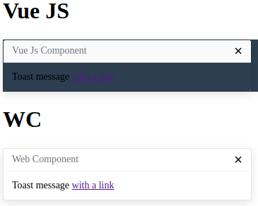

Web Components (WC) vs Vue Components (VC)
VC code is JSON.
Is inheritance possible?
How are dependencies declared?
WC follows normal development patterns.
VC is not a real HTML element. It requires JS magic to run and browser plugins to debug.
What happened to the custom toast tag?
VC can only exist in a Vue application.
VC is not encapsulated.
WC doesn’t need an IDE plugin.
WC is a real HTML element which can be used anywhere HTML can be used and can be debugged with the development tools built into browser.
WC is encapsulated
VC needs an IDE plugin.
VC doesn’t play well with native APIs

Slide 9

Who is using Web Components?
SalesForce – Lightning Web Components
FireFox - UI
Apple – Apple Music Web Client
Red Hat – PatternFly Elements
General Electric – Predix Design System
SAP – Web Component System
Meetup.com – Swarm Design System
The open source community - open-wc
Even JavaScript Frameworks: Vue, Angular, React

Slide 10

Why use web components?
Safety
  It’s a standardized technology.
  Recommended by W3C.
  Supported by all major browsers.
  Adopted by enterprise level companies.
  Framework-agnostic.
  Encapsulation – No unintended side effects from other styles or scripts loaded in page.
  Proven to work. We’ve had web component in production since 3/2/20.
Performance
  API implemented in web engines instead of in JavaScript.
  Don’t need to ship large JavaScript library to client.
Makes life easier
  Distributed by a package management tool. No more copy and paste.
  Custom tags are self descriptive making the mark up easier to read.
  All code/markup/styles are in one place which makes finding the code easier.
  Encapsulation – No unintended side effects from other styles or scripts loaded in page.
  Automated testing and documentation reduce bugs.
  Provides a stable API for behavior testing.
  Reduce work by leveraging a huge selection of open source 3rd party components.
Path of least resistance
  We already know how to use HTML.
  Don’t need browser or IDE plugins.
  Project already set up
  Website build process already set up.
  Dependency management already set up.
  Web components already in production.
  Team members already experienced with technology.
  Code review already set up
  Nexus server is already set up
  Development guide already available

Slide 11

What’s the plan?
Train.
  Development guide following best practices already set up.
Develop web components to replace velocity templates and repeated mark up.
  Not everything needs to be a web component.
  If a significant chunk of mark up is repeated it should be a component.
  If a template file has its own script and style sheet it should be a component.
  Components should be application agnostic.
  Break things down to be as small as practically possible.
  Avoid reinventing the wheel by leveraging the open source community.
    Vaadin components
    Iron elements
  Set up development operations to run tests and generate documentation/reports.
Profit.
  Developer time
    Reduce development time by reusing components.
    Semantically meaningful markup helps developers understand code.
    Code, markup, and styles are all self contained and dependencies explicitly declared.
  Software Quality
    Encapsulated so it will work as designed no matter where it’s used.
    Able to be unit tested so bugs are caught sooner.
    Dedicated documentation so the components are properly used.

