Slide 1
WEEK 5: FINAL PROJECT
Online Course
Registration System
Requirements • UML Design • PHP/MySQL Implementation • Class Registration
Quiban. Jomar P.
CST499: Capstone for Computer Software Technology
Charmelia Butler
September 07, 2026
Notes:
Hello, my name is Jomar Quiban. This presentation summarizes my CST499 capstone project, the Online Course Registration System. I will cover the requirements captured in the SRS, the UML design models, the website interface, the MySQL database, the PHP implementation, and the completed class-registration workflow.

Slide 2
1. Project Overview
The final system connects the requirements, design, interface, database, and PHP implementation.
Problem
Solution
Project Flow
Students need a convenient way to create an account, view available online courses, register for classes, manage a schedule, and cancel enrollment.
A web-based registration application using a PHP front end, MySQL database, authenticated student sessions, and enrollment management logic.
Week 1: Requirements → Week 2: UML design → Weeks 3–4: PHP/MySQL implementation → Final: Compiled deliverables and presentation.
Requirements
Design
Implementation
Verification
Notes:
The project addresses the problem of online course enrollment. The solution is a web application where the student is the primary user. The project progressed from requirements in Week 1, to UML design in Week 2, to PHP and MySQL implementation in Weeks 3 and 4, and finally to this compiled final presentation.

Slide 3
2. SRS Summary
Key requirements carried from the Software Requirements Specification.
Account & authentication
Student profile
Create account with a unique User ID and password; securely authenticate returning users.
Capture full name, phone number, and email address.
Course catalog
Registration & waitlist
List courses with enrollment capacity.
Enroll when seats are available; use a first-come, first-served waitlist when full.
Cancellation
Quality & security
Allow students to cancel enrollment and notify the first waitlisted student when a seat opens.
Use authentication, protected personal information, HTTPS, reliability, usability, and maintainability requirements.
Notes:
The SRS defines the system around two high-priority feature groups. The first is user registration and authentication. The second is course registration and waitlist management. The requirements also establish semester-based course listings, course-capacity rules, cancellation behavior, security requirements, and quality attributes. These requirements became the design and implementation baseline for the project.

Slide 4
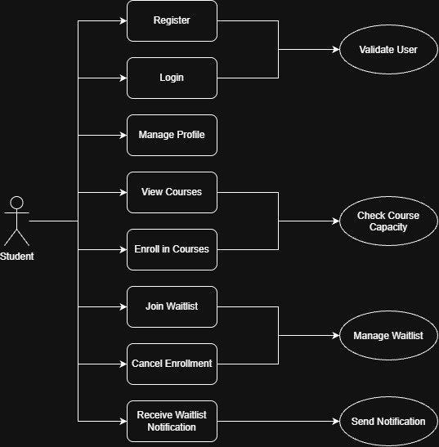
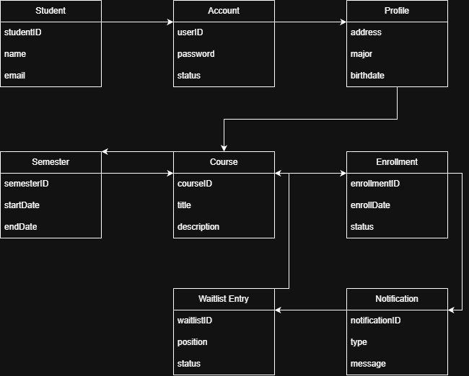
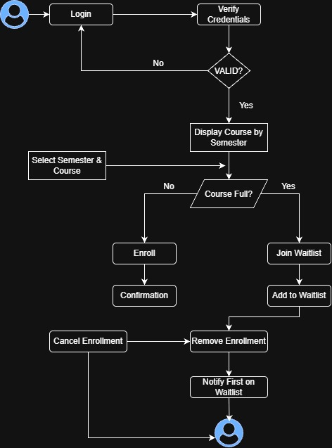
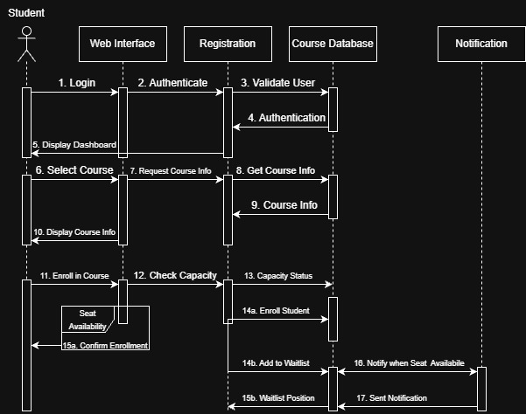
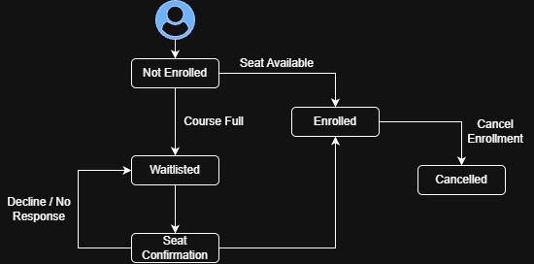
3. UML Design Model
The Week 2 models translate the SRS into static and dynamic views of the system.
Use Case
Class
Activity
Sequence
State
The diagrams show actors and functions, system classes and relationships, enrollment workflow, component interactions, and enrollment states.
Notes:
The UML work provides the design bridge between requirements and implementation. The use case model identifies the student interactions. The class model defines the main data objects and relationships. The activity model captures the enrollment workflow. The sequence model shows the time-ordered communication between the student, interface, registration logic, database, and notification service. The state model represents how a course enrollment moves between not-enrolled, waitlisted, offered, enrolled, and cancelled states.

Slide 5
4. Enrollment State Model
The state diagram explains how registration status changes over time.
Not Enrolled
Waitlisted
Offered Seat
Enrolled
Cancelled
Notes:
The state model is especially important for the course-registration requirement. A student can start not enrolled, move directly to enrolled when a seat is available, or become waitlisted when the class is full. When a seat becomes available, the first student can be offered the seat and then transition to enrolled. An enrolled student can also cancel the enrollment.

Slide 6
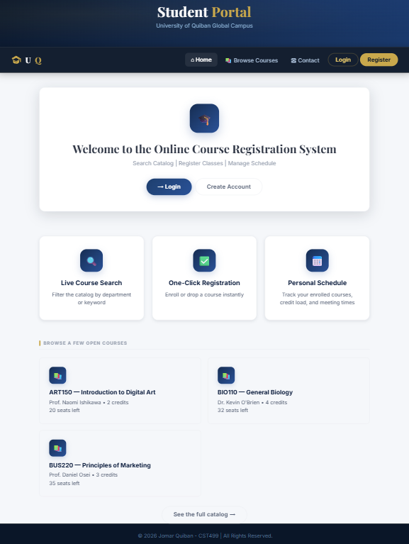
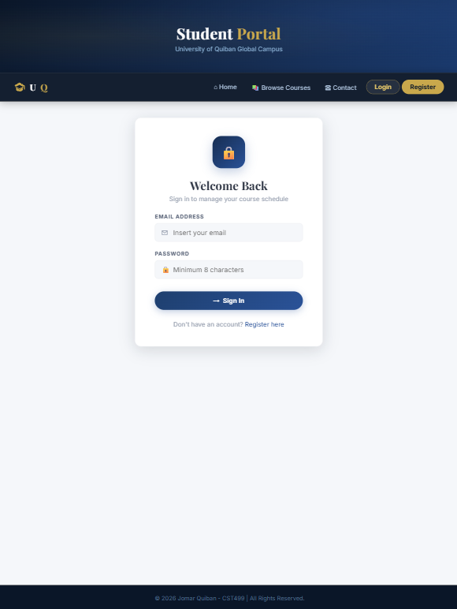
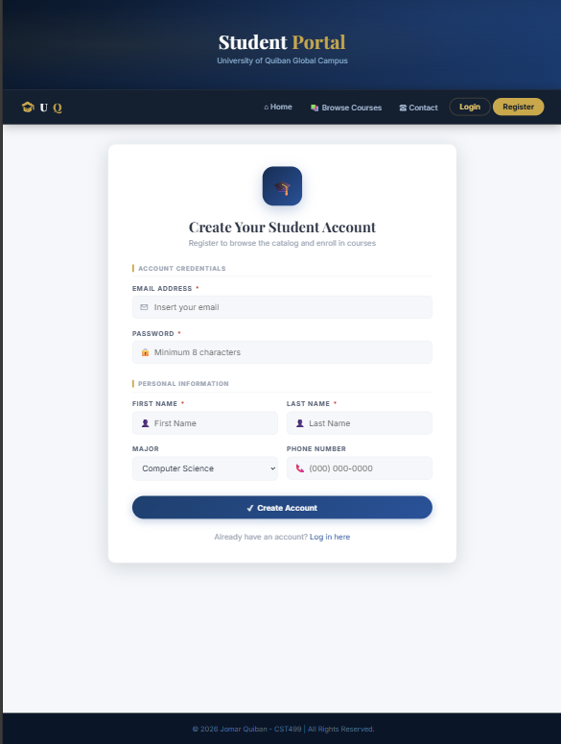
5. Website Design: Landing, Login, Registration
Actual interface screens from the completed application
Landing Page
Login Page
Registration Page
index.php
login.php
registration.php
Design choices: consistent header/navigation • card-based layout • clear forms and feedback • session-aware content
Notes:
These are actual screenshots from the completed website. The landing page introduces the system and routes the student to authentication. The login page validates credentials and creates an authenticated session. The registration page collects the required account and personal information and validates it before storing the record. The consistent header and card-based layout make the pages feel like one product.

Slide 7
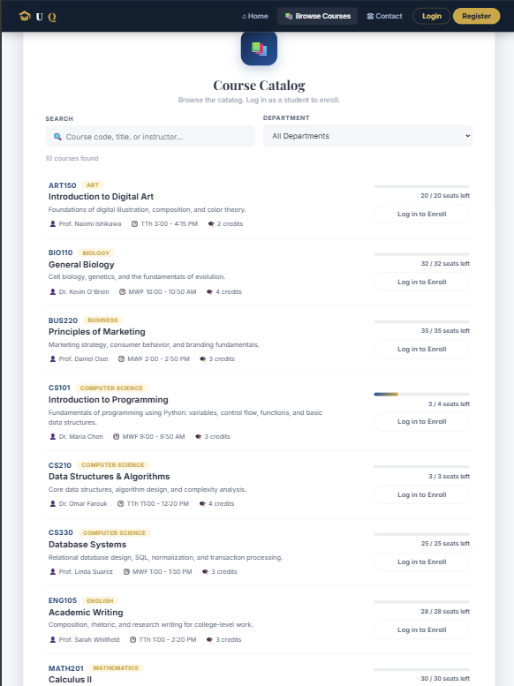
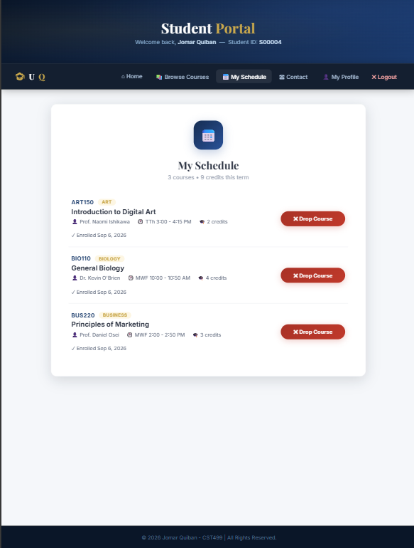
6. Enrollment Page Design
The course catalog and My Schedule pages are database-driven
1 Login
2 Browse
3 Capacity
4 Enroll
5 Schedule
6 Drop
Course Catalog (courses.php)
My Schedule (my_courses.php)
Enroll = open seat • Drop = already enrolled • Full = no capacity • Login prompt = unauthenticated visitor
The available action changes with the student’s login and enrollment state, so the interface reflects live database data.
Notes:
The enrollment page is database-driven. The course catalog displays current course information and changes the available action based on the student state. An open course that is not already selected shows Enroll. A course already on the schedule shows Drop. A full course is unavailable. The My Schedule page joins enrollment data to course data and shows the student’s current classes.

Slide 8
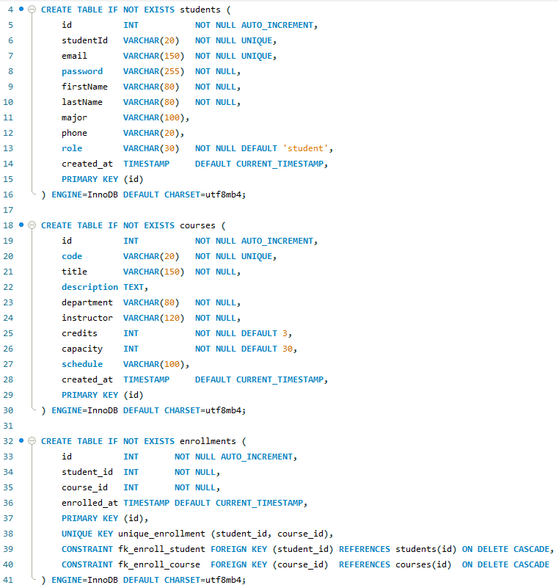
7. MySQL Database and Class Registration
The database stores identity, course, and enrollment data and enforces integrity
Core tables
students
• student_id (PK)
• user_id (UNIQUE)
• password_hash
• full_name / email / phone
courses
• course_id (PK)
• course_code / title
• semester / max_capacity / credits
enrollments
• enrollment_id (PK)
• student_id (FK) / course_id (FK)
• UNIQUE(student_id, course_id)
Key behavior: check capacity → create enrollment row → schedule updates → drop deletes enrollment row.
Notes:
The MySQL layer is organized around students, courses, and enrollments. The enrollment table acts as the join table between students and courses. Unique and foreign-key constraints help enforce data integrity. The application checks capacity before inserting an enrollment, and dropping a course removes the corresponding enrollment row. The database screenshot shown here is from the actual project presentation.

Slide 9
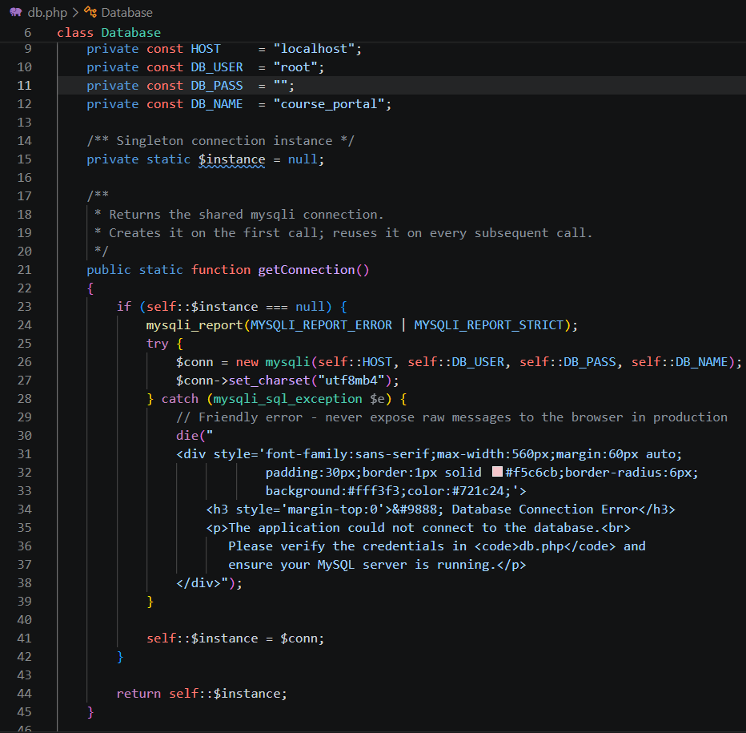
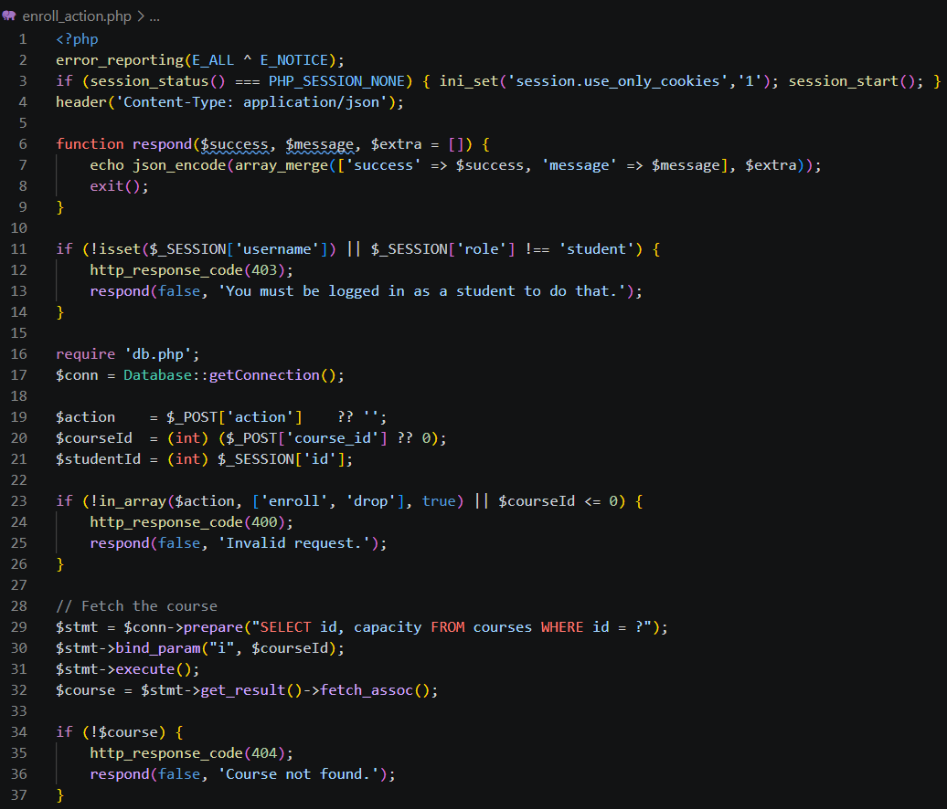
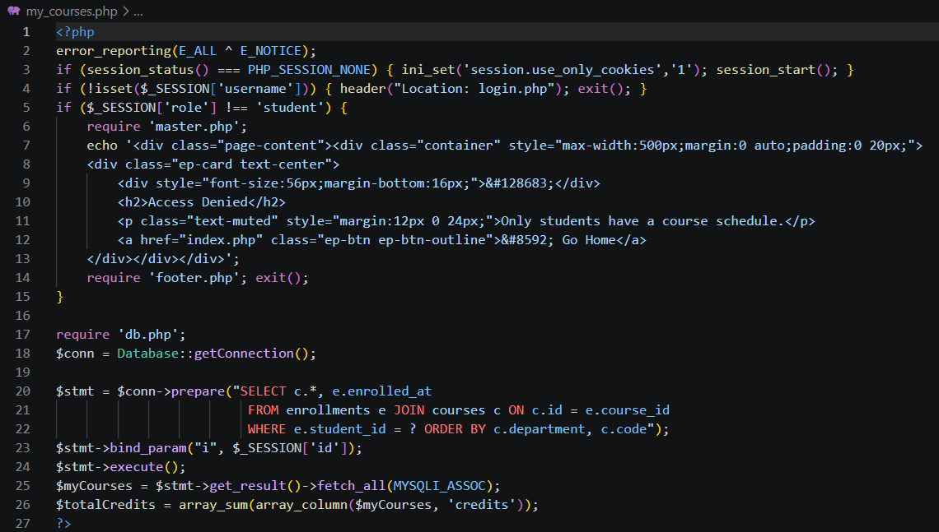
8. PHP Implementation
Source code connects the pages, sessions, validation, and MySQL operations
Database / connection
Enrollment endpoint
Course listing / join query
Secure coding themes: prepared statements • server-side validation • password hashing • authenticated sessions • transaction-aware enrollment processing
Notes:
The PHP implementation is organized around reusable database access and focused page responsibilities. The project uses a custom database connection class, registration and login logic, and an enrollment action endpoint. Prepared statements, server-side validation, password hashing, authenticated sessions, and capacity checking are used to support the core workflow. The screenshots on this slide are actual source-code captures from the project presentation.

Slide 10
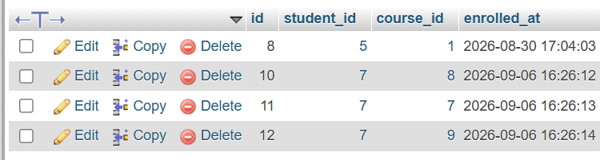
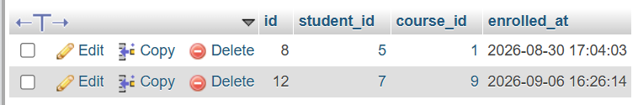
TESTING
9. Verifying Functionality Against the Database
Every feature was tested directly, not just observed on the page — a query was run before and after each action.
Register: enrollments starts empty for the test student, then shows one new row after clicking Enroll.
Add another course: a second row appears for a different course_id without disturbing the first.
Drop: the matching row disappears entirely, confirmed with a follow-up SELECT.
10

Slide 11
10. Project Summary and Lessons Learned
How the final pieces fit together
Requirements
Design
Implementation
Verification
SRS requirements
Unique account IDs
Course capacity
Waitlist and cancellation
Five UML models
Static and dynamic views
Traceability to SRS
Landing, login, registration
MySQL data model
PHP enrollment workflow
Database before/after checks
Schedule state changes
Feedback incorporated
The capstone demonstrates the progression from
Requirements → UML design → PHP/MySQL implementation → Verified class registration.
Key Takeaway
Notes:
In summary, the project demonstrates the progression from software requirements to UML design and then to PHP and MySQL implementation. The final product supports the core registration and schedule-management workflow, and the data changes can be verified directly in the database. The main lesson is the importance of traceability, reusable design, data integrity, and verification throughout the software development life cycle.

Slide 12
References
Selected sources used for the project and presentation
Booch, G., Rumbaugh, J., & Jacobson, I. (2007). The unified modeling language user guide (2nd ed.). Addison-Wesley.
Pressman, R. S., & Maxim, B. R. (2020). Software engineering: A practitioner’s approach (9th ed.). McGraw-Hill Education.
Sommerville, I. (2021). Software engineering (10th ed.). Pearson.
Tsui, F., Karam, O., & Bernal, B. (2018). Essentials of software engineering (4th ed.). Jones & Bartlett Learning.
The final presentation combines the actual website, database, PHP, and UML artifacts from the project materials.
Notes:
These are the primary sources used for the project and presentation. The presentation is grounded in the submitted SRS and UML documents, with software-engineering texts supporting the broader design and development concepts.

