Slide 1
Thomas alva edison
1847-1931

Slide 2
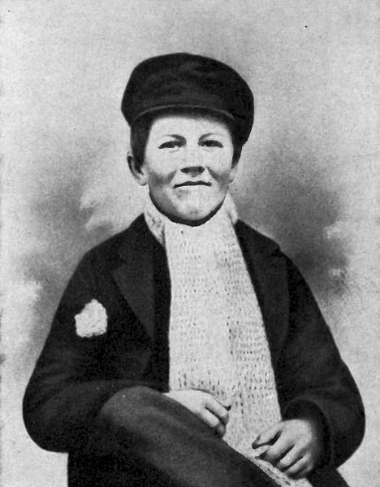
Early life
Born in Milan, Ohio in 1847
Very little formal education.
Started work at 13, and taught himself how to operate a telegraph.
Worked as a telegraph operator from 16.
His first inventions were mostly related to the development and improvement of the telegraph system.

Slide 3
Industrial research
Edison is credited with the creation of the first industrial research laboratory.
The development of this project was funded through the sales of his improvements to the telegraph.
Here, Edison employed many clever people and provided all the resources they could possibly need to develop basically anything… so long as it would make money.
He was quoted to have said that the lab had “a stock of almost every conceivable material”.
The credit went to Edison for the inventions developed in this lab.

Slide 4
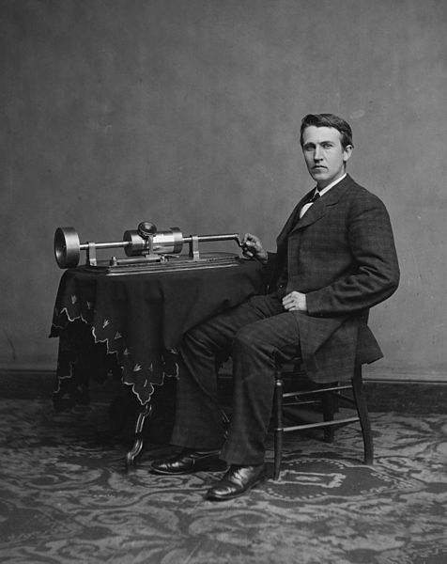
phonograph
First invention he was really noticed for.
Sound recording devices had already been invented, but this was the first to also be able to replay the sounds.
When recording, a diaphragm moved a stylus that created a groove in foil wrapped around a cylinder.
When playing back, the cylinder was rotated and the stylus ran through the grooves vibrating the diaphragm and faintly playing back the sound.

Slide 5
Power distribution
The development of transformers by Westinghouse Electric made AC the much better choice for large power grids.
Edison’s patented low voltage DC lightbulbs would require widespread implementation of a DC power grid.
To try to slow the development of AC systems, Edison started what was essentially a smear campaign against AC.
He was eventually forced out of his company “Edison general electric” when his failed efforts to stop the progress of AC resulted in much smaller profits.

Slide 6
General electric
General Electric is the result of the merger of “Edison general electric” and “Thomson-Houston”.
When created this company controlled ¾ of US electrical business.
General Electric is still a fortune 500 company today, with involvement in: Aviation, Current, Digital, Energy connections, Global research, Healthcare, Lighting, Oil and Gas, Power, Renewable energy, Transportation, Financial services, Medical devices, Life sciences, Pharmaceutical, Automotive, Software development, Military.

Slide 7
Innovator or improver?
The industrial research lab was certainly an innovative system, nobody had really done that before and it was a excellent success which lead to Edison holding over 1000 patents.
Many of those patents (including the electric light bulb) were the inventions of others. Edison would buy the patents from them and then use his many resources to make the inventions commercially viable.
Without a doubt, Thomas Edison drove forward invention and innovation throughout his life, but perhaps he should be remembered as a catalyst for innovation not the innovator himself.

