Slide 1
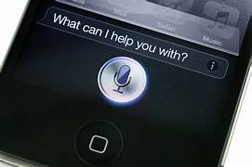
WELCOME

Slide 2
VIRTUAL ASSISTANT SISIRA
PRESENTED BY,
Madhuri baburao kamble (21)
Amruta sitaram kathrut (22)
Rutuja Ramesh mokale (32)

Slide 3
INDEX
Introduction
Problem statement
System architecture diagram
List of modules
Flowchart
Uses of Logic
Algorithm
Implementation
Conclusion
References

Slide 4
Introduction
The Virtual Assistant Project, named "Sisira”.
Sisira incorporates features like voice recognition, text-to-speech conversion, and basic natural language processing to enhance user interaction.
It provides personalized greetings based on the time of day, offers reminders for specific events, and displays the current date and time
Sisira can also perform tasks such as opening applications like Notepad, accessing popular websites like Google, YouTube, and Instagram, playing music, and retrieving specific files or information based on user queries.
it uses the Ctime library to retrieve the current date and time information and display it to the user.
The project's modular structure allows for easy maintenance and expansion of features in the future.

Slide 5
Problem Statement
The problem addressed in this mini-project is the development of a voice-activated virtual assistant named Sisira. The goal is to create a user-friendly and personalized assistant that can understand natural language and perform various tasks based on user inputs.
The project aims to provide users with an intelligent and efficient virtual assistant that can effectively assist them in their daily tasks, retrieve information, perform actions, and improve overall user experience.

Slide 6
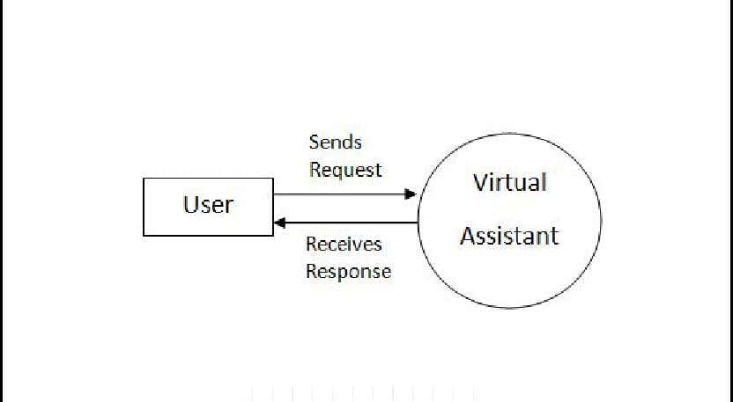
System architecture diagram

Slide 7
List of Modules
1. Greeting Module
2. Date and Time Module
3. Reminder Module
4. Password Validation Module
5. User Interaction Module

Slide 8
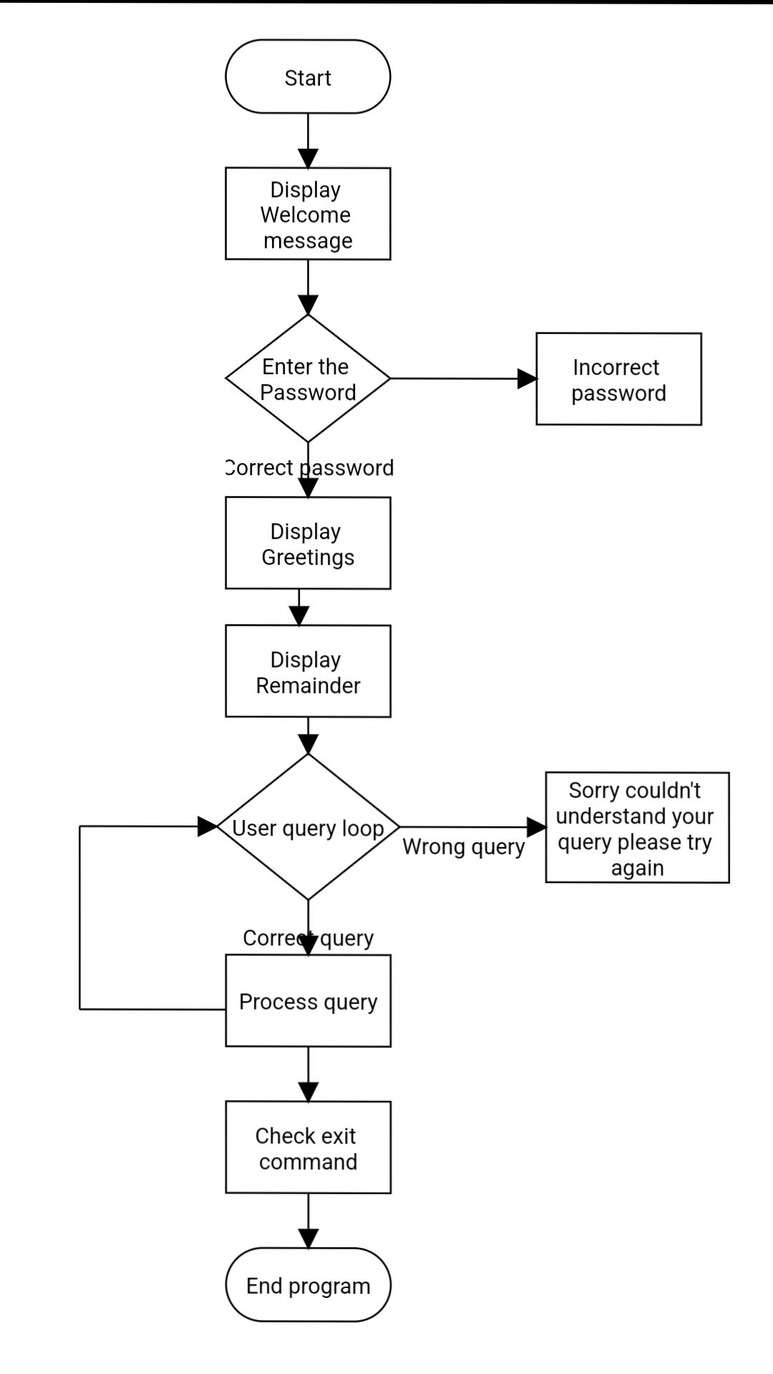
Flowchart

Slide 9
Usage of logic
The provided code is for a virtual assistant named "Sisira." It greets the user based on the time of day and provides reminders for specific activities.
The program runs in a loop, asking the user for a password. If the password is correct, it proceeds to handle user queries.
It recognizes greetings, termination commands, and various queries about the assistant's identity, time, and applications to open. The program uses the "espeak" tool for text-to-speech functionality.

Slide 10
Algorithm
Step 1: Start
Step 2: Display welcome messages
Step 3: Enter password if wrong exit
Step 4: Display Greetings
Step 5: User Query loop
Step 6: Process Query
Step 7: End

Slide 11
Implementation
The code provided in the question represents a basic implementation of a virtual assistant project. It includes functionality for greeting the user, providing reminders, performing actions based on user input, and integrating with external services.
1. Libraries and Dependencies
2. Function Definitions
3. Main Function
4. Usage of External Commands

Slide 12
Conclusion
The project implemented a basic virtual assistant using C++ programming language. The virtual assistant greets the user, provides reminders based on the current time, and performs various actions based on user input. It integrates with external services like speech synthesis and opens applications or websites upon request. While the project serves as a simple demonstration of a virtual assistant, further enhancements can be made to expand its functionalities and improve user experience. This project showcases the potential of virtual assistants in providing assistance and automation in various tasks.

Slide 13
References
https://coderspacket.com/voice-assistant-in-cpp
https://www.geeksforgeeks.org/project-idea-virtual-health-assistant/
https://www.quora.com/How-do-I-write-a-virtual-assistant-software-in-C

Slide 14

THANKS

