Slide 1
Recommendation System Pipeline
ROLL NUMBER: 2025AG05563
• Individual assignment
• MovieLens explicit-rating recommendation
• End-to-end data management + model workflow
ROLL NUMBER: 202AG05563

Slide 2
Problem & Objectives
• Recommend movies users may enjoy from historical ratings
• Reliable ML requires clean, validated, reusable data
• Build ingestion → validation → features → training → evaluation → orchestration
ROLL NUMBER: 202AG05563

Slide 3
Dataset: MovieLens
• Public movie ratings dataset (latest-small)
• Each interaction: userId, movieId, rating, timestamp
• Rating range: 0.5–5 stars
• One row = one user–movie rating
ROLL NUMBER: 202AG05563

Slide 4
Architecture
• 1. Ingest raw ratings
• 2. Validate schema, missing values, duplicates, rating range
• 3. Prepare reproducible train/test split
• 4. Transform & persist features
• 5. Train → evaluate → recommend
• 6. Airflow schedules pipeline
ROLL NUMBER: 202AG05563

Slide 5
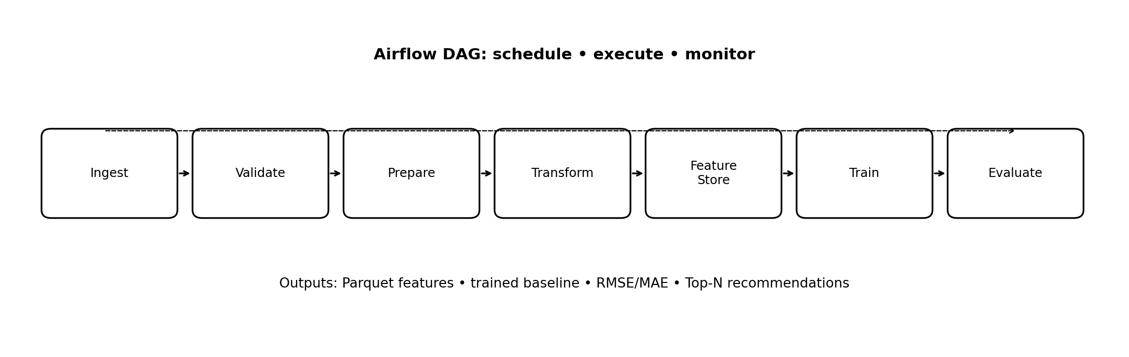
ROLL NUMBER: 202AG05563

Slide 6
Data Quality & Preparation
• Fail-fast checks: required columns and no missing values
• Duplicate user–movie interactions are rejected
• Ratings must be in valid range
• 80% train / 20% test; fixed seed = 42
ROLL NUMBER: 202AG05563

Slide 7
Feature Management
• User mean rating and rating count
• Movie mean rating and rating count
• Global training mean
• Parquet offline store for reusable features
• Feature statistics computed from training data only
ROLL NUMBER: 202AG05563

Slide 8
Baseline Model
• Transparent user/item mean baseline
• Prediction averages global, user, and item means when available
• Unknown user/item falls back to global mean
• Simple benchmark before advanced models
ROLL NUMBER: 202AG05563

Slide 9
Evaluation & Recommendations
• Metrics: RMSE and MAE on held-out ratings
• Lower error means closer rating predictions
• Exclude already-seen movies
• Sort candidate scores and return Top-N
• Run pipeline to populate metrics.json
ROLL NUMBER: 202AG05563

Slide 10
Orchestration & Reproducibility
• Apache Airflow DAG runs weekly
• Single pipeline entry point: python src/pipeline.py
• Fixed random seed; modular Python components
• Set DAG project path before deployment
ROLL NUMBER: 202AG05563

Slide 11
Limitations & Future Work
• Random split: consider temporal split
• Baseline lacks latent factors/content
• Cold-start fallback is limited
• Upgrade: SVD/ALS, ranking metrics, Feast, model registry
• Add monitoring, drift checks, alerts, online serving
ROLL NUMBER: 202AG05563

Slide 12
Conclusion & Proof of Work
• Implemented modular end-to-end workflow and artifacts
• Notebook documents execution and analysis
• Report explains decisions, model, metrics, limitations
• Personalize, execute, capture actual outputs before submission
ROLL NUMBER: 202AG05563

