Slide 1
Hindi Speech Recognition
Group Members:
Niket Khandelwal (111070008)
Tanmay Inamdar (111070014)
Gaurav Deshmukh (111070016)
Jignesh Jain (111070050)
Project Guide:
Prof. Manasi Kulkarni

Slide 2
Speech Recognition
Speech recognition in computer system domain may be defined as the ability of computer systems to accept spoken words in audio format and then generate its content in text format.

Slide 3
Motivation
Hindi - popular language (~258m people in India) written in devanagari script
Difficult to represent on a keyboard
Sophisticated input methods exist for European and even Asian languages
Difficult and time consuming to type using existing methods
Lack of easy input methods discourages people from using it on computer

Slide 4
Problem Statement
The primary aim of the project is to develop an easier alternative for existing input systems for Hindi language. We propose a speech-to-text solution to solve this problem.
We aim to develop an isolated word detection system for finite vocabulary, which is an elementary solution

Slide 5
Existing systems
Native keyboards for Devanagari
Phonetic keyboard mappings like Bolnagri, InScript
Transliteration tools like Google Transliterate

Slide 6
Problems with Existing systems
Native keyboards: rare, specialized hardware
Phonetic keyboards: need to remember layout, difficult to use
Transliteration tools: sometimes unexpected and inaccurate results

Slide 7
Speech Recognition: Our Approach
Our system uses isolated word detection technique
Speech is first segmented into isolated words
Every word is then compared with words in dictionary to find the best match
Such system can recognize all words in dictionary

Slide 8
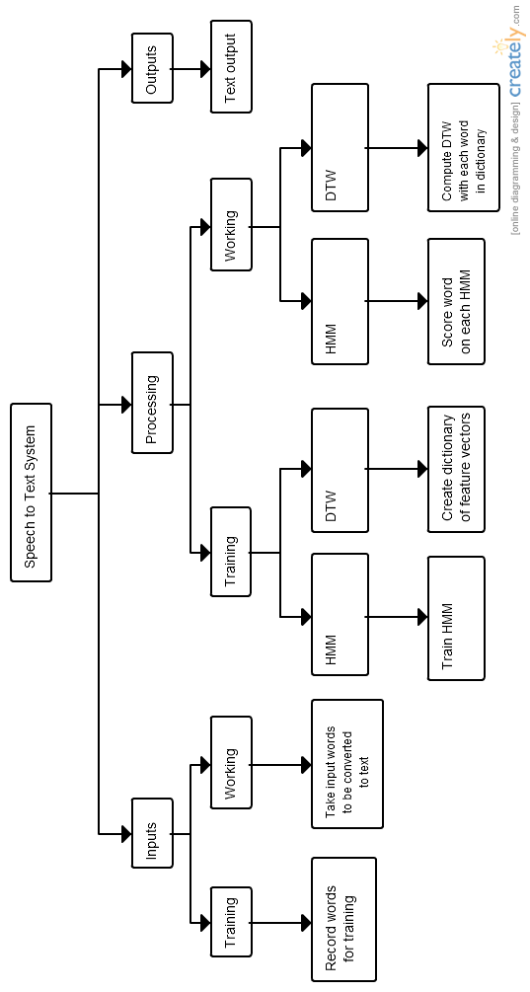
Architecture Diagram

Slide 9
Steps involved in Speech Recognition
Voice Recording
Word Isolation
Feature Extraction
Recognition using Acoustic Models

Slide 10
Sound Recording Component
Input is from Microphone
Output is fed to Word Isolation Component
This component takes input from microphone and saves it as wave file. This audio file serves as input to Word Isolation Component.
The sampling frequency is 44.1 kHz, i.e. there are 44100 audio samples per second

Slide 11
Word Isolation Component
Input is from Sound Recording Component
Output is isolated words which is fed to Feature Extractor Component
This component takes input recorded audio and isolates words
It is done by marking regions in audio as speech and
non-speech

Slide 12
Feature Extraction component
Input is from audio files from Word Isolation component
Output is feature vectors which is fed to recognition component
Component divides audio in overlapping frames of 25ms
It generates MFCC coefficients for each frame and stores them as feature vectors

Slide 13
MFCC
Mel Frequency Cepstral Coefficients (MFCCs) features are widely used in automatic speech and speaker recognition
MFCC Features are used to identify the components of the audio signal that are good for identifying the linguistic content and discarding all the other stuff which carries information like background noise, emotion etc.
Sounds generated by a human are filtered by the shape of vocal tract i.e. tongue, teeth etc. The shape of the vocal tract manifests itself in the envelope of the short time power spectrum, and the job of MFCCs is to accurately represent this envelope.

Slide 14
Steps involved in MFCC Calculation
Frame the signal into short frames.
For each frame calculate the periodogram estimate of the power spectrum.
Apply the mel filterbank to the power spectra, sum the energy in each filter.
Take the logarithm of all filterbank energies.
Take the DCT of the log filterbank energies.
Keep DCT coefficients 2-13, discard the rest.
Calculate delta and delta-delta coefficients for greater accuracy

Slide 15
Recognition component
Input is feature vectors from Feature Extraction component
Output is text corresponding to recognized speech
Recognition Component uses one of the following two approaches:
Dynamic Time Warping (DTW)
Hidden Markov Model (HMM)

Slide 16
Dynamic Time Warping (DTW)
Dynamic time warping is an algorithm for measuring similarity between two sequences that may vary in time or speed
DTW has been applied to video, audio, and graphics – indeed, any data that can be turned into a linear representation can be analyzed with DTW
A well-known application has been automatic speech recognition, to cope with different speaking speeds of different users

Slide 17
Hidden Markov Model (HMM)
HMM is a statistical Markov model in which the system being modeled is assumed to be a Markov process with unobserved (hidden) states
HMM is characterized by three probability measures:
A - State transition probability distribution matrix
B - Observation symbol probability distribution in state
𝜋 - Initial state distribution

Slide 18
Applications of HMM in Speech Recognition
HMM has three major applications in speech recognition systems:
Compute probability of observation sequence given the HMM (Forward-backward algorithm)
Choose state sequence given the observation sequence and HMM (Viterbi algorithm)
Adjust parameters of HMM to maximize probability of observation sequence (Baum-Welch algorithm)
In our system, relevant applications are 3 (training) and 1 (detection)

Slide 19
Baum-Welch Algorithm
It makes use of Expectation-Maximization (EM) Algorithm
It outputs maximum likelihood estimate of parameters of the HMM, given a set of observed feature vectors
It is used to train the HMM using the training data

Slide 20
Forward-backward Algorithm
It is an inference algorithm that computes posterior probabilities of hidden state variables, given a sequence of observations
It makes use of dynamic programming to efficiently compute values required to compute posterior marginal distributions
The first pass goes forward in time, whereas second pass goes backward in time, hence the name

Slide 21
Comparison of HMM and DTW
DTW works accurately for small training data, and for known speakers
However, DTW has the running time of O(|V| n²)
HMM is a probabilistic method has running time O(|V| s²)
HMM can give reasonable accuracy for multiple speakers
Where |V| - number of words in dictionary
n - number of frames (~100)
s - number of states (3)

Slide 22
Data Set Generation
Three different sets of words were used as dictionary, each containing 10 words
Set-1: Hindi numerals from 1 to 10
Set-2,3: Commonly used Hindi words
For each word in a set, 4 different speakers recorded 5 samples each
Thus each dictionary contains 200 total samples for each set

Slide 23
Test Results
Using HMM (Set 1)
Type of Sound | Number of Sounds | Correct Recognition
Seen sound | 30 | 24
Unseen sound seen user | 30 | 18
Unseen user | 20 | 8

Slide 24
Test Results
Using DTW (Set 1)
Type of Sound | Number of Sounds | Correct Recognition
Seen sound | 30 | 30
Unseen sound seen user | 30 | 21
Unseen user | 20 | 5

Slide 25
Applications
As an alternative to existing input systems
Can replace intermediate human writer for illiterate people
Also for physically challenged people
System works well for known voices and for finite vocabulary, so it can be used as voice command system

Slide 26
Limitations and Future Work
Our system performs finite vocabulary detection, because only one HMM layer
Practical speech-to-text systems can have multiple HMM layers for phone detection, word detection, language model
Limited dataset, so it doesn’t handle variations in speech, dialects etc. very well

Slide 27
References
Rabiner L. ‘A Tutorial On Hidden Markov Models and Selected Applications in Speech Recognition’
R. Gupta, ‘Speech Recognition For Hindi’
MFCC Tutorial: http://practicalcryptography.com/miscellaneous/machine-learning/guide-mel-frequency-cepstral-coefficients-mfccs/
Single Speaker Speech Recognition in Hidden Markov Models: http://kastnerkyle.github.io/blog/2014/05/22/single-speaker-speech-recognition/

Slide 28
Thank You!

