Slide 1
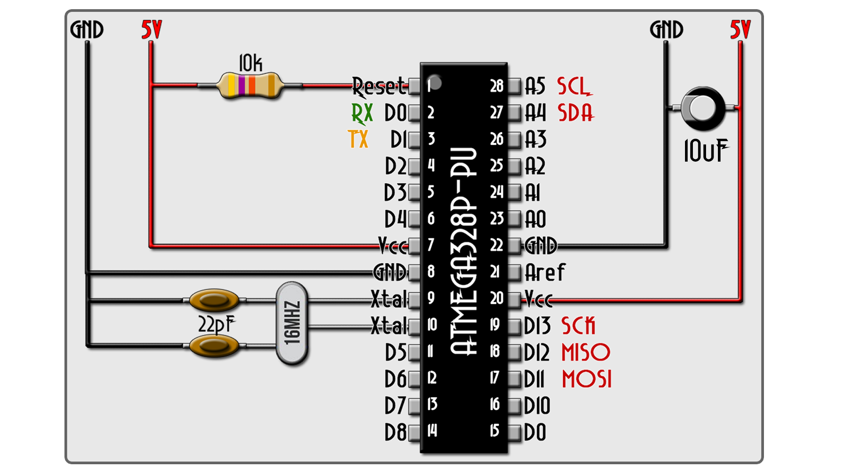


PART 1 - The prepare schematic
Voltage supply is 3,3 volts. This supply has to be well regulated with no voltage spikes and an extra 10uF capacitor between 3V3 and GND. Also, the reset pin is negative enabled. In order to disable it, we need to apply 3V3 to it.
To reset, a 10k Ohms resistor is needed between RESET and Vcc.
In this tutorial, ATMega328P works at 3V3. For that, between pins 9 and 10 we place a 8MHz crystal. But this crystal, in order to oscillate needs two capacitors of 22pF connected to GND. In the figure above, you have all the pins of the chip. Right now, if the microcontroller has a bootloader, we could upload a code. But let's imagine it doesn't have a bootloader.

Slide 2
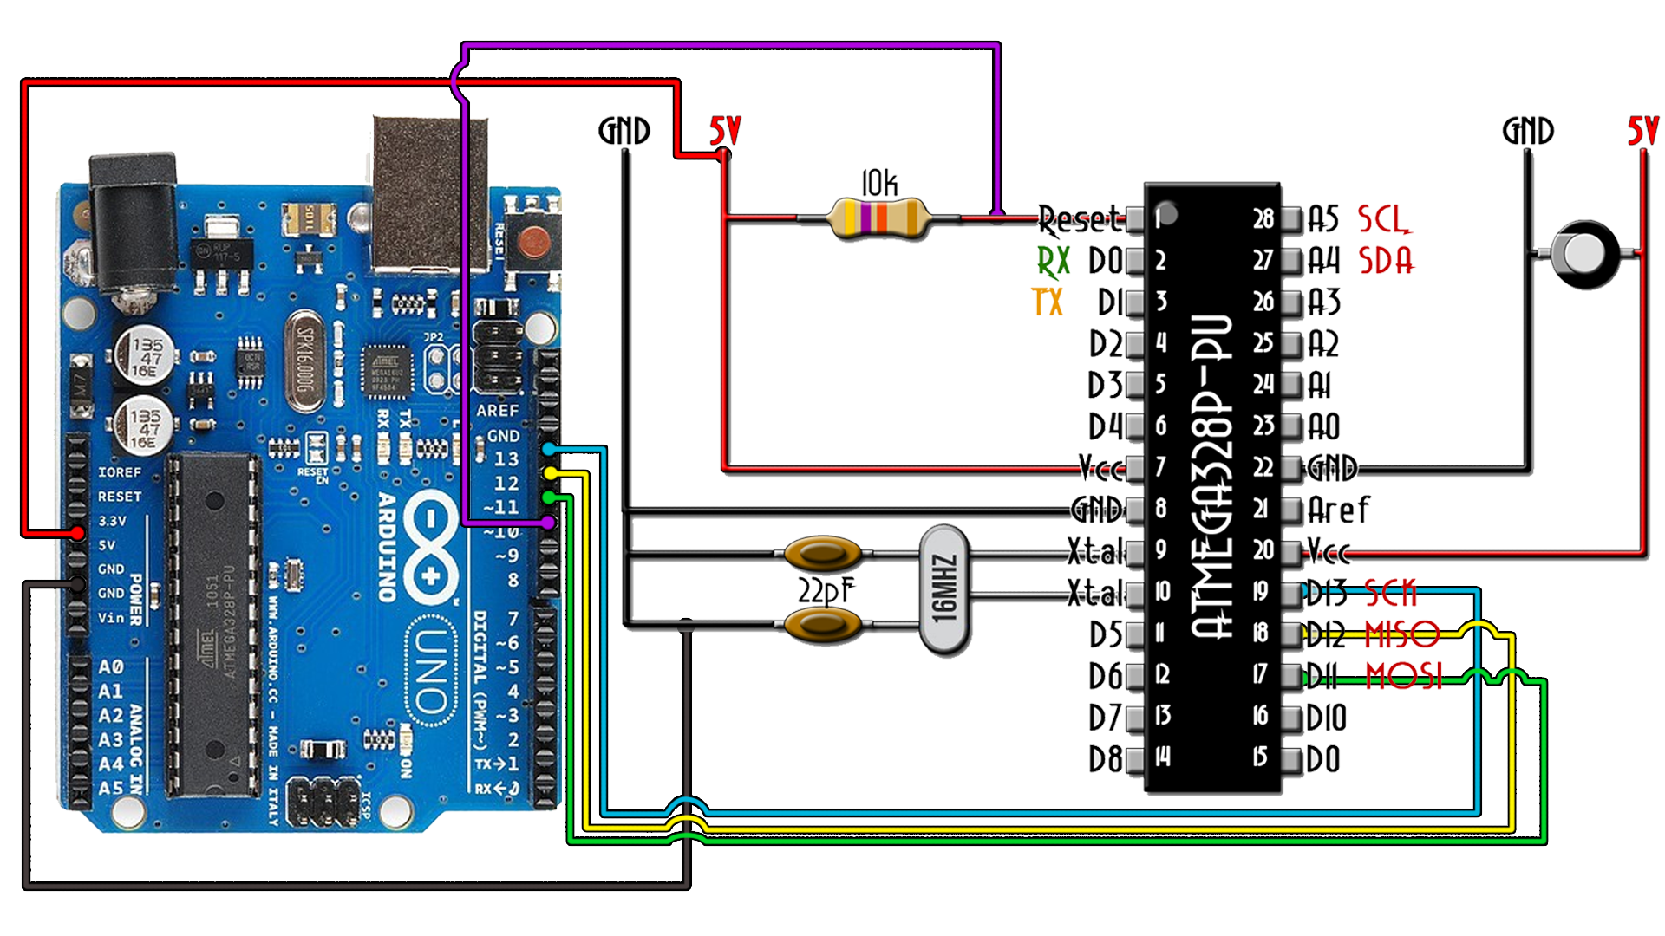

PART 2 - Burn Bootloader
Now, if the chip doesn't have the bootloader (virgin chip), you have to make next connections from an Arduino ProMini. These are the SPI pins, CLOCK, MISO and MOSI.
Now connect the Arduino to your PC. Open Arduino IDE and go to File → Examples → Arduino ISP and upload that example. It’s time to burn the bootloader. Go to Tools → Programmer → Arduino as ISP. By that we change the programmer to ISP. Finally, go to Tools → Burn bootloader. Now the LEDs of the Arduino will blink a lot. Once you get the message of bootloader burned we are good to go.

Slide 3
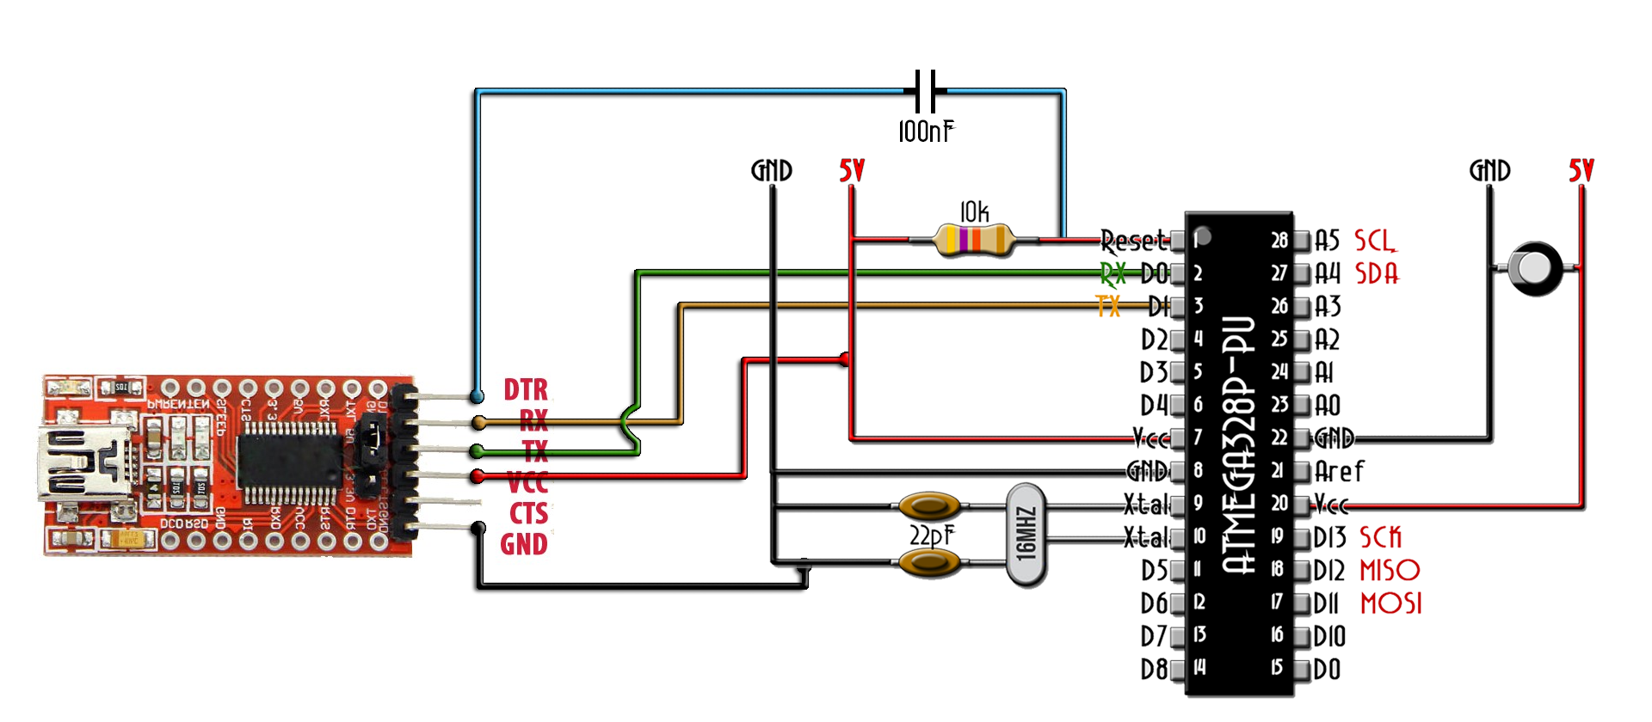
PART 3 - Upload a code
Now, we have the bootloader so we can communicate with the RX and TX pins and upload a code. For that we need and FTDI module. Make the next connections and upload your code.

