Slide 1

Weight loss Program
Visualization

Slide 2
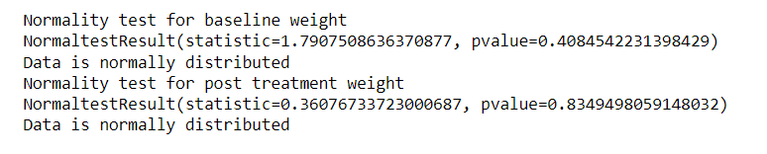
Statistic functions

Slide 3



Statistic functions
DESCRIPTIVE

Slide 4
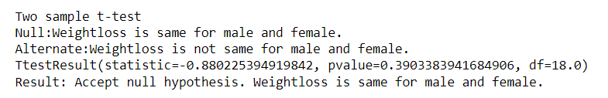
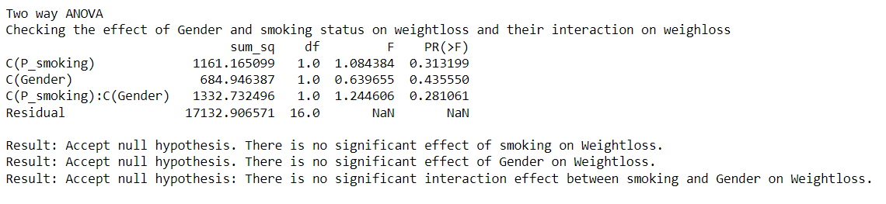
Inferential statistics
tTEST
ANOVA

Slide 5
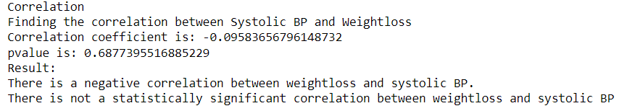
Inferential statistics
CORRELATION

Slide 6
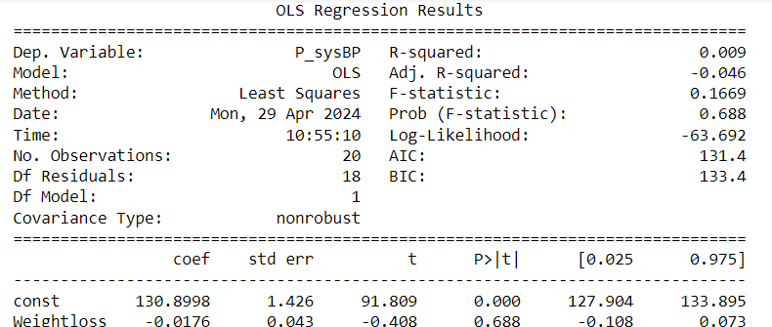
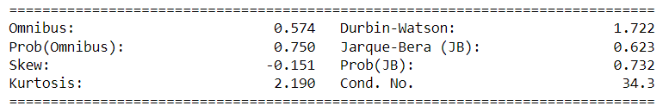
Inferential statistics
REGRESSION

Slide 7
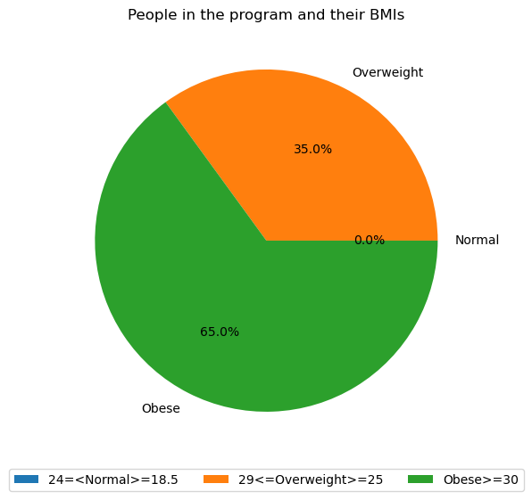
Visualization
Pie Chart | BMI

Slide 8
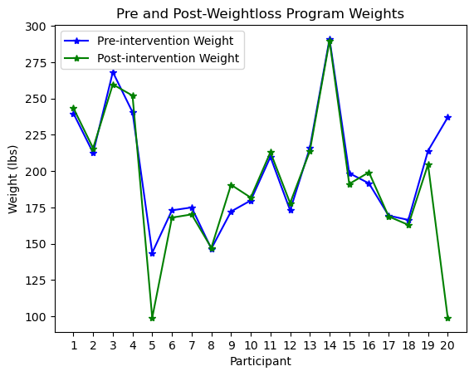
Visualization
Line Plot | Baseline weight and post-intervention weight

Slide 9
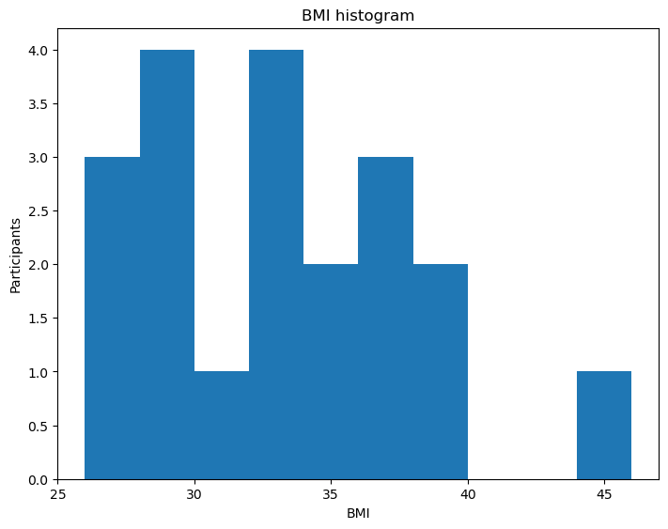
Visualization
Histogram | BMI

Slide 10
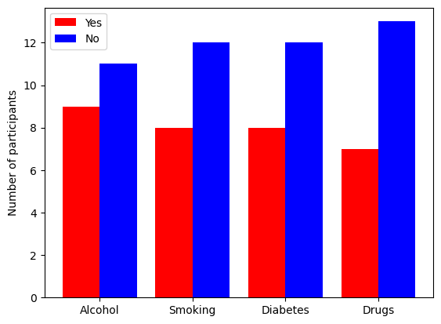
Visualization
Bar Chart | Comorbidity count

