Slide 1

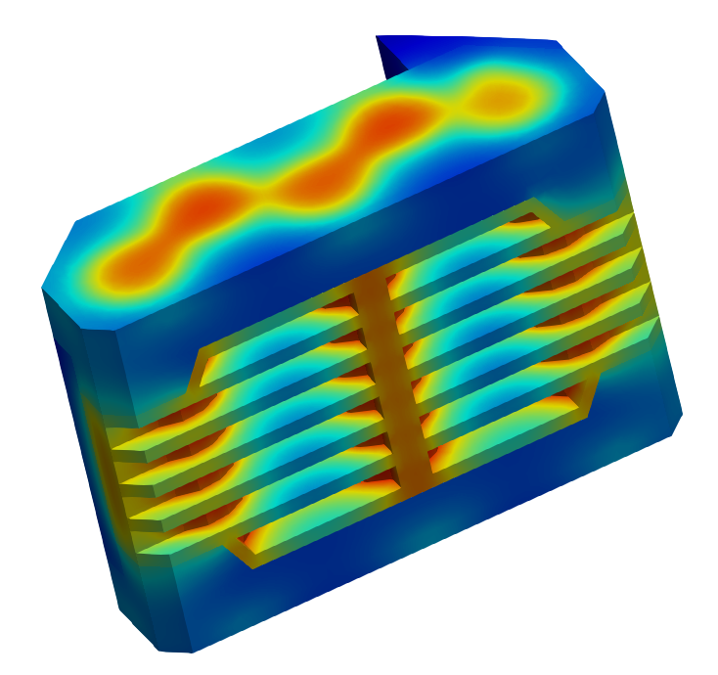
Q-Bat use case Power tool’s battery pack

Slide 2
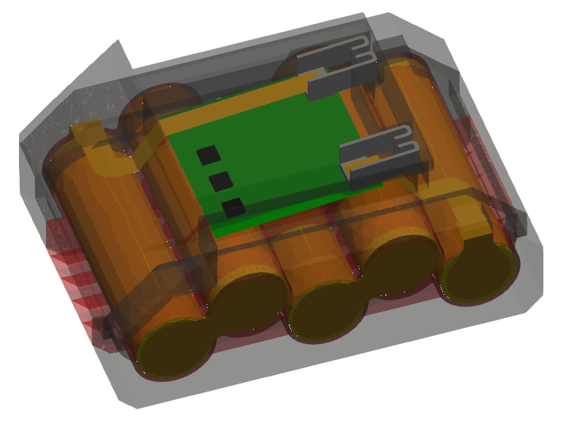
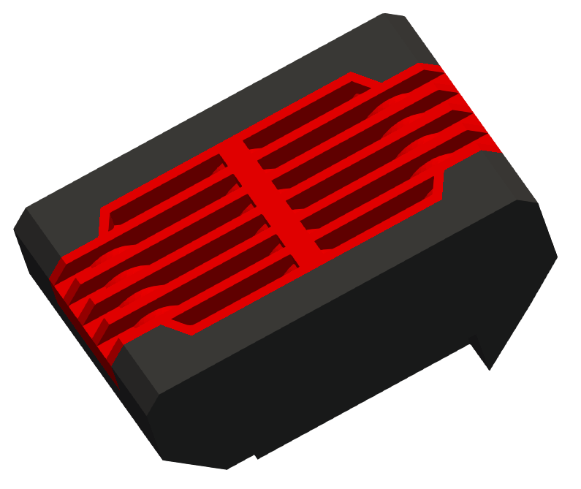
Overview of model
This use case presents how to perform simulation of heat transfer in a power tool’s battery pack in Q-Bat software.
The model consists 5 groups of 21700 Li-ion cells (5s1p), terminals, connectors, bus burs, transistors, circuit board and casing.

Slide 3
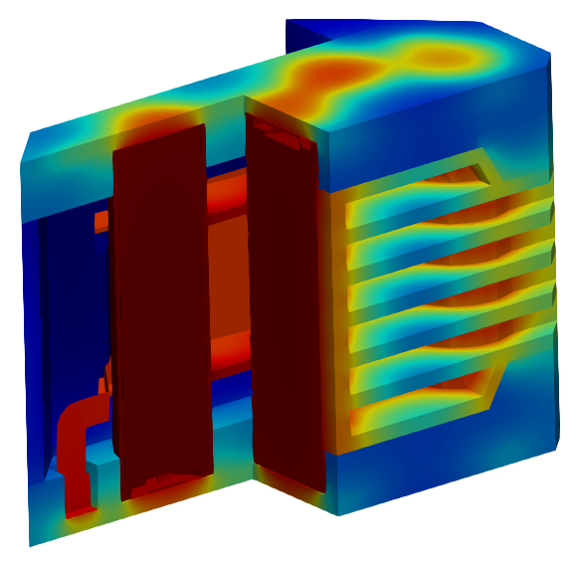
Thermal model
Heat generated uniformly across cell volume
Thermal contacts set to transfer heat between chosen surfaces
Additional heat generation in due to losses
Robin boundary condition is assigned to the casing outer boundaries.
Ambient temperature of 25 °C

Slide 4
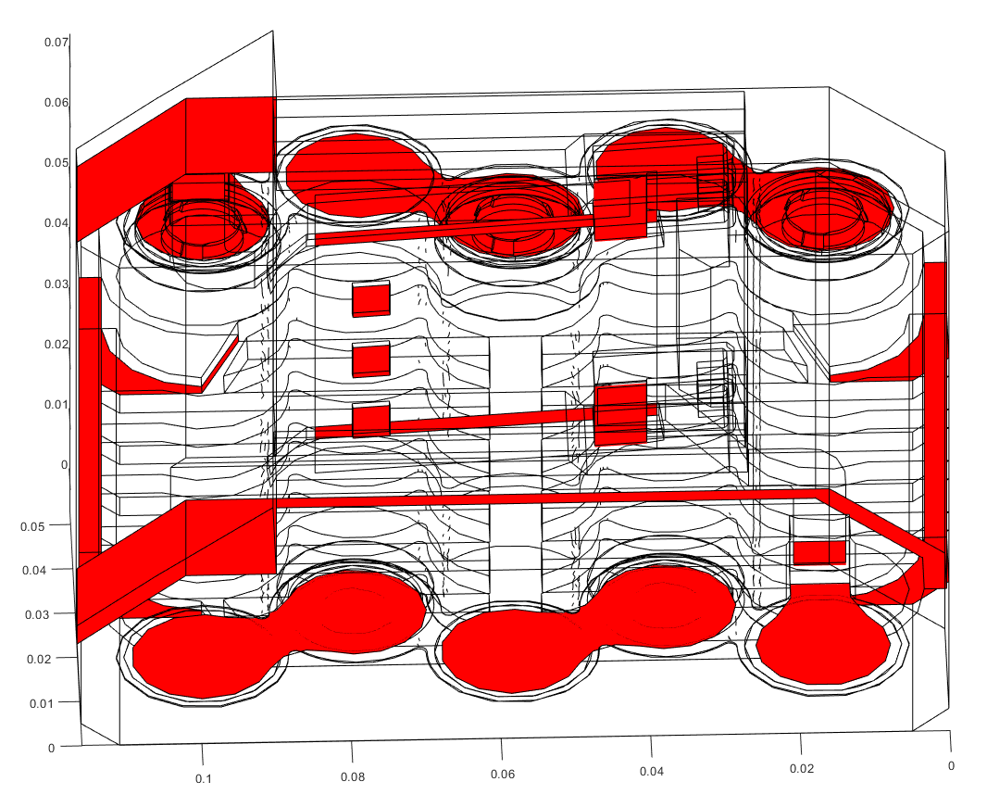
Model assembly
All components are aggregated in multiple assemblies and contact regions between them are created.
Different contact conductivities are set.
Overall 64 contact regions.

Slide 5
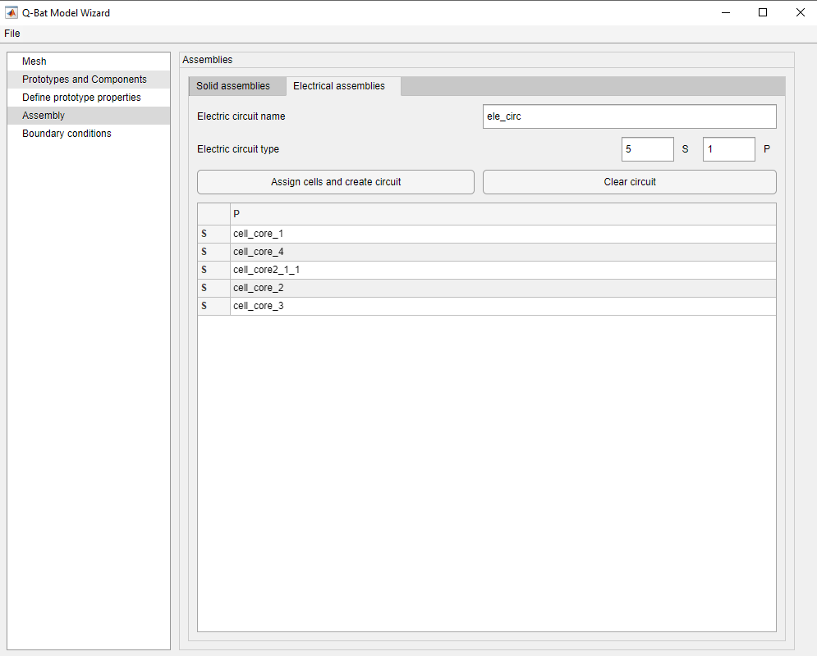
Electric circuit
5 cells connected in series
Heat generation is set by specifying the electrical properties of the cell (capacity, voltage, resistance) and applied current load, that varies in time
Cells are modelled using RC equivalent circuit model

Slide 6
Prototype properties
Material properties of the cells and heat comoponents are defined in the Excel spreadsheet
Part | rho | cp | λφ | λr | λz
Cell | 2650 | 1250 | 28 | 1.3 | 28
 |  |  | λx | λy | λz
Casing | 1200 | 1200 | 0.2 | 0.2 | 0.2
Connectors | 8890 | 385 | 388 | 388 | 388
Bus bars | 8890 | 385 | 388 | 388 | 388
Terminals | 7870 | 460 | 52 | 52 | 52
Transistors | 8890 | 385 | 388 | 388 | 388
Circuit board | 6778 | 600 | 271 | 271 | 271

Slide 7
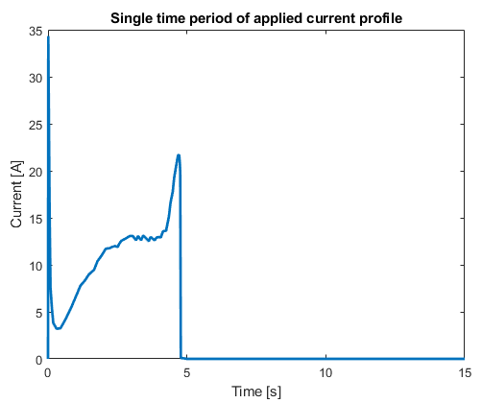
Example 1 – Normal operation
Operation of battery pack during regular use of a power tool
Current profile consists of 24 reapeted cycles, which simulate screwing in a screw followed by a break
Initial state of charge is 80%
Overall 360 seconds of operation simulated

Slide 8
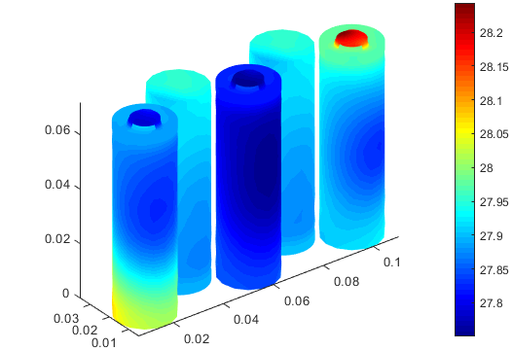
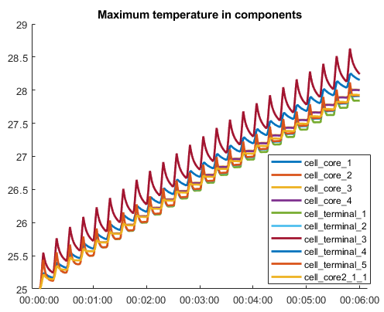
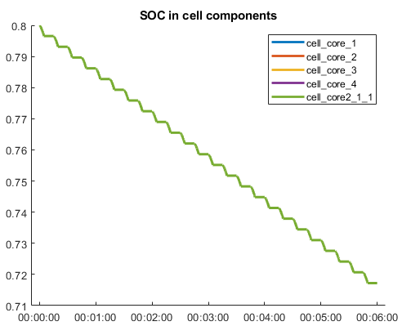
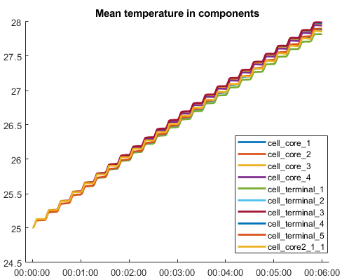
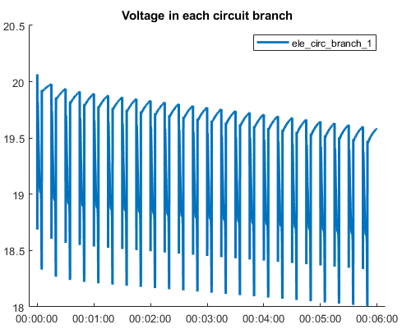
Example 1 – Post-processing
°C

Slide 9
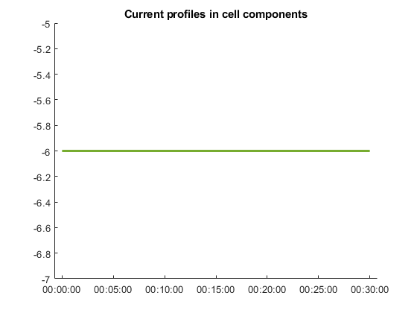
Example 2 – Rapid charging
Operation of battery pack during fast charging
Constant current of 6 A
Initial state of charge is 0%
Overall half an hour of operation simulated

Slide 10
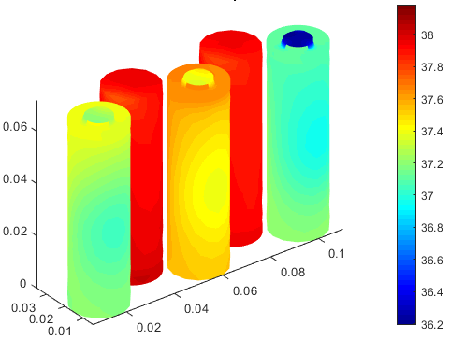
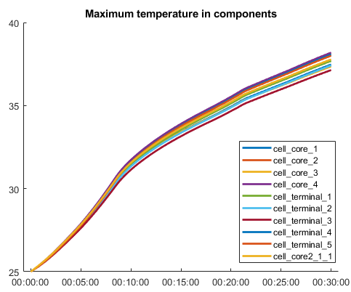
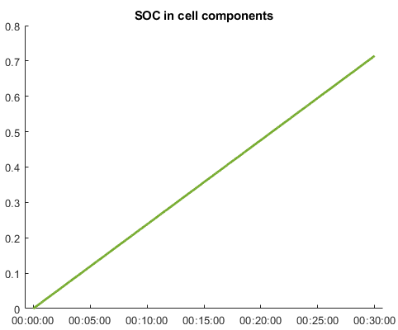
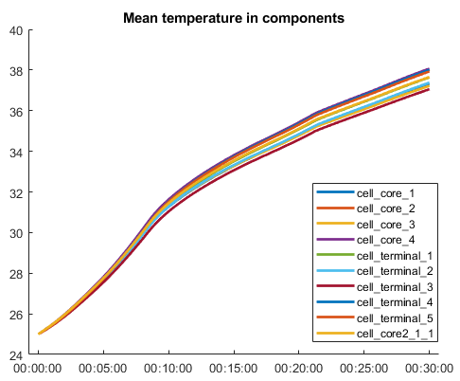
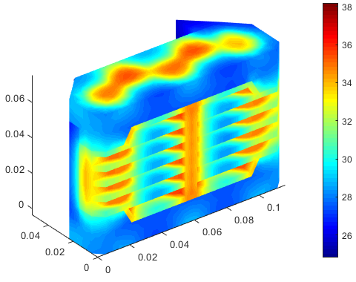
Example 2 – Post-processing
°C

Slide 11
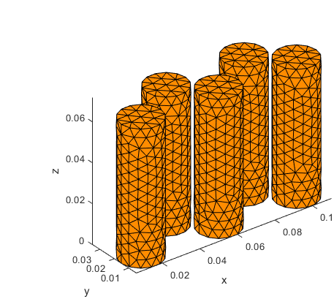
Example 3 – Thermal propagation
One cell is heating significantly more due to malfunction. Heat dissipation from a faulty cell will be checked.
Constant current of 6 A
Initial state of charge is 0%
Overall half an hour of operation simulated
Faulty cell

Slide 12
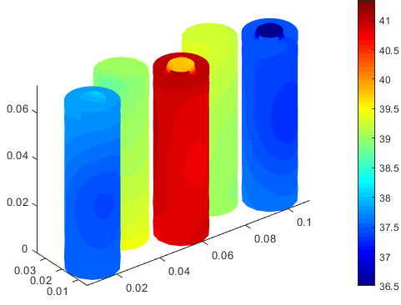
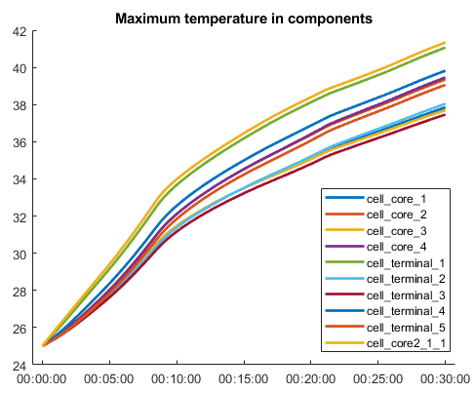
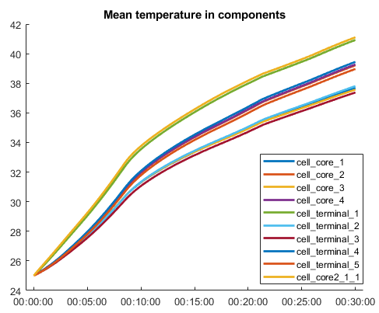
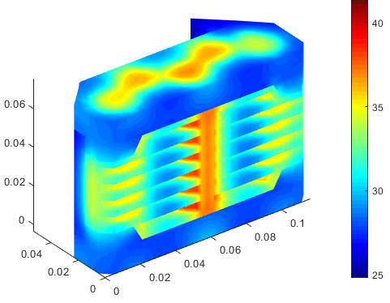
Example 3 – Post-processing
°C

Slide 13
Summary
The model consists of:
13 prototypes,
28 components,
209 000 mesh elements,
64 contact regions.
The overall simulation time is only 10-20 minutes.

Slide 14
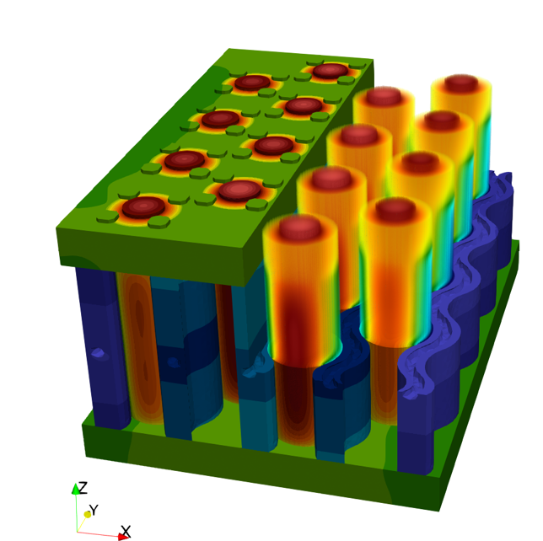
Learn more
Q-Bat is a MATLAB-based product for real-time battery thermal simulation in 3D with CFD-like accuracy. Its main features are:
Near real-time execution
Accurate 3D data of battery temperature distribution
The capability of exporting the model to the Simulink
Fast model definition via dedicated GUI and TUI.
To learn more:
QuickerSim https://emobility.quickersim.com/
Q-Bat product page https://www.mathworks.com/products/connections/product_detail/quickersim-q-bat.html
For a free Q-Bat lite license, visit QuickerSim licensing website https://licensing.quickersim.com/
To get full version trial write to q-bat@quickersim.com

