Slide 1

EdgeMATX
673
Design and Integration of a TinyML Systolic Accelerator with PicoRV32
Cycles
54x
Peak Speedup
Submitted by
Nishchay Pallav 221EC233
Mohammad Omar Sulemani 221EC230
Md Atib Kaif 221EC129
19/19
Tests Pass
4x4
Under the Guidance of Dr Rathamala Rao
Systolic Array
Dept. of Electronics & Communication Engineering National Institute of Technology Karnataka, Surathkal 575025

Slide 2
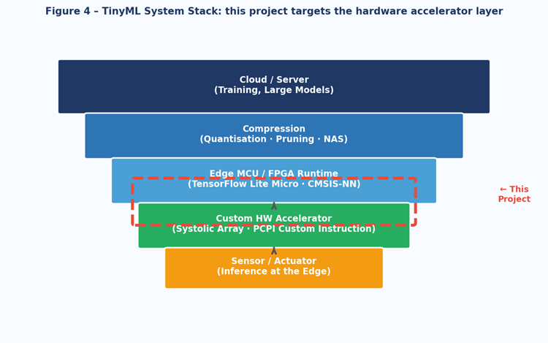
Introduction
A hardware coprocessor for matrix multiplication on embedded RISC-V
What is EdgeMATX?
A custom hardware coprocessor tightly coupled to the open-source PicoRV32 RISC-V processor. A single custom instruction replaces 64 sequential software operations with 16 fully parallel hardware MACs.
Why Does It Matter?
> TinyML inference on edge devices is dominated by dense matrix operations
> General-purpose RISC-V cores execute these sequentially -- very slowly
> Purpose-built systolic hardware delivers 38-54x speedup at minimal area
Our Approach
One opcode. CPU stalls. 4x4 systolic array fires. Results appear in memory. 673 deterministic cycles -- every time.
Scope & Status
RTL simulation complete. 19/19 tests passing. Two live web visualizers. FPGA deployment upcoming.
EdgeMATX | NITK Surathkal | ECE Department | 2026

Slide 3
The Problem
Matrix multiplication is ubiquitous -- and painfully slow on embedded CPUs
Where It's Needed
Sequential CPU Execution
The Gap
TinyML Inference
Neural network layers are dense GEMM ops
Digital Signal Proc.
Convolution = repeated matrix multiply
Scientific Computing
Linear solvers, transforms, all matrix ops
Image Processing
Filters, transforms, feature extraction
for i in range(4):
for j in range(4):
for k in range(4):
C[i][j] += A[i][k]
* B[k][j]
26 K
cycles wasted per 4x4 multiply
100%
sequential execution on CPU
64 multiply-accumulate ops
executed one at a time
RV32I (no MUL): 26,130 cycles
RV32IM (with MUL): 7,975 cycles
0x
hardware parallelism
EdgeMATX | NITK Surathkal | ECE Department | 2026

Slide 4
The Solution: EdgeMATX
A custom PCPI coprocessor tightly coupled to PicoRV32
One custom instruction replaces 64 sequential CPU operations
Tightly Coupled
Systolic Datapath
Q5.10 Fixed-Point
PCPI interface: zero memory-mapped overhead. CPU stalls and resumes -- no interrupts, no DMA.
4x4 array of 16 processing elements. All 16 MACs execute in parallel every clock cycle.
16-bit signed arithmetic. No floating-point hardware needed -- ideal for constrained silicon.
673
Deterministic cycles
38.83x
Speedup (sparse data)
53.86x
Speedup (dense data)
11.85x
Speedup vs MUL rv32im
EdgeMATX | NITK Surathkal | ECE Department | 2026

Slide 5
Project Progress
Simulation-complete milestone -- all RTL objectives achieved
DONE
Phase 1: RTL Design
DONE
Phase 2: Simulation & Verification
4x4 systolic array in Verilog (Q5.10 fixed-point MACs)
PCPI coprocessor wrapper for PicoRV32
Memory-mapped I/O: A@0x100 B@0x140 C@0x200
19/19 standalone accelerator tests -- 100% PASS
8/8 CPU integration regression tests -- 100% PASS
Cycle benchmarking: 673 deterministic cycles confirmed
DONE
Phase 3: Tooling & Documentation
NEXT
Phase 4: FPGA Deployment
Two interactive web visualizers deployed on Vercel
Full LaTeX project report submitted
38-54x speedup measured and documented
Synthesize on Pynq-Z2 (Xilinx Zynq-7020)
On-board cycle validation and timing closure
AXI-BRAM memory interface integration
EdgeMATX | NITK Surathkal | ECE Department | 2026

Slide 6
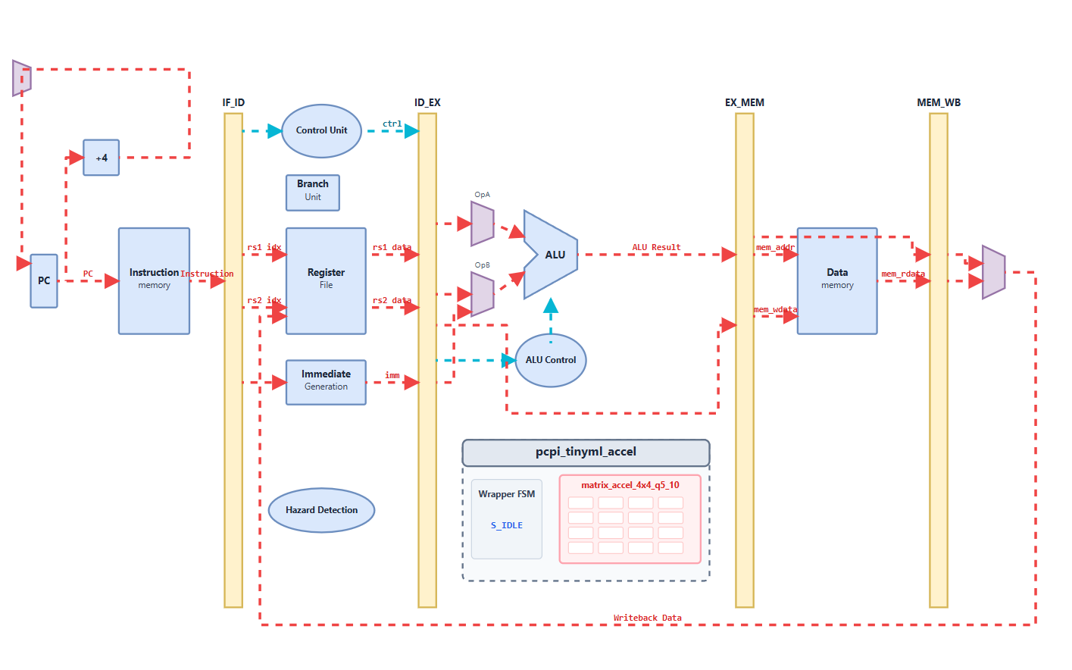
System Architecture
Firmware -> PicoRV32 -> PCPI -> 4x4 Systolic Accelerator -> Memory
Architecture Layers
Firmware (RISC-V C)
Loads matrices at mapped addresses, issues custom opcode 0x5420818b
PicoRV32 CPU
RV32I core, ENABLE_PCPI=1, decodes custom opcode, stalls until pcpi_ready
PCPI Wrapper
Detects instruction, drives systolic engine, asserts pcpi_ready on finish
4x4 Systolic Array
16 Q5.10 MAC units, output-stationary dataflow, 673 deterministic cycles
Flat Memory Map
A: 0x100-0x13C B: 0x140-0x17C C (result): 0x200-0x23C
EdgeMATX | NITK Surathkal | ECE Department | 2026

Slide 7
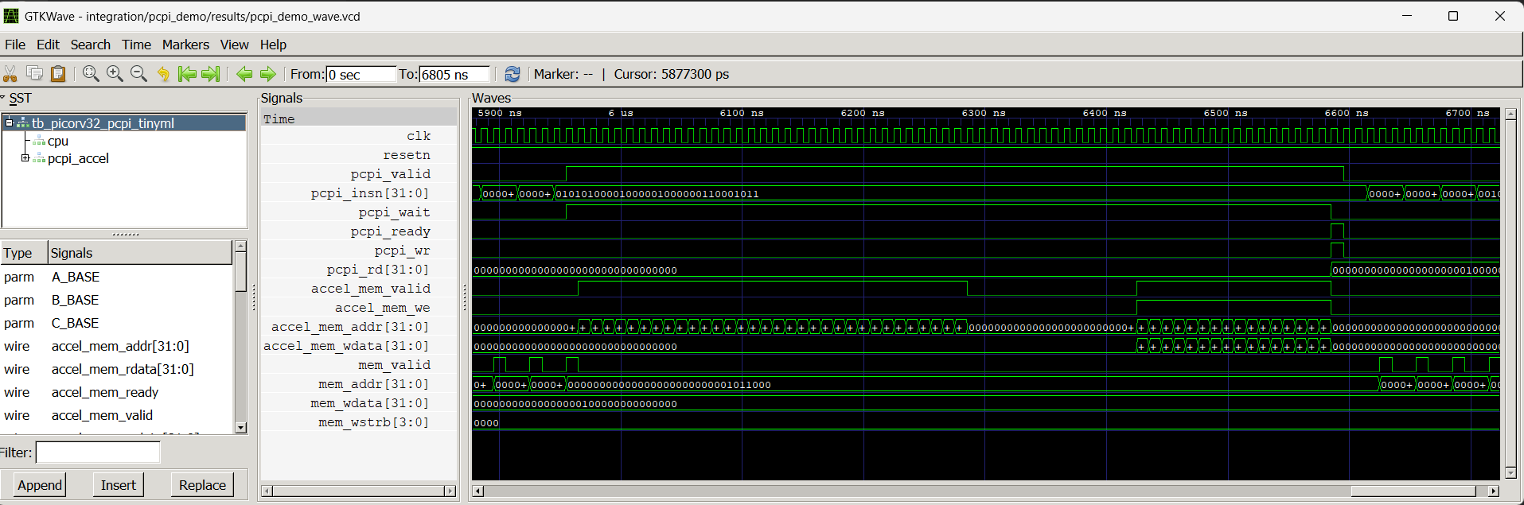
PCPI: The Custom Instruction Bridge
Pico Co-Processor Interface -- zero-cost hardware dispatch
Interface Signals
Execution Handshake
pcpi_valid
CPU -> CoPro | Custom instruction detected
pcpi_insn
CPU -> CoPro | Full 32-bit instruction word
pcpi_rs1/2
CPU -> CoPro | Source registers (matrix A/B addr)
pcpi_ready
CoPro -> CPU | Computation done -- CPU resumes
pcpi_wr/rd
CoPro -> CPU | Write-back flag + result (unused)
pcpi_wait
CoPro -> CPU | Hold CPU stall (optional)
1
CPU fetches 0x5420818b custom opcode
2
pcpi_valid=1, rs1/rs2 broadcast to coprocessor
3
CPU stalls -- awaiting pcpi_ready=1
4
Coprocessor reads matrix A & B from memory
5
4x4 systolic array computes 16 dot products
6
Results written to matrix C region (0x200-0x23C)
7
pcpi_ready=1 -- CPU resumes next instruction
Custom opcode: 0x5420818b (custom-0 space, funct7=0101010, rs2=00000, funct3=000, opcode=0001011)
EdgeMATX | NITK Surathkal | ECE Department | 2026

Slide 8
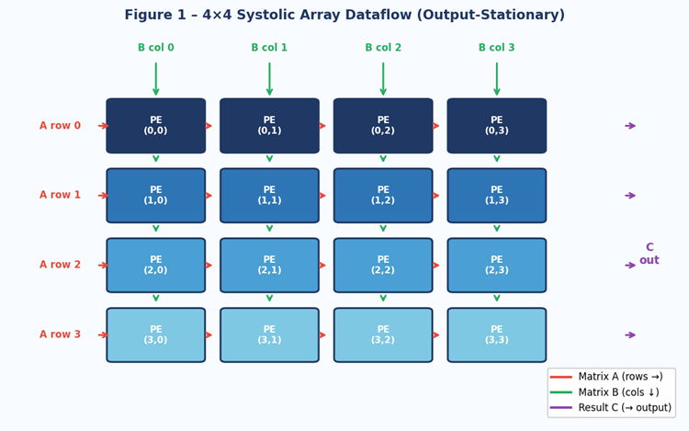
The 4x4 Systolic Array
16 parallel Processing Elements -- output-stationary dataflow
How It Works
Output-stationary
Each PE accumulates its partial sum for C[i,j] in place
Row broadcast
Row i of matrix A flows right across row i of PEs
Column broadcast
Column j of matrix B flows down column j of PEs
Parallel MACs
All 16 PEs fire simultaneously every clock cycle
Deterministic
673 cycles regardless of operand values
16-bit Q5.10
Multiply -> shift-right 10 -> accumulate -> truncate
EdgeMATX | NITK Surathkal | ECE Department | 2026

Slide 9
Q5.10 Fixed-Point Arithmetic
16-bit two's complement -- integer simplicity, fractional precision
S
I4
I3
I2
I1
I0
F9
F8
F7
F6
F5
F4
F3
F2
F1
F0
15
14
13
12
11
10
9
8
7
6
5
4
3
2
1
0
Sign (1 bit)
Integer part (5 bits)
Fractional part (10 bits)
Range
Resolution
Format
Scaling
-32.0 to +31.999
1 / 1024 ~ 0.001
16-bit signed integer
Multiply -> shift right 10 bits
Processing Element MAC Operation (per clock cycle):
(1) Multiply
(2) Scale
(3) Accumulate
(4) Pass through
a_in x b_in -> 32-bit signed product
product >>> 10 (arithmetic right-shift corrects Q5.10)
acc += scaled_product (32-bit running sum)
a_out <- a_in ; b_out <- b_in (feed neighbours)
EdgeMATX | NITK Surathkal | ECE Department | 2026

Slide 10
Verification Strategy
Four-layer simulation campaign -- unit tests to full system benchmarking
4
Layer 4 | Performance Benchmarking
673 cycles
Cycle-count measurement against two software baselines (no-MUL and MUL-equipped).
3
Layer 3 | Protocol Handoff Validation
PASS
Isolated test of PCPI signal handshake -- pcpi_valid, pcpi_ready, pcpi_insn correctness.
2
Layer 2 | CPU Integration Regression
8 / 8 PASS
Full system simulation: PicoRV32 + PCPI wrapper + accelerator. 8 input profiles.
1
Layer 1 | Standalone Unit Tests
19 / 19 PASS
Accelerator module in isolation. Zero, identity, dense, boundary, negative-element cases.
EdgeMATX | NITK Surathkal | ECE Department | 2026

Slide 11
Verification Results
100% pass rate across all test flows -- simulation-complete milestone
Test Category Breakdown
100%
Zero / Null Matrix
2/2
Identity Matrix
3/3
PASS RATE
Dense (varied magnitudes)
8/8
19 / 19 standalone unit tests
8 / 8 integration cases
5 / 5 professor demo cases
PASS handoff protocol test
PASS one-command gate check
Q5.10 Sign Boundary
4/4
Negative Elements
2/2
Integration: varied inputs
8/8
Professor Demo Cases
5/5
EdgeMATX | NITK Surathkal | ECE Department | 2026

Slide 12
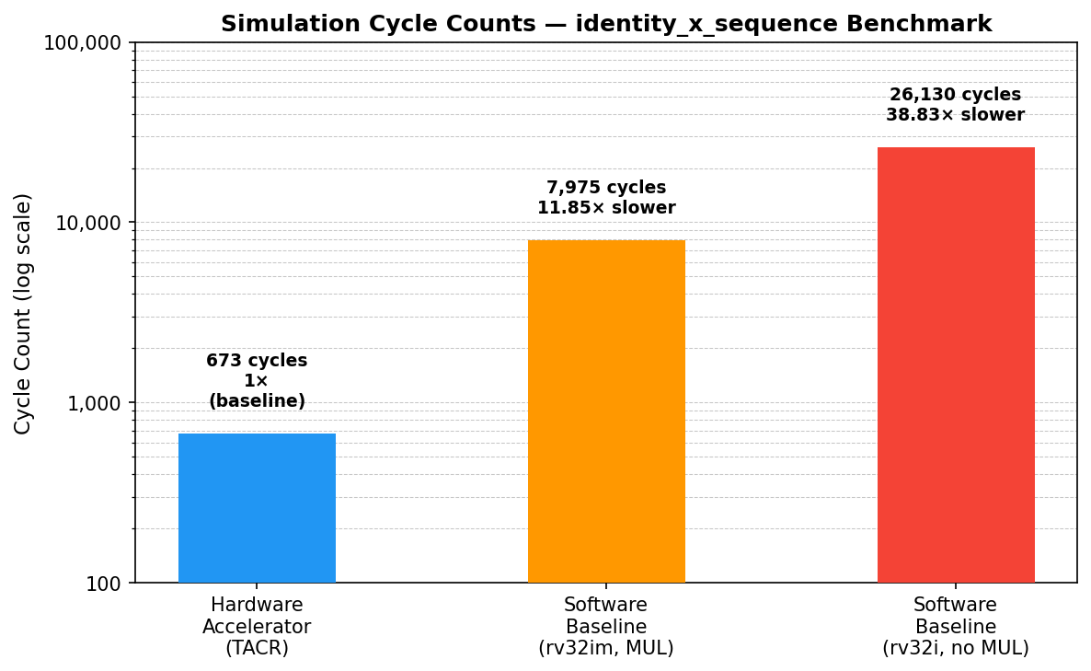
Performance: Cycle Counts
Deterministic execution -- 673 cycles regardless of input values
673
EdgeMATX Accelerator
rv32i + PCPI
7,975
Software + MUL
rv32im baseline
26,130
Software (no MUL)
rv32i baseline
36,246
Software (no MUL, dense)
dense input profile
EdgeMATX | NITK Surathkal | ECE Department | 2026

Slide 13
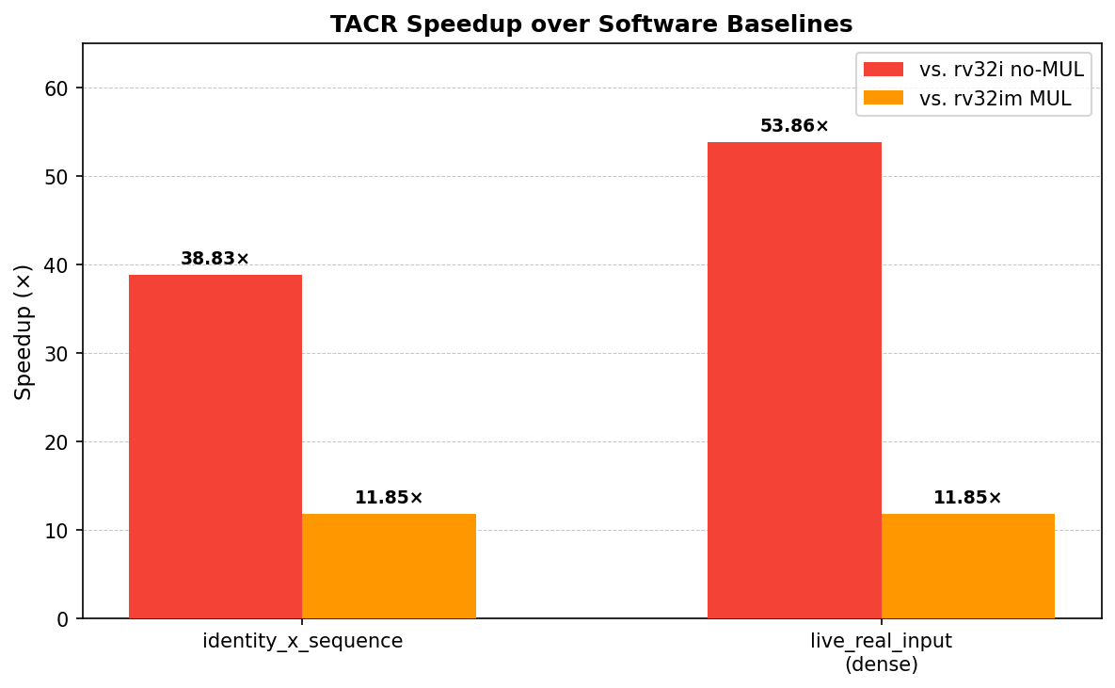
Performance: Speedup
38-54x over rv32i baseline -- 11.85x over MUL-equipped core
38.83x
53.86x
11.85x
Sparse vs rv32i
Dense vs rv32i
Any vs rv32im
Identity-sequence benchmark 26,130 -> 673 cycles
Live dense profile 36,246 -> 673 cycles
Even against MUL-equipped core 7,975 -> 673 cycles
EdgeMATX | NITK Surathkal | ECE Department | 2026

Slide 14
MLPerf Tiny Proxy Benchmark
Industry-standard framing via MLCommons Tiny Anomaly Detection proxy on PicoRV32
MLCommons Tiny
MLPerf Tiny is the most widely used industry benchmark family for tiny edge-AI inference.
EdgeMATX accelerates the tiled matrix-multiply kernel, so we report an Anomaly Detection proxy run: same mapped workload, same 100 MHz assumption, and a fair three-way comparison across HW, RV32I software, and RV32IM software.
mlcommons/tiny benchmark reference
Graphical View: Relative Compute Cost
Exact Benchmark Numbers
Per 4x4 tile, normalized to HW = 1x cost
Same benchmark task, same clock, same Q5.10 data format
HW Accel
1.0x
Metric
HW
SW_I
SW_IM
6.00 ms
Cycles / 4x4 tile
117.2
26130.0
7974.0
Speedup vs HW
1x
222.9x
68.0x
SW MUL
68.0x
Proxy cycles (32)
3752
836160
255168
408.27 ms
AD cycles
600320
133785600
40826880
AD ms @ 100 MHz
6.00
1337.86
408.27
SW no-MUL
222.9x
AD target (<10ms)
MEETS
EXCEEDS
EXCEEDS
1337.86 ms
SW_I / SW_IM benefit
--
--
3.3x
Key takeaway: only the accelerator path meets the <10 ms MLPerf Tiny AD target.
+30% ovhd ms
7.80
1739.21
530.75
EdgeMATX | NITK Surathkal | ECE Department | 2026

Slide 15
Interactive Visualizers
Explore the design live in your browser -- click links below
Architecture Overview
Processor Signal Simulation
riscv-visualizer-2.vercel.app
tinyml-pcpi-visualizer.vercel.app
High-level system architecture and dataflow
Firmware layer | PicoRV32 | PCPI | Systolic Array
Step-through execution with annotations
Instruction decode | PCPI signal timeline
Accelerator invocation waveform
Systolic array computation state
EdgeMATX | NITK Surathkal | ECE Department | 2026

Slide 16
What's Next: Pynq-Z2 FPGA Deployment
Simulation-proven design -> physical hardware closure
DONE
NEXT
FUTURE
Simulation
FPGA Synthesis
Scale & Deploy
673-cycle verified behaviour on Icarus Verilog
Map to Pynq-Z2 Xilinx Zynq-7020 Post-synthesis timing
On-board cycle counts AXI-BRAM memory 8x8 array extension
->
->
Open Items Before Hardware Closure
Cycle-scaling estimator anchor needs updating (869 -> 673)
On-board rdcycle CSR measurements to cross-validate simulation results
AXI-BRAM memory interface replacing software-driven memory reads
EdgeMATX | NITK Surathkal | ECE Department | 2026

Slide 17
Conclusion
Simulation-complete milestone -- all objectives achieved
Hardware Accelerator
CPU Integration
4x4 systolic array with 16 Q5.10 fixed-point MACs, implemented in Verilog
Tightly coupled to PicoRV32 via PCPI -- single opcode dispatch, zero overhead
Deterministic Execution
Verified Performance
673-cycle latency, invariant to operand values -- ideal for real-time systems
38.83x - 53.86x speedup over rv32i; 11.85x over MUL-equipped rv32im
100% Test Coverage
Interactive Tooling
19/19 standalone | 8/8 integration | 5/5 professor demo | handoff PASS
Two live web visualizers for architecture walkthrough and signal-level simulation
EdgeMATX | NITK Surathkal | ECE Department | 2026

Slide 18
Thank You
Questions & Discussion
Team
Nishchay Pallav 221EC233
Mohammad Omar Sulemani 221EC230
Md Atib Kaif 221EC129
Guide: Dr Rathamala Rao
Live Visualizers
riscv-visualizer-2.vercel.app
tinyml-pcpi-visualizer.vercel.app
Dept. of Electronics & Communication Engineering National Institute of Technology Karnataka, Surathkal 575025 | 2026

