Slide 1

Home Remedy App
By Kaden Fox, Aiden Davis, and Morgan Davis

Slide 2

Project Overview
Picture a parent at 2 a.m. with a feverish child, a scratchy throat of their own, and no desire to scroll through a dozen search results. Hearth Remedy is a mobile app that puts the home remedies families already trust into one simple place. Anyone can open the app, see the remedies other people swear by, and share their own. Posts are ranked by community votes, so the most helpful remedies rise to the top without the user having to dig for them.
The idea behind the name is the hearth: the warm center of a home where advice has always been passed from one person to the next. Hearth Remedy turns that tradition into a shared, searchable, mobile experience.

Slide 3
Problem addressed
When people or their kids get sick with a simple ailment, they often do not want to visit a doctor, even though a doctor is still the recommended choice for anything serious. They also do not want to spend time sorting through scattered articles and forum threads. Existing remedy apps are mostly fixed catalogs written by the developer, and community discussion on general platforms is hard to scan. There is room for a focused app where remedies are easy to find, easy to compare, and shaped by real people.

Slide 4
Our Rational
Our other ideas seemed either too simple or too daunting
This project had room for stretch goals in case we were ahead of schedule (we weren’t)
Everyone was familiar with blazer,
Mobile development seemed like the emerging technology we all wanted to explore compared to the others

Slide 5
Tech Stack
C#
Npgsql
SQLite
NET MAUI Blazor Hybrid
ASP.NET Core Web API
HTML & CSS (Razor)
Entity Framework Core
Git and GitHub
AI Tools
Visual Studio
Windows Emulator, Android Emulator and Physical Phone
Postgres/Supabase

Slide 6
Tech supporting the project
Git for version control and sharing
AI was used for debugging and helping understand unknown concepts, as well as some documentation stuff
MAUI Blazor Hybrid gives us a true mobile app without maintaining separate Android and iOS codebases, and Blazor lets us build the interface with familiar web skills
The team already knows C# and .NET, which lets us spend our four weeks building features instead of learning a new language.
Supabase helped unify the database.

Slide 7
Emerging Tech
Mobile
.NET MAUI Blazor Hybrid

Slide 8
Positives
UI looks decent overall(we don't talk about post creation)
Database is unified and simple on the backend
Application works on mobile and looks nice
Sorting and filtering works well
Attendance was really high

Slide 9
Obstacles encountered
Merging the Back end and the front end
Small discrepancies between the two made refactoring more tedious than expected
Merging sometimes reverted progress already made
Backend switch from local to hosted mid-development
Disagreements on standards
Backend to frontend had more intermediate steps that initially planned because of AI

Slide 10
Off the rails
Wanted to add post reporting but had to abandon that
Had less development time than expected
Wanted to be able to save and/or favorite posts

Slide 11
Lessons Learned
Clear communication is key
Discuss what belongs in the front end or back end before development

Slide 12
Changes for the future
Making one place for models to belong
Clarify expectations/design decisions before development

Slide 13

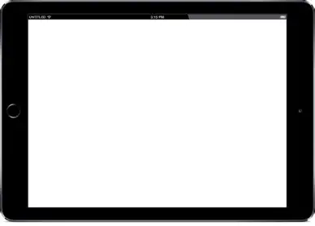
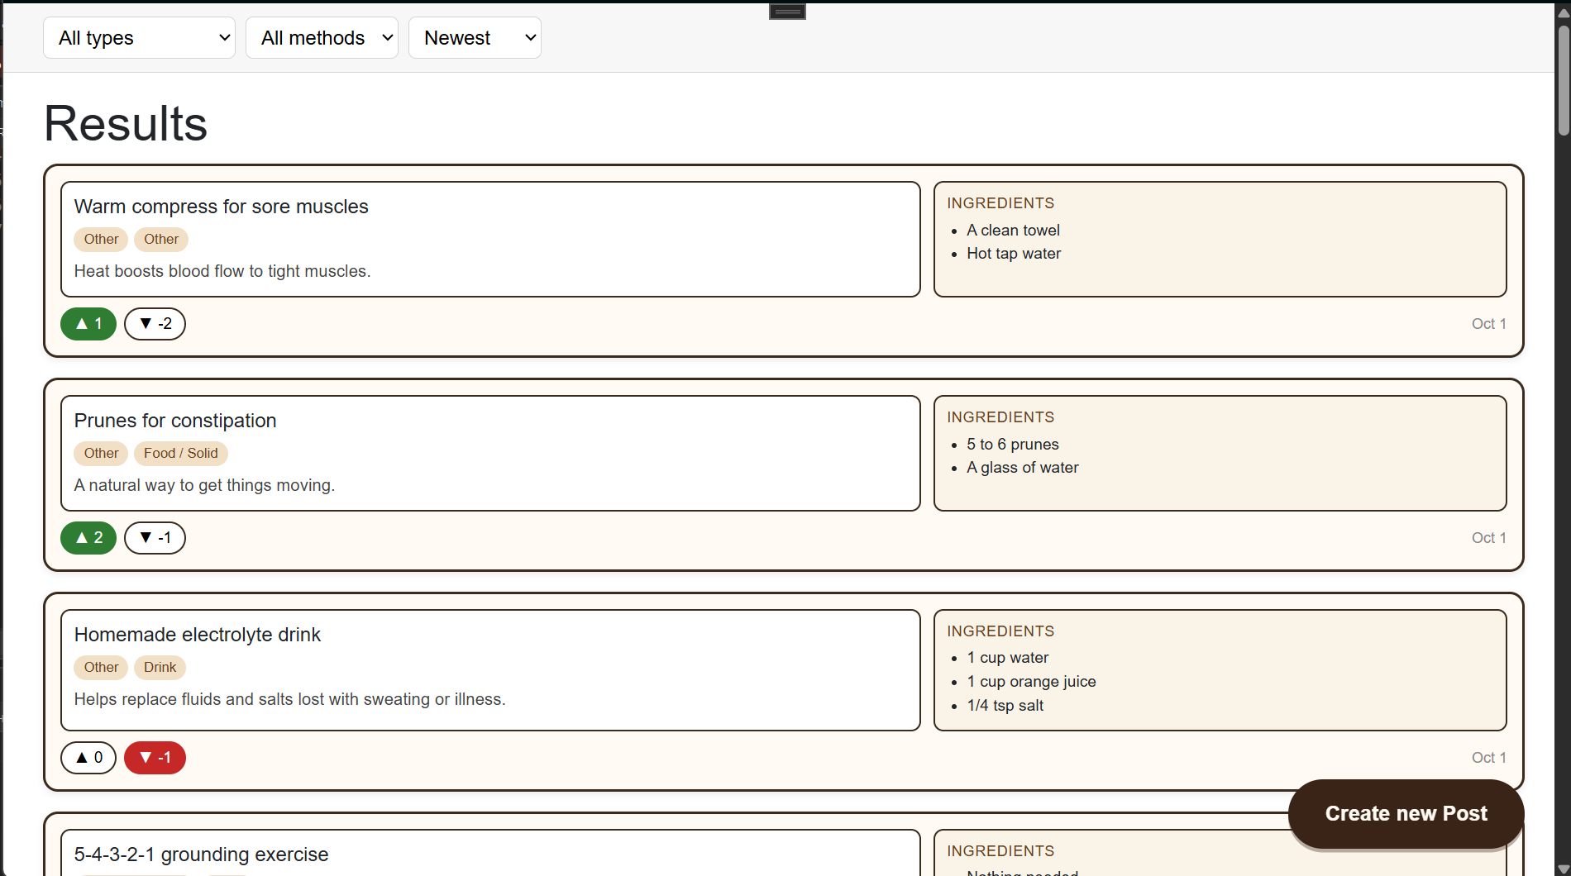
DEMO THE PRODUCT

