Slide 1
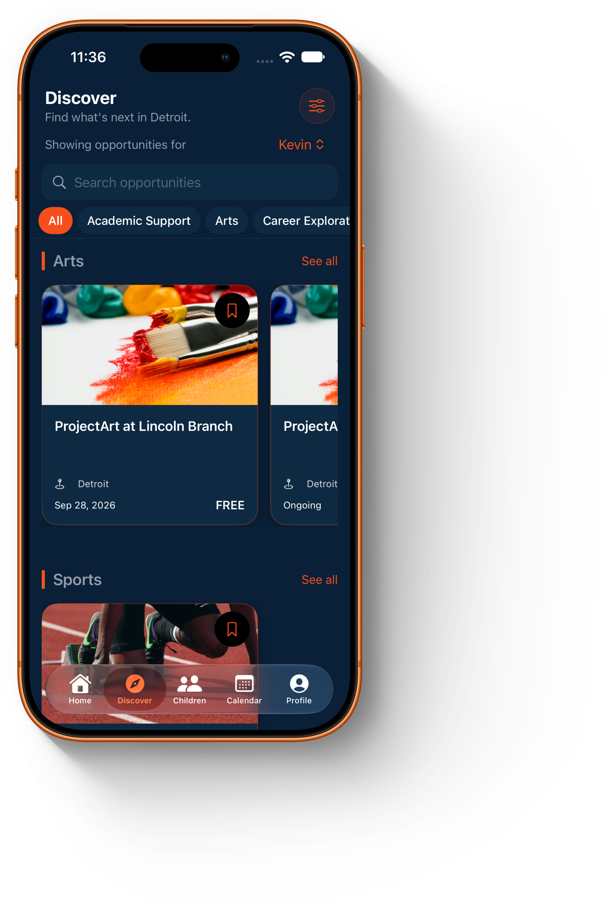
DETROIT YOUTH OPPORTUNITY PLATFORM
Opportunity 313
A clearer path from finding an opportunity to taking part.
Kevin Colston | Founder & Builder
OPPORTUNITY 313
01
Notes:
Opportunity 313 helps Detroit youth and families find programs, jobs, and learning pathways, then understand the next step to participate. I built an iOS MVP and website and am looking for a Detroit partner to test the full path from discovery to enrollment.

Slide 2
THE PROBLEM
Finding a program should not be the hardest step.
81,091
64%
Detroit children with parent-reported unmet demand for afterschool programs.
of surveyed Detroit parents cite inconvenient locations as a barrier.
Families need current details on eligibility, cost, location, schedule, and the person to contact. Providers need a reliable way to keep those details current.
Sources: Detroit After 3PM (March 2026); YDRC Detroit OST Landscape Analysis (2026). Figures describe broader demand and access barriers.
02
Notes:
The afterschool study estimates unmet demand for 81,091 Detroit children. Location is a barrier for 64% of parents surveyed. Those are contextual figures, not our addressable market or evidence that software creates new seats. The pilot will test whether better discovery and accurate listings help families take the next step.

Slide 3
THE PRODUCT
One place to discover, decide, and act.
01
Discover
Find opportunities by age, interest, and location.
02
Decide
Check eligibility, cost, schedule, and deadlines.
03
Act
Save the listing and connect with its provider.
OPPORTUNITY 313
03
Notes:
Follow one family journey. Search a relevant program, read whether the child qualifies, check cost and deadline, and use the provider contact. Saved listings and deadlines make return visits useful. The platform is meant to help a family reach a real provider, not just browse a directory.

Slide 4
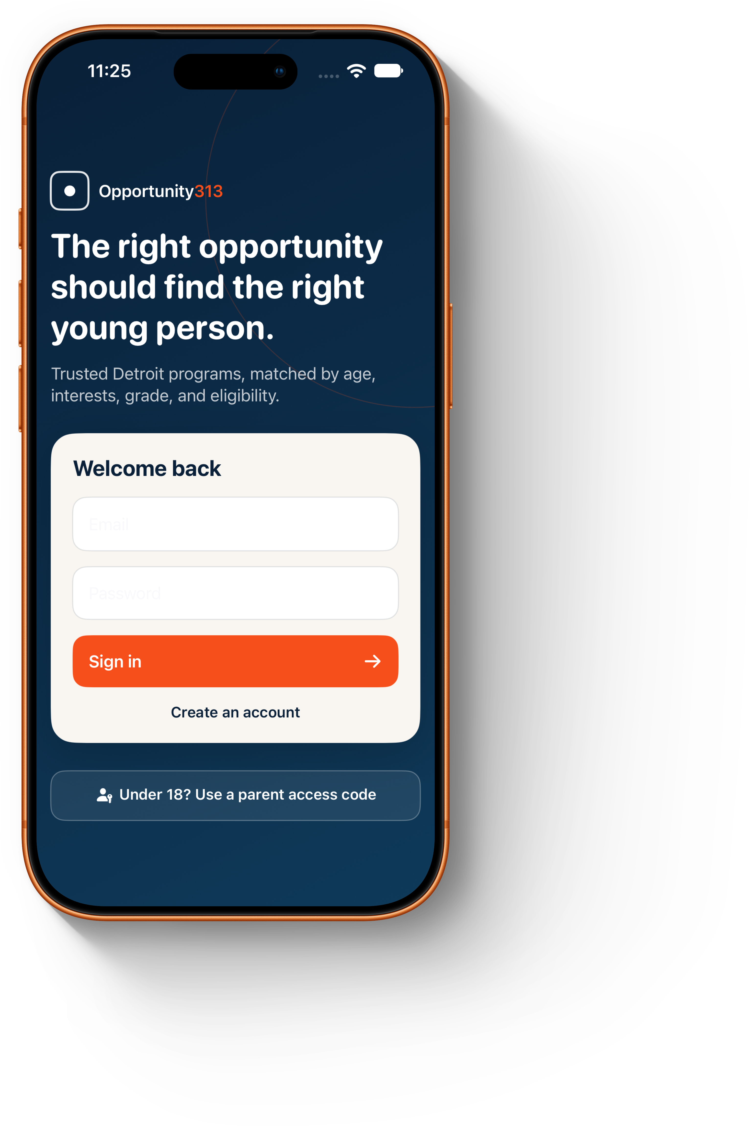
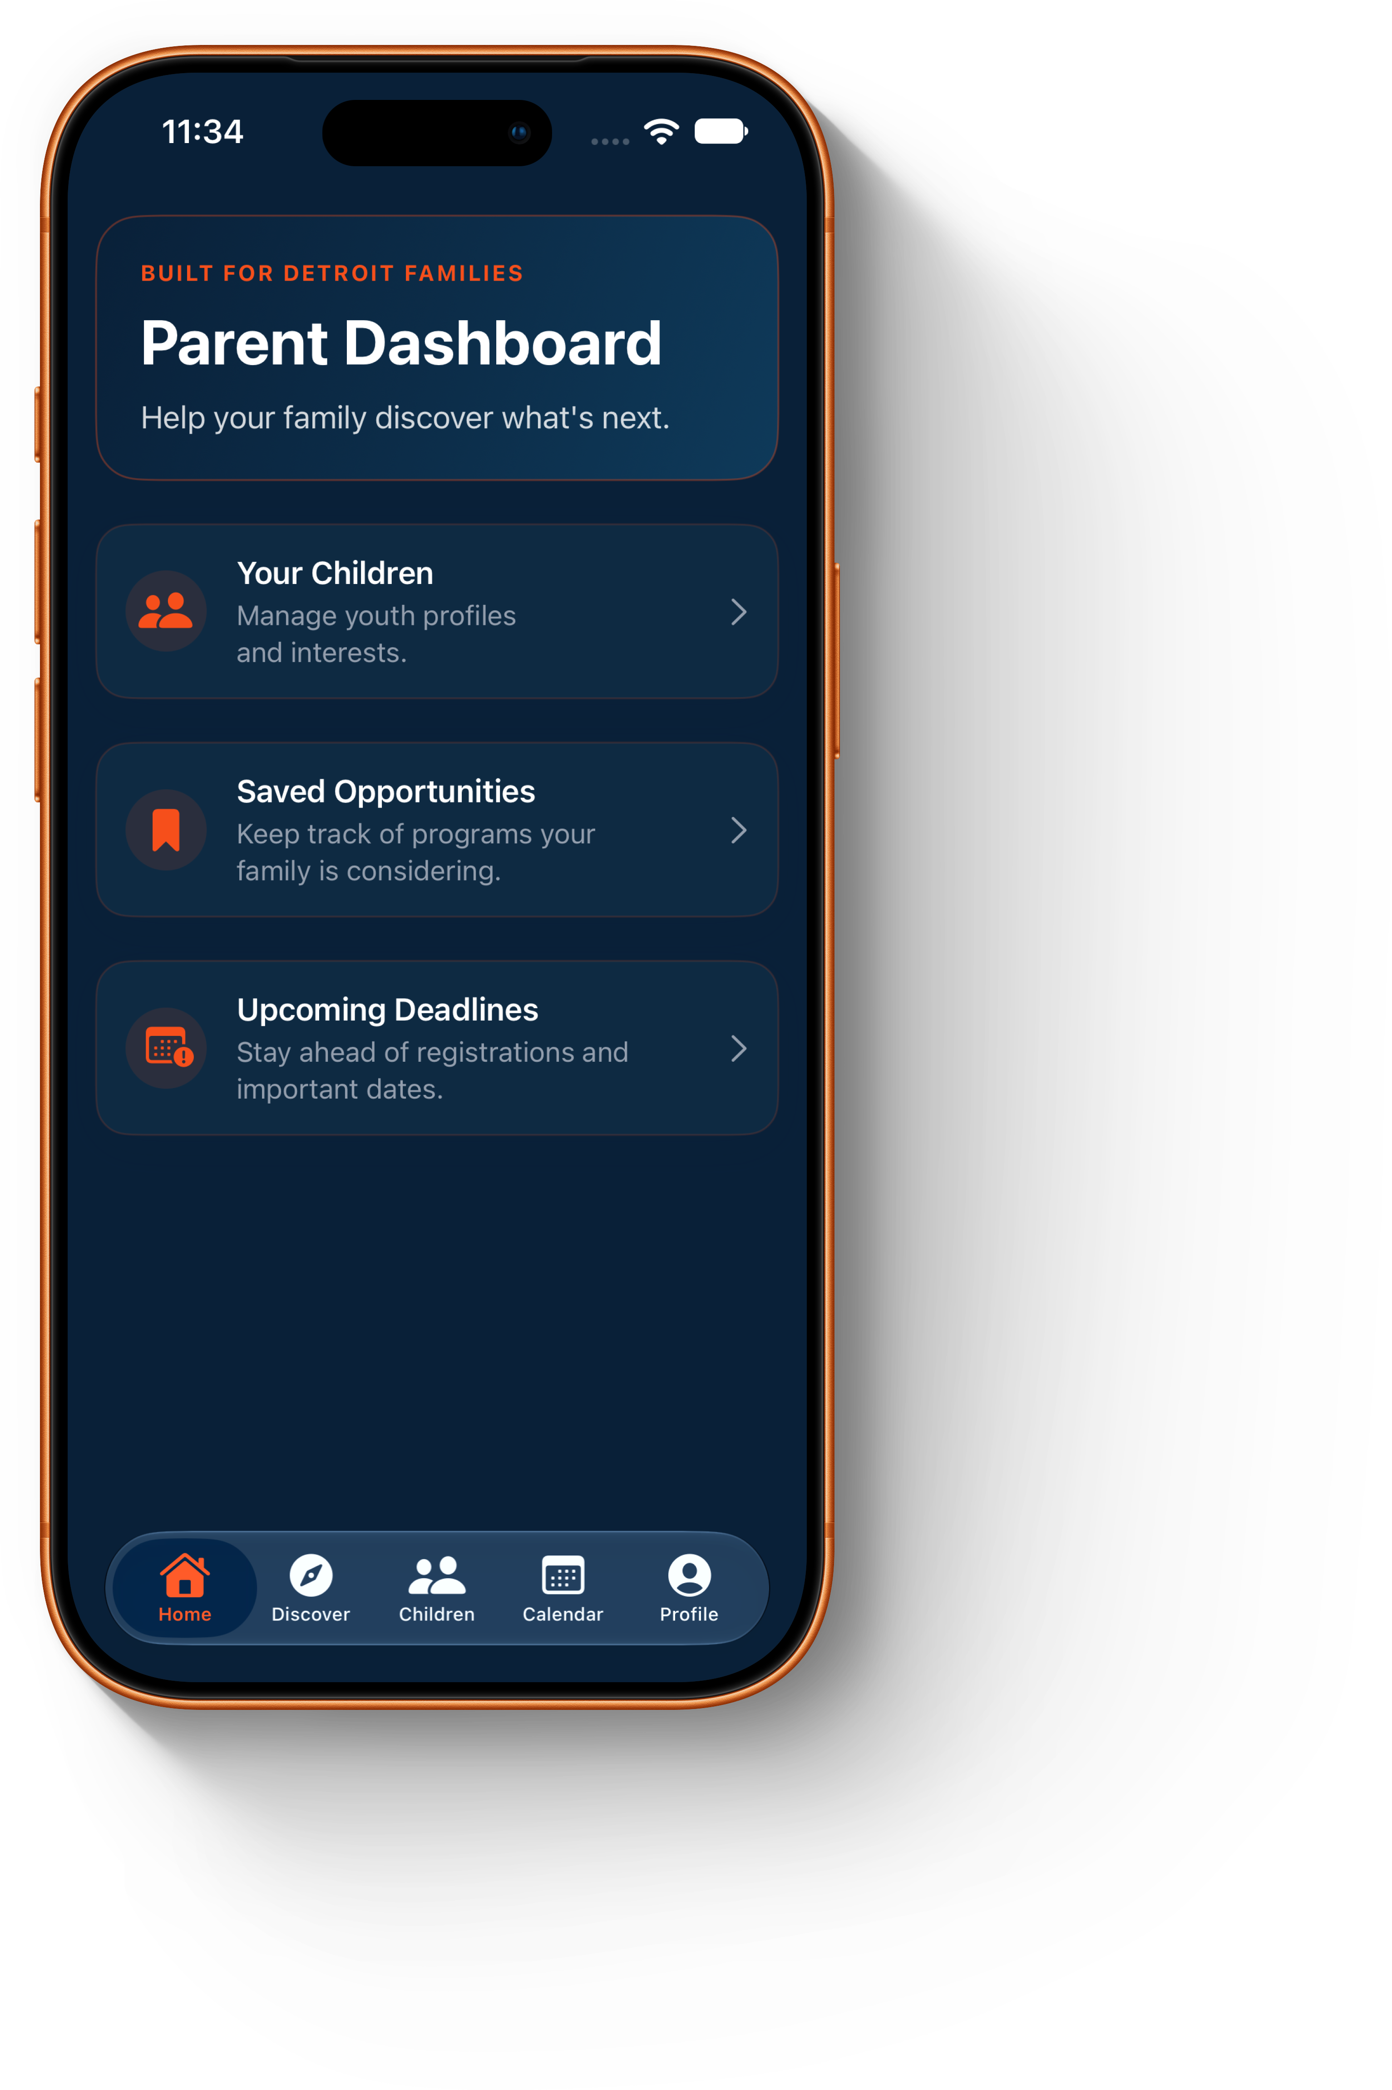
CURRENT IOS MVP
Built screens, ready for a Detroit pilot.
Sign in
Parent dashboard
Discover
OPPORTUNITY 313
04
Notes:
Show the actual MVP screens. Walk through signing in, selecting a child profile, and exploring the discovery feed. The product also has provider submission and administrator approval flows according to the current build. Demonstrate those live if available; do not claim direct provider integrations or completed enrollments before the pilot verifies them.

Slide 5
HOW THE PLATFORM STAYS USEFUL
The listing has an owner and a review path.
Providers submit
Admin review
Families act
Program details, eligibility, dates, location, and a contact method.
Check the listing before families see it and flag changes over time.
Search, save, and connect to the provider with a clear next step.
Trust depends on current listings. The pilot will measure accuracy as well as use.
OPPORTUNITY 313
05
Notes:
Opportunity 313 serves two sides: families who need understandable information and providers who need their programs represented accurately. A review step before publication supports trust. The pilot will establish who owns updates, how often listings are checked, and what happens when a program fills or a deadline passes.

Slide 6
DETROIT LAUNCH PLAN
Pilot in one partner network, then expand.
Pilot request
What we will measure
One Detroit school or community partner, provider introductions, and 25–50 youth and family testers.
Relevant opportunities found
Provider contacts or referrals
Confirmed enrollments when partners can report them
Outdated listings and access barriers
The first proof is a completed family journey, not a large sign-up count.
OPPORTUNITY 313
06
Notes:
The pilot is proposed, not signed. Recruit a partner with existing youth outreach, then onboard a small set of providers and 25 to 50 youth and family testers. Instrument the journey from search to provider contact. Enrollment needs partner reporting or user follow-up; do not present it as already measured. Record barriers that the platform cannot solve, especially full programs and transportation.

Slide 7
SUSTAINABILITY
A partner-funded model to test after the pilot.
Who benefits
Revenue hypotheses
Families get a free way to find opportunities. Providers can reach qualified participants and manage listings.
Institutional partnerships and provider subscriptions, subject to willingness-to-pay research.
Expansion follows verified outcomes and a repeatable provider review process.
OPPORTUNITY 313
07
Notes:
We have not validated pricing or signed paid contracts. Our hypothesis is that institutions could fund access and providers might pay for workflow or reach. The pilot should first demonstrate useful referrals and listing quality. Expansion to another Detroit network would require proof that onboarding and review can be repeated efficiently.

Slide 8
THE ASK
Help test a better route to opportunity.
Seeking one Detroit pilot partner.
Introduce youth-serving providers and help recruit 25–50 families. Together, we can test whether people find a relevant program and reach the next step.
Kevin Colston | Founder & Builder
Opportunity 313
Detroit, Michigan
colstk1@gmail.com
OPPORTUNITY 313
08
Notes:
Ask for a conversation with one Detroit school, library, or youth organization that can coordinate a focused pilot. The immediate help needed is a partner, provider introductions, and 25 to 50 testers. I am Kevin Colston, the founder and builder. Follow up with a product demo and a pilot scope.

