Slide 1

MATHANGO APPLICATION: MATHS AND DJANGO

Slide 2

Welcome to MATHANGO
Mathangoapp is the single Django application in the Mathango
Django project, where the entire
functionality of the website is based. The back end utilises Python Programming using
Django Libraries. The front end utilises HTML for the overall structure of the webpage, CSS for the aesthetics, Django templates for server-client functionality and Javascript for server-client communication, aesthetics as well as other essential functionality.

Slide 3
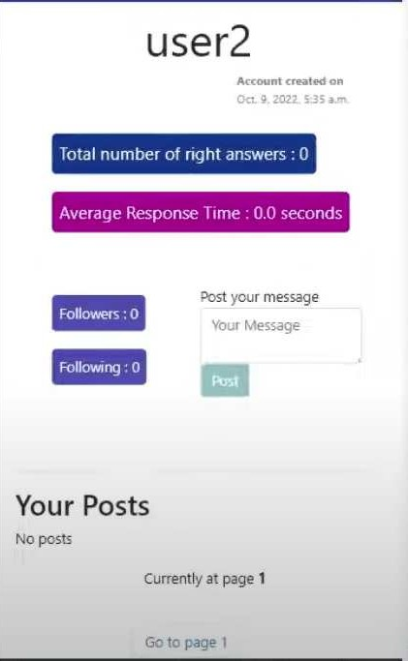
PROFILE PAGE
This is the user profile page. This has two purposes. One is for the user to view his own profile.
Another is for the user to view profiles of other users. User’s Statistics are shown on the page, along with the number of followers and number of players he/she follows. Messages posted by native user is show on his profile
under Your posts

Slide 4
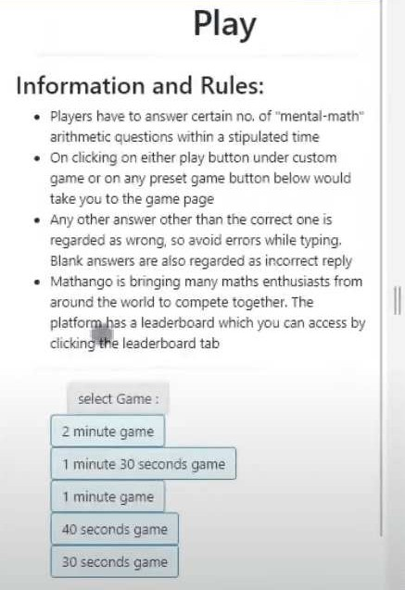
INDEX PAGE
This is the homepage of Mathango website. Some rules are posted on the top, then there are some preset
game-times and then there is a custom game-time setting.

Slide 5
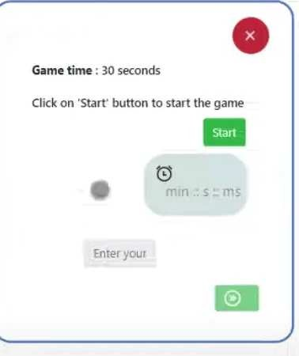
GAME PAGE
This is the main game page of the website. On selecting a game time from
the index page, the user is redirected to the game page where he plays the mathango game.The game page has a simple interface but a very complicated underlying Javascript code which communicates continuously with the server. Such a communication ensures security from cheaters and correct assessment of answers and validation of scores.

Slide 6
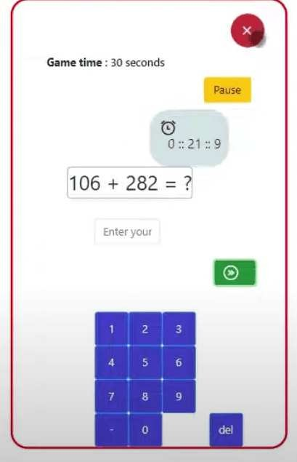
Arithmetic Challenges
Put your arithmetic skills to the test with challenging exercises that cover addition, subtraction, multiplication, and
division.

Slide 7
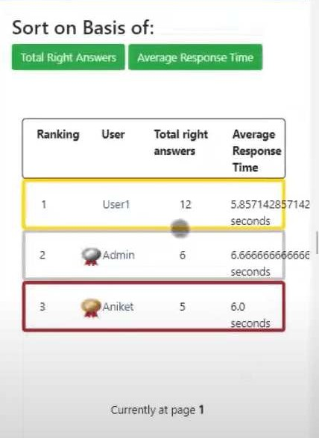
Leaderboards
Players are either ranked using the total right answers (highest to lowest) or the average response time per question (lowest to highest). The first three players who top the category of ranking are highlighted as gold, silver and bronze medalist.
Ranking system can be
changed using the two green buttons: average response time and total right answers

Slide 8

Educational Impact
Experience the positive impact of MATHANGO on arithmetic skills and overall math proficiency. The gamified approach enhances motivation and engagement, leading to improved learning outcomes and confidence in math.

Slide 9
Thanks!

