Slide 1
Assignment 2: Fever Dream
By: Jonathan Hansen

Slide 2
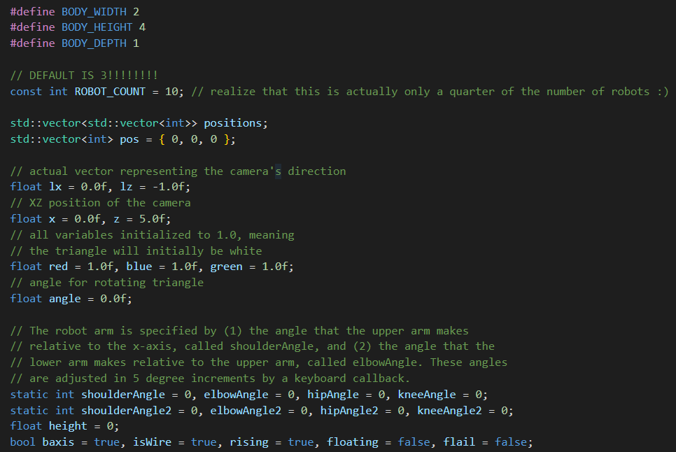
Variables
A bunch of variables are declared at the start.
First two vectors are defined to make storing robot positions easy.
Then Variables for the camera location are initialized.
Finally we have the variables for the robot joints and the Booleans for certain actions.

Slide 3
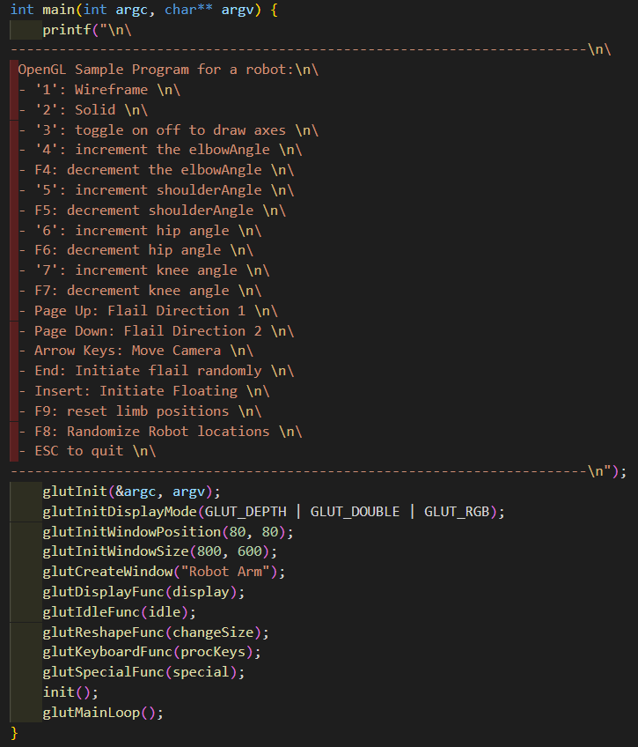
Main
The main function creates the window that will display the robot, as well as initializes the functions that will be used for Display, Idle, and the keystrokes.

Slide 4
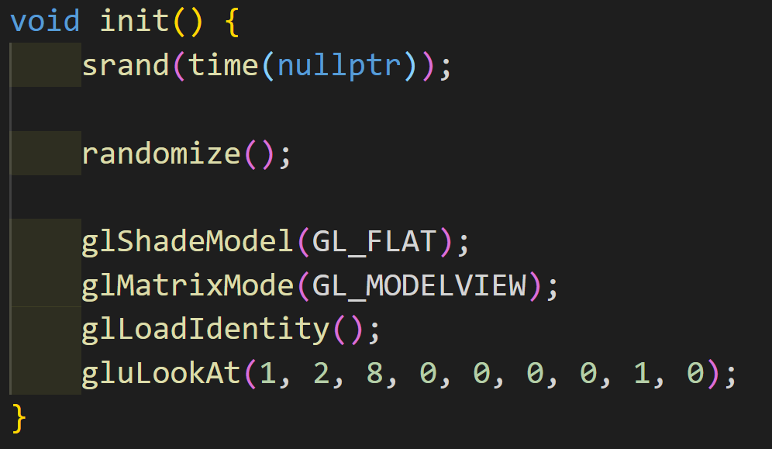
Init
The init function initializes srand() as well as calls my randomize function filling a vector with robot positions. Then it sets up the camera.

Slide 5
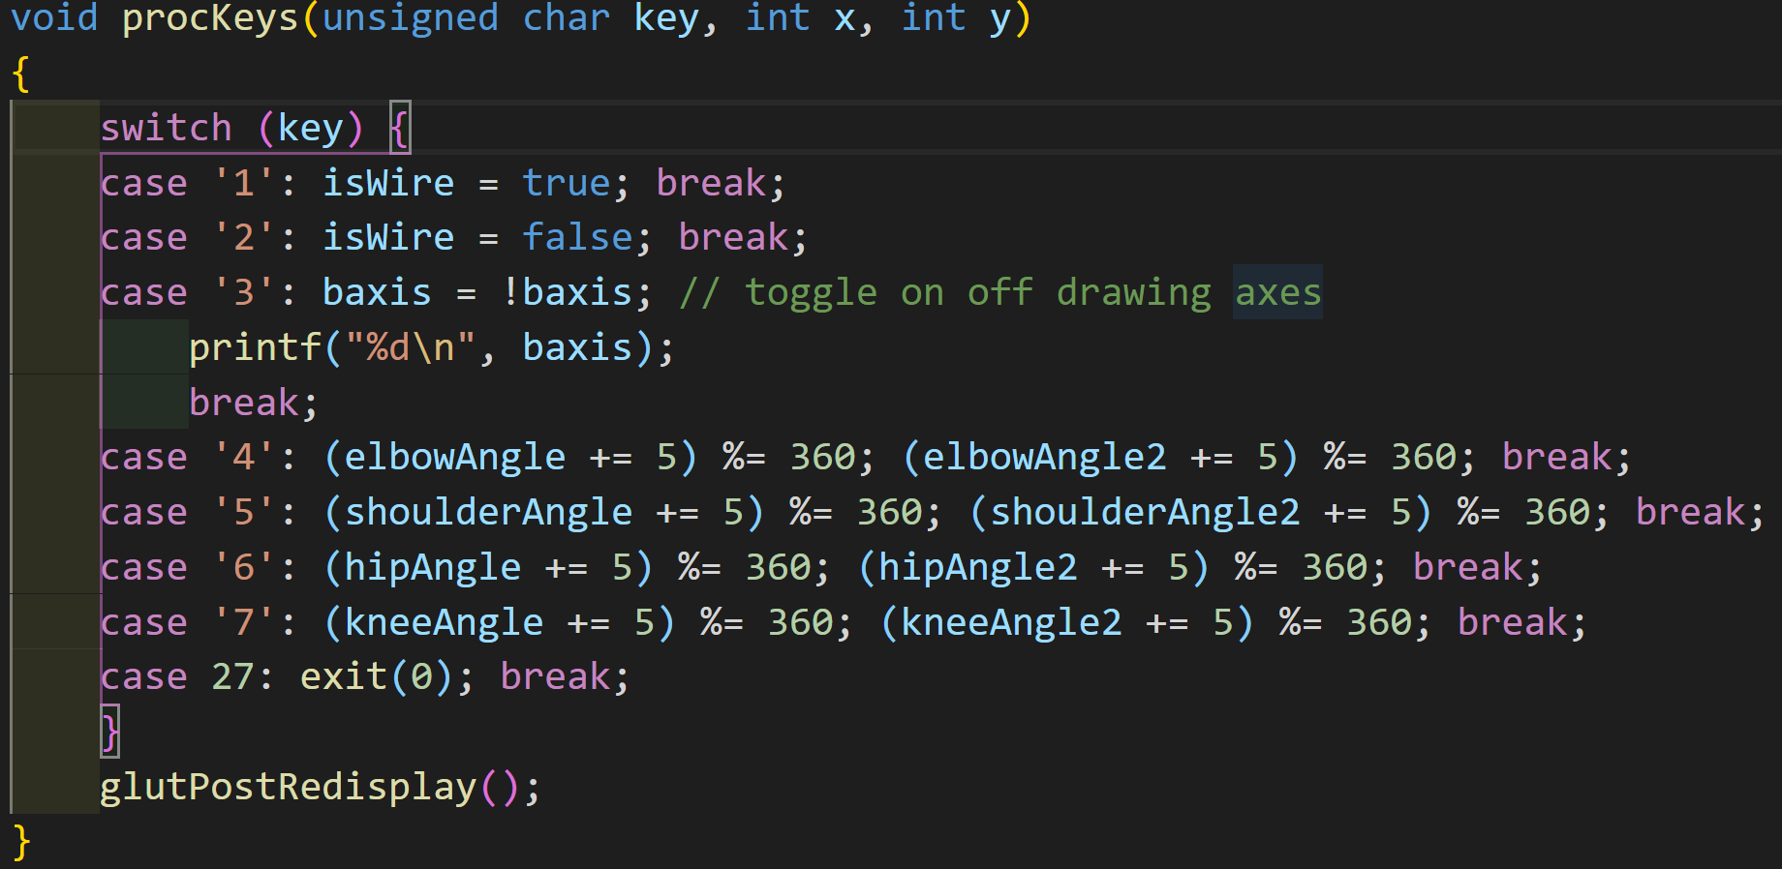
Keys
The procKeys function controls positive joint increases as well as axis and solid/wire toggles.

Slide 6
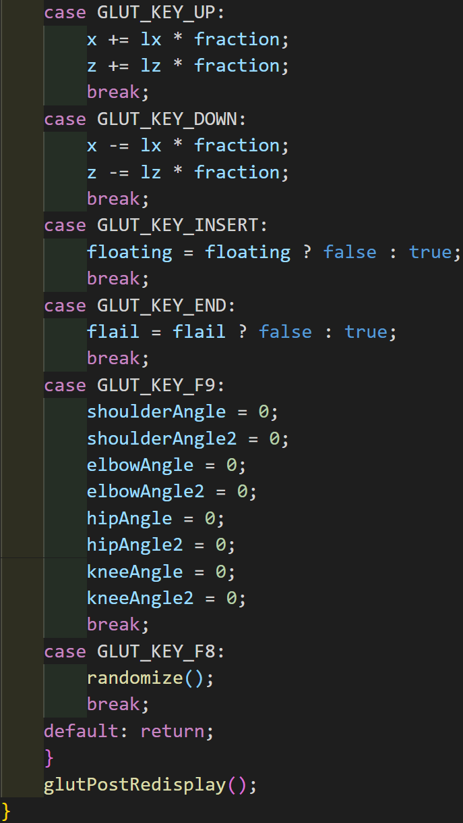
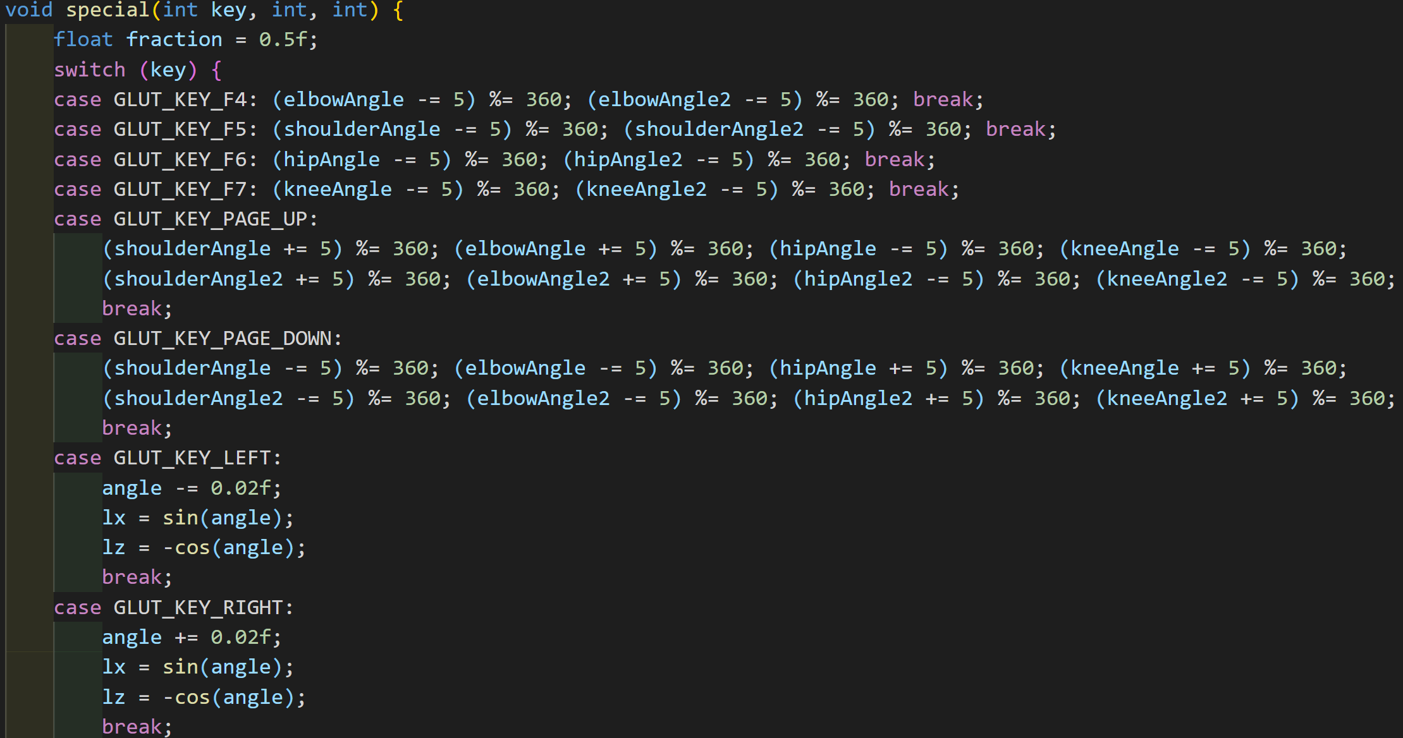
Keys Special
The special function controls negative joint increases as well as the fun stuff, such as Floating, Flailing, Randomizing robot locations, and resetting position.

Slide 7
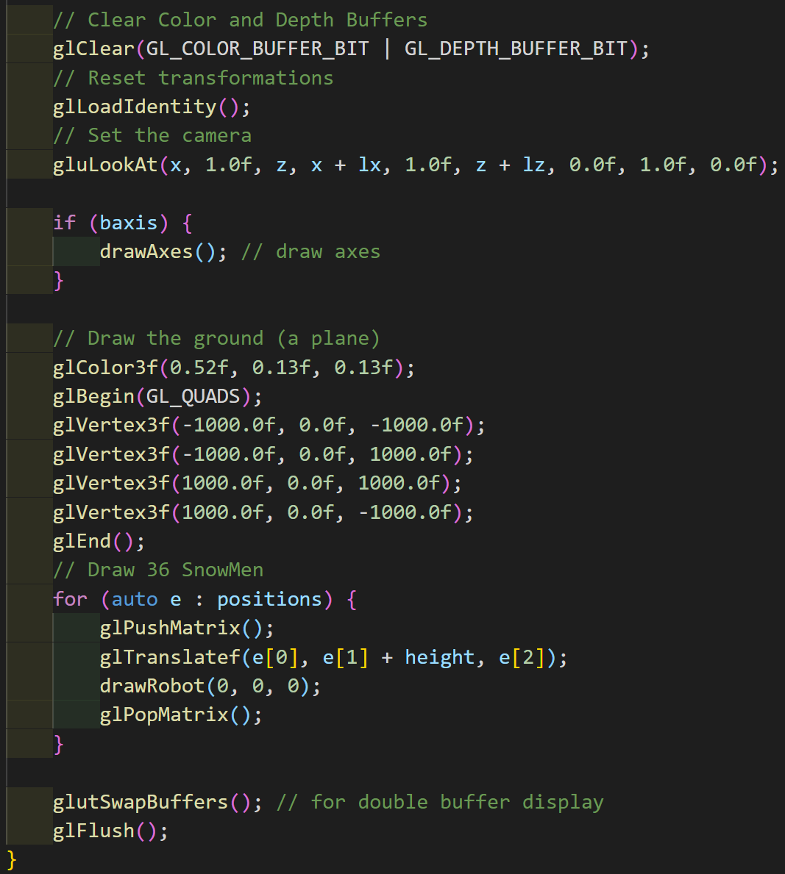
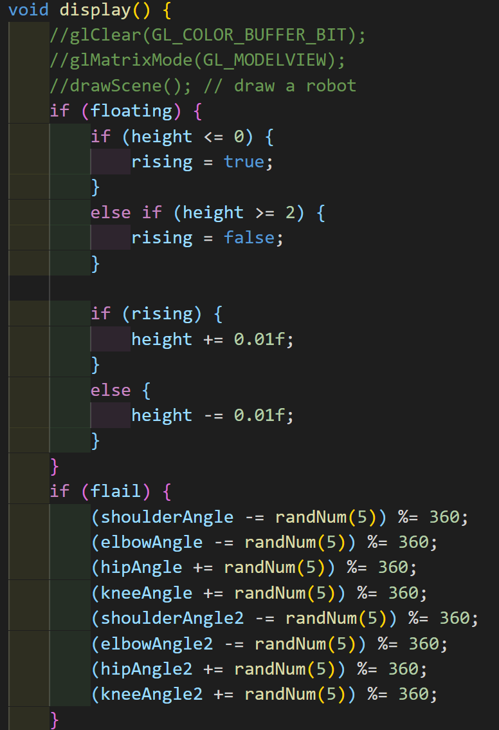
Display/Idle
The Idle function is just my display function since the robots should be constantly moving during the float and flail commands.
First is the nested ifs that make the floating work.
Second is the if that makes the flailing continuous.
Next I set the new camera position.
Fourth I draw axis if they are on and the red plane the robots stand on.
Finally I have a range based for draw the robots

Slide 8
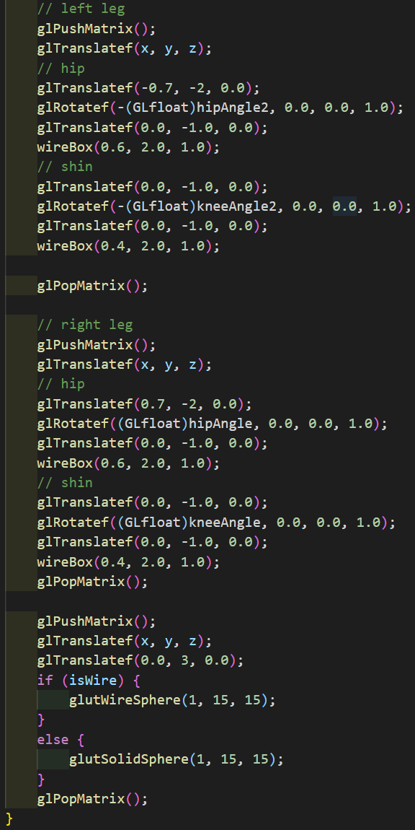
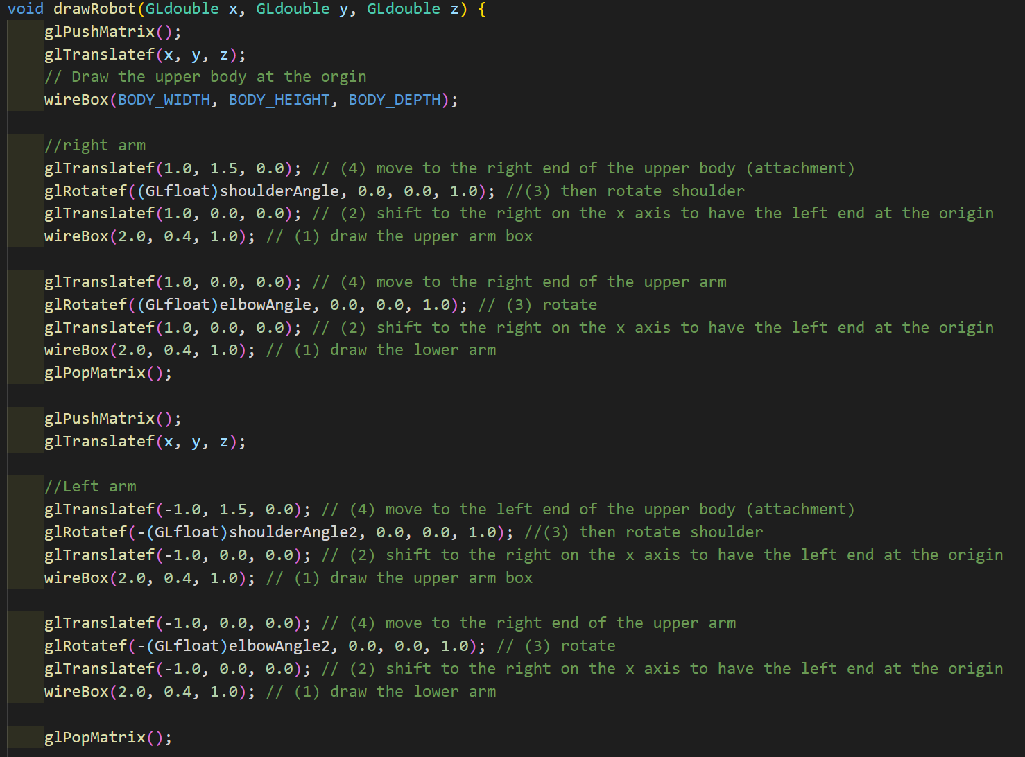
DrawRobot
The draw robot function draws the robot one limb at a time, making sure each joint links to where it should by pushing and popping matrices and translations.

Slide 9
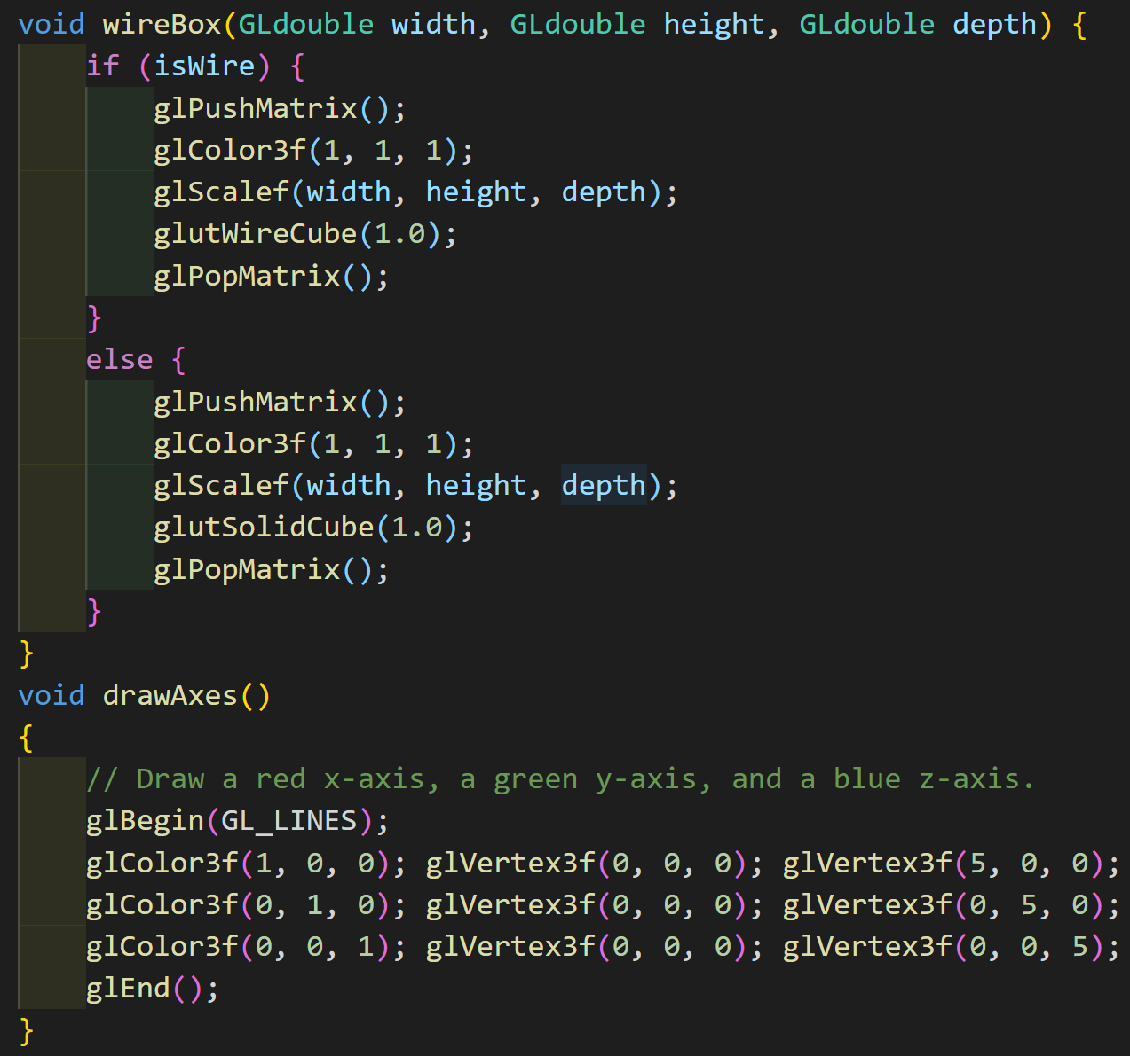
Extra Draw Functions
The WireBox function is used to draw wire/solid boxes for the robots
The draw axis function draws the axis…

Slide 10
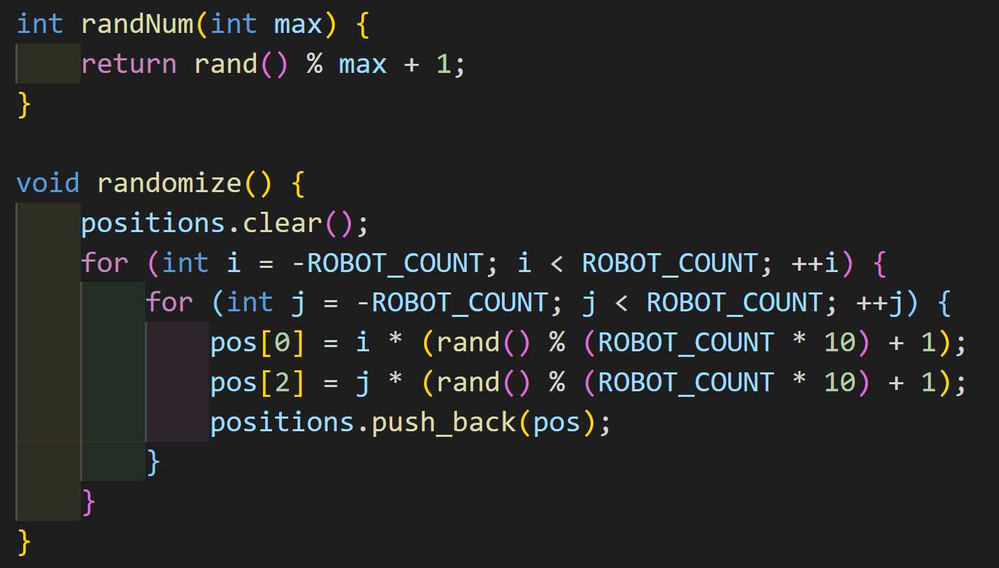
Random Functions
The randnum function generates a number between 1 and max. (Used in the flail action.)
The randomize function randomizes the positions of the robots.

Slide 11
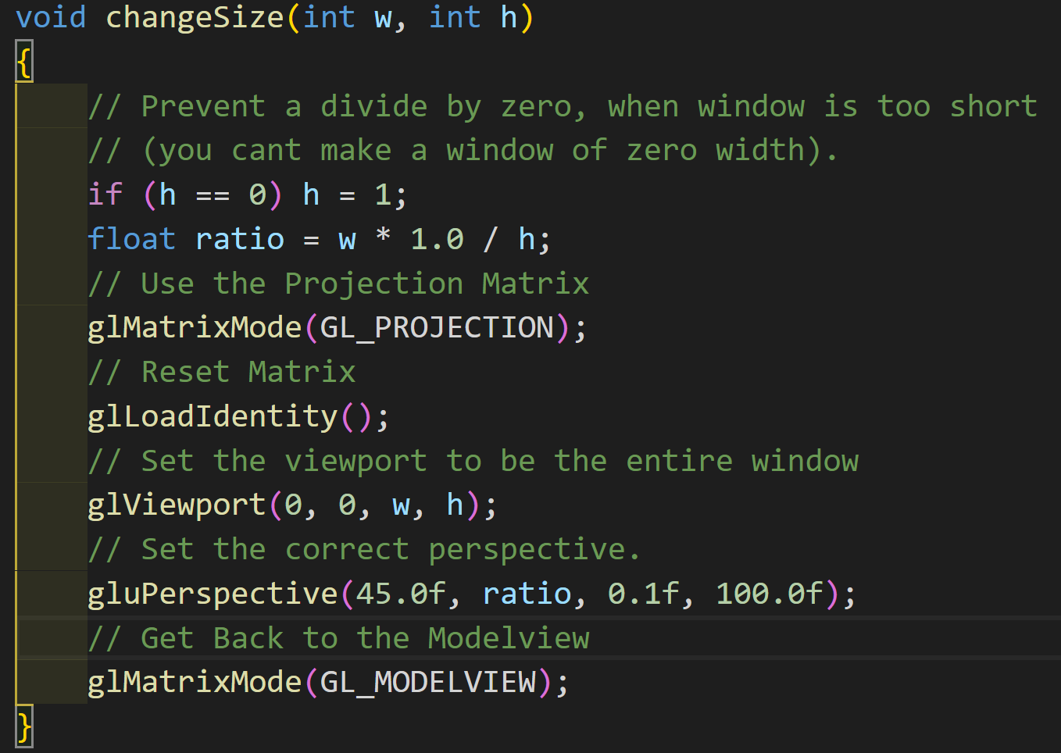
ChangeSize
The change size function handles window reshaping done by the user.

Slide 12
DOWNLOAD
https://github.com/Quigmodacon/GraphicsFeverDream

