Slide 1
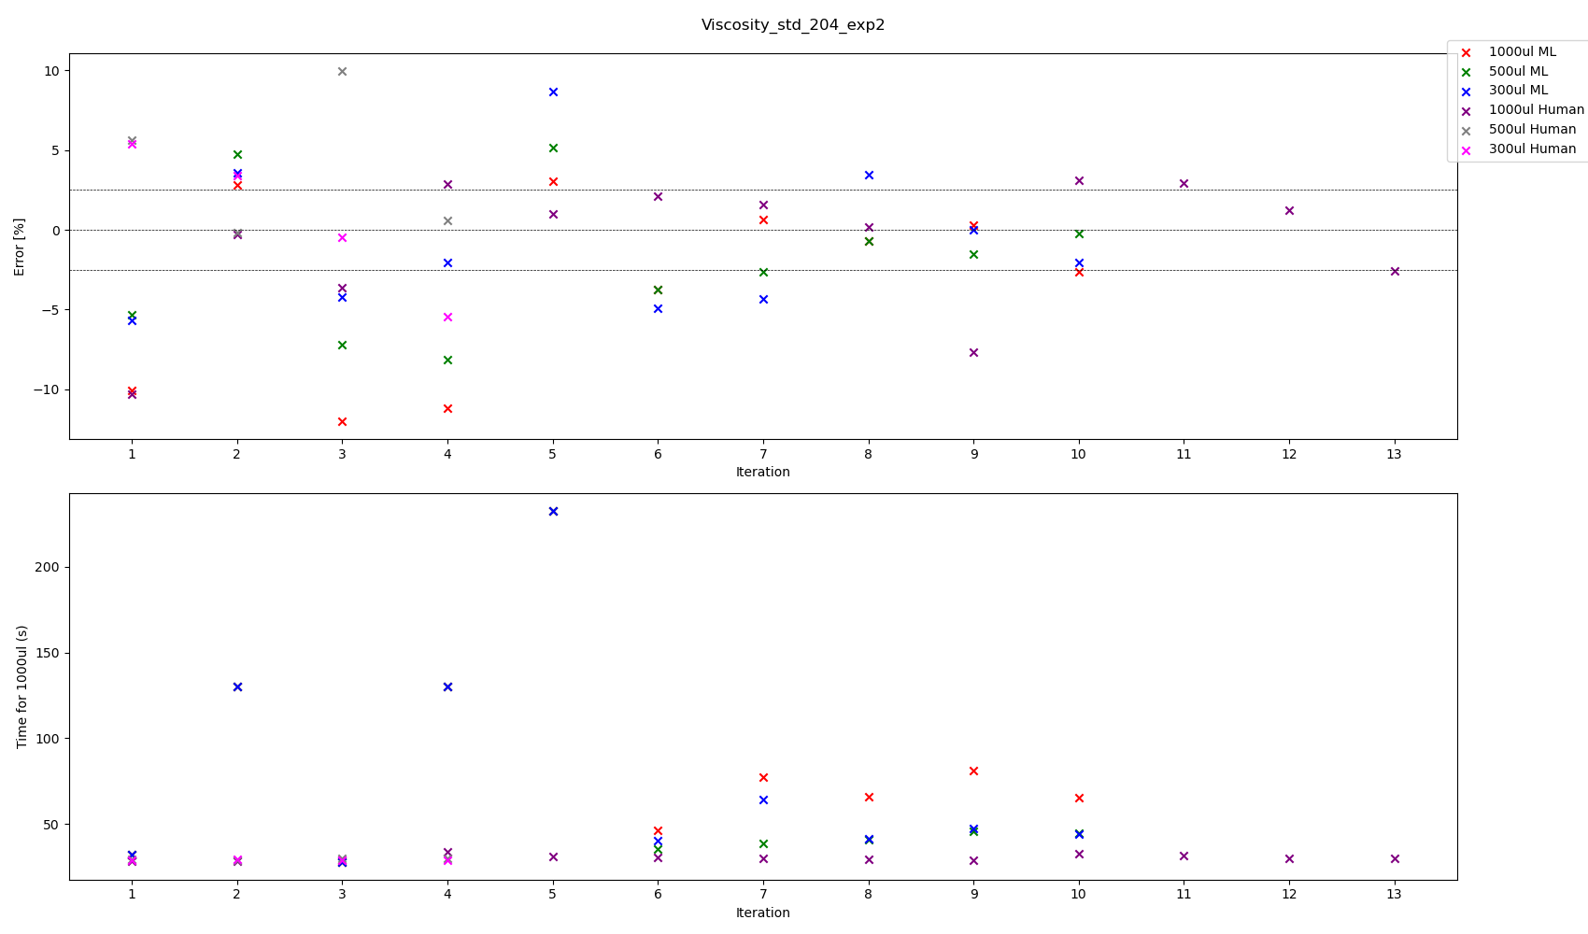

Slide 2
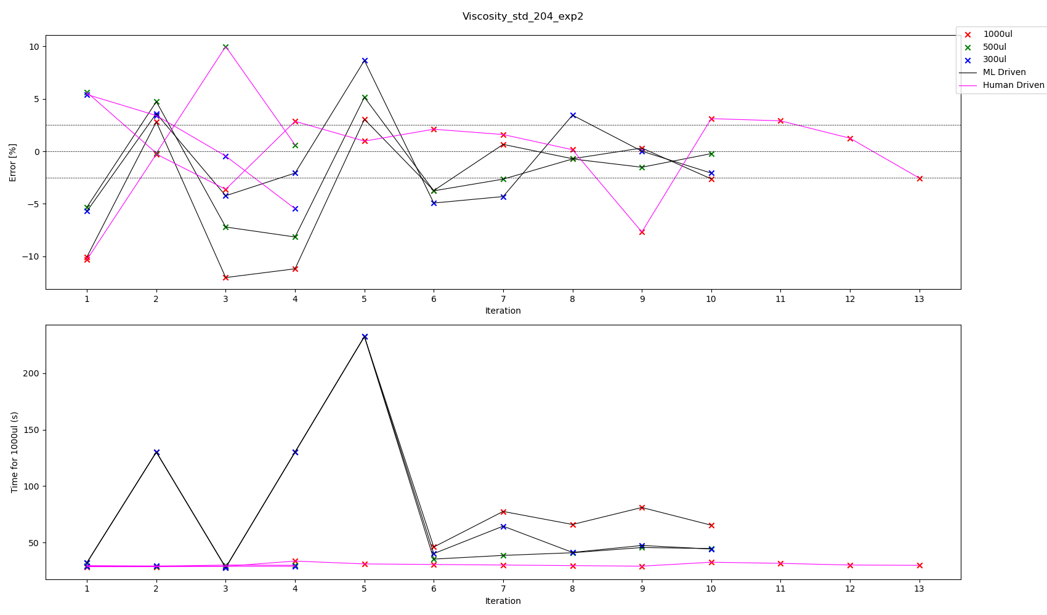

Slide 3
All experiments we have touch tip for aspiration, no touch tip for dispense
Viscosity Standard 204 – Best parameters according to volume pipetted
Volume | ML or Human | Aspiration Rate | Dispense Rate | Blow Out Rate | Delay Aspirate | Delay Dispense | Delay Blow Out | %error | Total Time for transfer | Iteration
300 | ML | 80.219249 | 40.113611 | 0 | 5 | 5 | 0 | +0.011575 | 47.395030 | 9
300 | Human | 70 | 70 | 5 | 0.3 | 0 | 0 | -0.451441 | 28.871429 | 3
500 | ML | 81.334604 | 44.694355 | 0 | 5 | 5 | 0 | -0.219933 | 44.669080 | 10
500 | Human
1000 | ML
1000 | Human

