Slide 1
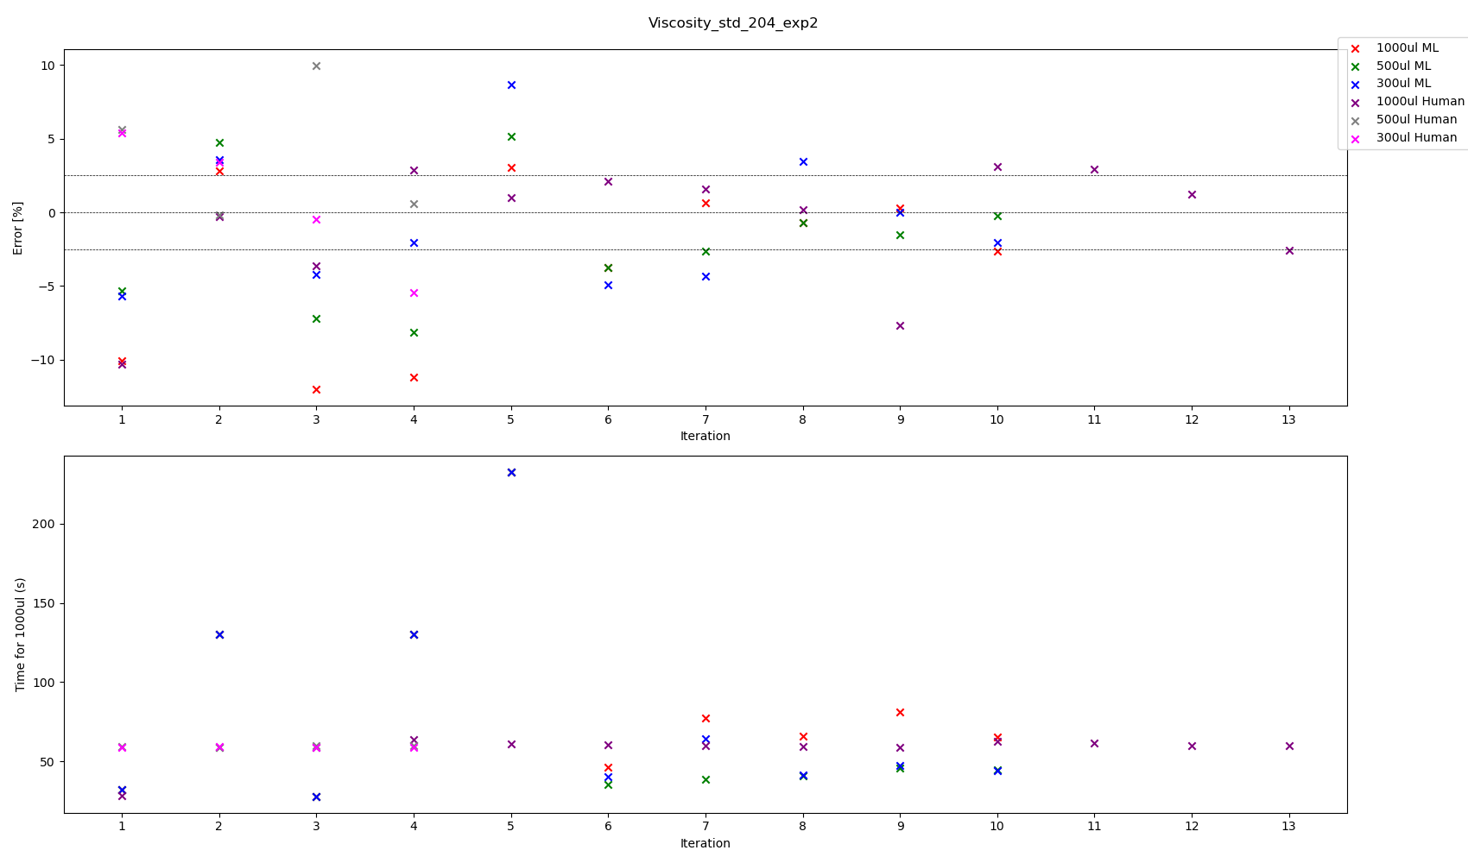

Slide 2
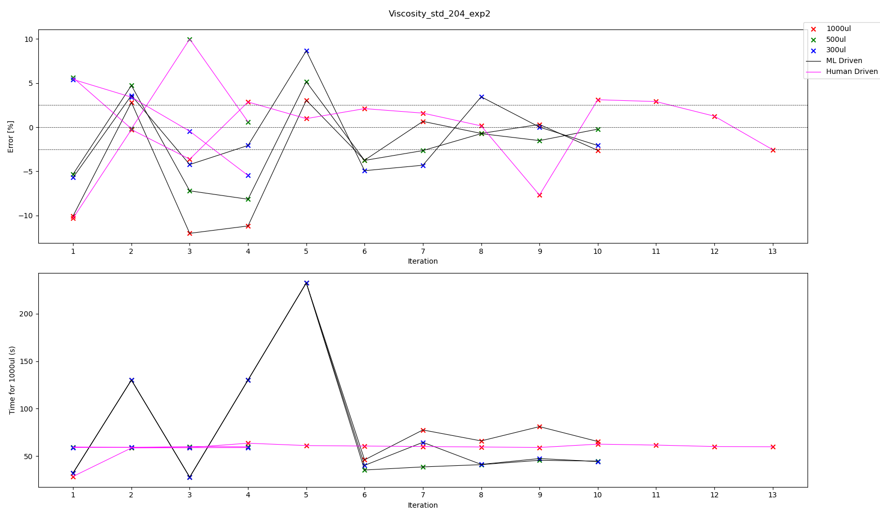

Slide 3
All experiments we have touch tip for aspiration, no touch tip for dispense
Viscosity Standard 204 – Best parameters according to volume pipetted experiment 2
Volume | ML or Human | Aspiration Rate | Dispense Rate | Blow Out Rate | Delay Aspirate | Delay Dispense | Delay Blow Out | %error | Total Time for transfer 1000 ul | Iteration
300 | ML | 80.219249 | 40.113611 | 0 | 5 | 5 | 0 | +0.011575 | 47.395030 | 9
300 | Human | 70 | 70 | 5 | 0.3 | 0 | 0 | -0.451441 | 58.871429 | 3
500 | ML | 81.334604 | 44.694355 | 0 | 5 | 5 | 0 | -0.219933 | 44.669080 | 10
500 | Human | 70 | 70 | 5 | 0.5 | 0 | 0 | -0.173631 | 59.071429 | 2
1000 | ML | 53.327046 | 26.853867 | 0 | 5 | 5 | 0 | -0.706100 | 65.990795 | 8
1000 | ML | 44.301651 | 20.638166 | 0 | 5 | 5 | 0 | 0.312536 | 81.026441 | 9
1000 | Human | 70 | 70 | 5 | 1 | 0 | 0 | 0.150480 | 59.571429 | 8

Slide 4
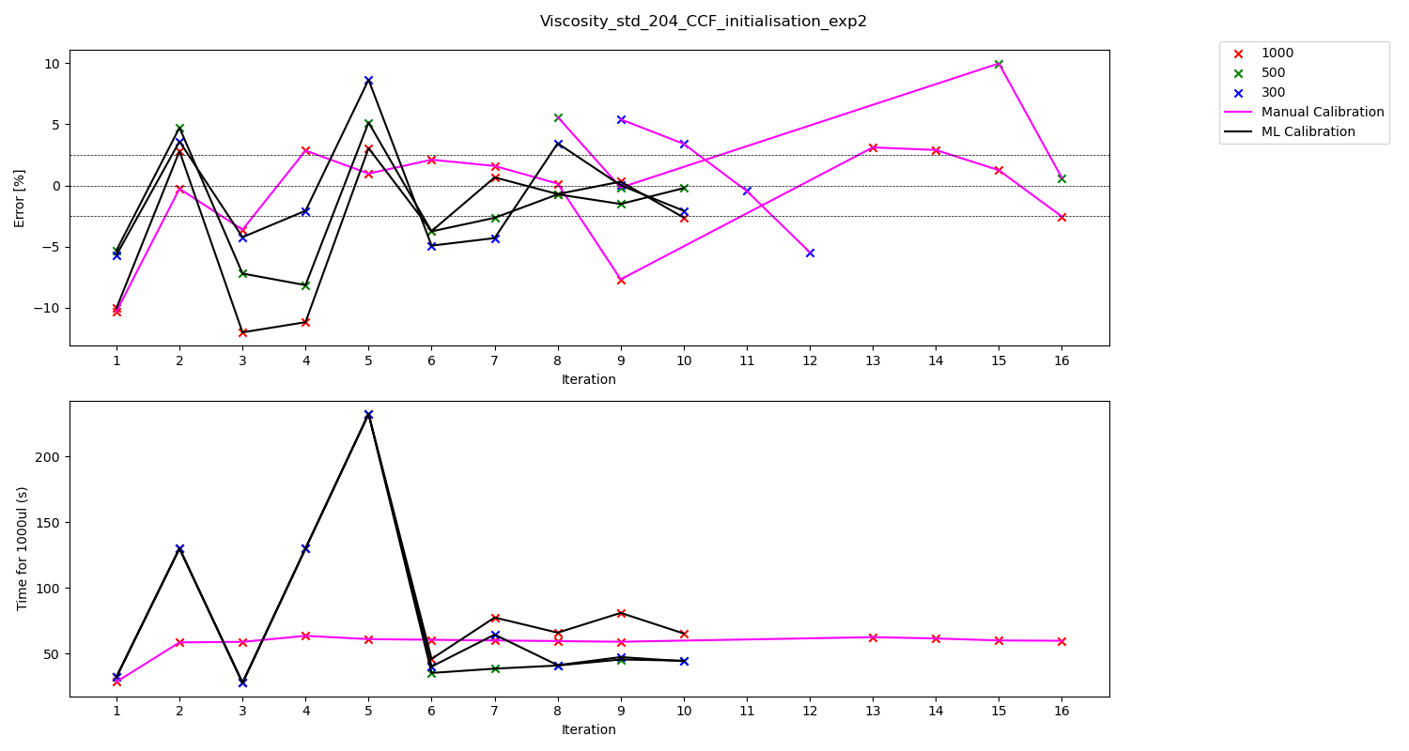

Slide 5
All experiments we have touch tip for aspiration, no touch tip for dispense
Viscosity Standard 204 – Best parameters according to volume pipetted experiment 2
Volume | ML or Human | Aspiration Rate | Dispense Rate | Blow Out Rate | Delay Aspirate | Delay Dispense | Delay Blow Out | %error | Total Time for transfer 1000 ul | Iteration
300 | ML | 80.219249 | 40.113611 | 0 | 5 | 5 | 0 | +0.011575 | 47.395030 | 9
300 | Human | 70 | 70 | 5 | 0.3 | 0 | 0 | -0.451441 | 58.871429 | 11
500 | ML | 81.334604 | 44.694355 | 0 | 5 | 5 | 0 | -0.219933 | 44.669080 | 10
500 | Human | 70 | 70 | 5 | 0.5 | 0 | 0 | -0.173631 | 59.071429 | 9
1000 | ML | 53.327046 | 26.853867 | 0 | 5 | 5 | 0 | -0.706100 | 65.990795 | 8
1000 | ML | 44.301651 | 20.638166 | 0 | 5 | 5 | 0 | 0.312536 | 81.026441 | 9
1000 | Human | 70 | 70 | 5 | 1 | 0 | 0 | 0.150480 | 59.571429 | 8

Slide 6
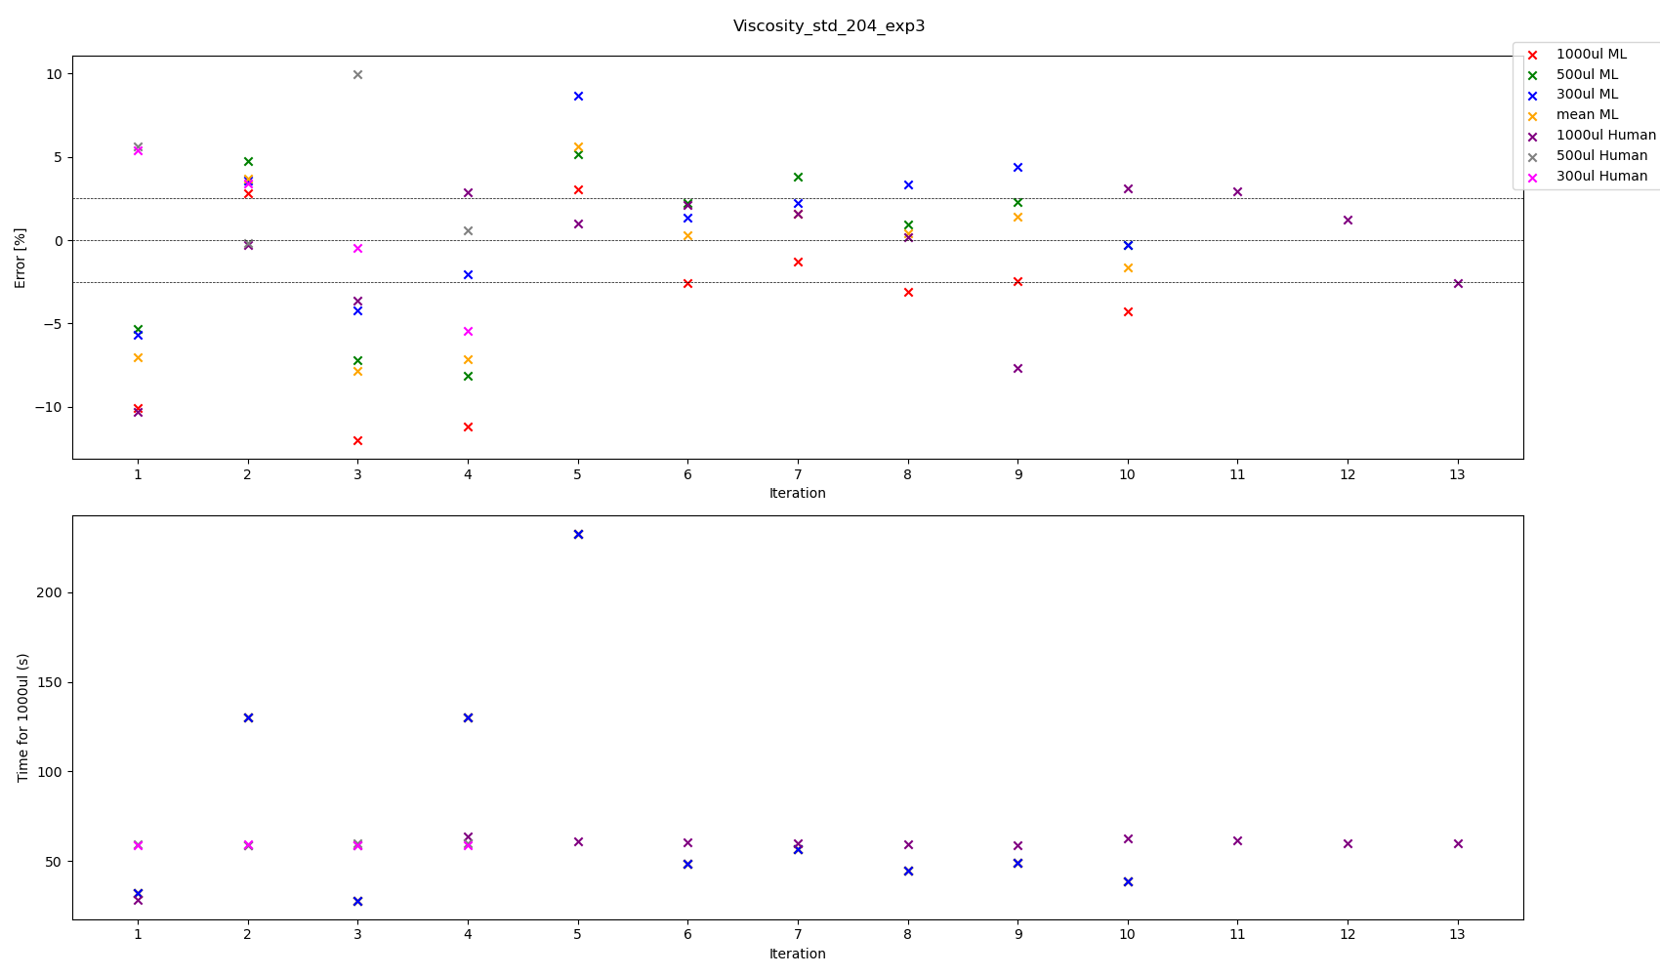

Slide 7
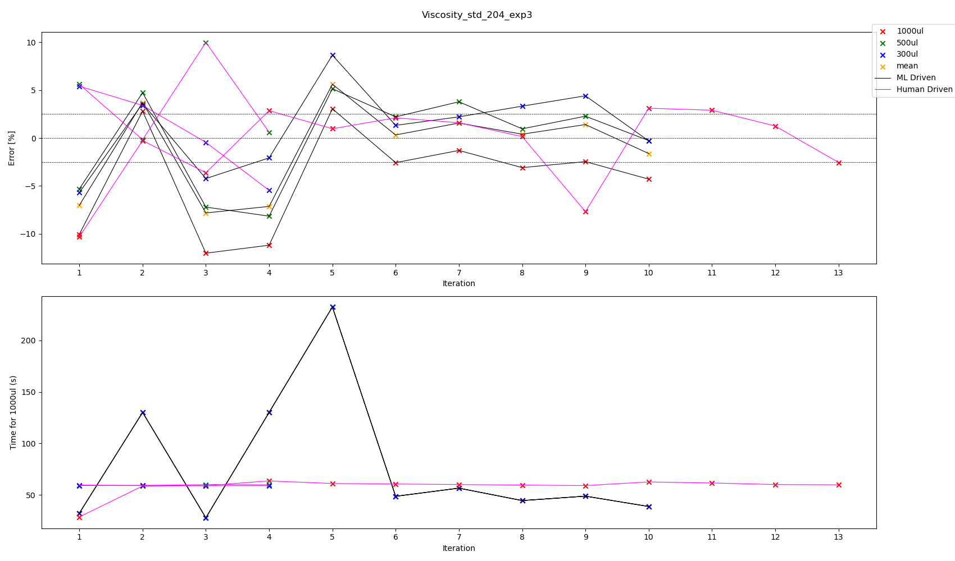

Slide 8
All experiments we have touch tip for aspiration, no touch tip for dispense
Viscosity Standard 204 – Best parameters according to volume pipetted experiment 3
Volume | ML or Human | Aspiration Rate | Dispense Rate | Blow Out Rate | Delay Aspirate | Delay Dispense | Delay Blow Out | %error | Total Time for transfer 1000 ul | Iteration
300 | ML | 110.673791 | 50.793095 | 0 | 5 | 5 | 0 | -0.297102 | 38.723278 | 10
300 | Human | 70 | 70 | 5 | 0.3 | 0 | 0 | -0.451441 | 58.871429 | 3
500 | ML | 110.673791 | 50.793095 | 0 | 5 | 5 | 0 | -0.266235 | 38.723278 | 10
500 | Human | 70 | 70 | 5 | 0.5 | 0 | 0 | -0.173631 | 59.071429 | 2
1000 | ML | 78.136789 | 29.618935 | 0 | 5 | 5 | 0 | -1.296446 | 56.560255 | 7
1000 | Human | 70 | 70 | 5 | 1 | 0 | 0 | 0.150480 | 59.571429 | 8
Mean | ML | 98.504223 | 35.123162 | 0 | 5 | 5 | 0 | 0.321539 | 48.623090 | 6
Mean | ML | 93.316186 | 42.075689 | 0 | 5 | 5 | 0 | 0.399995 | 44.482948 | 8

Slide 9
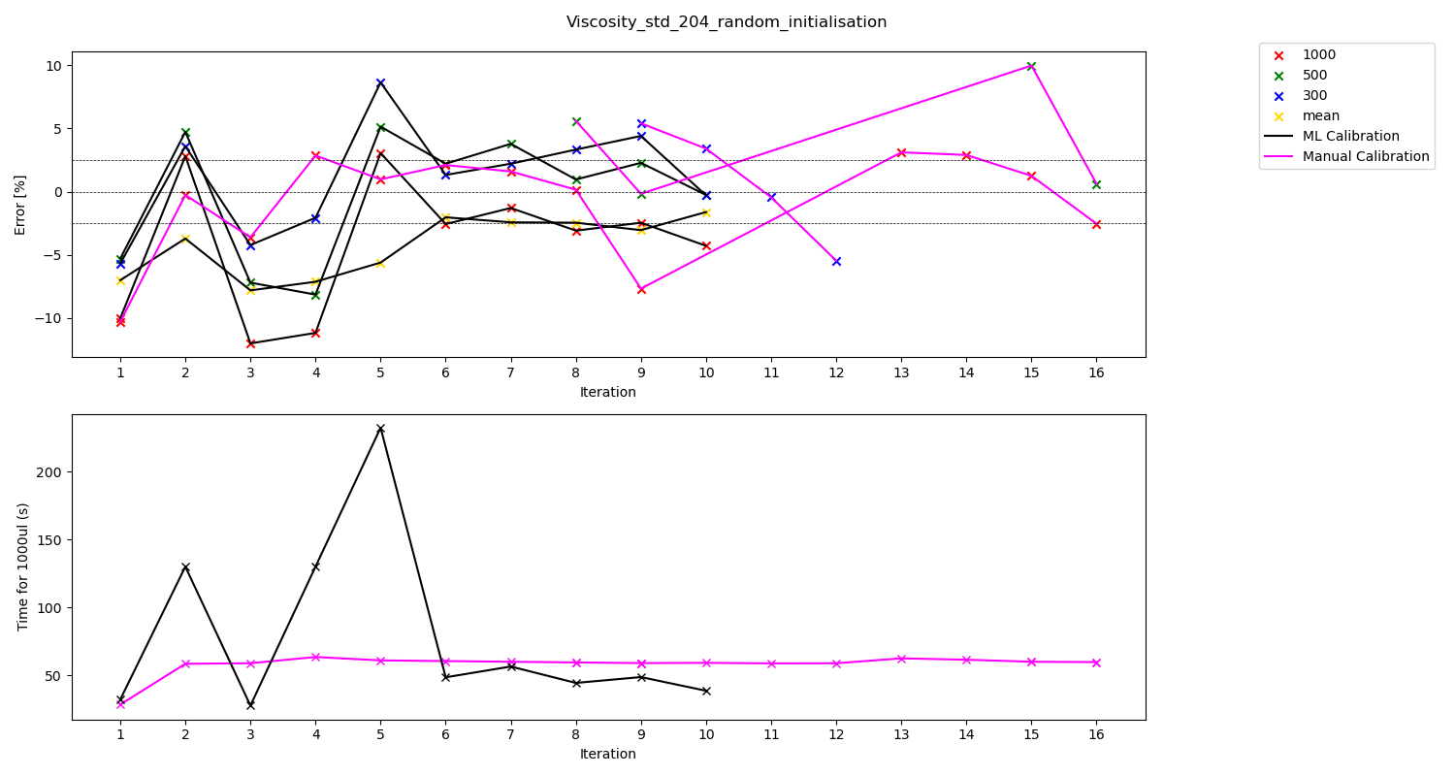

Slide 10
All experiments we have touch tip for aspiration, no touch tip for dispense
Viscosity Standard 204 – Best parameters according to volume pipetted experiment 3
Volume | ML or Human | Aspiration Rate | Dispense Rate | Blow Out Rate | Delay Aspirate | Delay Dispense | Delay Blow Out | %error | Total Time for transfer 1000 ul | Iteration
300 | ML | 110.673791 | 50.793095 | 0 | 5 | 5 | 0 | -0.297102 | 38.723278 | 10
300 | Human | 70 | 70 | 5 | 0.3 | 0 | 0 | -0.451441 | 58.871429 | 11
500 | ML | 110.673791 | 50.793095 | 0 | 5 | 5 | 0 | -0.266235 | 38.723278 | 10
500 | Human | 70 | 70 | 5 | 0.5 | 0 | 0 | -0.173631 | 59.071429 | 9
1000 | ML | 78.136789 | 29.618935 | 0 | 5 | 5 | 0 | -1.296446 | 56.560255 | 7
1000 | Human | 70 | 70 | 5 | 1 | 0 | 0 | 0.150480 | 59.571429 | 8
Mean | ML | 98.504223 | 35.123162 | 0 | 5 | 5 | 0 | -2.034701 | 48.623090 | 6
Mean | ML | 93.316186 | 42.075689 | 0 | 5 | 5 | 0 | -2.460418 | 44.482948 | 8

Slide 11
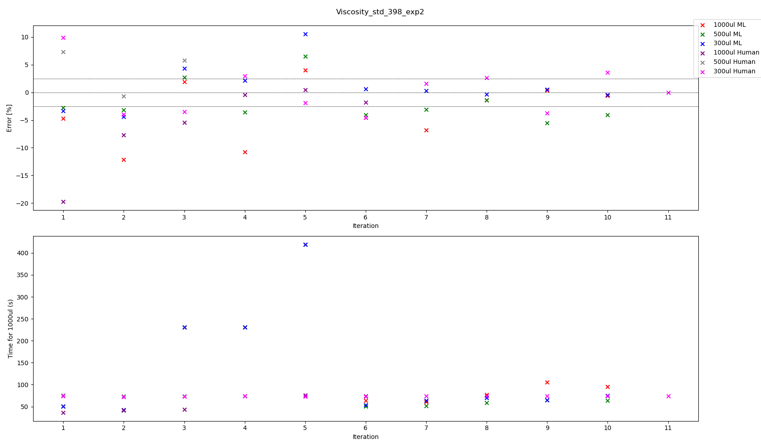

Slide 12
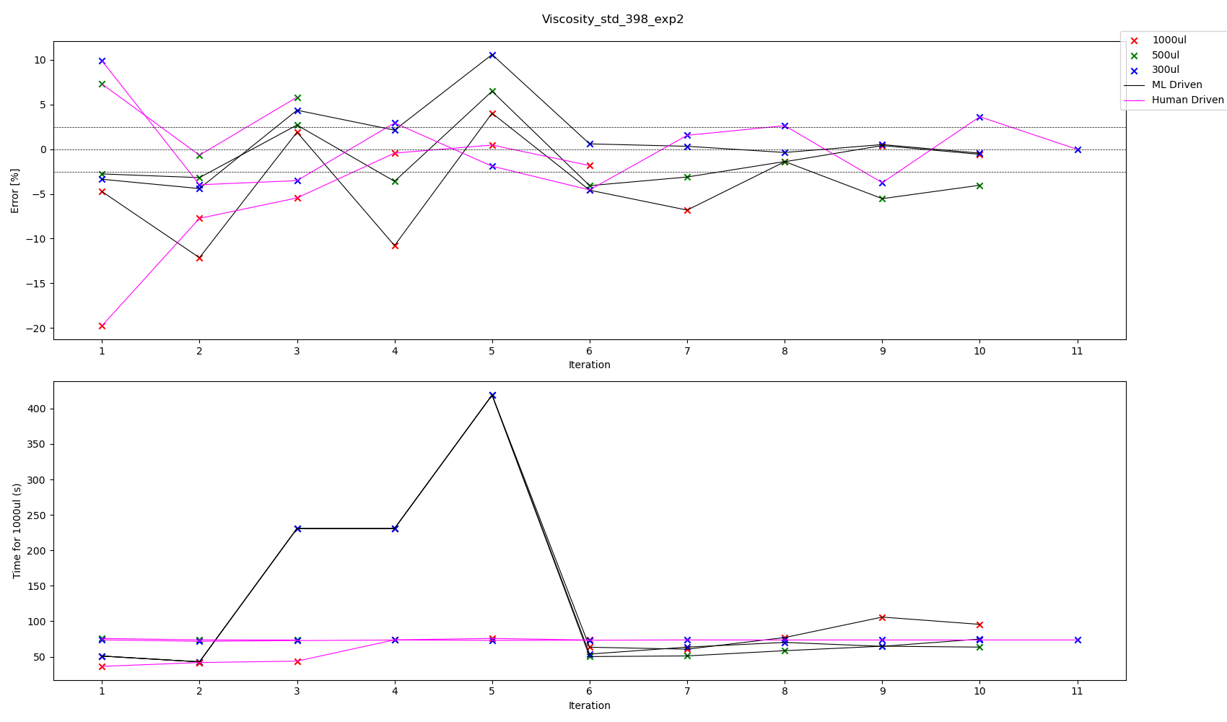

Slide 13
All experiments we have touch tip for aspiration, no touch tip for dispense
Viscosity Standard 398 – Best parameters according to volume pipetted experiment 2
Volume | ML or Human | Aspiration Rate | Dispense Rate | Blow Out Rate | Delay Aspirate | Delay Dispense | Delay Blow Out | %error | Total Time for transfer 1000 ul | Iteration
300 | ML | 38.062178 | 57.306192 | 0 | 5 | 5 | 0 | 0.591943 | 53.722922 | 6
300 | ML | 28.438369 | 54.485468 | 0 | 5 | 5 | 0 | 0.322878 | 63.517279 | 7
300 | Human | 53 | 53 | 5 | 2.83 | 3 | 0 | -0.023063 | 73.565849 | 11
500 | ML | 37.253687 | 46.253603 | 0 | 5 | 5 | 0 | -1.383764 | 58.462918 | 8
500 | Human | 53 | 53 | 5 | 3 | 3 | 0 | -0.668819 | 73.735849 | 2
1000 | ML | 51.956283 | 13.054118 | 0 | 5 | 5 | 0 | 0.403598 | 105.851130 | 9
1000 | ML | 42.496897 | 16.109093 | 0 | 5 | 5 | 0 | -0.576568 | 95.607871 | 10
1000 | Human | 53 | 53 | 5 | 1 | 5 | 0 | -0.438192 | 73.735849 | 4

Slide 14
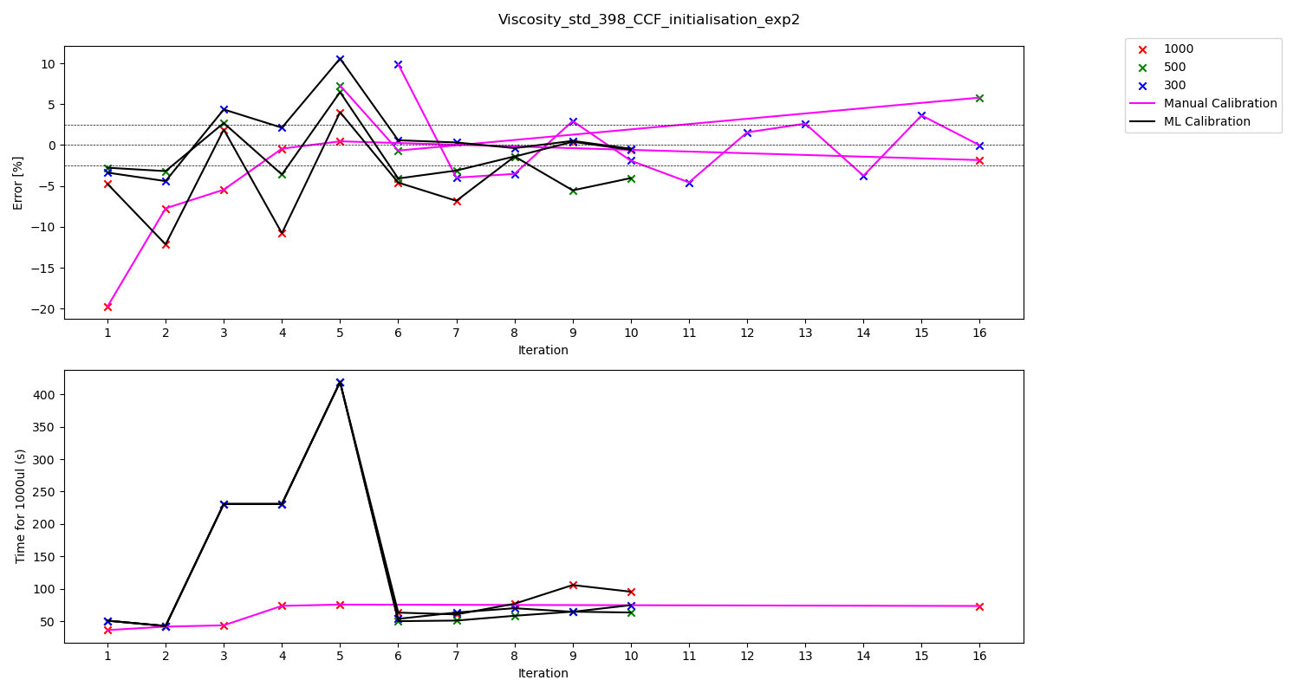

Slide 15
All experiments we have touch tip for aspiration, no touch tip for dispense
Viscosity Standard 398 – Best parameters according to volume pipetted experiment 2
Volume | ML or Human | Aspiration Rate | Dispense Rate | Blow Out Rate | Delay Aspirate | Delay Dispense | Delay Blow Out | %error | Total Time for transfer 1000 ul | Iteration
300 | ML | 38.062178 | 57.306192 | 0 | 5 | 5 | 0 | 0.591943 | 53.722922 | 6
300 | ML | 28.438369 | 54.485468 | 0 | 5 | 5 | 0 | 0.322878 | 63.517279 | 7
300 | Human | 53 | 53 | 5 | 2.83 | 3 | 0 | -0.023063 | 73.565849 | 16
500 | ML | 37.253687 | 46.253603 | 0 | 5 | 5 | 0 | -1.383764 | 58.462918 | 8
500 | Human | 53 | 53 | 5 | 3 | 3 | 0 | -0.668819 | 73.735849 | 6
1000 | ML | 51.956283 | 13.054118 | 0 | 5 | 5 | 0 | 0.403598 | 105.851130 | 9
1000 | ML | 42.496897 | 16.109093 | 0 | 5 | 5 | 0 | -0.576568 | 95.607871 | 10
1000 | Human | 53 | 53 | 5 | 1 | 5 | 0 | -0.438192 | 73.735849 | 4

Slide 16
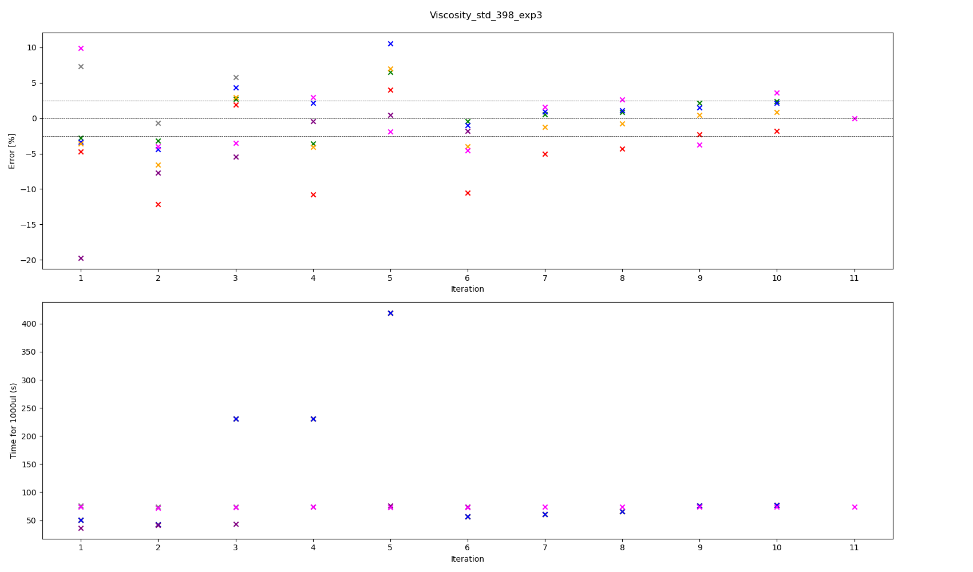

Slide 17
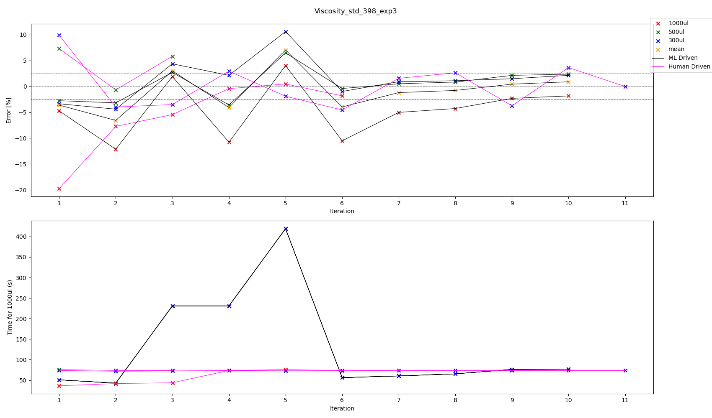

Slide 18
All experiments we have touch tip for aspiration, no touch tip for dispense
Viscosity Standard 398 – Best parameters according to volume pipetted experiment 3
Volume | ML or Human | Aspiration Rate | Dispense Rate | Blow Out Rate | Delay Aspirate | Delay Dispense | Delay Blow Out | %error | Total Time for transfer 1000 ul | Iteration
300 | ML | 54.909220 | 35.685845 | 0 | 5 | 5 | 0 | -0.984010 | 56.234193 | 6
300 | ML | 45.322314 | 35.333833 | 0 | 5 | 5 | 0 | 0.899446 | 60.365673 | 7
300 | Human | 53 | 53 | 5 | 2.83 | 3 | 0 | -0.023063 | 73.565849 | 11
500 | ML | 54.909220 | 35.685845 | 0 | 5 | 5 | 0 | -0.415129 | 56.234193 | 6
500 | Human | 53 | 53 | 5 | 3 | 3 | 0 | -0.668819 | 73.735849 | 2
1000 | ML | 44.249646 | 22.724214 | 0 | 5 | 5 | 0 | -1.845018 | 76.604973 | 10
1000 | Human | 53 | 53 | 5 | 1 | 5 | 0 | -0.438192 | 73.735849 | 4
Mean | ML | 39.299209 | 33.334143 | 0 | 5 | 5 | 0 | -0.785414 | 65.445076 | 8
Mean | ML | 40.938049 | 23.891547 | 0 | 5 | 5 | 0 | 0.426661 | 76.282960 | 9

Slide 19
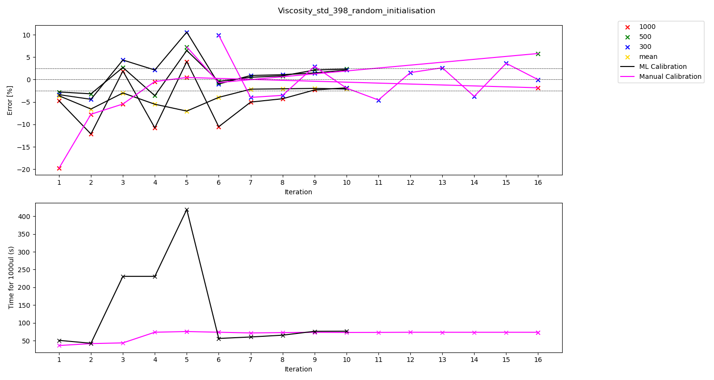

Slide 20
All experiments we have touch tip for aspiration, no touch tip for dispense
Viscosity Standard 398 – Best parameters according to volume pipetted experiment 3
Volume | ML or Human | Aspiration Rate | Dispense Rate | Blow Out Rate | Delay Aspirate | Delay Dispense | Delay Blow Out | %error | Total Time for transfer 1000 ul | Iteration
300 | ML | 54.909220 | 35.685845 | 0 | 5 | 5 | 0 | -0.984010 | 56.234193 | 6
300 | ML | 45.322314 | 35.333833 | 0 | 5 | 5 | 0 | 0.899446 | 60.365673 | 7
300 | Human | 53 | 53 | 5 | 2.83 | 3 | 0 | -0.023063 | 73.565849 | 16
500 | ML | 54.909220 | 35.685845 | 0 | 5 | 5 | 0 | -0.415129 | 56.234193 | 6
500 | Human | 53 | 53 | 5 | 3 | 3 | 0 | -0.668819 | 73.735849 | 6
1000 | ML | 44.249646 | 22.724214 | 0 | 5 | 5 | 0 | -1.845018 | 76.604973 | 10
1000 | Human | 53 | 53 | 5 | 1 | 5 | 0 | -0.438192 | 73.735849 | 4
Mean | ML | 39.299209 | 33.334143 | 0 | 5 | 5 | 0 | -2.066677 | 65.445076 | 8
Mean | ML | 40.938049 | 23.891547 | 0 | 5 | 5 | 0 | 0.426661 | 76.282960 | 9

Slide 21
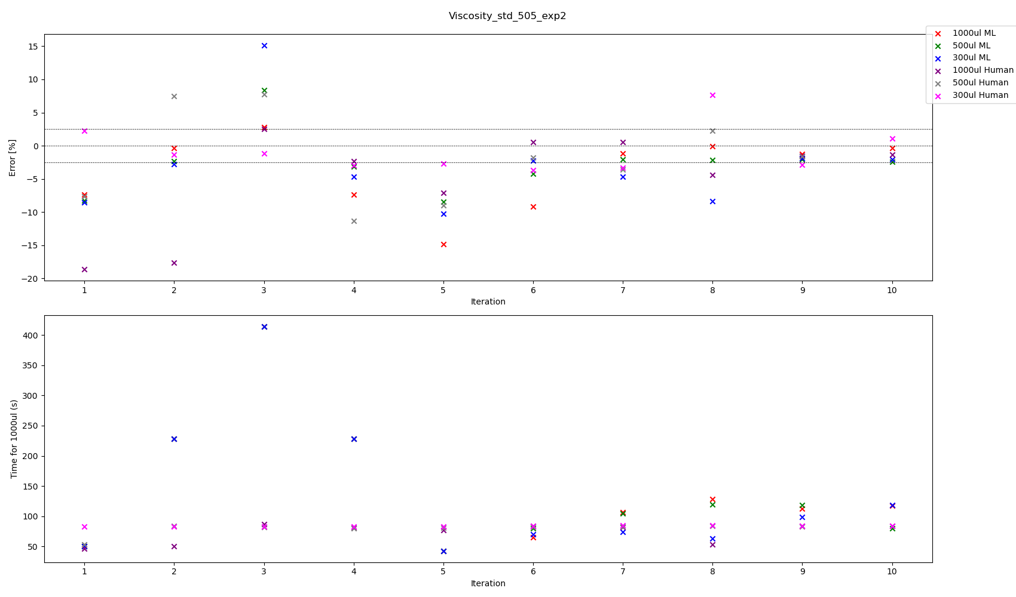

Slide 22
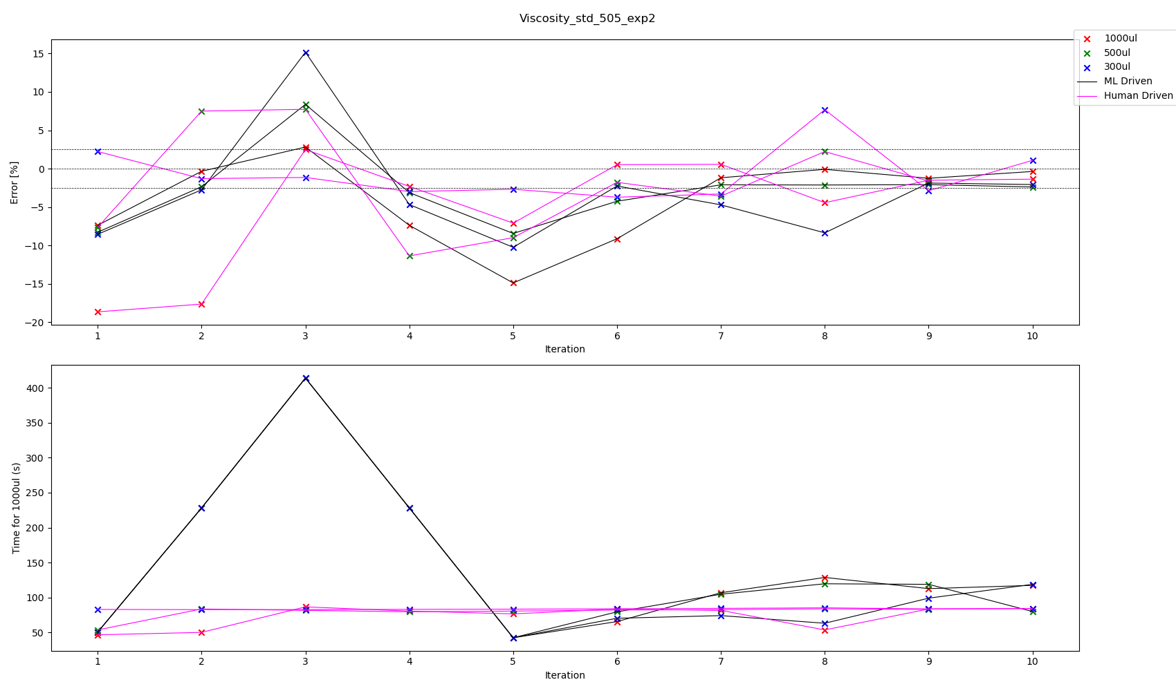

Slide 23
All experiments we have touch tip for aspiration, no touch tip for dispense
Viscosity Standard 505 – Best parameters according to volume pipetted experiment 2
Volume | ML or Human | Aspiration Rate | Dispense Rate | Blow Out Rate | Delay Aspirate | Delay Dispense | Delay Blow Out | %error | Total Time for transfer 1000 ul | Iteration
300 | ML | 49.815477 | 14.513244 | 0 | 5 | 5 | 0 | -1.877231 | 98.976668 | 9
300 | Human | 41 | 43 | 5 | 4 | 2.5 | 0 | 1.078736 | 84.146058 | 10
500 | ML | 52.997340 | 11.122566 | 0 | 5 | 5 | 0 | -2.084533 | 118.776184 | 9
500 | ML | 37.061581 | 23.337657 | 0 | 5 | 5 | 0 | -2.383969 | 79.831322 | 10
500 | Human | 41.5 | 43 | 5 | 3 | 2.5 | 0 | -1.623863 | 82.852199 | 9
1000 | ML | 36.438157 | 10.967022 | 0 | 5 | 5 | 0 | -0.092134 | 128.626216 | 8
1000 | ML | 30.922621 | 13.340393 | 0 | 5 | 5 | 0 | -0.368536 | 117.299094 | 10
1000 | Human | 43 | 43 | 5 | 3.5 | 3.5 | 0 | 0.518254 | 83.511628 | 6
1000 | Human | 43 | 43 | 5 | 2.5 | 2.5 | 0 | 0.564321 | 81.511628 | 7

Slide 24
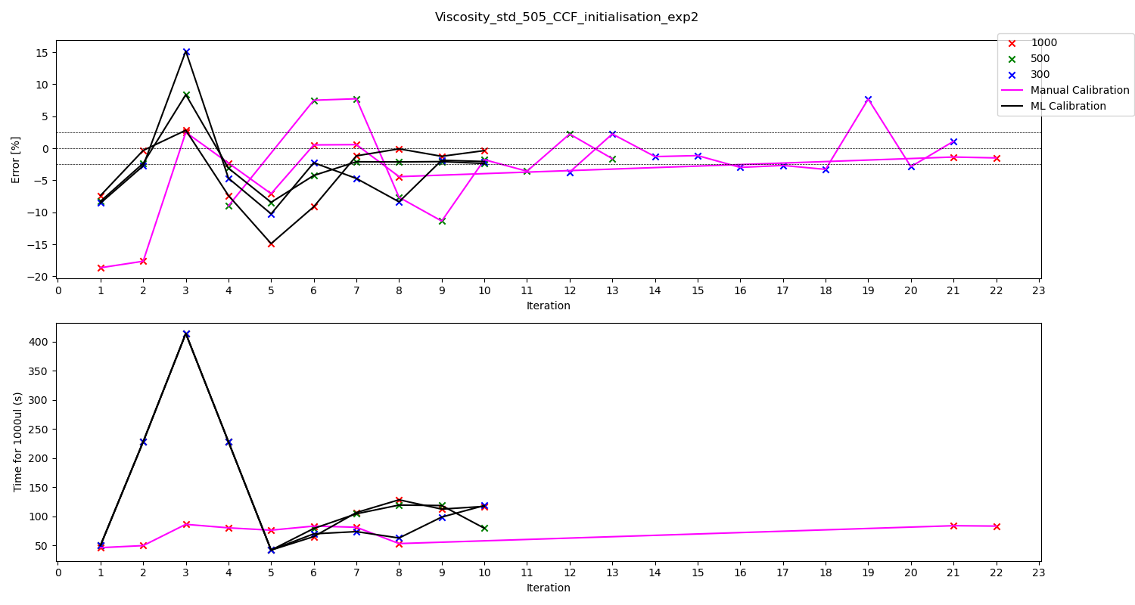

Slide 25
All experiments we have touch tip for aspiration, no touch tip for dispense
Viscosity Standard 505 – Best parameters according to volume pipetted experiment 2
Volume | ML or Human | Aspiration Rate | Dispense Rate | Blow Out Rate | Delay Aspirate | Delay Dispense | Delay Blow Out | %error | Total Time for transfer 1000 ul | Iteration
300 | ML | 49.815477 | 14.513244 | 0 | 5 | 5 | 0 | -1.877231 | 98.976668 | 9
300 | Human | 41 | 43 | 5 | 4 | 2.5 | 0 | 1.078736 | 84.146058 | 21
500 | ML | 52.997340 | 11.122566 | 0 | 5 | 5 | 0 | -2.084533 | 118.776184 | 9
500 | ML | 37.061581 | 23.337657 | 0 | 5 | 5 | 0 | -2.383969 | 79.831322 | 10
500 | Human | 41.5 | 43 | 5 | 3 | 2.5 | 0 | -1.623863 | 82.852199 | 13
1000 | ML | 36.438157 | 10.967022 | 0 | 5 | 5 | 0 | -0.092134 | 128.626216 | 8
1000 | ML | 30.922621 | 13.340393 | 0 | 5 | 5 | 0 | -0.368536 | 117.299094 | 10
1000 | Human | 43 | 43 | 5 | 3.5 | 3.5 | 0 | 0.518254 | 83.511628 | 6
1000 | Human | 43 | 43 | 5 | 2.5 | 2.5 | 0 | 0.564321 | 81.511628 | 7

Slide 26
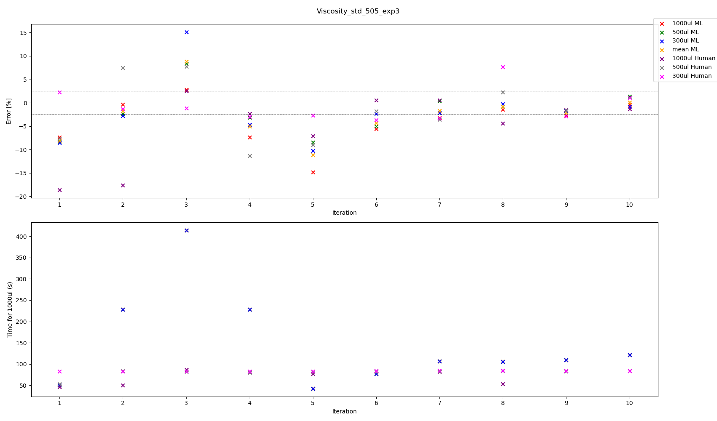

Slide 27
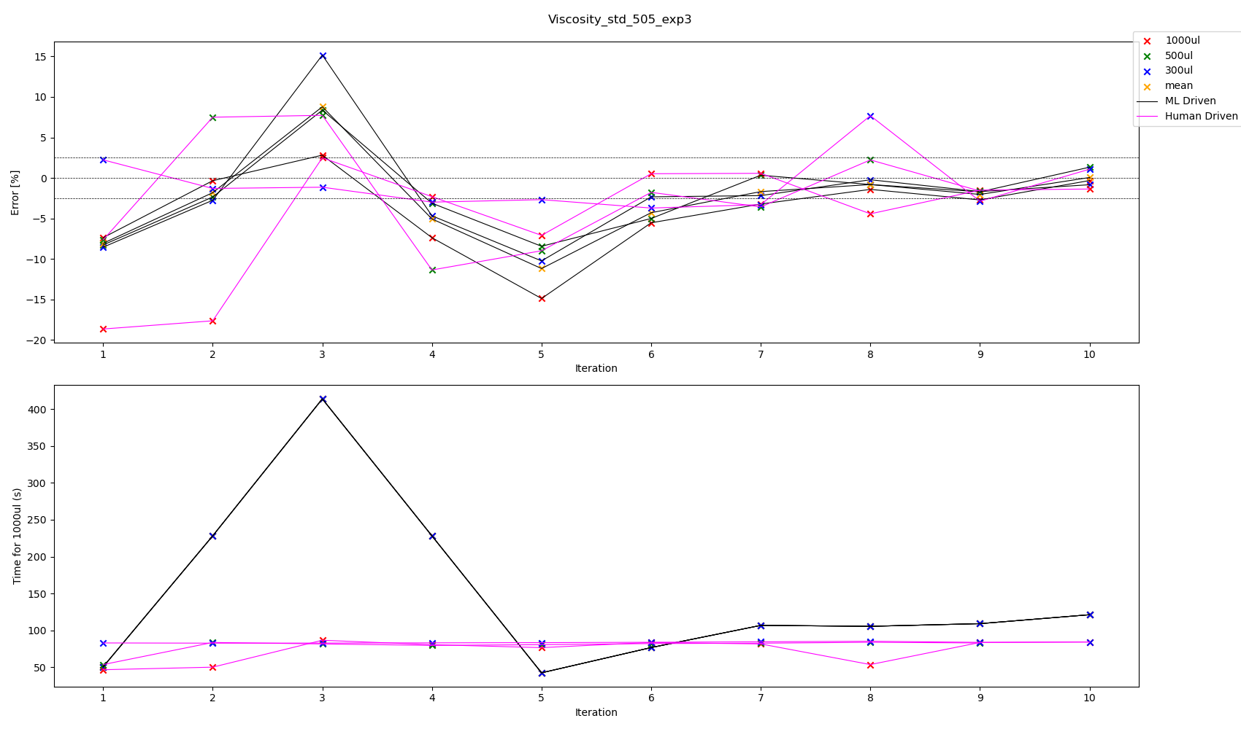

Slide 28
All experiments we have touch tip for aspiration, no touch tip for dispense
Viscosity Standard 505 – Best parameters according to volume pipetted experiment 3
Volume | ML or Human | Aspiration Rate | Dispense Rate | Blow Out Rate | Delay Aspirate | Delay Dispense | Delay Blow Out | %error | Total Time for transfer 1000 ul | Iteration
300 | ML | 51.774776 | 13.141273 | 0 | 5 | 5 | 0 | -0.226496 | 105.410553 | 8
300 | Human | 41 | 43 | 5 | 4 | 2.5 | 0 | 1.078736 | 84.146058 | 10
500 | ML | 45.272971 | 13.405824 | 0 | 5 | 5 | 0 | 0.333986 | 106.682682 | 7
500 | Human | 41.5 | 43 | 5 | 3 | 2.5 | 0 | -1.623863 | 82.852199 | 9
1000 | ML | 44.364301 | 11.284247 | 0 | 5 | 5 | 0 | -0.322469 | 121.159760 | 10
1000 | Human | 43 | 43 | 5 | 3.5 | 3.5 | 0 | 0.518254 | 83.511628 | 6
1000 | Human | 43 | 43 | 5 | 2.5 | 2.5 | 0 | 0.564321 | 81.511628 | 7
Mean | ML | 51.774776 | 13.141273 | 0 | 5 | 5 | 0 | -0.820249 | 105.410553 | 8
Mean | ML | 44.364301 | 11.284247 | 0 | 5 | 5 | 0 | 0.053745 | 121.159760 | 10

Slide 29
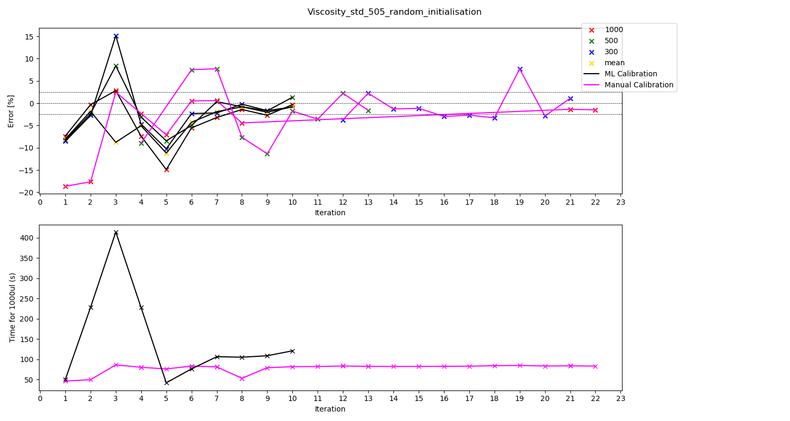

Slide 30
All experiments we have touch tip for aspiration, no touch tip for dispense
Viscosity Standard 505 – Best parameters according to volume pipetted experiment 3
Volume | ML or Human | Aspiration Rate | Dispense Rate | Blow Out Rate | Delay Aspirate | Delay Dispense | Delay Blow Out | %error | Total Time for transfer 1000 ul | Iteration
300 | ML | 51.774776 | 13.141273 | 0 | 5 | 5 | 0 | -0.226496 | 105.410553 | 8
300 | Human | 41 | 43 | 5 | 4 | 2.5 | 0 | 1.078736 | 84.146058 | 21
500 | ML | 45.272971 | 13.405824 | 0 | 5 | 5 | 0 | 0.333986 | 106.682682 | 7
500 | Human | 41.5 | 43 | 5 | 3 | 2.5 | 0 | -1.623863 | 82.852199 | 13
1000 | ML | 44.364301 | 11.284247 | 0 | 5 | 5 | 0 | -0.322469 | 121.159760 | 10
1000 | Human | 43 | 43 | 5 | 3.5 | 3.5 | 0 | 0.518254 | 83.511628 | 6
1000 | Human | 43 | 43 | 5 | 2.5 | 2.5 | 0 | 0.564321 | 81.511628 | 7
Mean | ML | 51.774776 | 13.141273 | 0 | 5 | 5 | 0 | -0.820249 | 105.410553 | 8

Slide 31
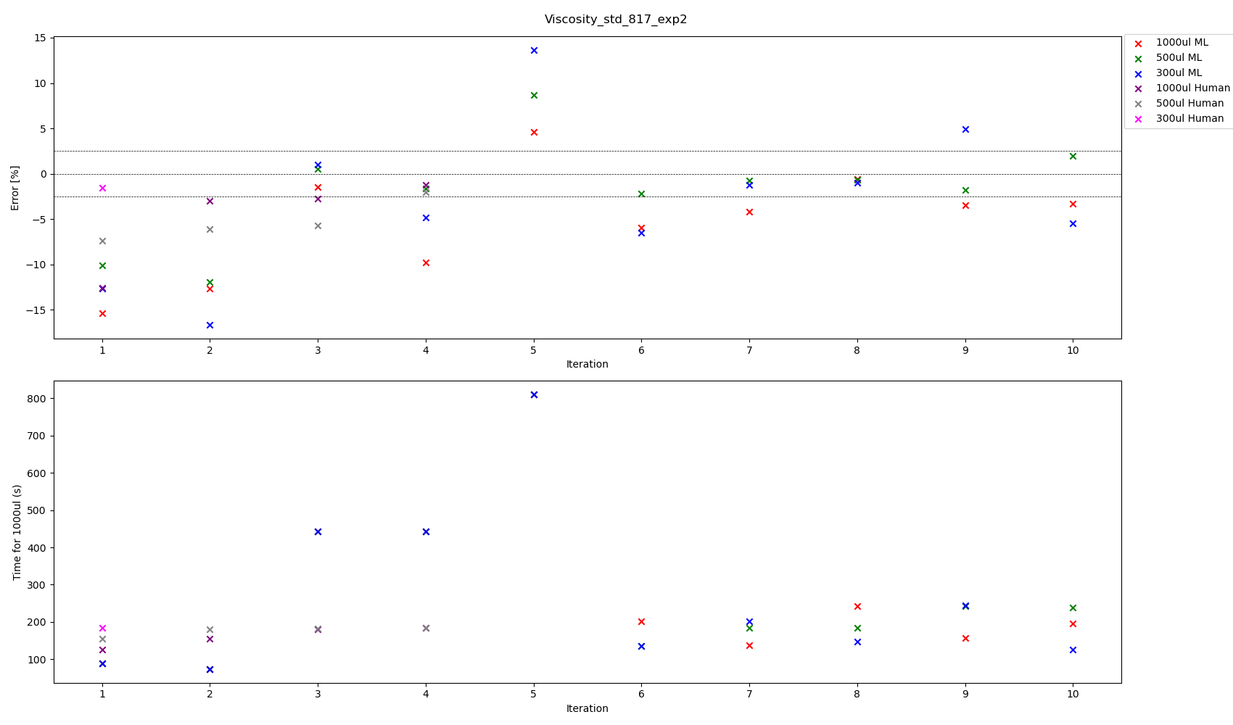

Slide 32
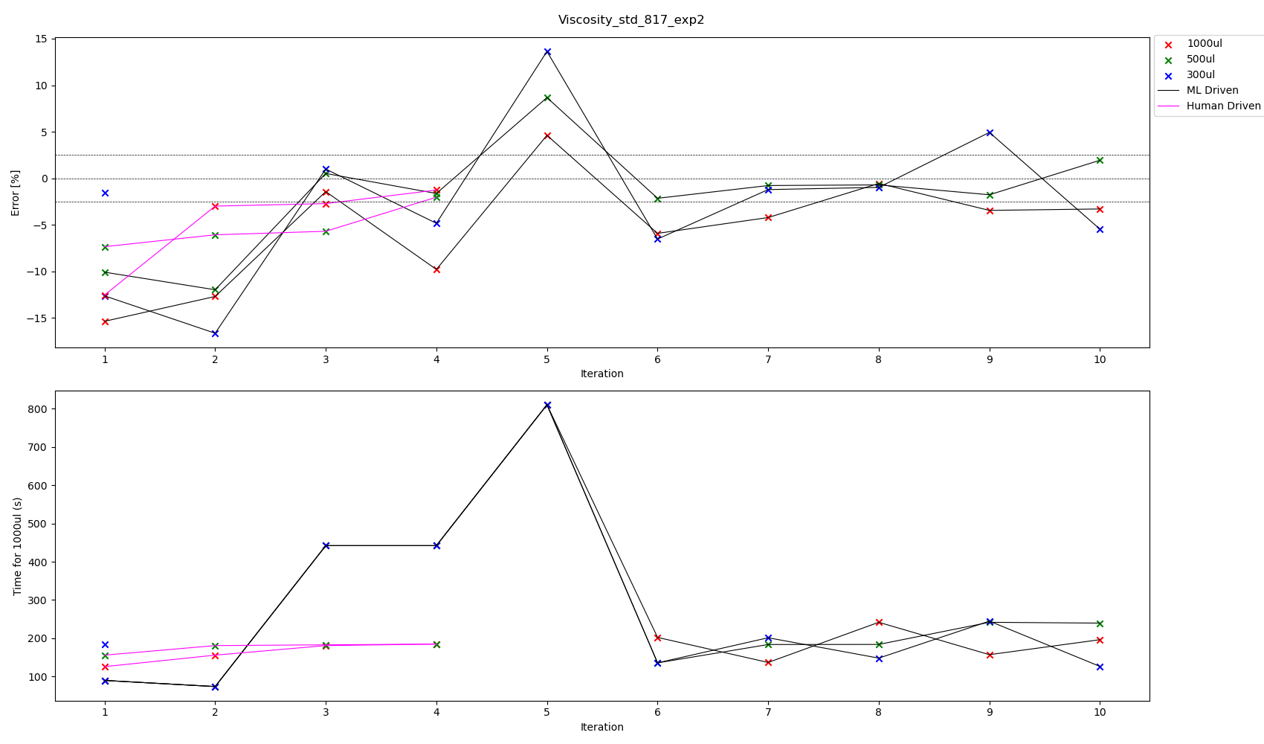



Slide 33
All experiments we have touch tip for aspiration, no touch tip for dispense
Viscosity Standard 817 – Best parameters according to volume pipetted experiment 2
Volume | ML or Human | Aspiration Rate | Dispense Rate | Blow Out Rate | Delay Aspirate | Delay Dispense | Delay Blow Out | %error | Total Time for transfer 1000 ul | Iteration
300 | ML | 18.715216 | 11.784961 | 0 | 5 | 5 | 0 | -0.976455 | 148.28636 | 8
300 | Human | 20 | 8 | 0 | 5 | 5 | 0 | -1.567053 | 185 | 1
500 | ML | 23.640162 | 7.605711 | 0 | 5 | 5 | 0 | -0.779589 | 183.781045 | 7
500 | ML | 27.782234 | 7.244950 | 0 | 5 | 5 | 0 | -0.708717 | 184.021409 | 8
500 | Human | 20 | 8 | 0 | 5 | 5 | 0 | -2.031656 | 185 | 4
1000 | ML | 28.455588 | 5.083888 | 0 | 5 | 5 | 0 | -0.555162 | 241.842347 | 8
1000 | Human | 20 | 8 | 0 | 5 | 5 | 0 | -1.263879 | 185 | 4

Slide 34
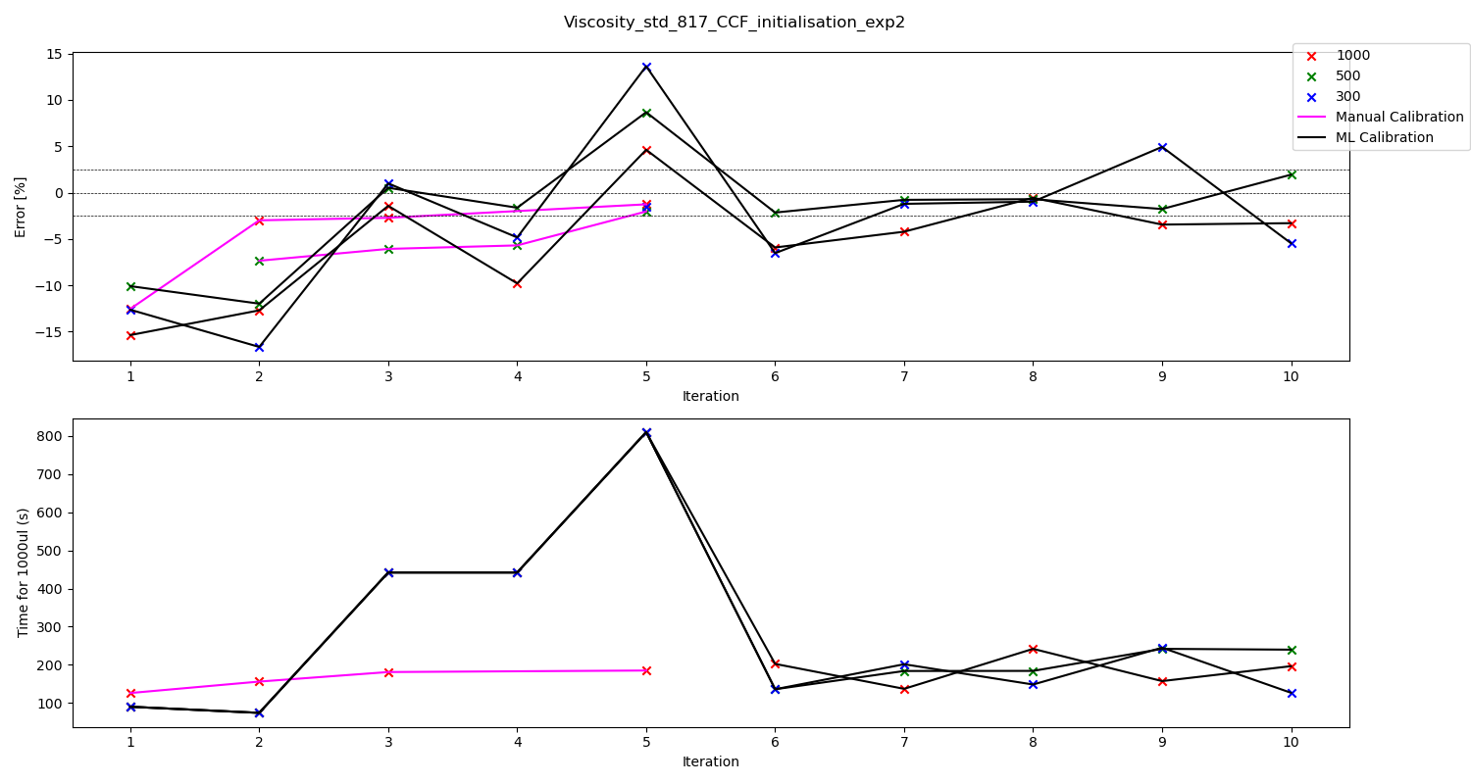

Slide 35
All experiments we have touch tip for aspiration, no touch tip for dispense
Viscosity Standard 817 – Best parameters according to volume pipetted experiment 2
Volume | ML or Human | Aspiration Rate | Dispense Rate | Blow Out Rate | Delay Aspirate | Delay Dispense | Delay Blow Out | %error | Total Time for transfer 1000 ul | Iteration
300 | ML | 18.715216 | 11.784961 | 0 | 5 | 5 | 0 | -0.976455 | 148.28636 | 8
300 | Human | 20 | 8 | 0 | 5 | 5 | 0 | -1.567053 | 185 | 5
500 | ML | 27.782234 | 7.244950 | 0 | 5 | 5 | 0 | -0.708717 | 184.021409 | 8
500 | Human | 20 | 8 | 0 | 5 | 5 | 0 | -2.031656 | 185 | 5
1000 | ML | 28.455588 | 5.083888 | 0 | 5 | 5 | 0 | -0.555162 | 241.842347 | 8
1000 | Human | 20 | 8 | 0 | 5 | 5 | 0 | -1.263879 | 185 | 5

Slide 36
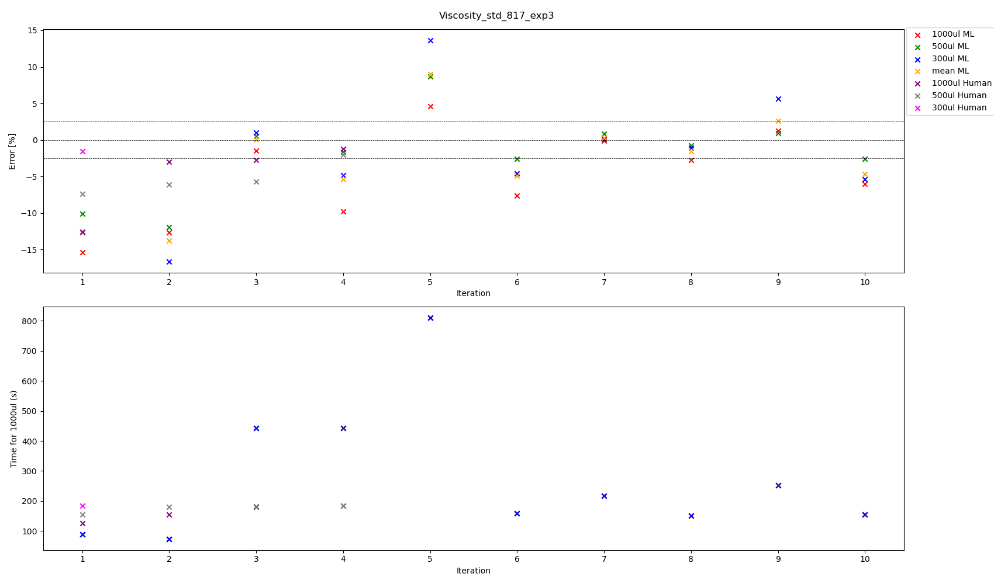

Slide 37
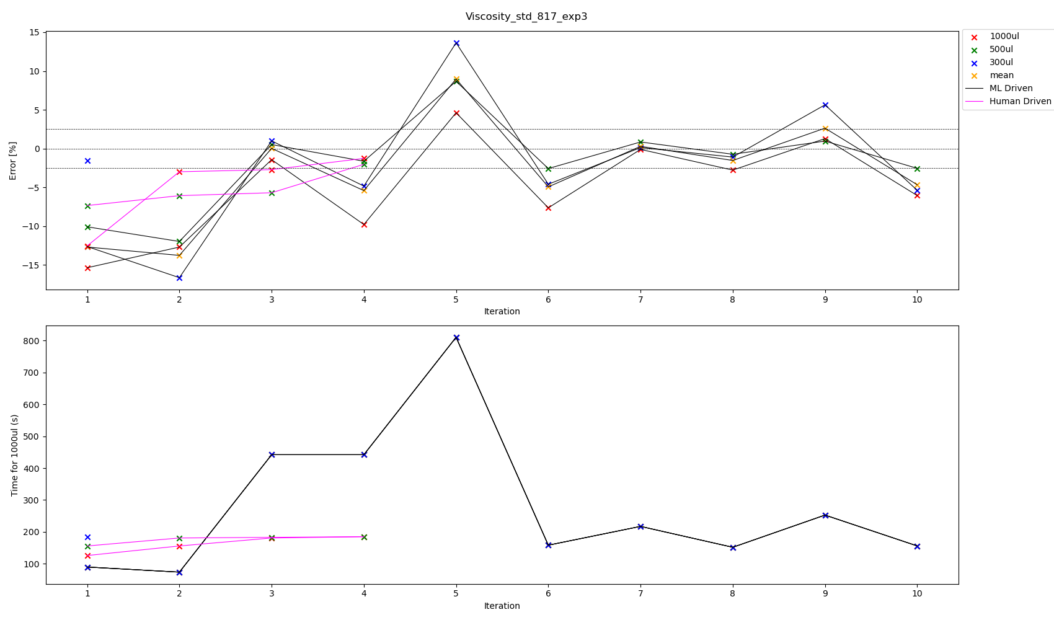



Slide 38
All experiments we have touch tip for aspiration, no touch tip for dispense
Viscosity Standard 817 – Best parameters according to volume pipetted experiment 3
Volume | ML or Human | Aspiration Rate | Dispense Rate | Blow Out Rate | Delay Aspirate | Delay Dispense | Delay Blow Out | %error | Total Time for transfer 1000 ul | Iteration
300 | ML | 19.630164 | 6.392805 | 0 | 5 | 5 | 0 | 0.125994 | 217.367862 | 7
300 | ML | 16.556084 | 12.276070 | 0 | 5 | 5 | 0 | -1.094574 | 151.860050 | 8
300 | Human | 20 | 8 | 0 | 5 | 5 | 0 | -1.567053 | 185 | 1
500 | ML | 16.556084 | 12.276070 | 0 | 5 | 5 | 0 | -0.732341 | 151.860050 | 8
500 | Human | 20 | 8 | 0 | 5 | 5 | 0 | -2.031656 | 185 | 4
1000 | ML | 19.630164 | 6.392805 | 0 | 5 | 5 | 0 | -0.106308 | 217.367862 | 7
1000 | Human | 20 | 8 | 0 | 5 | 5 | 0 | -1.263879 | 185 | 4
Mean | ML | 19.630164 | 6.392805 | 0 | 5 | 5 | 0 | 0.290049 | 217.367862 | 7
Mean | ML | 16.556084 | 12.276070 | 0 | 5 | 5 | 0 | -1.534241 | 151.860050 | 8

Slide 39
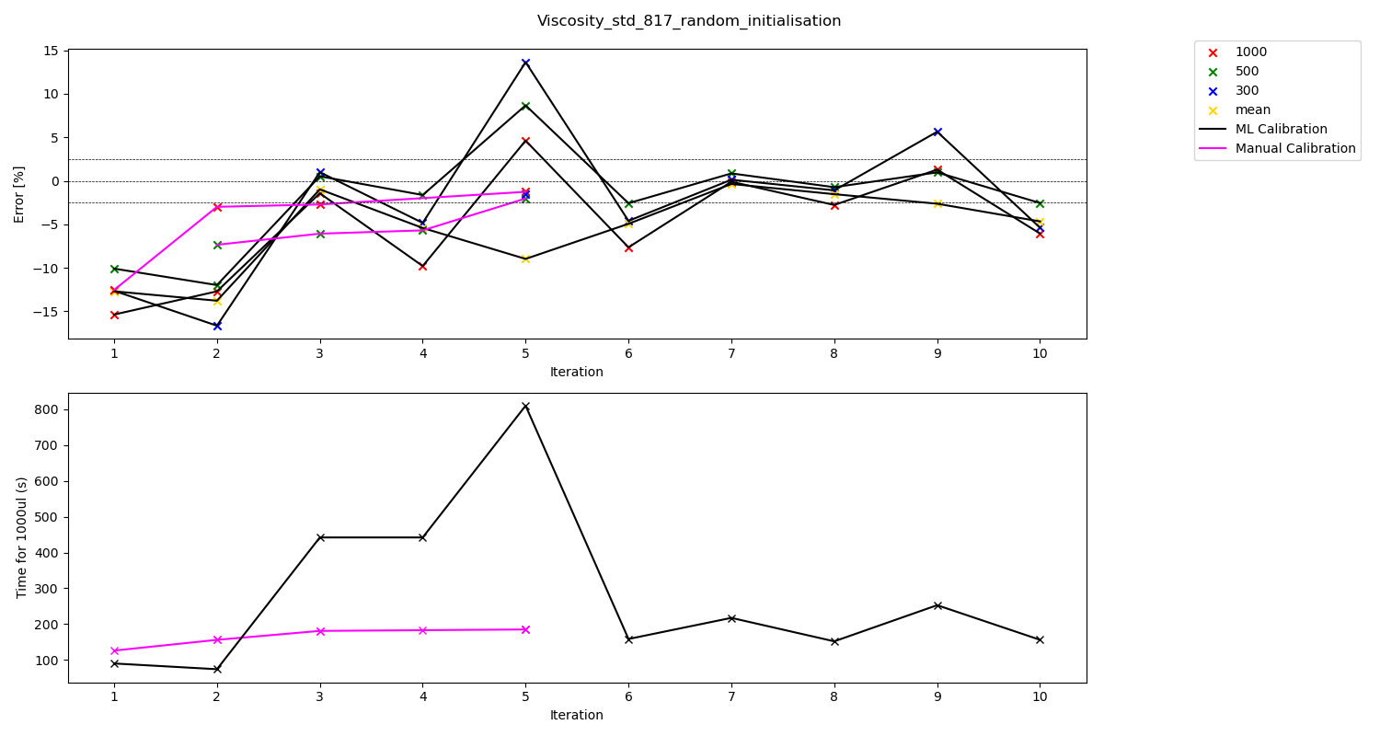

Slide 40
All experiments we have touch tip for aspiration, no touch tip for dispense
Viscosity Standard 817 – Best parameters according to volume pipetted experiment 3
Volume | ML or Human | Aspiration Rate | Dispense Rate | Blow Out Rate | Delay Aspirate | Delay Dispense | Delay Blow Out | %error | Total Time for transfer 1000 ul | Iteration
300 | ML | 19.630164 | 6.392805 | 0 | 5 | 5 | 0 | 0.125994 | 217.367862 | 7
300 | ML | 16.556084 | 12.276070 | 0 | 5 | 5 | 0 | -1.094574 | 151.860050 | 8
300 | Human | 20 | 8 | 0 | 5 | 5 | 0 | -1.567053 | 185 | 5
500 | ML | 16.556084 | 12.276070 | 0 | 5 | 5 | 0 | -0.732341 | 151.860050 | 8
500 | Human | 20 | 8 | 0 | 5 | 5 | 0 | -2.031656 | 185 | 5
1000 | ML | 19.630164 | 6.392805 | 0 | 5 | 5 | 0 | -0.106308 | 217.367862 | 7
1000 | Human | 20 | 8 | 0 | 5 | 5 | 0 | -1.263879 | 185 | 5
Mean | ML | 19.630164 | 6.392805 | 0 | 5 | 5 | 0 | -0.360921 | 217.367862 | 7
Mean | ML | 16.556084 | 12.276070 | 0 | 5 | 5 | 0 | -1.534241 | 151.860050 | 8

Slide 41
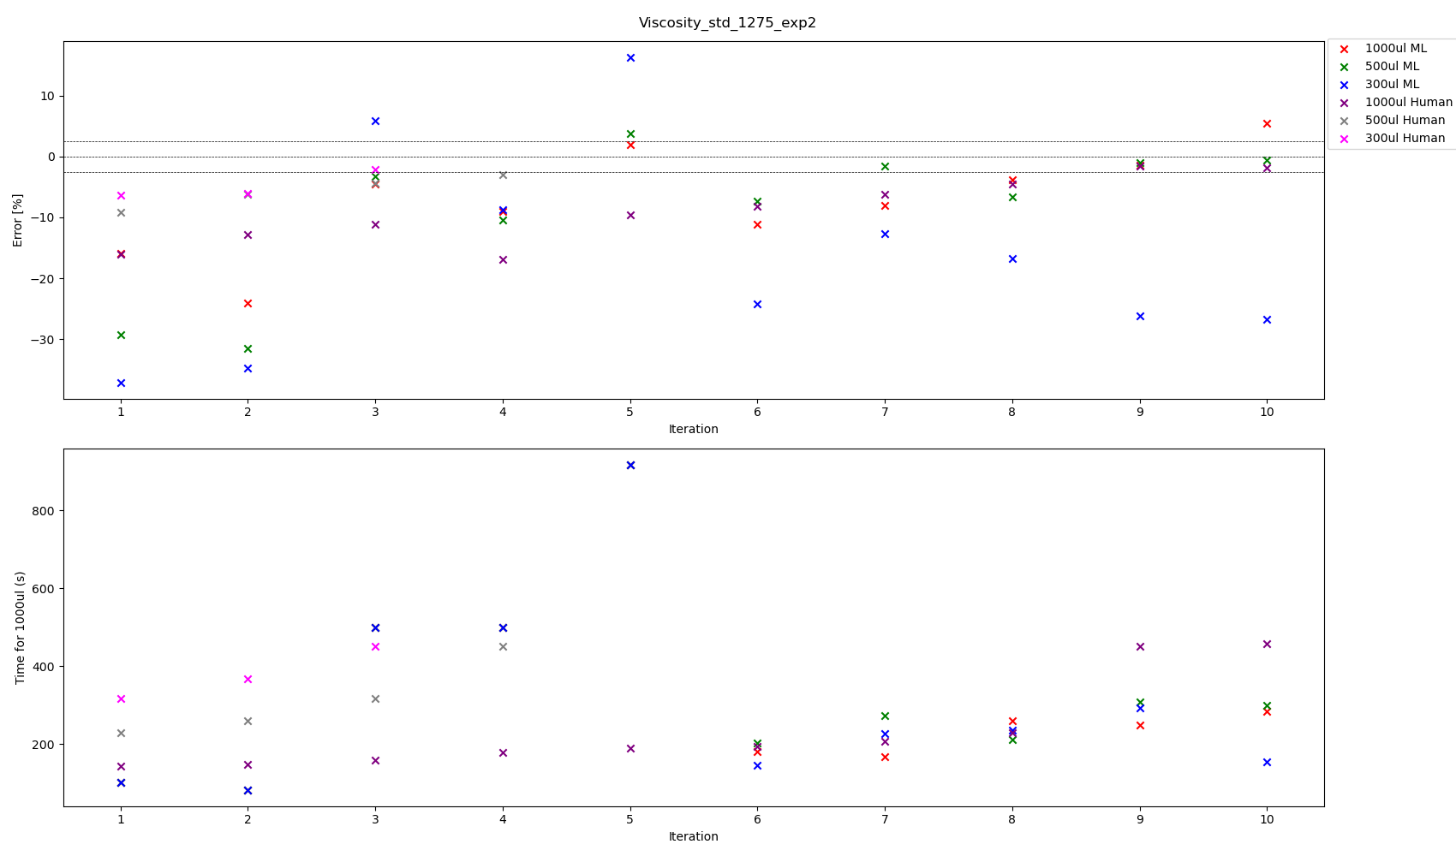

Slide 42
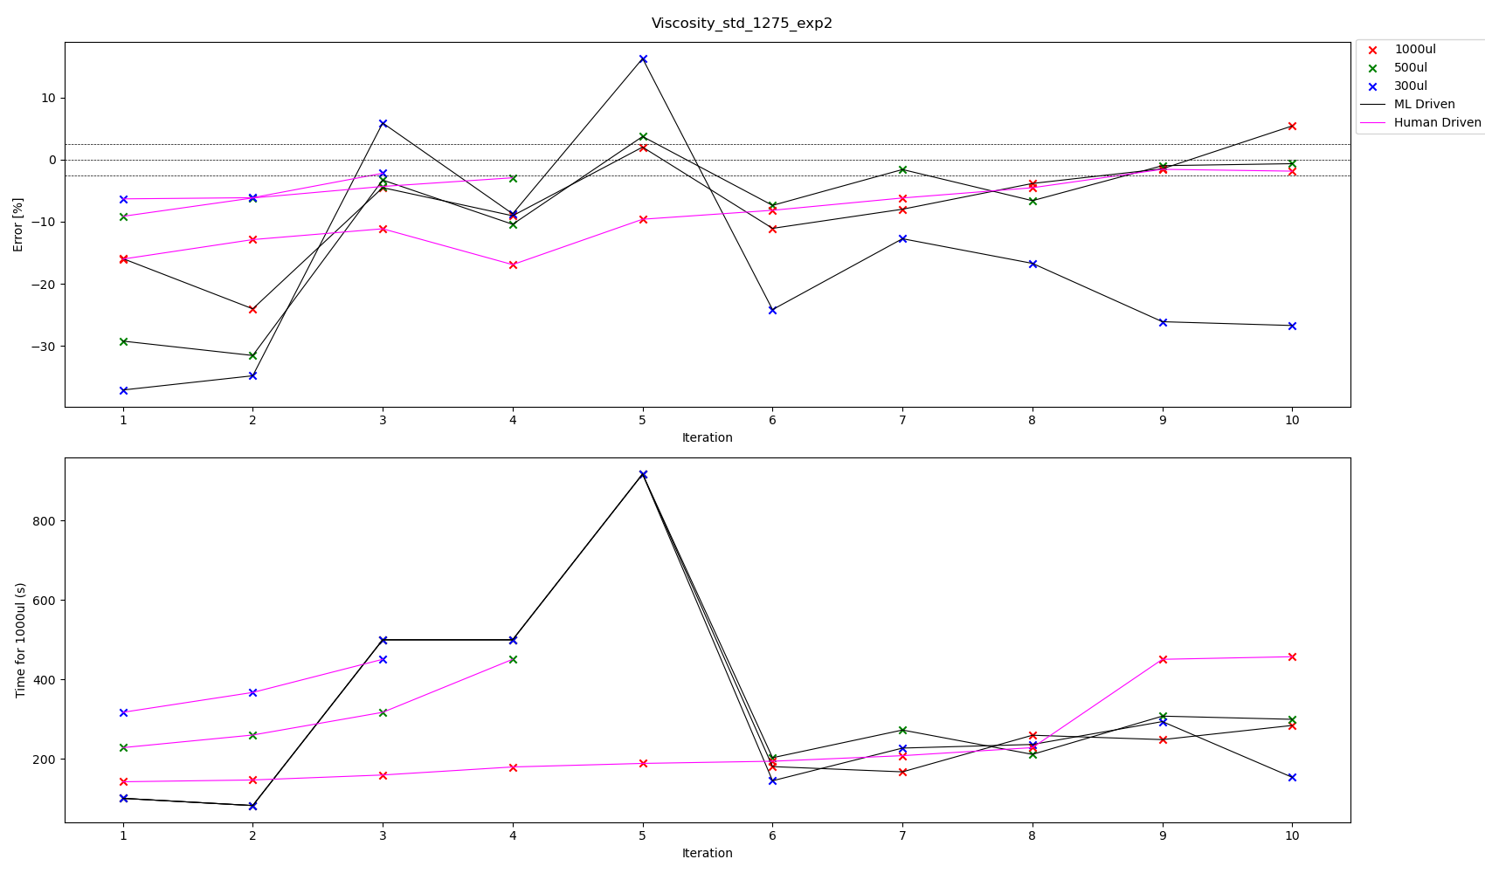

Slide 43
All experiments we have touch tip for aspiration, no touch tip for dispense
Viscosity Standard 1275 – Best parameters according to volume pipetted experiment 2
Volume | ML or Human | Aspiration Rate | Dispense Rate | Blow Out Rate | Delay Aspirate | Delay Dispense | Delay Blow Out | %error | Total Time for transfer 1000 ul | Iteration
300 | ML | 18.388306 | 6.144974 | 0 | 5 | 5 | 0 | -12.736569 | 227.117009 | 7
300 | Human | 9 | 3 | 0 | 3 | 3 | 0 | -2.205433 | 450.444444 | 3
500 | ML | 12.501784 | 5.478683 | 0 | 5 | 5 | 0 | -1.602564 | 272.514202 | 7
500 | ML | 10.869956 | 5.063828 | 0 | 5 | 5 | 0 | -0.663919 | 299.475744 | 10
500 | Human | 9 | 3 | 0 | 3 | 3 | 0 | -2.930403 | 450.444444 | 4
1000 | ML | 7.477992 | 9.550622 | 0 | 5 | 5 | 0 | -1.488095 | 248.430956 | 9
1000 | Human | 9 | 3 | 0 | 3 | 3 | 0 | -1.568223 | 450.444444 | 9

Slide 44
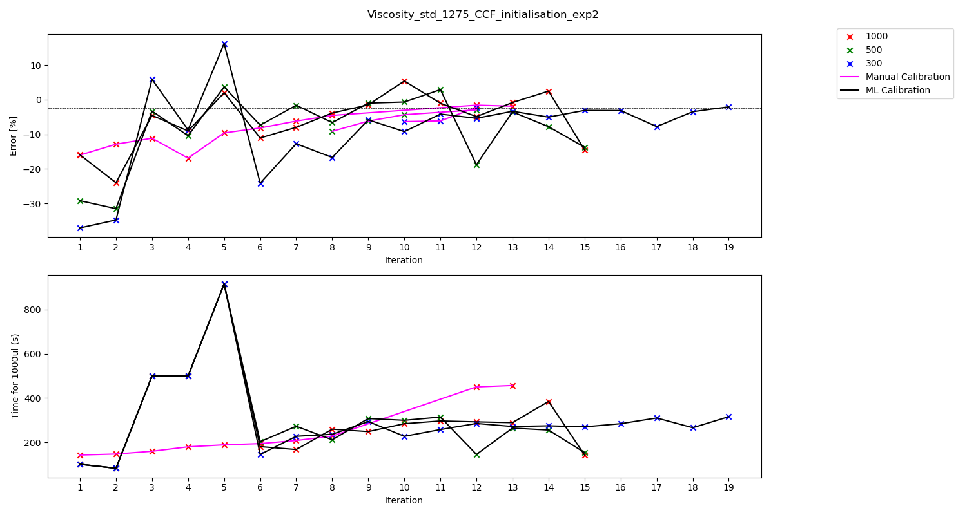

Slide 45
All experiments we have touch tip for aspiration, no touch tip for dispense
Viscosity Standard 1275 – Best parameters according to volume pipetted experiment 2 updated with more trials
Volume | ML or Human | Aspiration Rate | Dispense Rate | Blow Out Rate | Delay Aspirate | Delay Dispense | Delay Blow Out | %error | Total Time for transfer 1000 ul | Iteration
300 | ML | 10.440661 | 4.763605 | 0 | 5 | 5 | 0 | -2.052808 | 315.704410 | 19
300 | Human | 9 | 3 | 0 | 3 | 3 | 0 | -2.205433 | 450.444444 | 12
500 | ML | 12.501784 | 5.478683 | 0 | 5 | 5 | 0 | -1.602564 | 272.514202 | 7
500 | ML | 10.869956 | 5.063828 | 0 | 5 | 5 | 0 | -0.663919 | 299.475744 | 10
500 | Human | 9 | 3 | 0 | 3 | 3 | 0 | -2.930403 | 450.444444 | 12
1000 | ML | 7.477992 | 9.550622 | 0 | 5 | 5 | 0 | -1.488095 | 248.430956 | 9
1000 | ML | 5.214088 | 11.489550 | 0 | 5 | 5 | 0 | -0.812729 | 288.823716 | 13
1000 | Human | 9 | 3 | 0 | 3 | 3 | 0 | -1.568223 | 450.444444 | 12

Slide 46
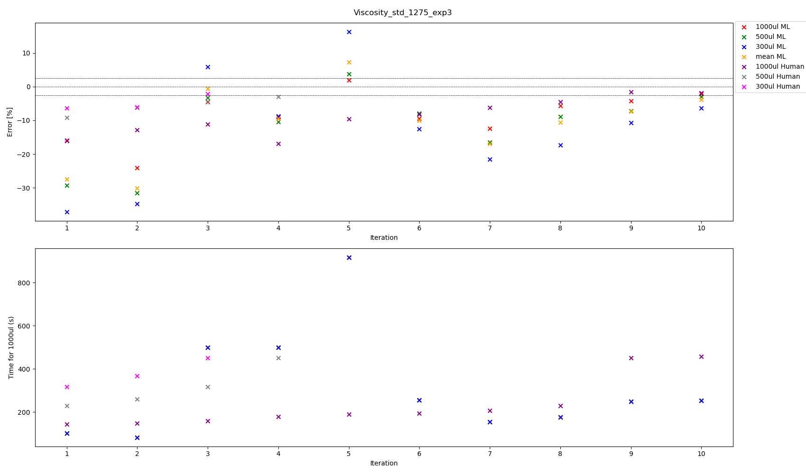

Slide 47
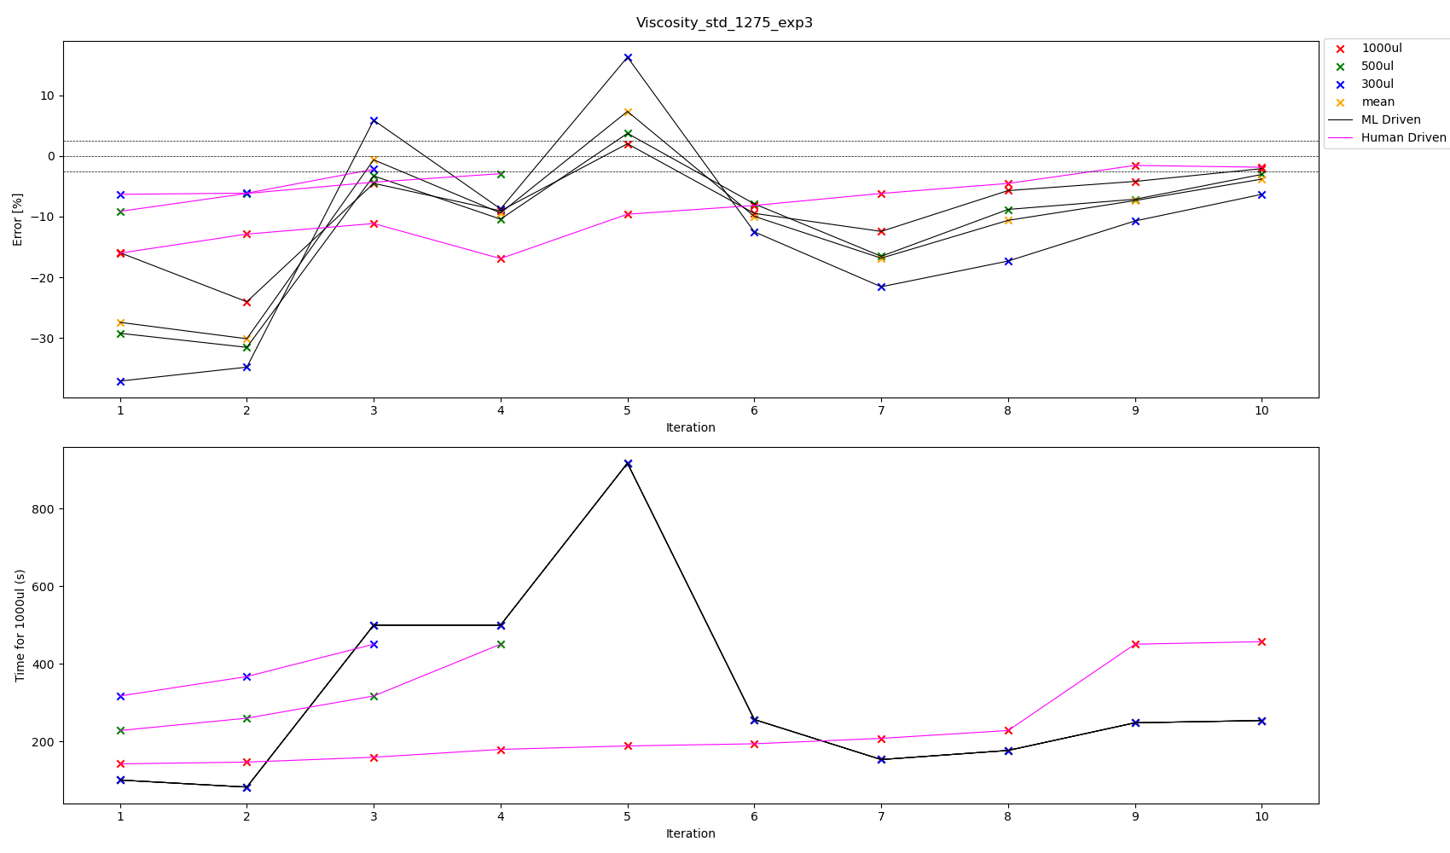



Slide 48
All experiments we have touch tip for aspiration, no touch tip for dispense
Viscosity Standard 1275 – Best parameters according to volume pipetted experiment 3
Volume | ML or Human | Aspiration Rate | Dispense Rate | Blow Out Rate | Delay Aspirate | Delay Dispense | Delay Blow Out | %error | Total Time for transfer 1000 ul | Iteration
300 | ML | 6.283318 | 11.792864 | 0 | 5 | 5 | 0 | -6.326313 | 253.948616 | 10
300 | Human | 9 | 3 | 0 | 3 | 3 | 0 | -2.205433 | 450.444444 | 3
500 | ML | 6.283318 | 11.792864 | 0 | 5 | 5 | 0 | -3.044872 | 253.948616 | 10
500 | Human | 9 | 3 | 0 | 3 | 3 | 0 | -2.930403 | 450.444444 | 4
1000 | ML | 6.283318 | 11.792864 | 0 | 5 | 5 | 0 | -2.094780 | 253.948616 | 10
1000 | Human | 9 | 3 | 0 | 3 | 3 | 0 | -1.568223 | 450.444444 | 9
Mean | ML | 6.283318 | 11.792864 | 0 | 5 | 5 | 0 | -3.821988 | 253.948616 | 10

Slide 49
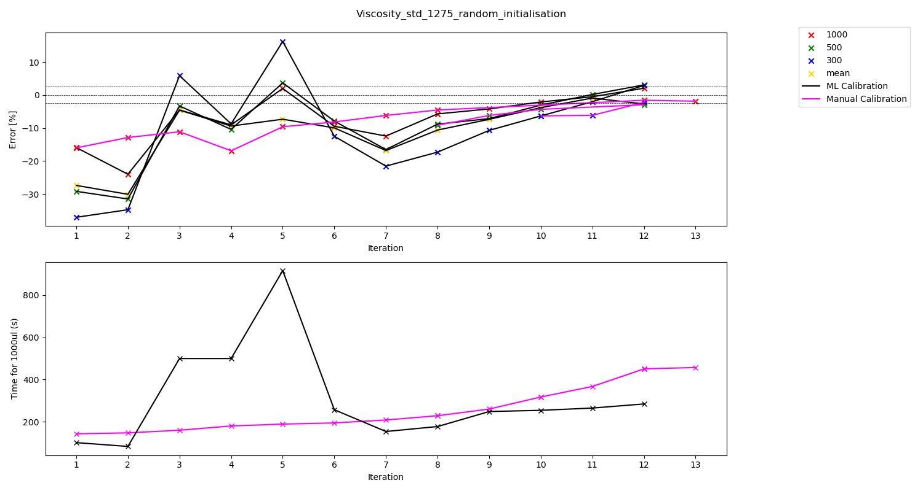

Slide 50
All experiments we have touch tip for aspiration, no touch tip for dispense
Viscosity Standard 1275 – Best parameters according to volume pipetted experiment 3 updated with more trials
Volume | ML or Human | Aspiration Rate | Dispense Rate | Blow Out Rate | Delay Aspirate | Delay Dispense | Delay Blow Out | %error | Total Time for transfer 1000 ul | Iteration
300 | ML | 6.739790 | 9.409947 | 0 | 5 | 5 | 0 | -2.014652 | 264.643097 | 11
300 | Human | 9 | 3 | 0 | 3 | 3 | 0 | -2.205433 | 450.444444 | 12
500 | ML | 6.739790 | 9.409947 | 0 | 5 | 5 | 0 | 0.183150 | 264.643097 | 11
500 | Human | 9 | 3 | 0 | 3 | 3 | 0 | -2.930403 | 450.444444 | 12
1000 | ML | 6.739790 | 9.409947 | 0 | 5 | 5 | 0 | -0.503663 | 264.643097 | 11
1000 | Human | 9 | 3 | 0 | 3 | 3 | 0 | -1.568223 | 450.444444 | 12
Mean | ML | 6.739790 | 9.409947 | 0 | 5 | 5 | 0 | -0.900488 | 264.643097 | 11

