Slide 1
CDA 5106: Advanced Computer
Architecture
Lecture 3: ISA
Prof. Jongouk Choi
University of Central Florida
Spring 2026

Slide 2
Objectives and Outline
Objectives:
Understand the design space of ISA, their trade offs
Able to generate code on various ISAs and analyze trade offs
Recite key features of major ISAs
Outline (totaling 3 sub-modules)
What is ISA?
ISA Styles: stacks, accumulator, register-memory, load-store
Alignment, endian-ness, instruction encoding
Addressing modes
Control transfer instruction types and styles
Examples of major ISAs

Slide 3
Module 3.1: Instruction Set Architecture1

Slide 4

Programming language is booming up!

Slide 5
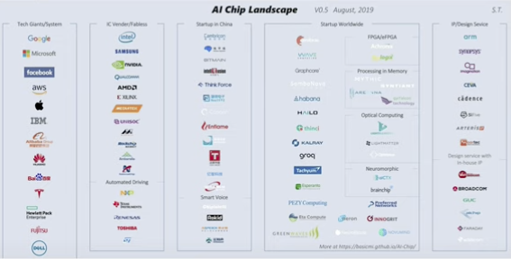
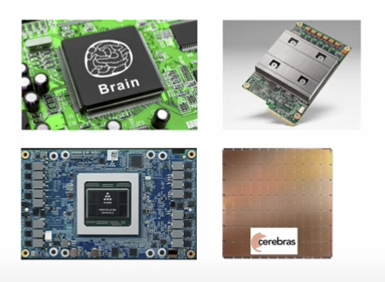

Hardware Complexity is Blowing Up!

Slide 6
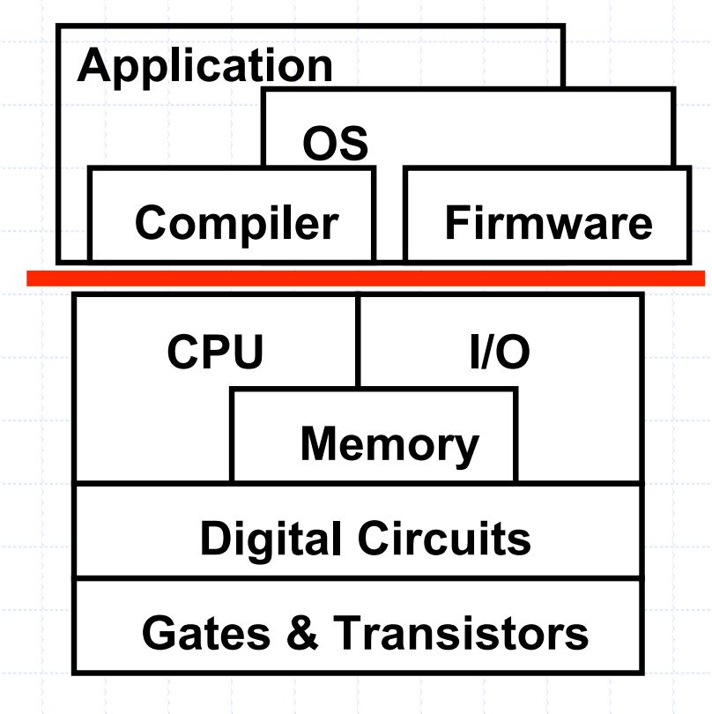
Instruction Set Architecture
What is ISA?
A well-define hardware-software interface
The “contract” between software/hardware
Functional definition of operations, addressing modes,
and storage locations supported by hardware
ISA

Slide 7
What is ISA?
Agreed upon interface between software and hardware
SW/compiler assumes, HW promises
What the software writer needs to know to write and debug system/user programs
Instructions: the words of a computer language
Instruction set: vocabulary
Instruction sets may differ from computer to computer, e.g., x86, arm, MIPS…, but have many things in common.
Computational operations
Memory access & addressing
Branches
Procedure calls
All instruction sets promote a common goal.
Make it easy to build the hardware and the compiler while maximizing performance and minimizing cost.
Notes:
Instruction set architecture is the agreement between hardware and software.
as long as the software follows the agreement, it can control the hardware.
[click]
instructions are the words of a computer language, and you can think it is like a vocabulary.
[click]
however, the set itself may differ from system to system.
if you target x86 intel architecture, the isa must be different.
But all systems have some common concepts
jcomputational operations.
There is always a way to access memory and handle the addressing for that.
All instruction sets support branches,
And there's also a method for procedure calls. or function calls.

Slide 8
Example: Arithmetic Operations
Addition
add a, b, c
a = b + c; (C programming)
Instruction
destination
sources
three operands
Notes:
let's first talke about the arithmetic operations with ISA.
since All hardware systems need to be able to add values.[click]
let's say we want to add b to c and store the sum into a.
that is a=b+c;[click]\
to run this operation, we need to have three operands, a destination and two sources.
The order of which are important for the language.
Our command is add, and
then our operands are listed a then b, then c,
which translates into a has been assigned the value of b plus c.[click]
this is like a R type MIpS instruction, we are going to talk about the type later.
So this is our first instruction, it is part of a classification of
instructions called R type instructions and for our R types,
they're always of this form, the name of the instruction and
then the three variables, two sources and one destination.

Slide 9
Example: Arithmetic Operations
a = b + c + d + e
add a, b, c #a = b + c
add a, a, d #a = b + c + d
add a, a, e #a = b + c + d + e
Each line can only have one instruction on it
Anything following a # is a comment.
Notes:
Let's look at a slightly more complex addition.
Let's suppose we wanted to add four things together.[click]
We'll do b plus c. Store the sum into a.[click]
And then we can take that quantity and use that as an operand for
another add operation for we'll add d on to that.
Store the sum in to a again.
And we'll use that as an operand for
the final add where we add e on to a and store the sum in a. [click]
In that way, after three add operations,
we'll have the value a value, that is b plus c plus d plus e.
So each line does a single add operation.
Any one line can only do one operation.

Slide 10
Perspectives
Once upon a time, computer architecture = ISA design
Evolution
pre-RISC: many different ISAs, trade-offs not well understood
RISC: people understand trade-offs, ISA standardized
VLIW (EPIC): the most recent big ISA design effort
MMX, SSE: ISA multimedia extension
Trend: new instructions to provide new capabilities, e.g.
Decimal arithmetic in IBM Power6
Intel SGX for secure enclaves, TSX for transactional memory support
Notes:
Single instruction multiple data

Slide 11
Why is the ISA important?
ISA decisions affect: (Revisit RISC vs. CISC…)
Memory cost of the machine
Short vs. long bit encodings
high vs. low semantic meaning per instruction
Hardware design
Simple, uniform-complexity ops => efficient pipeline
Don’t build hardware for instructions that never get used
Compiler and programming language issues
How much can compiler exploit ISA to optimize perf.
How well does ISA support high-level lang. constructs
Choice for hand coding vs. compiler generated code: semantics are easy to use vs. easy to generate code for

Slide 12
Topics: ISA Design Decisions & Outline
Style of operand specification: stack, accumulator, registers, etc.
Operand access limitations
Addressing modes for operands
Semantics:
Mix of operations supported
Control transfers
Encoding tradeoffs
Compiler influence

Slide 13
Styles of ISAs
Different ISA styles for assembly code: A = B+C

Slide 14
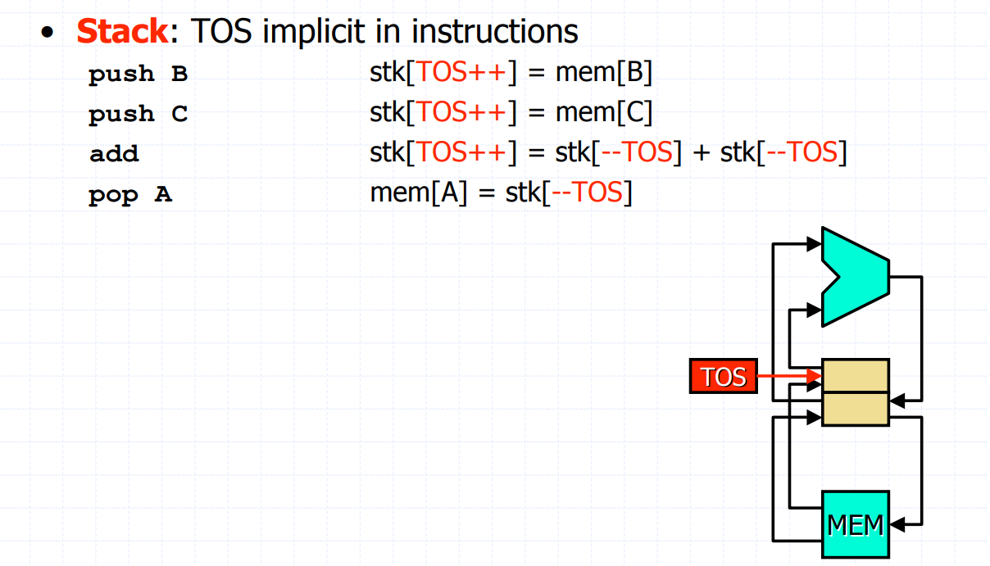

Slide 15
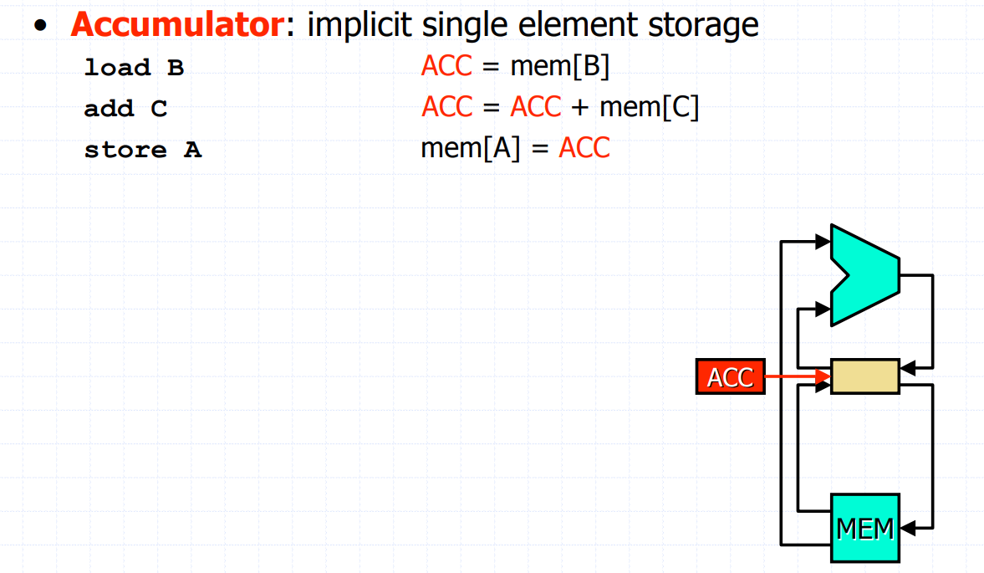

Slide 16
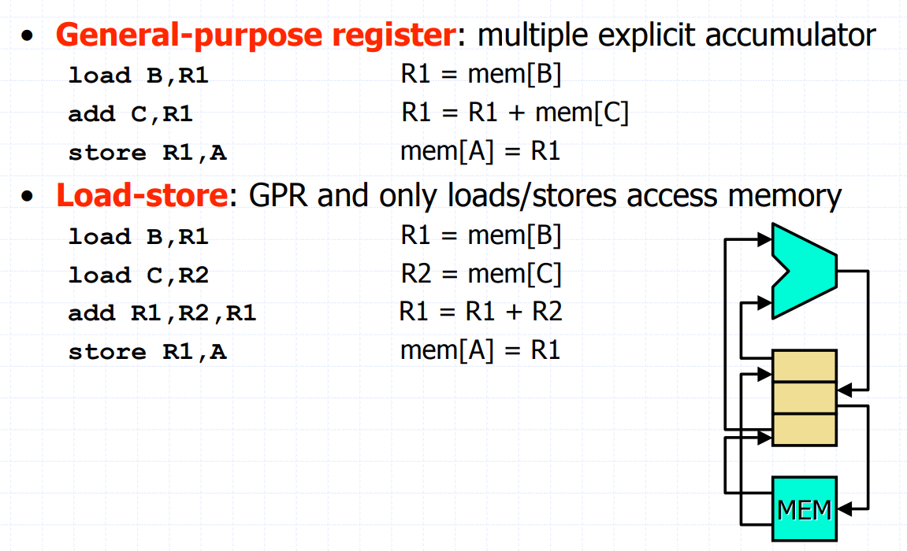

Slide 17
Suppose that we would like to compute
C = A+B
A = C-B
Assume that all of A, B, C, and D are initially in memory. What is the correct sequence of instructions in the Stack ISA?

Slide 18
Suppose that we would like to compute
C = A+B
A = C-B
Assume that all of A, B, C, and D are initially in memory. What is the correct sequence of instructions in the Stack ISA?
Push A
Push B
Add
Pop C
Push C
Push B
Sub
Pop A

Slide 19
Why stacks, accumulators?
Stacks:
Compact instruction format
All calculation operations take zero operands
E.g. Java bytecode (chosen for easy porting and low network b/w)
Accumulator:
Also a very compact format
Less dependence on memory than stack-based
For both:
Compact implies memory efficient
Good if memory is expensive
Notes:
8 bit only, out of 32 bits… stack 2, accumulator 1 value

Slide 20
Why registers?
Faster than memory
Latency: raw access time (once address is known)
Cache access: 2 cycles (typical)
Register access: 1 cycle
Allows fast reuse of values
Compiler does “register allocation” to keep useful data close to processor
Allows flexible instruction scheduling
(A*B) - (C*D) - (E*F)
A*B in R1, -C*D in R2, -E*F in R3: can easily rearrange ADD instructions
Stack or accumulator requires swaps/rotates
Notes:
Don’t need register
Register pressure?
Register allocation a= b+c, d=e+f;

Slide 21
Number of Registers?
How many?
How many is too few?
How many is too many?
Cons of having too many
Instruction word becomes longer (not too serious)
Register access time increases (if > 1 cycle, may cause slowdown?)
Context switch time increases
Anecdotes
X86: too few, MMX adds 8 more, x86-64 adds 8 more
Notes:
What is context switch?
intel 8
arm 16 or 32

Slide 22
Operand access limitations
Load/store (0,3)
(+) Fixed-length instructions possible: easy fetch/decode
(+) Simpler h/w: efficient pipeline & potentially lower CT
(-) Higher instruction count (IC)
(-) Fixed-length instructions are wasteful
Register/memory (1,2)
(+) No need for extra loads
(+) “A few lengths” better uses bits
(-) Destroys source operand (e.g., Add R1,R2)
(-) May impact CPI
Memory/memory
(+) Most compact (code density)
(-) High memory traffic (memory bottleneck)
Good code density
Notes:
Load/store: fixed 32 bit, 64 bit
CPI*CC*IC
Why wasteful?
jump d

Slide 23
Summary: Styles of ISAs
Stack ISA
Push <Addr>, Pop <Addr>, or ALU instructions
ALU: pop top two entries, perform ALU op, push result
Accumulator
Load/Store/ALU <Addr>: result affects accumulator register
Reg-Mem
Load/Store/ALU <Reg>, <Reg or Addr> (different from H&P!)
At most one operand can be address
Leftmost register acts as destination (if applicable)
Load-Store
Load/Store <Reg>, <Addr>
ALU <Reg1>, <Reg2>, <Reg3>: Reg1 is destination, Reg2, 3 are source
Notes:
For acuumulator, we need a special register.

Slide 24
Aside: Pros and cons of operand styles
Stack
Advantages: Simple Model of expression evaluation (reverse polish). Short instructions.
Disadvantages: A stack can‘t be randomly accessed. This makes it hard to generate eficient code. The stack itself is accessed every operation and becomes a bottleneck.
Accumulator
Advantages: Short instructions.
Disadvantages: The accumulator is only temporary storage so memory traffic is the highest for this approach.
Register/ load & store
Advantages: Makes code generation easy. Data can be stored for long periods in registers.
Disadvantages: All operands must be named leading to longer instructions.

Slide 25
Aside: Alignment
Byte alignment
Any access is accommodated
Word alignment
Only accesses that are aligned at natural word boundaries are accommodated due to DRAM/SRAM organization
Reduces number of reads/writes to memory
Eliminates hardware for alignment (typically expensive)
Often handle misalignment via software:
Compiler detects & generates appropriate instructions
…or O/S detects and runs “fixit” routine
memory (bytes)
0
1
2
Unaligned
access
3
4
5
6
7
Word size = 4 bytes
0
1
2
3
read #1
4
5
6
7
read #2
Asking for words beginning at 0 or 4 is OK
Asking for other words requires two reads
(e.g., ask for word starting at 2)
4
5
2
3
reorder
2
3
4
5
Notes:
Memory is like an array of byte
Struct{
Int a
Int b
Char c
Int d;
}

Slide 26
Aside: Endian-ness
Where is the most-significant byte (MSB) in a word?
Little-endian (e.g., x86)
“little”-endian comes from interpreting byte address 0 as the “least”-significant byte
Big-endian (e.g., IBM PowerPC)
“big”-endian comes from interpreting byte address 0 as the “most”-significant byte
LSB
MSB
0
1
2
3
Byte address
4
5
6
7
MSB
LSB
0
1
2
3
Byte address
4
5
6
7
Notes:
one program compile for little-endian storing a b c d a must bt address 0
but it turns out to be big-endia, then it will read d c b a

Slide 27
Module 3.2: Instruction Set Architecture2

Slide 28
RISC-Style ISA
Reduced Instruction Set Computing (RISC), as opposed to Complex Instruction Set Computing (CISC)
Designed from the ground up for easy pipelining and exploitation of instruction level parallelism (ILP).
Main characteristics
Load/store ISA: only loads/stores have a memory operand => Easy pipelining and uniform instruction width
Fixed instruction width => easy fetch and decode
Small number of addressing modes => easy pipelining
Large register file => 32 int + 32 fp registers
Aligned memory => easy data fetch
Notes:
Load/store ISA ensures that there is only a need for one MEM stage in the pipeline, and only load and store use it.
Load/store ISA also ensures instruction width can be fixed. At most an instruction has one long operand (mem address)
Fixed instruction width
ILP oriented: large number of registers reduce false dependences due to reuse

Slide 29
Common addressing modes
Register
Add R4, R3
R4 = R4 + R3
Used when value is in a register
Immediate
Add R4, #3
R4 = R4 + 3
Useful for small constants, which occur frequently
Displacement
Add R4, 100(R1)
R4 = R4 + Mem[100+R1]
Accesses the frame (arguments, local variables)
Accesses the global data segment
Accesses fields of a data struct

Slide 30
Addressing modes (cont.)
Register deferred/Register indirect
Add R3, (R1)
R3 = R3 + Mem[R1]
Access using a computed address
Indexed
Add R3, (R1 + R2)
R3 = R3 + Mem[R1 + R2]
Array accesses
R1 = base, R2 = index
Direct/Absolute
Add R1, (1001)
R1 = R1 + Mem[1001]
Accessing global (“static”) data
Notes:
We don’t really need these

Slide 31
Addressing modes (cont.)
Memory indirect/Memory deferred
Add R1, @(R3)
R1 = R1 + Mem[Mem[R3]]
Pointer dereferencing: x = *p; (if p is not register-allocated)
Autoincrement/Postincrement
Add R1, (R2)+
R1 = R1 + Mem[R2]; R2 = R2 + d (d is size of operation)
Looping through arrays, stack pop
Autodecrement/Predecrement
Add R1, -(R2)
R2 = R2 - d; R1 = R1 + Mem[R2] (d is size of operation)
Same uses as autoincrement, stack push
Scaled
Add R1, 100(R2)[R3]
R1 = R1 + Mem[100+R2+R3*d] (d is size of operation)
Array accesses for non-byte-sized elements

Slide 32
Wisdom about modes
Need:
Register, Displacement, Immediate and optionally Indexed (indexed simplifies array accesses)
Displacement size 12-16 bits (empirical)
Immediate: 8 to 16 bits (empirical)
Can synthesize the rest from simpler instructions
Example-- Mips architecture:
Register, displacement, Immediate modes only
both immediate and displacement: 16 bits
Choice depends on workload!
For example, floating-point codes might require larger immediates, or 64bit wordsize machines might also require larger immediates (for *p++ kind of operations)
Notes:
mentissa

Slide 33
Only a Few Needed
RISC machines typically implement register, immediate, displacement
i.e., load/store with only register displacement
What about other modes?
Can be synthesized from simpler addressing modes
e.g., memory indirect: Rj = M[M[Ri]] => Rk = M[Ri]; Rj = M[Rk]
May increase instruction format width
e.g. scaled requires 2 register operands plus an immediate
May be harder to pipeline and complex to handle
e.g. memory indirect requires two memory accesses, which may lead to two cache misses, two page faults, etc.
R1 = R1 + Mem[Mem[R3]]
Notes:
Rj = M[M[Ri]] => Rk = M[Ri]; Rj = M[Rk]

Slide 34
Control transfer semantics
Types of branches
Conditional
Unconditional
Normal
Call
Return
PC Relative (Branch) vs. Absolute (Jump)
Branch allows relocatable (“position independent”) code
Jump allows branching further than PC relative

Slide 35
Parts of a control transfer
Where
Determine target address
Whether
Determine if transfer should occur or not
When
Determine when in time the transfer should occur
Each of the three decisions can be decoupled or coupled

Slide 36
Types of control transfer (cont).
All three: Compare and branch instruction (e.g. VAX, PA-RISC)
Br (R1 = R2), destination
(+) A single instruction
(-) Heavy hardware requirement, inflexible scheduling
Whether separate from Where/When:
Condition code register (CMP R1,R2 … BEQ dest) (x86, PowerPC, SPARC)
(+) Sometimes test happens “for free”
(-) Hard for compiler to figure out which instructions depend on CC register
Condition register (SUB R1,R2 … BEQ R1, dest) (Alpha, MIPS)
(+) Simple to implement, dependencies between instructions are obvious to compiler
(-) Uses a register (“register pressure”)
Notes:
We cannot reuse the r1 between sub and beq instruction.
R! value must be consistent in between.

Slide 37
Prepare-to-branch Instruction
Decouple all three of Where/Whether/When
Where: PBR BTR1 = destination
BTR1 = “Branch target register #1”
Whether: CMP PR2 = (R1 = R2)
PR2 = “Predicate register #2”
When BR BTR1 if PR2
(+) Schedule each instruction so it happens during “free time” when hardware is idle
(-) Three instructions: higher IC
From the HP Labs PlayDoh architecture

Slide 38
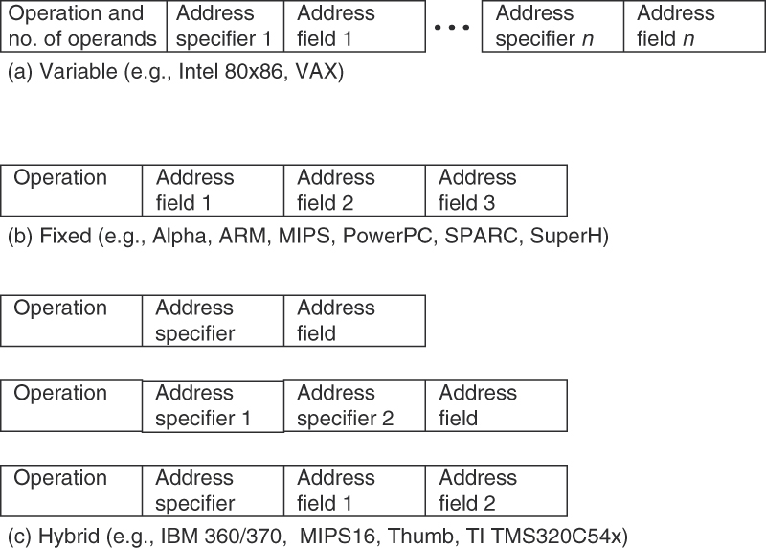
Instruction Encoding
Figure A.18 Three basic variations in instruction encoding: variable length, fixed length, and hybrid. The variable format can support any number of operands, with each address specifier determining the addressing mode and the length of the specifier for that operand. It generally enables the smallest code representation, since unused fields need not be included. The fixed format always has the same number of operands, with the addressing modes (if options exist) specified as part of the opcode. It generally results in the largest code size. Although the fields tend not to vary in their location, they will be used for different purposes by different instructions. The hybrid approach has multiple formats specified by the opcode, adding one or two fields to specify the addressing mode and one or two fields to specify the operand address.

Slide 39
Summary: Instruction Encoding tradeoffs
Variable width
Common instructions are short (1-2 bytes), less common or more complex instructions are long (>2 bytes)
(+) Very versatile, uses memory efficiently
(-) Instruction words must be decoded before number of instructions is known
E.g. VAX, x86 (instruction can be 1-17 bytes)
Fixed width
Typically 1 instruction per 32-bit word (Alpha is 2 instructions per word)
(+) Every instruction word is an instruction, Easier to fetch/decode
(-) Uses memory inefficiently
E.g. Alpha, ARM, MIPS, PowerPC, SPARC
Hybrid
Primarily for embedded processor to conserve memory
Often use subset of instructions, fewer registers, or even instruction compression (IBM)
E.g. IBM 360/370, MIPS16, ARM Thumb

Slide 40
Module 3.3: Instruction Set Architecture Example
Notes:
Project guideline

Slide 41
RECAP: addressing modes
Register
R4 = R4 + R3
Immediate
R4 = R4 + 3
Displacement
R4 = R4 + Mem[100+R1]
Register deferred/Register indirect
R3 = R3 + Mem[R1]
Indexed
R3 = R3 + Mem[R1 + R2]
Direct/Absolute
R1 = R1 + Mem[1001]
Memory indirect/Memory deferred
R1 = R1 + Mem[Mem[R3]]
Autoincrement/Postincrement
R1 = R1 + Mem[R2]; R2 = R2 + d (d is size of operation)
Autodecrement/Predecrement
R2 = R2 - d; R1 = R1 + Mem[R2] (d is size of operation)
Scaled
R1 = R1 + Mem[100+R2+R3*d] (d is size of operation)
may be unnecessary

Slide 42
RECAP: Types of control transfer (cont).
All three: Compare and branch instruction (e.g. VAX, PA-RISC)
Br (R1 = R2), destination
(+) A single instruction
(-) Heavy hardware requirement, inflexible scheduling
Whether separate from Where/When:
Condition code register (CMP R1,R2 … BEQ dest) (x86, PowerPC, SPARC)
(+) Sometimes test happens “for free”
(-) Hard for compiler to figure out which instructions depend on CC register
Condition register (SUB R1,R2 … BEQ R1, dest) (Alpha, MIPS)
(+) Simple to implement, dependencies between instructions are obvious to compiler
(-) Uses a register (“register pressure”)
Notes:
We cannot reuse the r1 between sub and beq instruction.
R! value must be consistent in between.

Slide 43
RECAP: Prepare-to-branch Instruction
Decouple all three of Where/Whether/When
Where: PBR BTR1 = destination
BTR1 = “Branch target register #1”
Whether: CMP PR2 = (R1 = R2)
PR2 = “Predicate register #2”
When BR BTR1 if PR2
(+) Schedule each instruction so it happens during “free time” when hardware is idle
(-) Three instructions: higher IC
From the HP Labs PlayDoh architecture

Slide 44
MIPS
An example of RISC ISA, designed from the ground up for easy pipelining and exploitation of instruction level parallelism.
Main characteristics
Load/store ISA: only loads/stores can have memory operand => easy pipelining and uniform instruction width
Fixed instruction width => easy fetch and decode
Small number of addressing modes => easy pipelining
Large register file => 32 int + 32 fp registers
Aligned memory => easy data fetch
Quantitatively designed
Notes:
Load/store ISA ensures that there is only a need for one MEM stage in the pipeline, and only load and store use it.
Load/store ISA also ensures instruction width can be fixed. At most an instruction has one long operand (mem address)
Fixed instruction width
ILP oriented: large number of registers reduce false dependences due to reuse

Slide 45
Addressing
Source:Corporaal05

Slide 46
Instruction format
op rs rt rd shamt funct
R
I
J
op rs rt 16 bit address
op 26 bit address
Example instructions
Instruction Meaning
add $s1,$s2,$s3 $s1 = $s2 + $s3
addi $s2,$s3,4 $s2 = $s3 + 4
lw $s1,100($s2) $s1 = Memory[$s2+100]
bne $s4,$s5,L if $s4<>$s5 goto L
j Label goto Label
Source:Corporaal05
Notes:
Notice opcode “addi” encodes the immediate addressing mode

Slide 47
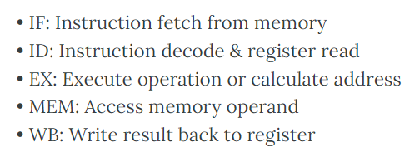
Pipelining
All integer instructions fit into the following pipeline
time
IF
ID
EX
MEM
WB
IF
ID
EX
MEM
WB
Instruction stream
IF
ID
EX
MEM
WB
IF
ID
EX
MEM
WB
IF
ID
EX
MEM
WB
Source:Corporaal05

Slide 48
Case Study: x86
X86 = Instruction set architecture originating from Intel 8086
Designed “quickly” as processors for first IBM PC
IBM required second sourcing (hence Intel & AMD)
Most popular today, despite drawbacks
Has been implemented in processors made by Intel, AMD, Cytrix, VIA, etc.
Started off as 16-bit (1978), then 32-bit (1985), 64-bit (1999)
Over the years, new instructions were added, more registers were added

Slide 49
x86 Registers: too few
16
8
8
general
purpose
registers
AH
AX
AL
EAX
BH
BX
BL
EBX
CH
CX
CL
ECX
DH
DX
DL
EDX
index
registers
ESI
EDI
pointer
registers
EBP
ESP
CS
SS
segment
registers
DS
ES
FS
GS
PC
EIP
condition codes (a.o.)
Source:Corporaal05
Notes:
https://www.eecg.utoronto.ca/~amza/www.mindsec.com/files/x86regs.html

Slide 50
Example Usage
Addressing Modes
Simple Example
Void MyFunction()
{
int a, b, c;
a = 10;
b = 5;
c = 2;
}
push ebp ; save ebp
mov ebp, esp ; ebp points to TOS
sub esp, 12 ; allocate local vars
mov [ebp-4], 10
mov [ebp-8], 5
mov [ebp-12], 2
Notes:
Ebp: base pointer return address
Esp: stack pointer
Scaled

Slide 51
Condition Code
Flag | Name | Description
Z | Zero flag | Indicates that the result of arithmetic/logical operation is zero
C | Carry flag | Indicates that an operation has a carry out. Enables numbers larger than a single word to be added/subtracted
S/N | Sign/negative flag | Indicates that the result of an operation is negative.
V/O/W | Overflow flag | Indicates that the result of an operation is too large to fit in a register (using two’s complement representation)
Subsequent conditional branch may test condition code
to determine whether it should be taken/not taken

Slide 52
X86 is Evolving: New Instructions
MMX (1996)
SSE (1999) - Pentium III
SSE2 (2001) - Pentium 4
SSE3 (2004)
SSSE3 (2006) - Intel Core
SSE4 (2006)
AVX (2011) - Sandy Bridge
AVX2 (2013) - Haswell (successor of Ivy Bridge)
SGX, MPX, SHA (2015) -
SME – Secure Memory Extension
TME - Total Memory Encryption

Slide 53
Aside: Additional Registers
Pentium MMX added:
Eight 64-bit MMX integer registers (MMX0 to MMX7)
Pentium III added:
Streaming SIMD Extensions (SSE) status register (MXCSR)
Eight 128-bit SSE floating point registers (XMM0 to XMM7)
64-bit mode added:
Eight 64-bit general registers (R8-R15)
R-prefix replaces E-prefix for other registers, e.g. RAX, RBX
SIMD extension added
128-bit registers, 256-bit registers, and 512-bit registers

Slide 54
Exercise
Explain each line of the following MIPS code and describe in a sentence or two what it computes. Assume that $a0 is used for the input and initially contains n (let’s say 10), a positive integer. Assume that $v0 is used for returning the output value.
What is the expected result in $v0 from this code?
begin: addi $t0, $zero, 0
addi $t1, $zero, 1
loop: slt $t2, $a0, $t1 bne $t2, $zero, finish
add $t0, $t0, $t1
addi $t1, $t1, 2 j loop
finish: add $v0, $t0, $zero

Slide 55
Exercise (Solution)
Explain each line of the following MIPS code and describe in a sentence or two what it computes. Assume that $a0 is used for the input and initially contains n (let’s say 10), a positive integer. Assume that $v0 is used for returning the output value.
What is the expected result in $v0 from this code?
begin: addi $t0, $zero, 0 // initialize $t0 = 0
addi $t1, $zero, 1 // initialize $t1 = 1
loop: slt $t2, $a0, $t1 // is n < $t1? bne $t2, $zero, finish // if so, then go to finish
add $t0, $t0, $t1 // else $t0 = sum of odd numbers < n
addi $t1, $t1, 2 // increment $t1 by 2 j loop // repeat loop
finish: add $v0, $t0, $zero // return $t0 in $v0
1 + 3 + 5 + ... + n (or n – 1 if n is even)
1 + 3 + 5 + 7 + 9 = 25

Slide 56
Further Study…

Slide 57
Using Condition Code in a Branch
Special instruction: compare
CMP SRC1,SRC2 ; set (Z,O,C,S) based on SRC1-SRC2
Example
for (i=0; i<10; i++)
a[i]++;
MOV EAX,0 ; EAX = i = 0
_L: CMP EAX,10 ; performs EAX-10, set CC’s
JNL _EXIT ; jump if not less to _EXIT
INC [EBX] ; Mem[EBX](=a[i])++
ADD EBX,4 ; EBX = &a[i+1]
INC EAX ; EAX++
JMP _L ; goto _L
_EXIT: ...
Source:Corporaal05

Slide 58
Example of Adding Vectors
// A 16byte = 128bit vector struct
struct Vector4
{
float x, y, z, w;
};
// Add two constant vectors and return the resulting vector
Vector4 SSE_Add ( const Vector4 &Op_A, const Vector4 &Op_B )
{
Vector4 Ret_Vector;
__asm
{
MOV EAX Op_A // Load pointers into CPU regs
MOV EBX, Op_B
MOVUPS XMM0, [EAX] // Move unaligned vectors to SSE regs
MOVUPS XMM1, [EBX]
ADDPS XMM0, XMM1 // Add vector elements
MOVUPS [Ret_Vector], XMM0 // Save the return vector
}
return Ret_Vector;
}

Slide 59
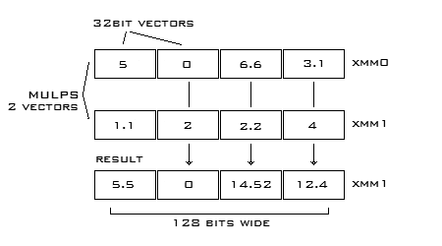
Example of SSE
Parallel Scalar
ADDPS ADDSS - Adds operands
SUBPS SUBSS - Subtracts operands
MULPS MULSS - Multiplys operands
DIVPS DIVSS - Divides operands
SQRTPS SQRTSS - Square root of operand
MAXPS MAXSS - Maximum of operands
MINPS MINSS - Minimum of operands
RCPPS RCPSS - Reciprical of operand
RSQRTPS RSQRTSS - Reciprical of square root of operand
Notes:
16 byte

