Slide 1
CDA 5106: Advanced Computer
Architecture
Lecture 4: Processor
Prof. Jongouk Choi
University of Central Florida
Spring 2026

Slide 2
Objectives and Outline
Reading: H&P, Appendix C and Chapter 3
Objectives:
Understand basic pipeline design and its performance
Understand hazards
Understand various types of branch prediction, and key branch predictors
Outline:
Module 4.1: pipeline design
Module 4.2: branch prediction
Module 4.3: more on branch prediction
Module 4.3: dependence hazards and pipeline performance

Slide 3
Module 4.1: Pipelining 1

Slide 4
Objectives and Outline
Objectives:
Understand basic 5-stage pipeline
Understand various hazards (data, structural, control) and how they cause pipeline stalls
Derive timing table for a set of instructions & pipeline design
Outline:
5-stage pipeline design
Various hazards (data, structural, control)
How hazards cause stalls, and how stalls
Extending pipeline for FP instructions

Slide 5
Instruction Level Parallelism
ILP is a set of techniques that allows multiple instructions to be processed in parallel.
Contributes substantially to performance growth of processors in the last few decades
Key Techniques
Pipelining
Branch prediction
Superscalar execution
Out-of-order engine

Slide 6
How to Execute an Instruction
Instruction fetch (“IF”)
IR = Mem[PC]
NPC = PC + 4
Instruction decode/Register fetch (“ID”)
A = Regs[IR_{6..10}]
B = Regs[IR_{11..15}]
Imm = sign-extend(IR_{16..31})
Execute (“EX”)
Memory reference: ALUOutput = A + Imm
Reg/Reg ALU Operation: ALUOutput = A op B
Reg/Immediate ALU Operation: ALUOutput = A op Imm
Branch: ALUOutput = NPC + Imm; Cond = (A op 0)
Notes:
For EX
Base addressing mode, ld r1 100(r2)
Add r1 r2 r3
Addi r1 r2 100
bne $t2, $zero, finish branch condition outcome is determined in stage 3.

Slide 7
Executing an Instruction (cont.)
Memory Access/Branch completion (“MEM“)
Memory Reference:
Load_Mem_Data = Mem[ALUOutput] /* Load */
Mem[ALUOutput] = B /* Store */
Branch
If (cond) PC = ALUOutput, else PC = NPC
Write back (“WB”)
Reg-Reg ALU Operation:
Regs[IR_{16..20}] = ALUOutput
Reg-Immediate ALU Operation:
Regs[IR_{11..15}] = ALUOutput
Load instruction:
Regs[IR_{11..15}] = Load_Mem_Data
Notes:
For WB
Add r1 r2 r3
Addi r1 r2 100
ld r1 100(r2)

Slide 8
Instruction Fetch (IF)
Instruction Decode (ID)
Execute (EX)
Memory (MEM)
Writeback (WB)
MUX
4
=0?
cond
ALU
NPC
PC
Regs
MUX
IR
(inst.
reg.)
A
data
cache
Instruction
cache
ALU
LMD
MUX
B
MUX
sign
extend
Imm
Notes:
Sign extension ALU takes only 32bit data,
what if addi r1 r2 1? 1 becomes 00000001
add r1 r2 r3
Addi r1 r2 1
datapath

Slide 9
Example: Analysis (non-pipelined)
All instructions (except branch):
IF, ID, EX, MEM, WB
Branch: (12%)
IF, ID, EX, MEM
CPI = 5*0.88+4*0.12 = 4.88 cycles
Graphically:
IC
Reg
ALU
DC
Reg
IC
Reg
ALU
DC
Reg
IC
Reg
ALU
DC
Reg

Slide 10
Pipelined DLX
Isolate each of IF, ID, EX, MEM, WB with latches
When instruction i is in WB, i+1 is in MEM, etc.
Graphically:
i
IC
Reg
ALU
DC
Reg
time
i+1
IC
Reg
ALU
DC
Reg
i+2
IC
Reg
ALU
DC
Reg
i+3
IC
Reg
ALU
DC
Reg
i+4
IC
Reg
ALU
DC
Reg

Slide 11
Pipeline speedup (no stalls)
For a pipeline of n stages:
IF
ID
EX
MEM
WB

Slide 12
Pipeline hazards
A hazard reduces the performance of the pipeline
Due to program’s characteristics
Three kinds:
Data hazards - Dependencies between instructions prevent their overlapped execution
Structural hazards - not enough hardware resources for all combinations of instructions
Control hazards - Branches change the PC, which results in late code

Slide 13
Structural hazards
Uncommon for our pipeline example
Consider a pipeline with a unified data+instruction cache:
time->
ld r1, 100(r2)
A (a load)
IF
ID
EX
MEM
WB
B
IF
ID
EX
MEM
WB
IF
ID
EX
MEM
WB
C
stall
IF
ID
EX
MEM
WB
make D wait
D
E
IF
ID
EX
MEM
WB

Slide 14
Modeling stalls
Ex:
n = 5 (e.g., DLX pipeline)
20% of instructions are branches
60% of branches are taken
Penalties:
Taken branches: 3 stall cycles
Not-taken branches: 0 stall cycles
How many stall cycles per instr. on average?
stall cycles/instr. = (0.8 x 0) + (0.2 x [ 0.6 x 3 + 0.4 x 0]) = 0.2 x 0.6 x 3 = 0.36
Speedup = 5 / 1.36 = 3.68
Notes:
We are going to measure the penalty caused by branch.
Non-pipelined cpi was 5, pipelined cpi is 1

Slide 15
Example
Consider the following code:
On DLX/RISC five-stage pipeline show the timing of the first iteration of the loop. Assume
Full forwarding or bypassing
Conditional branch is evaluated at the decode stage.
Fetch of the target instruction is delayed until the branch direction is known.
Loop: LD R1,0(R2) ;load R1 from address 0+R2
DADDI R1,R1,#1 ;R1=R1+1
SD 0(R2),R1 ;store R1 at address 0+R2
DADDI R2,R2,#4 ;R2=R2+4
DSUB R4,R3,R2 ;R4=R3-R2
BNEZ R4,Loop ;branch to Loop if R4=!0

Slide 16
Answer:
Instructions | 1 | 2 | 3 | 4 | 5 | 6 | 7 | 8 | 9 | 10 | 11 | 12 | 13 | 14
LD R1, 0(R2) | F | D | X | M | W
DADDI R1, R1, #1 |  | F | D | - | X | M | W
SD 0(R2), R1 |  |  | F | - | D | X | M | W
DADDI R2, R2, #4 |  |  |  |  | F | D | X | M | W
DSUB R4, R2, R2 |  |  |  |  |  | F | D | X | M | W
BNEZ R4, Loop |  |  |  |  |  |  | F | - | D | X | M | W
2nd iter: LD R1, 0(R2) |  |  |  |  |  |  |  | - | = | F | D | X | M | W
Notes:
Data hazard
Structure hazard
Control hazard

Slide 17
Module 4.2: Pipelining 2

Slide 18
Schedule
Quiz: Feb. 20 (online, all day)
Midterm: Feb. 25 (in-class, 6pm-7:15pm)

Slide 19
Objectives and Outline
Objectives:
Understand how control hazard affect pipeline performance
Understand how to predict branch and its target
Understand how to predict outcome of a branch
Outline:
Performance impact of control hazards
Branch Target Buffer (BTB) and Return Address Stack (RAS)
Dynamic branch predictors: 1-bit, Smith n-bit, McFarling’s GShare

Slide 20
Control Hazards
A BEQZ R1, G
A
IF
ID
EX
MEM
WB
B
IF
ID
EX
-
-
C
IF
ID
-
-
-
D
IF
-
-
-
-
G
IF
ID
EX
MEM
WB
NPC = PC+4 not always the brightest choice
Solution: use branch prediction. But what to predict?

Slide 21
Instruction Fetch (IF)
Instruction Decode (ID)
Execute (EX)
Memory (MEM)
Writeback (WB)
MUX
4
=0?
cond
ALU
NPC
PC
Regs
MUX
IR
(inst.
reg.)
A
data
cache
Instruction
cache
ALU
LMD
MUX
B
MUX
sign
extend
Imm

Slide 22
Move branch target back
Instruction Fetch (IF)
Instruction Decode (ID)
Execute (EX)
Memory (MEM)
Add an ALU
ALU
MUX
MUX
4
=0?
cond
=0?
cond
ALU
NPC
PC
MUX
IR
(inst.
reg.)
A
data
cache
Instruction
cache
RF
ALU
LMD
MUX
May increase time for ID
Eliminates 2 cycles, but still 1 additional stall
Notes:
Earlier pipeline stage

Slide 23
Branch Prediction: Eliminating Control Hazard Stalls
When
Detect an undecoded instruction is a branch
Where
Predicting where the branch will go (if taken)
Whether
(For conditional branches) Predict if it will branch or not, before execution
Optimal: try to determine all three in IF stage
Won’t work perfectly (prediction), but we can try our best
Notes:
Why IF? Because in the next clock cycle, we are gong to fetch the next instruction.
What is the next instruction?

Slide 24
Issues with When and Where
What does IF know?
Only the address of the instruction (PC)
Keep buffer (cache) of last known branch targets around
Buffer is written to by WB stage
Last
known
branches
Hit = we know it is a branch (“WHEN”),
BTB returns branch target (“WHERE”)
Miss = assume not a branch
PC value
BTB entry:
tag
pre-computed target
Traditional name for this is a Branch Target Buffer (BTB)

Slide 25
Aside: Predicting Where with returns
Problem: A lot of branches are returns from procedures
Holding the last target address is a poor predictor
Solution: Keep a hardware “stack” of return addresses
Push return address when a “call” is executed
Pop buffer on returns to get prediction
Bottom of stack is filled with old value on a pop
Need approx 4-8 entries for integer code
Each entry
in BTB now
contains:
tag
pre-computed target
return?
Notes:
Extend BTB
Recursive function?
Push push push… aside

Slide 26
Issues with Whether: Hardware branch prediction
1-bit schemes:
Add 1-bit prediction field to branch target buffer
Set prediction field = 1 if branch was taken, 0 if branch was not taken
At IF, check “branch prediction buffer”:
if prediction field = 1 then predict taken
else predict not-taken
Problems:
Some branches don’t do what they did last time!
Need more sophisticated predictor

Slide 27
Smith n-bit counter predictor
Replace prediction bit with n-bit counter:
2-bit counter
T
11
N
T
10
predict taken
N
T
initial state
(using NT
heuristic)
01
N
predict not-taken
00
T
Problems with n > 2 to 3
Smith called it “inertia”
N
Notes:
100 taken 1 not taken
No gain beyond 2 bit,,, all current

Slide 28
Example of Smith counter
T
T
T
T
T
T
N
T
T
N
N
N
N
N
N
N
N
T
T
previous state
01
10
11
11
11
11
11
10
11
11
10
01
00
00
00
00
00
00
01
new state
10
11
11
11
11
11
10
11
11
10
01
00
00
00
00
00
00
01
10
5 mispredictions out of 19 branch executions
T
N
T
N
T
N
T
N
T
N
T
N
T
N
T
N
T
N
previous state
01
10
01
10
01
10
01
10
01
10
01
10
01
10
01
10
01
10
new state
10
01
10
01
10
01
10
01
10
01
10
01
10
01
10
01
10
01
19 mispredictions out of 19: the infamous “toggle branch”

Slide 29
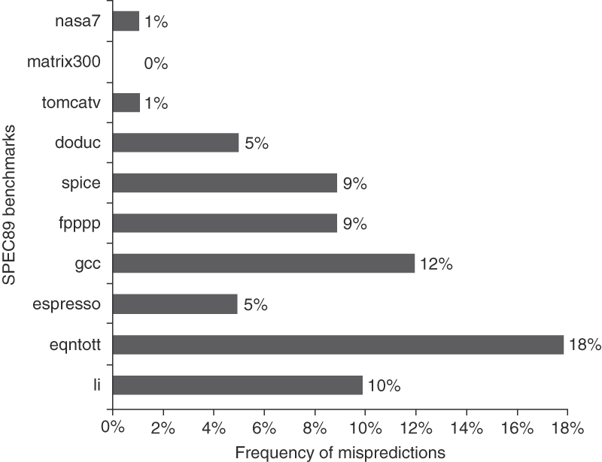
Effectivenss of 2-bit Predictor
Misprediction rate ~11% integer apps, 4% fp apps
Figure C.19 Prediction accuracy of a 4096-entry 2-bit prediction buffer for the SPEC89 benchmarks. The misprediction rate for the integer benchmarks (gcc, espresso, eqntott, and li) is substantially higher (average of 11%) than that for the floating-point programs (average of 4%). Omitting the floating-point kernels (nasa7, matrix300, and tomcatv) still yields a higher accuracy for the FP benchmarks than for the integer benchmarks. These data, as well as the rest of the data in this section, are taken from a branch-prediction study done using the IBM Power architecture and optimized code for that system. See Pan, So, and Rameh [1992]. Although these data are for an older version of a subset of the SPEC benchmarks, the newer benchmarks are larger and would show slightly worse behavior, especially for the integer benchmarks.

Slide 30
Example
Suppose we have a conditional branch that has an outcome shown in the table. What are the instances of the branch that will be correctly predicted using 2-bit prediction counter? Show the old counter state, prediction generated by the predictor, whether the prediction is correct, and the new state of the counter (after updated by the outcome of the current branch).
Show the prediction outcome for 2-bit counter.
Show the prediction outcome for 2-bit counter. Use T/N for 'Prediction Direction' and y/n for 'Mispredicted?'
Old Counter State | Prediction Direction | Actual Outcome | Mispredicted? | New Counter State
00 | N | T | y | 01
[A1] | [B1] | T | [C1] | [D1]
[A2] | [B2] | T | [C2] | [D2]
[A3] | [B3] | N | [C3] | [D3]
[A4] | [B4] | N | [C4] | [D4]

Slide 31
Example
Old Counter State | Prediction Direction | Actual Outcome | Mispredicted? | New Counter State
00 | N | T | y | 01
[01] | [N] | T | [y] | [10]
[A2] | [B2] | T | [C2] | [D2]
[A3] | [B3] | N | [C3] | [D3]
[A4] | [B4] | N | [C4] | [D4]
Old Counter State | Prediction Direction | Actual Outcome | Mispredicted? | New Counter State
00 | N | T | y | 01
[01] | [N] | T | [y] | [10]
[10] | [T] | T | [n] | [11]
[A3] | [B3] | N | [C3] | [D3]
[A4] | [B4] | N | [C4] | [D4]

Slide 32
Example
Old Counter State | Prediction Direction | Actual Outcome | Mispredicted? | New Counter State
00 | N | T | y | 01
[01] | [N] | T | [y] | [10]
[10] | [T] | T | [n] | [11]
[11] | [T] | N | [y] | [10]
[A4] | [B4] | N | [C4] | [D4]
Old Counter State | Prediction Direction | Actual Outcome | Mispredicted? | New Counter State
00 | N | T | y | 01
[01] | [N] | T | [y] | [10]
[10] | [T] | T | [n] | [11]
[11] | [T] | N | [y] | [10]
[10] | [T] | N | [y] | [01]

Slide 33
Improving the Smith Counter
Often branches exhibit correlated behavior
Example:
In the example, if the neither b1 or b2 are taken, then b3 will be taken. In other words, branch b3 behavior depends on other branches
addi x3, x1, -2
bnez x3, L1 // b1 (aa!=2)
add x1, x0, x0
L1: addi x3, x1, -2
bnez x3, L2 // b2 (bb!=2)
add x2, x0, x0
L2: sub x3, x1, x2
beqz x3, L3. // b3 (aa!=bb)
If (aa ==2)
aa = 0;
if (bb == 2)
bb = 0;
If (aa != bb) {

Slide 34
McFarling’s Gshare Correlating Predictor
Idea:
Capture correlations between branches (“gshare”)
Associate predictions with branch histories, not branch addresses (use different indexing scheme)
Gshare:
n-1
BHR
0
global branch history register
behavior of last branch
(shift in most recent outcome)
index
(using low order
bits of address)
...
each entry is a two-bit counter
(or perhaps simpler)

Slide 35
Gshare example
1
0
BHR
initially R1 = 0
A: BEQZ R1, D
...
D: BEQZ R1, F
matrix
...
F: NOT R1,R1
underlined means entry
was updated due to last
branch execution
G: JUMP A
00
01
10
11
BHR = 00
BHR = 01
BHR = 11
BHR = 10
A:
01
01
01
01
A:
10
01
01
01
A:
10
01
01
01
A:
10
01
01
00
D:
01
01
01
01
D:
01
01
01
01
D:
01
10
01
01
D:
01
10
01
01
00
01
10
11
00
01
10
11
00
01
10
11
00
01
10
11
A: T, pred N
New BHR = 01
D: T, pred N
New BHR = 11
A: N, pred N
New BHR = 10
D: N, pred N
New BHR = 00
BHR = 00
BHR = 01
BHR = 11
BHR = 10
A:
A:
11
01
01
00
A:
A:
10
01
01
00
D:
11
01
01
00
11
01
01
00
D:
01
10
00
01
01
10
00
01
D:
01
11
00
01
D:
01
11
00
01
00
01
10
11
00
01
10
11
00
01
10
11
00
01
10
11
A: T, pred T
New BHR = 01
D: T, pred T
New BHR = 11
A: N, pred N
New BHR = 10
Notes:
BHR, if it is taken, left shit +1, if it is not taken, left sifht + 0

Slide 36
Module 4.3: Pipelining 3

Slide 37
Objectives and Outline
Objectives:
Understand various dynamic branch predictors
Outline:
Dynamic branch predictors: Yeh/Patt predictor, Hybrid/tournament predictor, Seznec TAGE predictor
Static branch predictors: heuristics-based, Ball/Larus, profile-based
Case study of PowerPC 604 branch prediction structures

Slide 38
Yeh/Patt predictor
history table
pattern table
shift registers
1110111
2-bit counters
(indexed by history
pattern)
01
address of
branch
Notes:
Some branches can depend on themselves…

Slide 39
Yeh/Patt Example: toggle branch
A: TNTNTNTNTNTNTNTNTNTN
B: TTTTTTTTTTTTTTTTTTTTTT
HT
PT
HT
PT
HT
PT
HT
PT
HT
PT
A:
00
01
00
A:
01
10
00
A:
01
11
00
A:
10
11
00
A:
10
11
00
B:
00
01
01
B:
00
01
01
B:
01
01
01
B:
01
00
01
B:
11
01
01
00
01
10
00
01
10
00
01
10
00
01
10
00
01
10
00
01
11
00
01
11
00
01
11
00
01
11
00
01
11
A: T, pred N
B: T, pred T
A: N, pred N
B: T, pred N
A: T, pred N
HT
PT
HT
PT
HT
PT
HT
PT
HT
PT
A:
01
11
00
A:
01
11
00
A:
10
11
00
A:
10
11
00
A:
01
11
00
B:
11
01
01
B:
11
01
01
B:
11
00
01
B:
11
00
01
B:
11
00
01
00
10
10
00
10
10
00
10
10
00
10
10
00
11
10
00
01
11
00
10
11
00
10
11
00
11
11
00
11
11
B: T, pred N
A: N, pred N
B: T, pred T
A: T, pred T
In general: provides 96-98% accuracy for integer code
PT entries 01, 10 are “trained” for A
and 11 is “trained” for B

Slide 40
Hybrid/Tournament Predictors
Chooser
array of 2bit
counters
Predictor
#1
(e.g., gshare)
Predictor
#2
(eg, bimodal)
Both predictors supply a prediction-- pipeline uses only one
Chooser updated based on which predictor was correct
Increment chooser counter if #1 was correct, decrement if #2 was correct
address of
branch
prediction

Slide 41
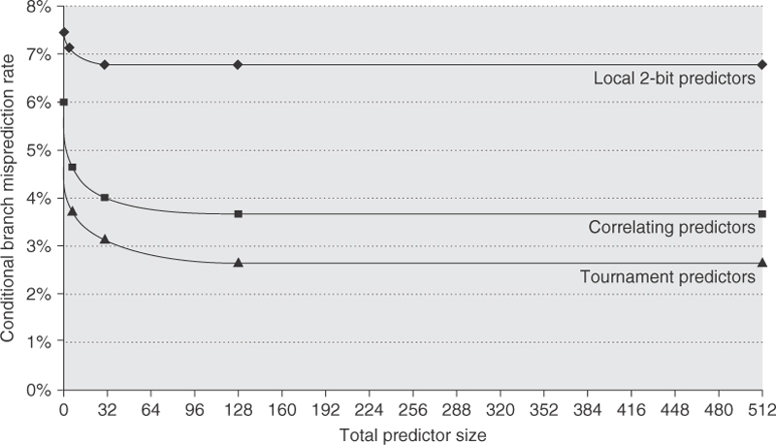
Accuracy of Various Predictors
Figure 3.4 The misprediction rate for three different predictors on SPEC89 as the total number of bits is increased. The predictors are a local 2-bit predictor, a correlating predictor that is optimally structured in its use of global and local information at each point in the graph, and a tournament predictor. Although these data are for an older version of SPEC, data for more recent SPEC benchmarks would show similar behavior, perhaps converging to the asymptotic limit at slightly larger predictor sizes.

Slide 42
Aside: Seznec’s TAGE Predictor [2006]
Winner of last several years of branch predictor competition
Multiple predictors with varied history lengths (T0..T4)
Tag is used: prediction generated if tag matches
Final prediction = from predictor with the longest history that matches tag
Mispred rate ~half of gshare

Slide 43
Can Compiler Help Predict Branch?
Heuristic #1: Branches are not taken
The majority of conditional branches are not taken
True about 60% of the time
Heuristic #2: backward branches are taken, forward branches are not taken (BTFNT)
Theme: Most backward branches are loops
Notes:
Since branches are PC relative, sign bit of offset = the prediction
Jim Smith reports 70% accuracy for this scheme for scientific workloads
Heuristic #3: Ball/Larus style predictions
Set of rules to predict branches in special situations

Slide 44
Examples of Ball/Larus predictions
Detect loops and use BTFNT
Since error values returned by library functions are negative:
…and since errors are rare
Predict BLTZ, BLEZ, etc. not taken
Predict BGTZ, BGEZ, etc., taken
If a call is in the body of an if…then, predict the “then” branch as not-taken
Since most calls in if…thens guard special case code
Problem:
Works great for SPECint92 (from which it was designed)
My code might not work like that!
Notes:
Branch less than zero
Branch grater than zero

Slide 45
Profiling
Three steps:
1. Run the program [the “profiled run”]
2. Record the preferred direction for each branch (T or NT)
3. Recompile to set the likely bits
What if the program takes inputs (e.g., sort)?
Collect a representative set of inputs somehow
Problems:
One prediction for entire run
The profiled run is slow!

Slide 46
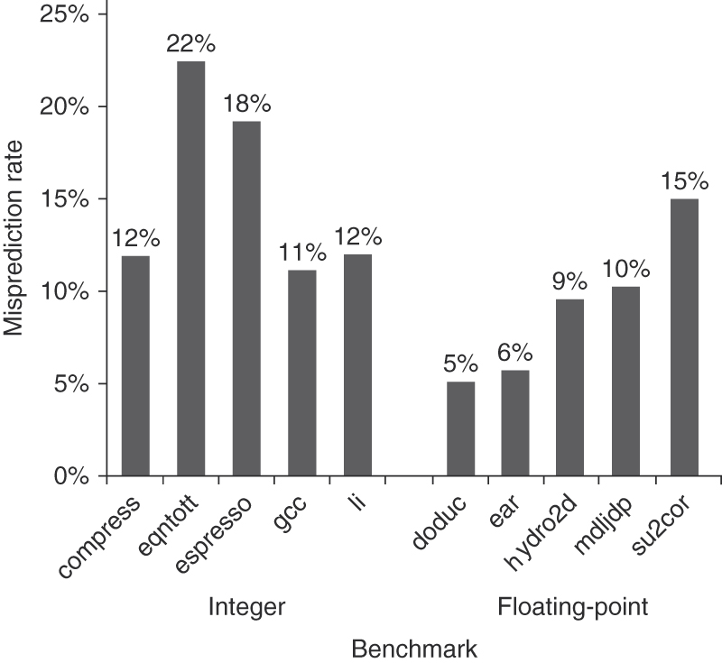
Effectiveness of Static Predictor
Reasonable accuracy, but misprediction higher than dynamic predictors
Figure C.17 Misprediction rate on SPEC92 for a profile-based predictor varies widely but is generally better for the floating-point programs, which have an average misprediction rate of 9% with a standard deviation of 4%, than for the integer programs, which have an average misprediction rate of 15% with a standard deviation of 5%. The actual performance depends on both the prediction accuracy and the branch frequency, which vary from 3% to 24%.

Slide 47
Module 4.4: Pipelining 4

Slide 48
Objectives and Outline
Objectives:
Understand various types of dependences (RAW/WAR/WAW) and (register vs. memory)
Draw data dependence graph given a set of instructions
Understand data forwarding (bypassing network)
Analyze pipeline performance through loop analysis
Outline:
Various data dependences and dependence graph
Data forwarding (bypassing network) impact on pipeline
Pipeline loop analysis
Case studies of example commercial processor pipelines

Slide 49
Let’s Revisit Types of dependencies
True-dependence (pure-dependence, flow-dependence)
ADD R1,R2,R3
SUB R4,R5,R1
May cause RAW hazards
Anti-Dependence
ADD R3,R2,R1
SUB R1,R4,R5
May cause WAR hazards
Due to reuse: Removed by using another register
Output-Dependence
ADD R1,R2,R3
SUB R1,R4,R5
May cause WAW hazards
Due to reuse: Removed by using another register

Slide 50
Dependence Graph
Example
A: ADD R1,R2,R3
B: SUB R4,R5,R1
C: ADD R6,R1,R4
D: MUL R3,R7,R8
E: DIV R4,R9,R10

Slide 51
Aside: Memory Dependences
Dependences occur not just between register addresses, but also memory addresses: Memory Dependences, e.g.
A: ST R1, [R2] // Mem[R2] <- R1
B: LD R3, [R2] // R3 <- Mem[R2]
C: LD R5, 10[R4] // R5 <- Mem[R4+10]
B is dependent on A, but is C dependent on A?
True dependent if R4+10 = R2
Not dependent if R4+10 != R2
Dependences harder to detect because they are based on register values, rather than register addresses
Will discuss in greater details in a later module

Slide 52
Data hazard
Read-after-write (RAW) hazard
value available
value needed
value written
add r1, r2, r3
IF
ID
EX
MEM
WB
add r4, r1, r5
IF
ID
stall
stall
ID
EX
MEM
WB
IF
stall
stall
IF
ID
EX
MEM

Slide 53
Data forwarding (bypasses)
ID/EX
EX/MEM
MEM/WB
bypass 1
bypass 2
IMM
MUX
bypass 3
D$
B
ALU
A
MUX
MUX
RF

Slide 54
Data forwarding (cont.)
byp 1
byp 2
byp 3
add r1, r2, r3
IF
ID
EX
MEM
WB
add r4, r1, r5
IF
ID
EX
MEM
WB
add r6, r1, r5
IF
ID
EX
MEM
WB
add r7, r1, r5
IF
ID
EX
MEM
WB
add r8, r1, r5
IF
ID
EX
MEM
WB

Slide 55
Stalls due to data hazards
Our simple pipeline
Most RAW hazards => no stall
Loads cause 1-cycle stall (cache hit)
value needed
value available
byp 2
lw r1, 0(r2)
IF
ID
EX
MEM
WB
add r4, r1, r5
IF
ID
stall
EX
MEM
WB
IF
stall
ID
EX
MEM

Slide 56
Other data hazards
WAR (write-after-read)
A r1, r2, r3
B r2, r4, r5
Hazard if B writes R2 before A reads R2
Doesn’t happen in simple DLX pipeline, but can in others
E.g., occurs if pipeline allows late register reads
Reads R1 during MEM3
SW 0(R2), R1 IF ID EX MEM1 MEM2 MEM3 WB
ADD R1, R3, R4 IF ID EX WB
writes R1 during WB

Slide 57
Other data hazards (cont.)
WAW (write-after-write)
A r1, r2, r3
B r1, r4, r5
Hazard if B writes R1 before A writes R1
Result: later instructions see wrong value in the register
Occurs if instructions can write register file out-of-order
This also doesn’t happen in simple DLX pipeline, but can in others:
writes 1st version of R1
LW R1, 0(R2) IF ID EX MEM1 MEM2 WB
ADD R1, R2, R3 IF ID EX WB
writes 2nd version of R1

Slide 58
Other data hazards (cont.)
Handling WAR/WAW hazards
Stall the later instruction (stalls in WB stage)
Compiler: don’t reuse register specifier
Hardware: register renaming (see next major topic – ILP)

Slide 59
Pipeline Performance
Pipeline performance depends on hazards
Pipeline loop analysis helps analyze pipeline performance
Evaluating impact of design changes
Identifying techniques needed to improve performance
Important for analysis: loop types and loop size
ALU Loop: loop for dependent ALU instructions
Size of loop: stage when value is produced – when needed
Load-to-use Loop: loop for inst dependent on a load inst
Size of loop: stage when value is read out from cache – when needed
Branch misprediction Loop: loop for when a conditional branch is mispredicted
Size of loop: when branch is resolved – fetch stage
Notes:
pipeline is good for performance improvment
however, it can hazards
to avoid hazards, we have bypass paths in the pipelines.
When we design our pipeline, we should also considier the bypass paths and their impact on performance.

Slide 60
Example
Without Data Forwarding
ALU Loop size = 4
Load-to-use Loop = 4
Branch Loop = 3
With Data Forwarding
ALU Loop size = 1
Load-to-use Loop = 2
Branch Loop = 3

Slide 61
Case 1: Deep Pipeline
ALU Loop size = 2 (was 1)
Load-to-use Loop = 4 (was 2)
Branch Loop = 6 (was 3)
Thus, deepening the pipeline also increases the critical loop size
Benefit primarily comes when instructions do not have dependences, or when branches are easy to predict
Diminishing return from deepening the pipeline

Slide 62
Case 2: RISC vs. CISC Pipeline
CISC
Assume CISC instruction decoded and broken into small RISC-like instructions (e.g. Macro Op -> Micro Op)
Question: is there a cost for doing this vs. RISC?
ALU Loop and Load-to-use Loop have the same size as RISC
But Branch Loop = 4 (vs. 3 in RISC) => branch misprediction is costlier
Thus, everything else the same, must compensate with a better branch predictor

Slide 63
Case 3: Increasing the L1Cache Size
Larger L1 Data Cache Size
Suppose doubling the size adds 1 additional cycle (one extra “M2” stage)
Question: what is the performance cost for doing this?
Load-to-use Loop is now 3 cycles (was 2 cycles)
Thus, worse performance for instructions dependent on the loads
Can compensate by scheduling the loads early
May also avoid increasing L1 cache size further, back it up with a large L2 cache instead

Slide 64
Case Study: Intel 486
486:
1989: first pipelined implementation of x86 processor (1M transistors)
CPI improved from 4.9 (386) to 1.95 (486)
5 Pipeline Stages
IF: fetch instruction from 32-byte prefetch queue
ID1: translate instruction into control signals or microcode, initiate address generation and memory access
ID2: access microcode memory. Output microinstruction to execute unit
EX: execute ALU and memory accessing operations (Note: Mem is folded into EX)
WB: write back result to register

Slide 65
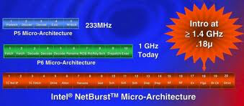
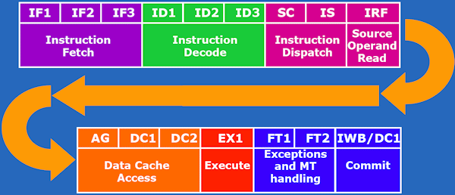
Other Examples
P5, P6, and NetBurst
Atom

Slide 66
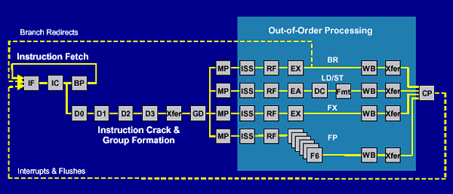
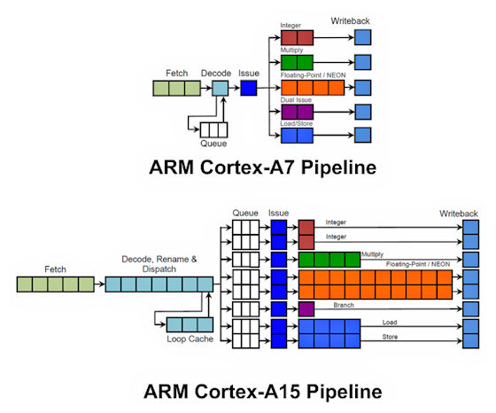
Other Examples
Power4
ARM A7 and A15

Slide 67
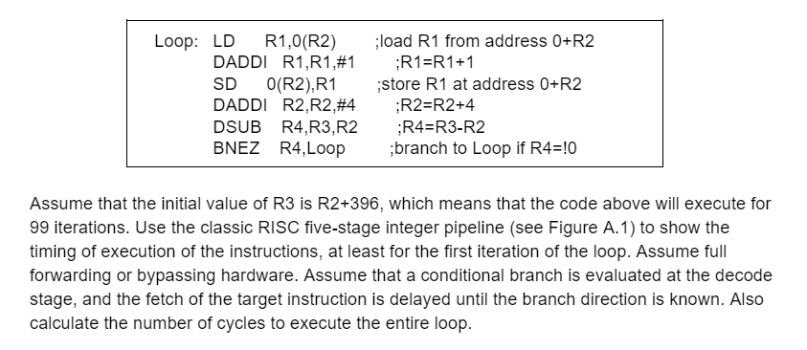
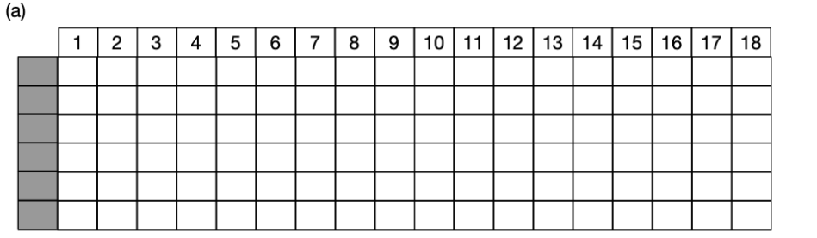
Other Examples

Slide 68
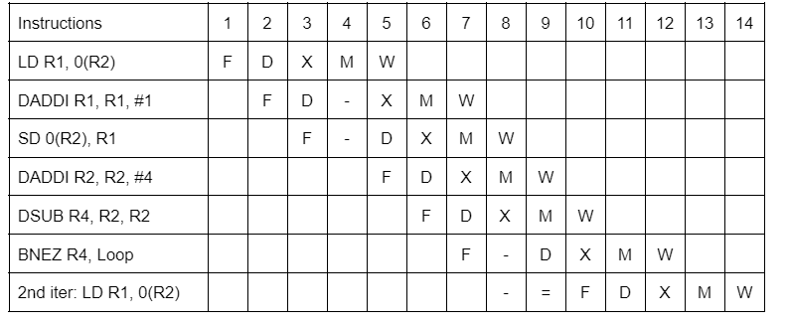
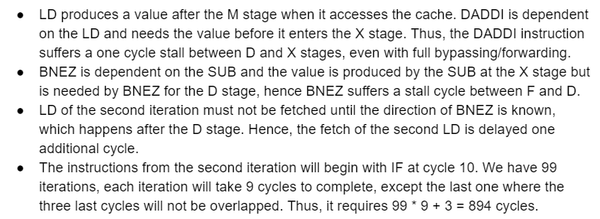
Other Examples

Slide 69
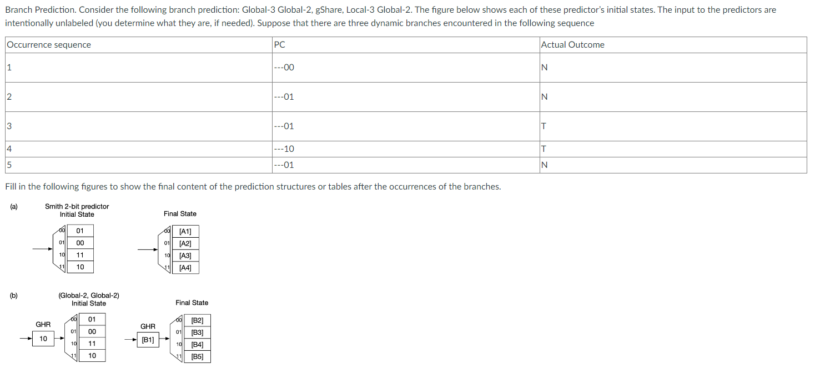

Slide 70
