Slide 1
Biohackathon Updates
BH Day 3 – November 14

Slide 2

01-OmicsPath
3 bullet points recap aims (current participants No and duration )
Data import from reactome database and convert to omicsdi format
Pathway Analyzer
Similar Pathways
3 bullets to describe achievement
Created Omicsdi compatibility model
Data Retrieved from Reactome apis and converted to omicsdi format
2 bullet of what help you need from whom
Need Scala, mongodb and frontend developers .
next steps
data similarity implementation

Slide 3
02-CompactIdentifiers
3 bullet points recap aims (current participants No and duration )
Run your own Identifiers.org Metaresolver
Access Identifiers.org new Cloud API via cloud-libapi
Contribute to the development of IdentifiersJS library
3 bullets to describe achievement
People were able to run not only our Metaresolver but also our Metadata Mining service
We got nice feedback about our Cloud API and the libapi library
ORCID developed an integration with our Cloud API for validation of Compact Identifiers
Compact Identifiers as Identifiers in Bioschemas (in collab with 11-Bioschemas)
2 bullet of what help you need from whom
Any DevOps geek that could help with infrastructure on Google Cloud?
Any front-end Ninja that can help us with our Cloud web front-end?

Slide 4
03-BioTools-EDAM
recap aims
enable local bio.tools deployments driven by http://github.com/bio-tools/biotoolsregistry/
formalise the technical / information requirement for the enhanced EDAM Format sub-ontology
sustainable methods for harvesting bio.tools content
evaluate dev deployment of bio.tools
achievement
Conda packages created for all bio.tools software dependencies
revised EDAM Editor Guide & Developer Guide https://edamontologydocs.readthedocs.io/en/latest/
revised EDAM Format request template https://github.com/edamontology/edamontology/issues/new/choose
4 new feature requests / issues for bio.tools
revised PubMedApps utility for creating bio.tools entries from the literature https://github.com/edamontology/edammap/tree/master/pubmedapps
next steps
plumbing of bio.tools front- and back-end architecture (experts in Django, REST, Apache NGINX, Conda)
EDAM Formats editing and additions (anyone!)

Slide 5

04-BioJS
Goals
Add example visualisations back on registry website
Revive education/tutorial site
Work towards Galaxy integration/component interoperability
What we’ve done so far (2 full time, a few part-time contributors)
Education page is back up and running - Two merged PRs today (Still needs updating, feel free to contribute)
New strategy for visualisation snippets, currently updating frontend
Started work to define interfaces for interopability
What we need
General help updating tutorials and discussions about interfaces/events
Knowledge about requirements for Galaxy plugins

Slide 6
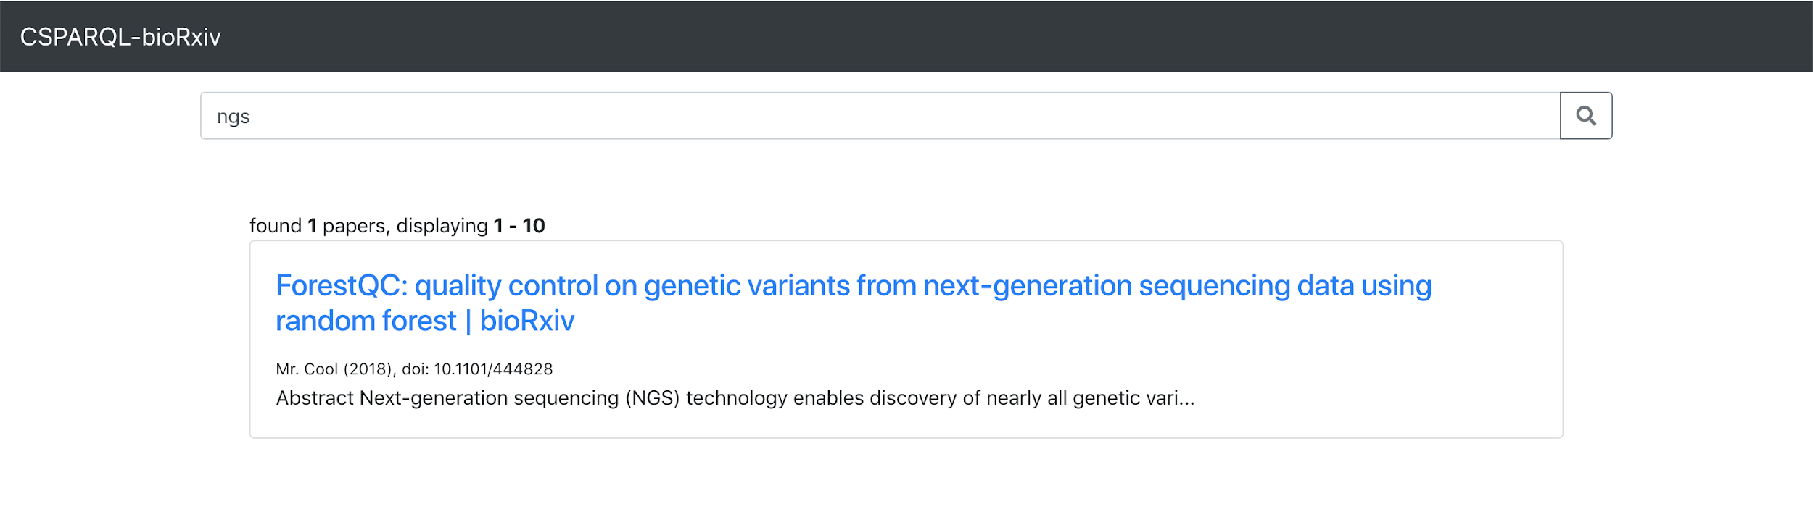
05-CSPARQL-bioRxiv
Project aims
Hard time following today’s great deluge of publications ? We help concentrate on what’s relevant given interests by using an ontology for biomedical publications from biorxiv and/or pubmed central.
Process streaming data from twitter feed to provide real-time publication notifications to users with a sparql compatible web interface.
Extract semantic features (topics, datasets etc.) and/or ontologies such as EDAM, Biotea.
Achievements :
Setup and chaining of all pipeline components (ready for iterative improvements)
Streaming biorxiv and pubmed twitter feeds
Servers: Initial web interface, SPARQL server on Pi3
What help you need from whom
Further discussion on Biotea/EDAM publication ontologies
Discussion with nlp experts on topic modelling and annotated datasets
Notes:
<3

Slide 7

06-Bioconda-RSAT
Initial goals
conda install -c bioconda rsat-core
conda install -c bioconda rsat-data
conda install -c bioconda rsat-web
Achievements so far
Almost all dependencies packaged
conda-build -c conda-forge -c bioconda \ -c rsat rsat-core
RSAT tests running on the command line
Difficulties
Problematic Perl packages: SOAP::WSDL, XML::Compile, Email::Sender.
Ensembl Perl API
Third-party stand-alone executables: mkvtree and vmatch
Adaptation of the modalities
RSAT Web server deployed via Ansible
Next steps and welcome expertise
conda install -c bioconda rsat-data
conda install -c bioconda rsat-web
RSAT server installation: ansible playbook
Perl - conda ambassadors
Post-biohackathon perspectives
Conda packaging of Ensembl API
Other missing Perl modules
Reorganization of the python scripts
Regroup the hundreds of commands (Perl and Python scripts) in generic commands with sub-commands.

Slide 8
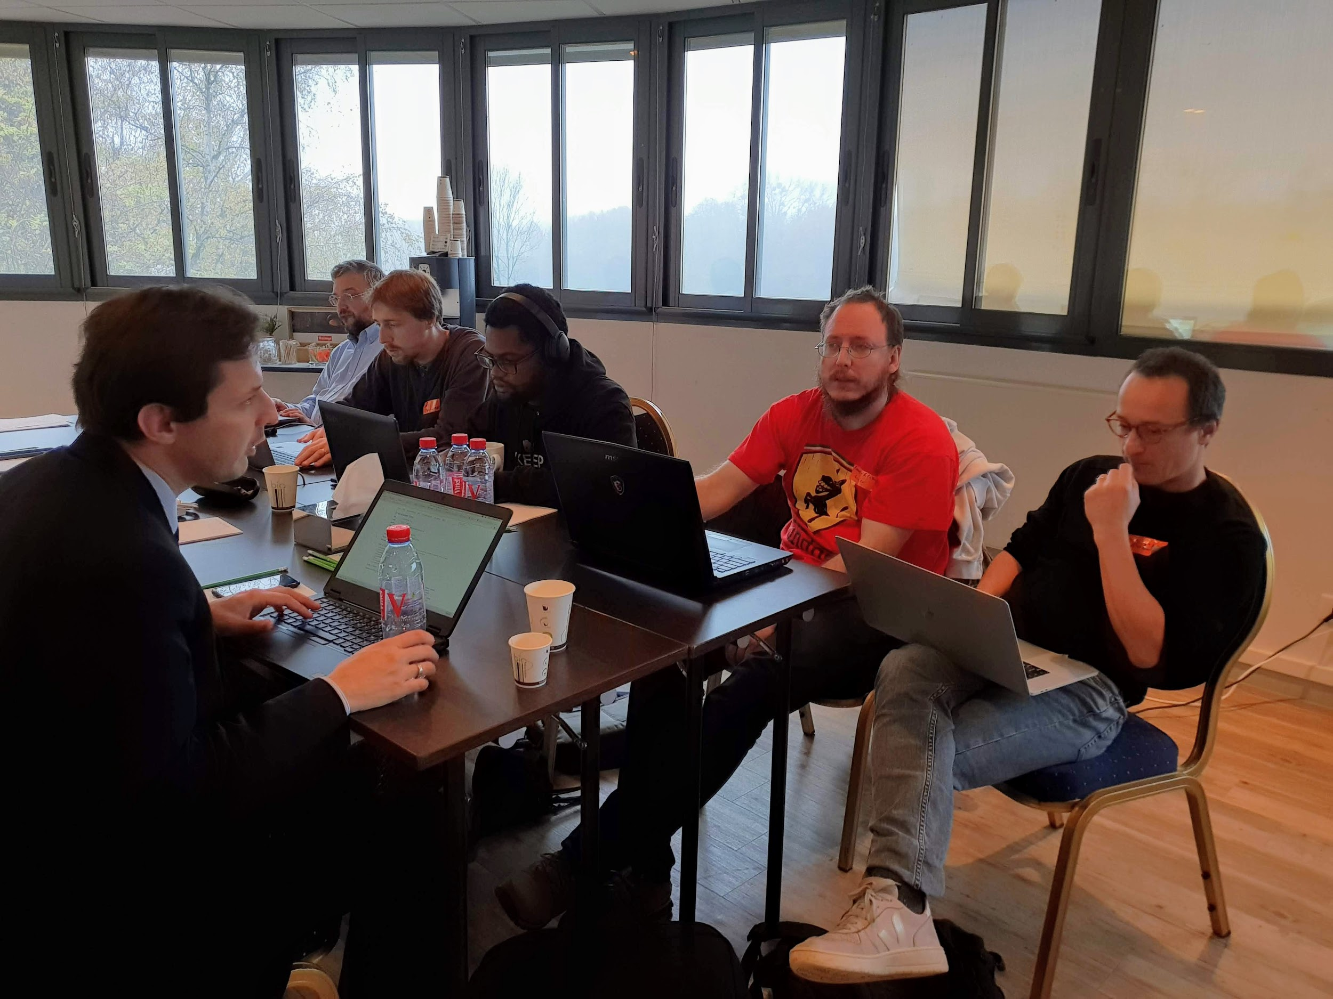
07-Pharmacogenomic LOD (PGxLOD)
Aims (recap)
1/ Improve PGxLOD (4 persons)
2/ Explore PGxLOD for ADR explanation (4 persons)
3/ Develop an observational PGxLOD (2 persons)
Achievement
1/Improved quality for relation extraction from text (i.e. PubMed abstracts)
2/Designed a learning task
3/Generate a fake 1000-patient matrix (with treatment changes and ADR occurrences)
Help / Advices needed
Machine learners (Patryk, Miguel...)
Anyone with knowledge on standard for patient and temporal data

Slide 9
08-DataClearinghouse
3 bullet points recap aims
Being able to reuse curated resources like MarRef database to curate BioSamples
Export Breeding API data to ISA tab and validate the results against MIAPPE
Build a data clearing house to exchange validated metadata (?)
4 bullets to describe achievement
MIAPPE to BrAPI mapping
Started to validate BrAPI to ISA
Started to build a MarRef API
Build a JSON schema for BioSchemas sample profile
1 bullet point of what help you need from whom
Spring and Scala

Slide 10
09-OntologyValidation
Task
Build a repository of AJV (https://ajv.js.org) JSON schema plugins for keyword extensions
Implement ontology term validation extensions
Progress
Forked of existing Human Cell Atlas project implementation and made it more generic and reusable https://github.com/elixir-europe/json-schema-validator
Next steps
Setup demo service running at the EBI
Release plugin to npm
Update examples and documentation

Slide 11

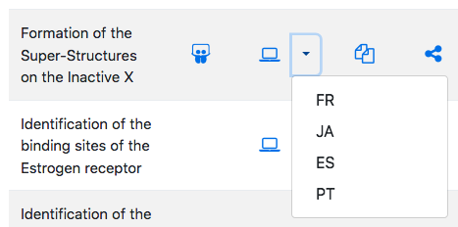
10-Galaxy Training Material
3 bullet points recap aims (4 days, 2 participants, 3 from this afternoon, everybody welcome)
New content creation and improvement of existing materials and framework
Instructor Handbook
Internationalization/localisation of materials
3 bullets to describe achievement
FAIRness assessment of Galaxy training materials
Automatic translation of tutorials using Google translate
Automatic workflow testing, cleanup of open PRs and issues.
2 bullet of what help you need from whom
English native speakers!
Review and testing of existing materials/PRs
Training philosophies, what are your tips and tricks for teaching?

Slide 12
11-Bioschemas
Recap of aims (three tables, 15-20 people)
Multiple Datasets and DataCatalogs marked up
Create new profiles: Studies, DNA, Molecular Entity, Chemical Substance, ...
Refining profiles: Gene, Gene Variant, Protein, Protein Annotation, Sample
Achievements
New MolecularEntity specification, Various updated profiles
~10 Datasets and DataCatalogs marked up
Compact Identifier interoperability explored (in collab with 02-CompactIdentifiers)
We need you!
Profiles (new and updated) need reviewing
Feedback welcome at https://github.com/elixir-europe/BioHackathon/projects/3
Deployment of the MolecularEntity specification

Slide 13
13-SPARQL-RareDiseases
3 bullet points recap aims (4 days, 5 participants so far )
Provide catalogue of relevant resource in the Rare Diseases field, available through SPARQL
Setup queries catalog
Federated queries accross sources
3 bullets to describe achievement
Setup a wikibase system to host description of resources, queries in natural languages, queries in sparlq. (some sparql endpoint such Uniprot are already in wikidata
Write “use cases” queries in natural language (http://185.54.113.31:8181/wiki/Potential_queries_in_Natural_language)
Write “sparql queries” (http://185.54.113.31:8181/wiki/Collection_of_federated_SPARQL_queries)
next steps
Define “mandatory” description of resource in the catalogue (SHex etc.)
More queries (in federated way) to solve the use cases

Slide 14
14-Orphanet-PhenoScrapper
Project aims (4 days 3 partcipants )
Speed-up the process of Orphanet disease-HPO annotation by using text-mining recognition
Extract automatically HPO terms in publication and/or in Orphanet definitions.
Improve the curation process by comparison between the automated recognition and the annotations already provided by Orphanet.
Achievement
Modelized a pipeline for scrapping HPO terms from free PMC articles (XML/PDF parsing).
Building a web application.
Evaluation of various toolkits for text-mining/scrapping and mapping with HPO (e.g. ConceptMapper).
what help you need from whom
Still searching the best scrapping tool

Slide 15
15-GA4GH-WES
3 bullet points recap aims (current participants No and duration )
Pluggable workflow engines (1)
Task distribution (1.5)
Authorization & authentication (2)
Production-grade deployment (4.5)
3 bullets to describe achievement
Started refactoring for pluggable workflow engines
Skeleton “proxy” TES
Added a simple UI client. Designed OIDC flow: UI -> WES -> TES
Deployed WES and tested the connexion to MongoDB and RabbitMQ in OpenShift.
2 bullet of what help you need from whom
Celery expert

Slide 16
16-Alternative episodes for the 4 Open Source Software (4OSS)
recap aims (current participants No and duration )
Denise, Fotis, Mateusz, Paula, Victoria
no more GitLab (it’s not possible to connect with release on Zenodo)
adding content as the optional part of the “make your software open” episode
achievement
Making your software reusable with Docker
Sharing and collaborating with Notebooks
2 bullet of what help you need from whom
the more the merrier
Do you use notebooks for research? how? why?

Slide 17
17-CWL-Galaxy
Participants: Michael R. Crusoe, Manabu Ishii, Stian Soiland-Reyes, John Chilton, Nicola Soranzo, Arnaud Meng, Hervé Ménager, Pau Ruiz Safont, Pjotr Prins, François Moreews, Jérôme Raciazek
Achievements:
Development:
All required CWL conformance tests now work in the fork of Galaxy with John Chilton’s hands
CWL-born PR to galaxyproject/galaxy (Nicola)
Tests:
Metagenomics tools and workflows on the latest version of common-workflow-language/galaxy (Hervé, Jérôme)
CWL user guide tested using the CWL GUI, Rabix (Manabu)
Toil refactoring to enable provenance reporting and ResearchObject.org output (Pau)
Want to join?
Anyone interested is welcome (room “Grand Prix de Bahrein”)

Slide 18
18-PSICQUIC_2.0
4 bullet points recap aims (Noemi del Toro, John Zobolas, Elisabet Barrera )
myPsicquic
PSICQUIC Cluster
PSICQUIC Extensions
PSICQUIC View
3 bullets to describe achievement
Discussions and planning about .sif and miTab 2.8 extension
PSICQUIC View: Redesign from scratch, selection of query builder and integration of it
PSICQUIC Extensions: miTab 2.8 integration
1 bullet of what help you need from whom
Developer with SolrCloud expertise

Slide 19
19-MetagenomicsMetadata
3 bullets points recap aims (current participants No and duration )
Create a universal model to infer amplified 16S regions in amplicon data using HMM
Integrated script into production pipeline / create CWL tool
Expand to 18S data
3 bullets to describe achievement
Created 16S model
Integrated into MGnify annotation pipeline
18S model underway, with CWL tool wrapper
Started retro-fitting to existing amplicon data in MGnify resource
1 bullet of what help you need from whom
Biosamples; how should this data be retrieved from our API

Slide 20
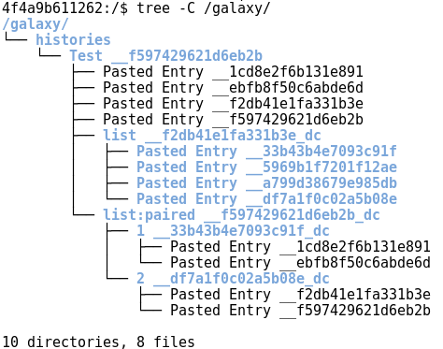
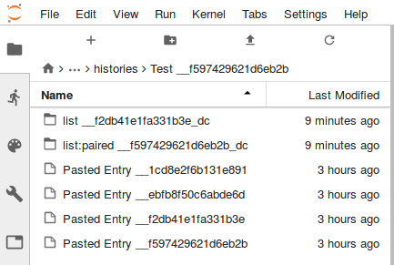
20-Shiny-RStudio-Galaxy
Our group and aims:
Develop easier access to data for Galaxy Interactive Environments (GIEs)
Install GIEs using Ansible + Documentation
Improve Shiny GIEs
Achievements:
Developed a Galaxy FUSE Filesystem + Docker Volume Driver + Updated Galaxy to use this
Loaded this in JupyterHub (new GIE soon)
Explored use of Ansible for GIE installation
We need you:
Shiny developers

Slide 21




21-FAIR-TrainingMaterials
Aims and achievements
Discussion: What is a training material, what does FAIR mean for training materials
“training material” definition
Comprehensive list of metadata for training materials
Metadata mapping to known vocabularies
FAIR assessment against metrics for Elixir Excelerate Train the Trainer
Guidelines/manifesto to achieve FAIRness in training materials
FAIR is not a simple checklist so...
11 participants
14 training materials to assess
42 desirable properties as metadata

Slide 22
22-FAIRDOM-SEEK-ResearchAssets
3 bullet points recap aims (current participants No and duration )
Exchanging assets between SEEKs
Galaxy integration
Incorporating Bioschemas
3 bullets to describe achievement
Converting our current RDF/XML model to JSON-LD, and embed in appropriate web-pages and updating our Research Objects
Executing Galaxy workflows stored in SEEK, along with data, passed across to Galaxy using a python script together with BioBlend
2 bullet of what help you need from whom
unsure how to combine Bioschema/schema.org with our current markup (or perhaps it should just replace it entirely)
Best way to authenticate with Galaxy though web interface (e.g. OAuth2)

Slide 23
23-RDF-ModelsAndTools
3 bullet points recap aims (current participants No and duration)
7 participants
Looking for the applications of our RDF datasets and tools for RDF data
International collaborations with the other topics, aim to continue in the NBDC/DBCLS BioHackathon in Matsue on December
3 bullets to describe achievement
Aligned the models of our RDF and BioSchemas for BioSample database (Tazro w/ Melanie, Luca, Simon)
Discussed about the promotion of use of identifiers.org/taxonomy URI for the taxonomy annotation
2 bullet of what help you need from whom
To everyone: Use identifiers.org/taxonomy in your data to connect resources in a graph
REGISTER NOW: http://2018.biohackathon.org/registration

Slide 24
24-ToolsMetadata
Project aims (4 participants )
To markup pages of biological databases and tools
To make rich snippets of biological databases and tools in search results
Achievement
Discuss about the schema of tool pages to fit our aims
Investigated some markup schemas (bio.tools, bioschema, schema.org, Google structured data)
Make a sample markup of bio.tools entry with BioSchemas and constructed a mockup
Need help
BioSchemas experts for discussing about markup image
Markup experts to comment our proposal

Slide 25
25-ProtVista-Bioschemas
3 bullet points recap aims (current participants No and duration )
To define a way to represent protein domains with bioschemas
To take this info from a website, and represented with Nightingale
All by myself
3 bullets to describe achievement
Example of hasSequenceLocation domain=>protein
Setting up the Showcase up for Nightingale
Playing with suspense
2 bullet of what help you need from whom
Bioschemas protein => domain
Any other protein services interested in providing this sort of info

Slide 26
26-Blockchain-TrackingBioSamples
3 bullet points recap aims (current participants No and duration )
3 participants, 4 days.
Use blockchain technology to support provenance and sample supply chain management.
BioSamples as surrogate for other biomedical samples
3 bullets to describe achievement
Tutorial on Hyperledger Blockchain and Composer tool.
Define a first version of business network application for BioSamples submissions
Identify provenance of curation as the most important process to track
2 bullet of what help you need from whom
Validate results with BioSample team
JS expertise welcome

Slide 27
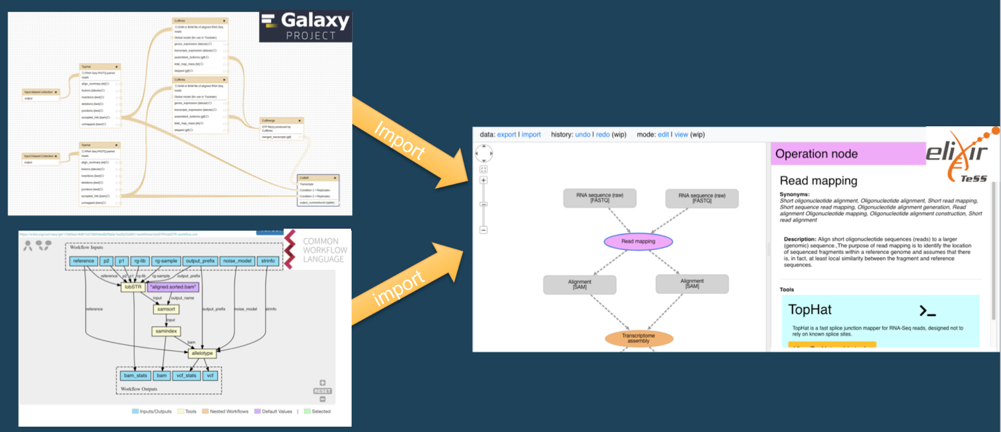
27-TeSS-ConceptMaps
Import Workflows into Concept Maps to make linked, interactive Training Resources!
Concept Maps teach people what the core concepts of typical data analysis pipelines are
They are annotated with EDAM Operations/Data/Formats and offer helpful links to bio.tools and FAIRSharing
The task is to create skeleton Concept Maps by importing Workflows
Progress
✓ Parse CWL and Convert to Concept Maps
✓ Map content of CWL fields to Concept Map fields
✘ Create >=1 fantastic Training Material
Help Needed
Someone to help create a fantastic Training Material
A Workflow Author/Expert or a Training professional
Discussion about CWL / Concept Maps going forward
CWL Experts/Owners

Slide 28


28-Biotea-Bioschemas-Publications
→
Aims
Map Biotea model for metadata and references to Bioschemas profiles
Journal, PublicationIssue, PublicationVolume, ScholarlyArticle
#bhparis2018
Collaboration with team 05-CSPARQL-BioRxiv → Biotea parser and web tool to convert PDF to HTML
What is still missing?
Profiles

Slide 29
29-ProteinTargets-KnowledgeNetworks
Main aims (current participants 2, duration 4 days )
Create linked/integrated data defining drug, protein target, pathway and phenotype relationships
Providing a better understanding of these data by enabling the interrogation of data via
SQL: all sort of queries
Graph: motif discovery, subgraphs, graph algorithms (connected components, Label propagation, shortest path, etc)
Improve drug pathway effect prediction tools
Day 1 achievements
Defined set of data resources (data to consume) and EDA
Define first/initial Data Model and established basic graph linking attributes
Started consuming data resources using Zeppelin/Spark
Would anyone like to help with
Consuming data using Zeppelin/Spark
Merging data for graph dataframe.

